Slide 1
AgShare: Building Community and Content with Multiple Partners
Dr. Christine Geith
AgShare Co-PI, Assistant Provost
Michigan State University

Slide 2
In what ways can OER impact agriculture in Africa?

Slide 3
What is AgShare?
What is Ag?
All aspects of African animal, plant, forestry, and fisheries production and value networks.
What is Share?
Action
Collaboration
Intentionally creating and sharing African teaching, learning and research resources that are free, openly-licensed and effective.

Slide 4
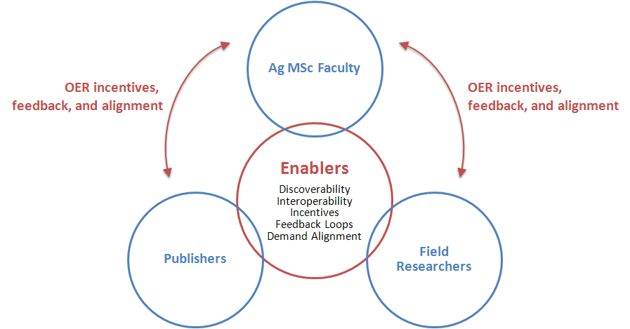
What is the scope of AgShare?
Community-Wide Partners
Resource Partners

Slide 5
What is the scope of AgShare?
Building Relationships
&
Capacity
Community-Wide Partners
Content Providers

Slide 6
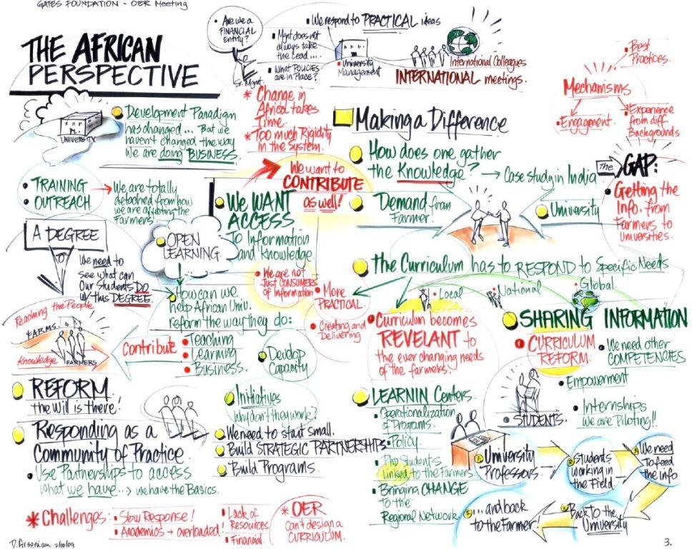

Slide 7
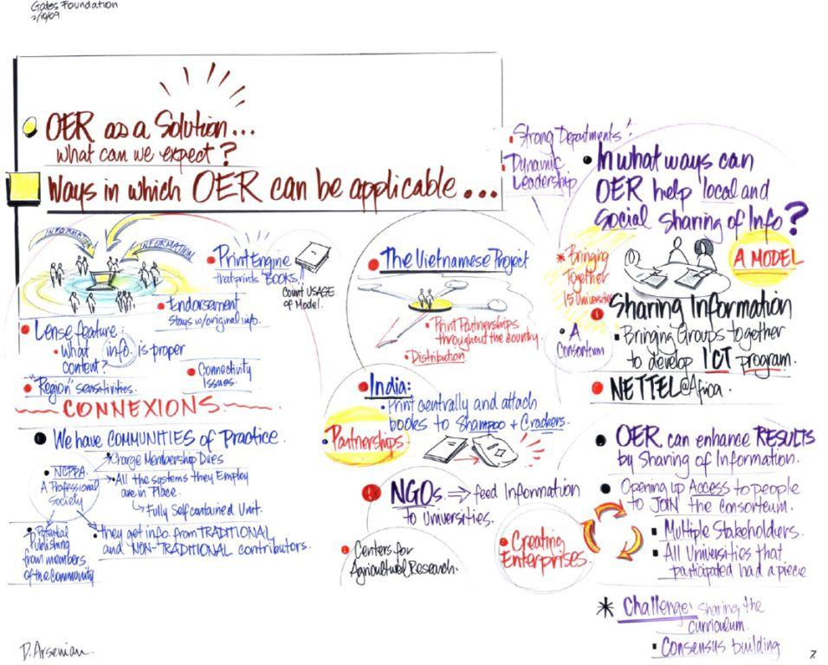

Slide 8
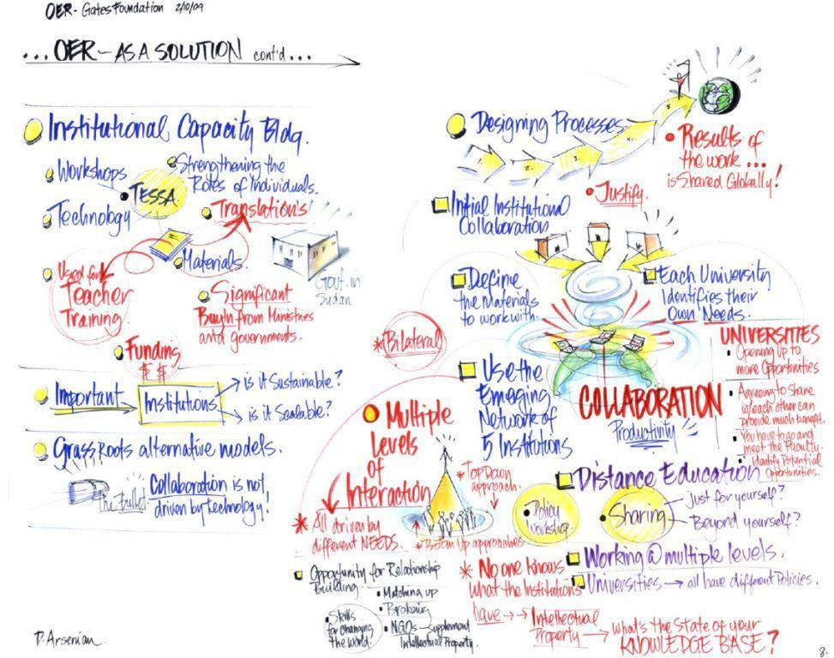

Slide 9
AgShare Vision
To impact the welfare and health of farmers in Africa
by empowering MSc students and graduates of African institutions
to achieve change in agriculture
by leveraging African knowledge through OER processes and products
that are integrated into universities and the global knowledge pool.

Slide 10
First Pilot Convening March 2010 Nairobi, Kenya

Slide 11
Pilots Started June 2010
3 Countries: Ethiopia, Uganda, Kenya
4 Universities
Haramaya University, Ethiopia
Moi University, Kenya
Makerere University, Uganda
United States International University, Kenya
2 University Networks
CMAAE
RUFORUM

Slide 12
CMAAE | Makerere | USIU | Haramaya
Collaborative creation of OER case studies across two universities in the CMAAE. Coffee in Ethiopia and Maize in Kenya. | OER creation and community engagement as part of student field research: Dairy Value Chain. South-western Uganda. Case materials for MSc and down streamed materials for improved farmer practice. | OER co-creation and feedback loops by students in internships and African faculty of agriculture. Course taught to leaders of farmer organizations, aspirant commercial farmers, and other interested parties. | OER creation of the course Perspectives on Agriculture Extension for the RUFORUM MSc AICM program.
Strengths as a pilot
Replication and customization in CMAAE; co-creation using two universities; students and faculty working together to create cases; involvement of community-wide partners. | Ties research and OER sustainably with graduate student research; Ties with community engagement platform; creates field-based OER illustrating practices; potential down streaming to farmers. | Co-creation using multi-institutions of different types; community feedback loops; students on internships create content; content can be shared through commercial farmer producer organizations. | Replication and customization throughout RUFORUM; creating a complete OER course; enables undergraduate and graduate students to participate in creating materials as part of internships and field projects.

Slide 13
Promising Pilot Methods
Community-Wide Partners
Faculty and Curriculum
Resource Partners
Student Agents of Change (research, internships)
Downstreaming OER
Upstreaming OER

Slide 14
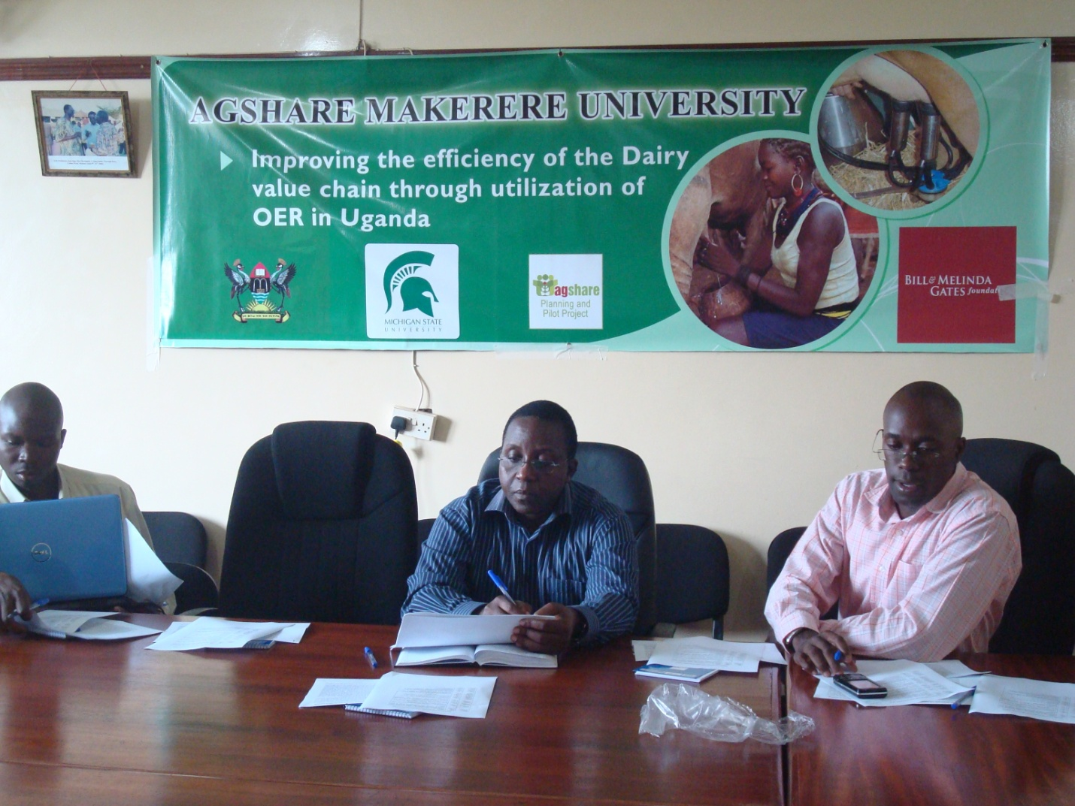
Makerere University Pilot

Slide 15
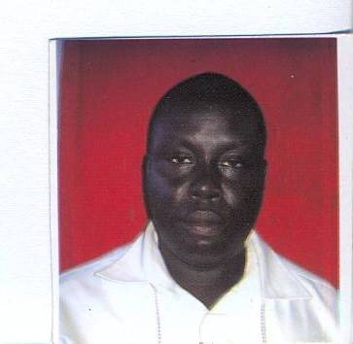
Student, Master of Livestock Development and Management
PROPOSED TOPIC:
DAIRY HYGIENE PRACTICES IN UGANDA: A CASE STUDY OF KIRUHURA DISTRICT
Student, Master of Agribusiness Management
PROPOSED TOPIC:
ECONOMIC ANALYSIS OF MILK AND DAIRY PRODUCTS MANAGEMENT IN UGANDA: A CASE STUDY OF KIRUHURA DISTRICT

Slide 16
AgShare Results in Progress
Evidence of impact
Increased visibility (i.e. DiscoverEd)
Advocacy for open sharing
Catalyst role for students (ie. AgShare Fellows)

Slide 17
AgShare Core Team
Dr. John Kaneene, Co-PI, Michigan State University
Dr. Cliff Lampe, Co-PI, Michigan State University
Neil Butcher, OER Africa
Catherine Ngugi, OER Africa
Nathan Yergler, Creative Commons
Lisbeth Levey, open resource specialist
Krishna Alluri, community-wide partner specialist
Gashaw Kebede, evaluator
Flora McMartin, OER evaluation specialist
Karen Vignare, Project Lead, Michigan State University
Funded by the Bill & Melinda Gates Foundation

