Slide 1


The Human Rights Key
A visual tool for promoting the agency of health professionals
Veronica Mitchell
University of Cape Town
South Africa
Veronica.Mitchell@uct.ac.za
The Human Rights Key by Veronica Mitchell
University of Cape Town, 2011

Slide 2

The Key
For
    Health Professionals – our focus
    Clients / Patients

Slide 3

International
Spheres of influence

Slide 4
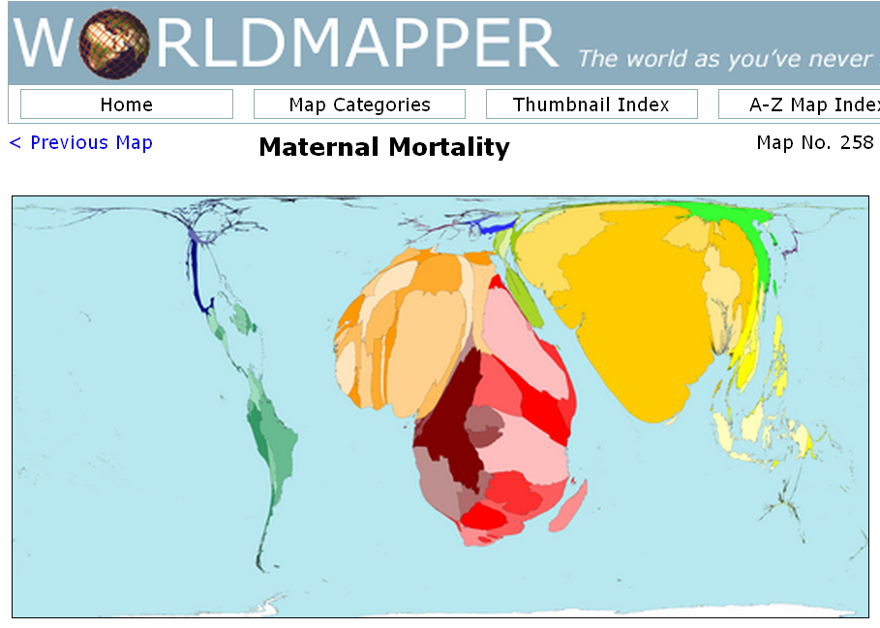
Global disparities
http://www.worldmapper.org/display.php?selected=258

Slide 5

National
History
Culture
Gender sensitivity
Power
Spheres of influence

Slide 6

Local
Stigma
Discrimination
Marginalization
Spheres of influence

Slide 7
Knowledge / Knowing
Empathy / Acting
Reflection / Self-Awareness
R
E
K

Slide 8
Five Star
Health Professionals
Socially Accountable

Slide 9
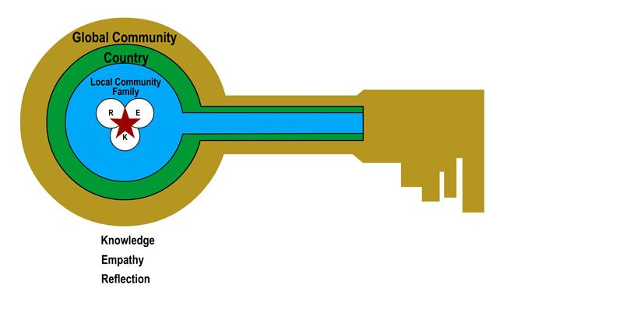
Professional & Personal
being & becoming

Slide 10
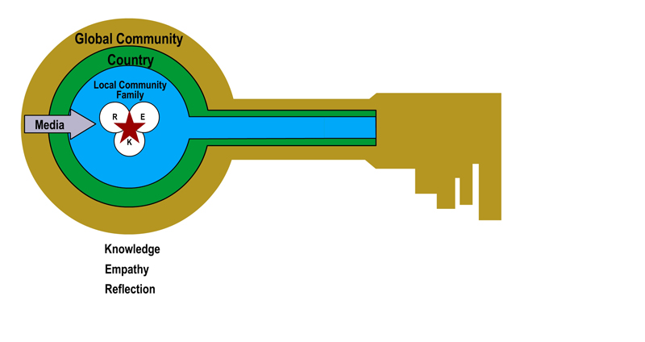

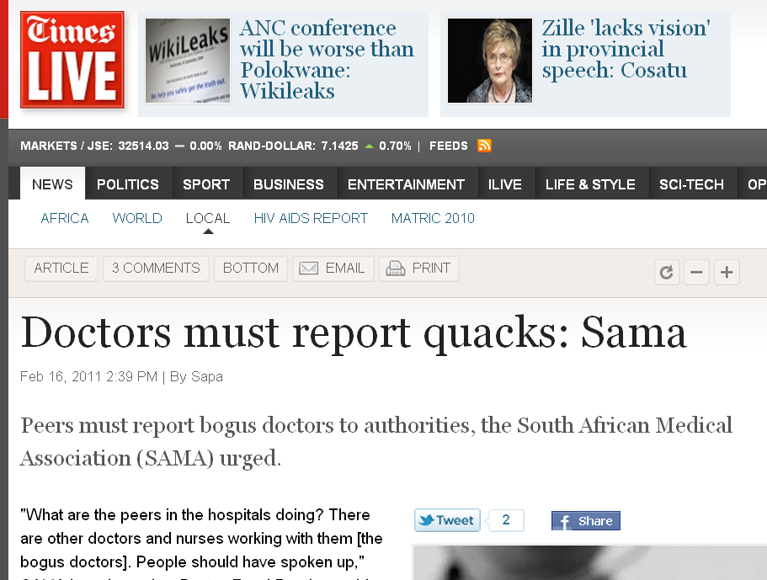
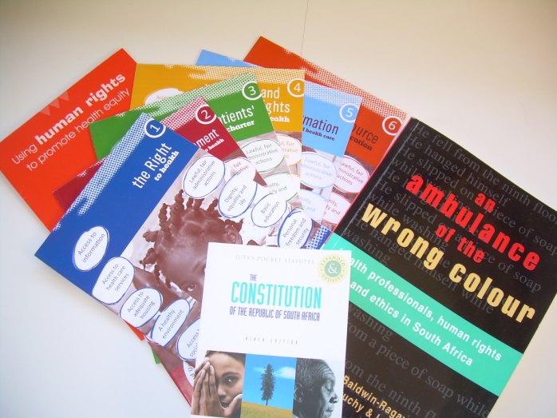


MEDIA
Traditional
Social media

Slide 11
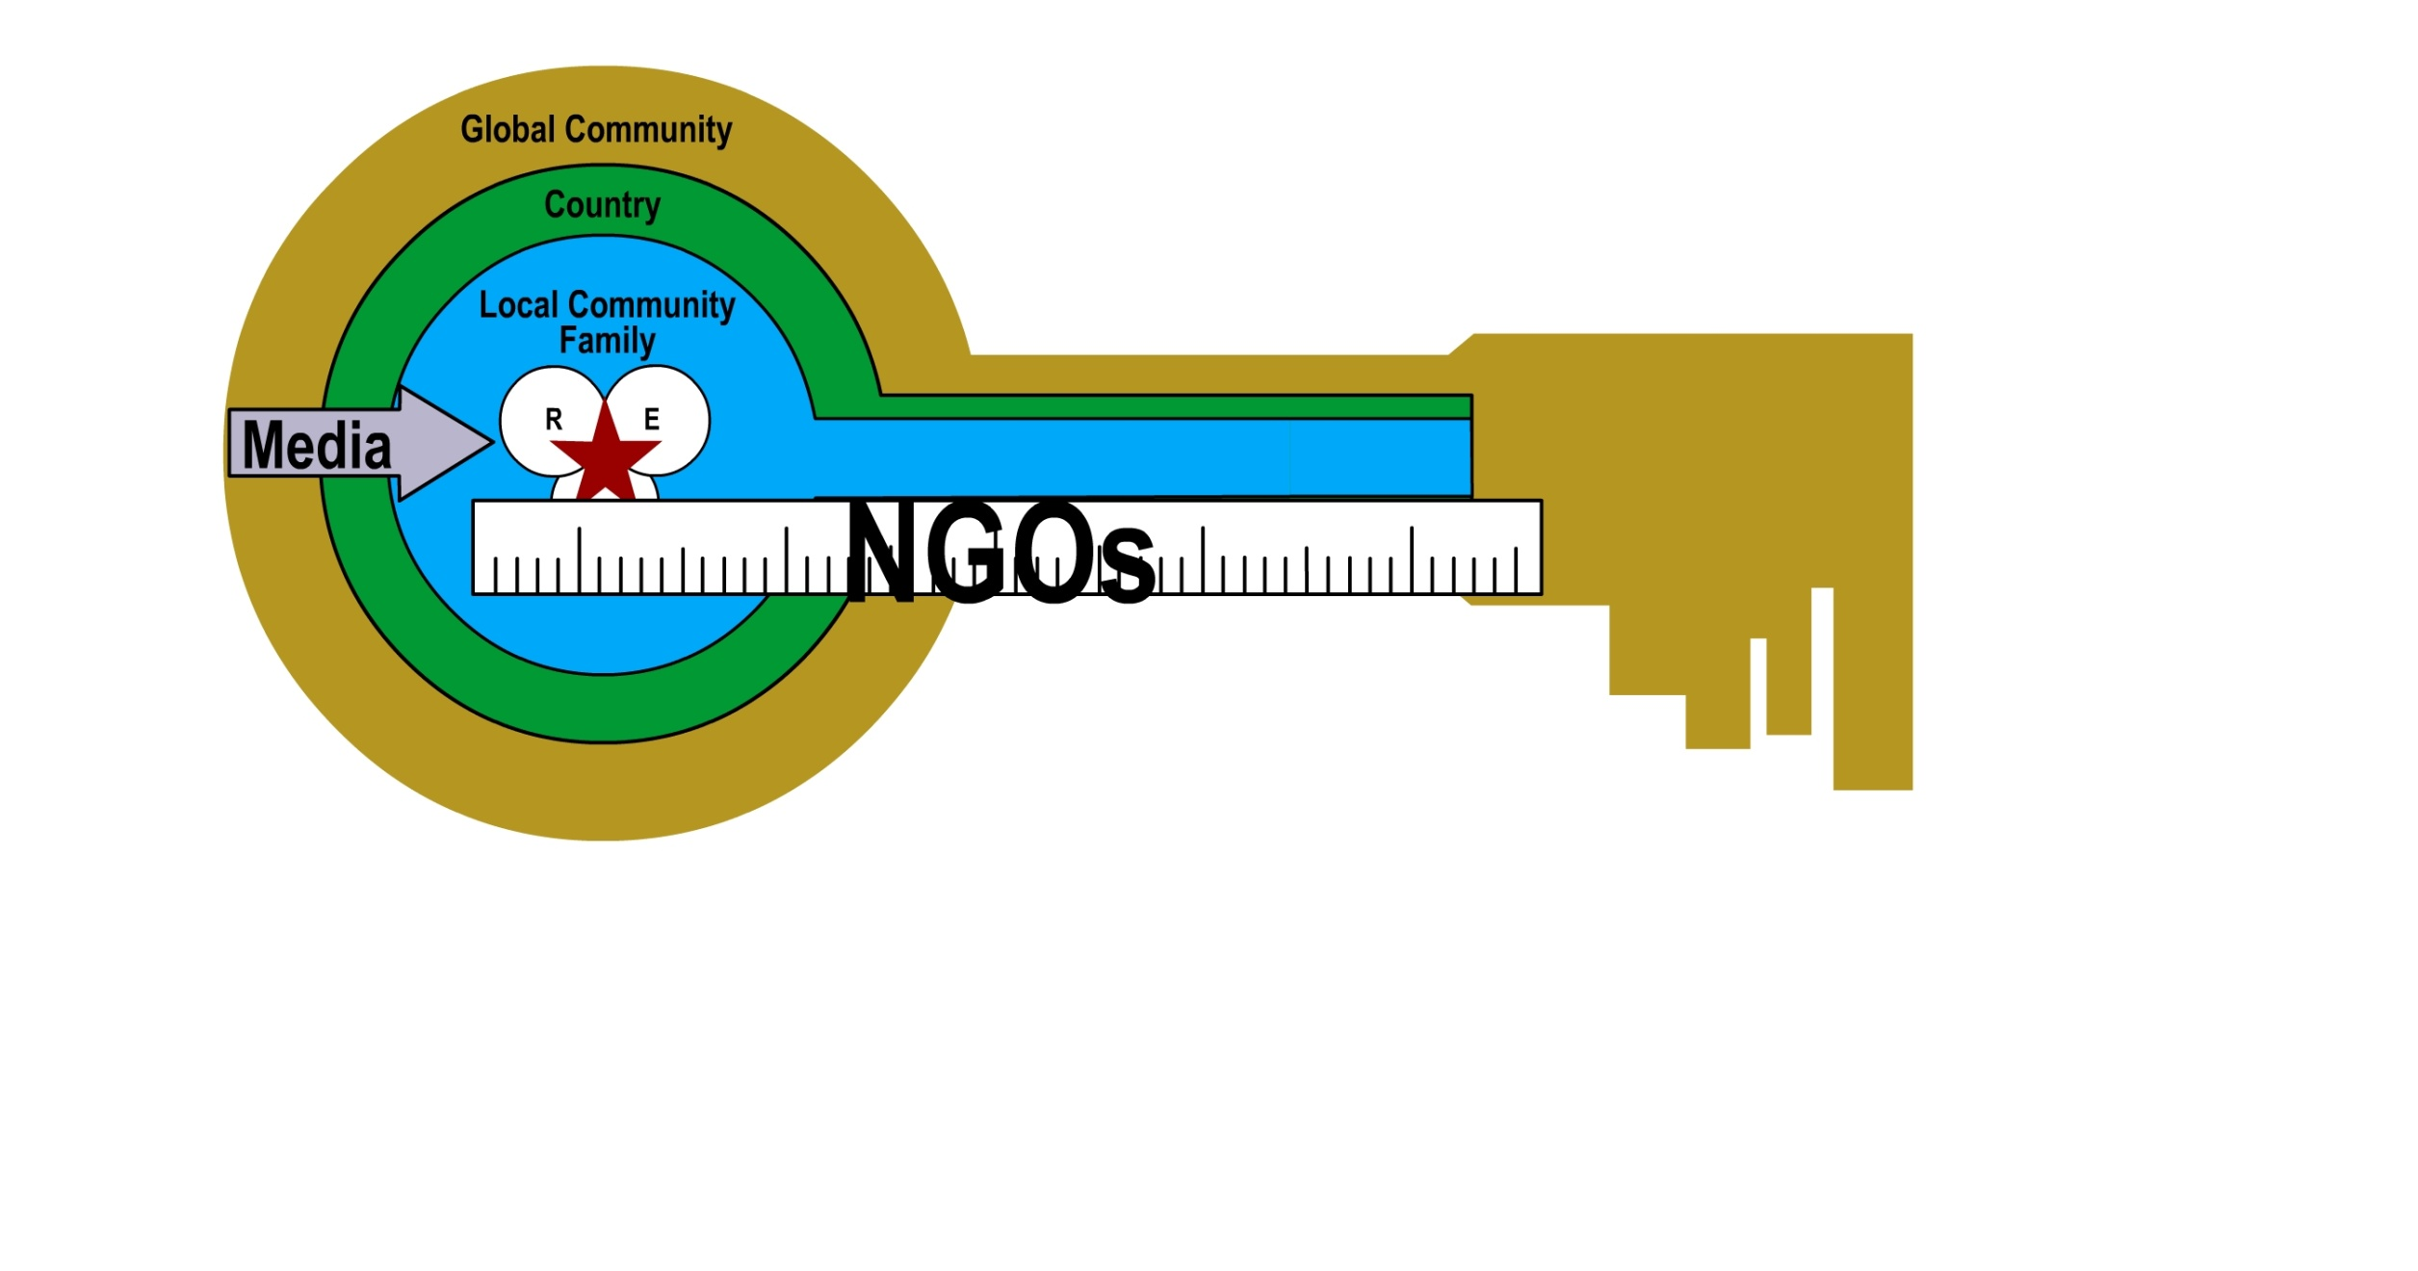
Advocacy for justice & freedom
Education & Support
Shadow reports
  to measure States’ accountability
  promote transparency

Slide 12











International
HUMAN
RIGHTS
WATCH
AMNESTY
INTERNATIONAL
Local
WITNESS
SEE IT
FILM IT
CHAMGE IT

Slide 13
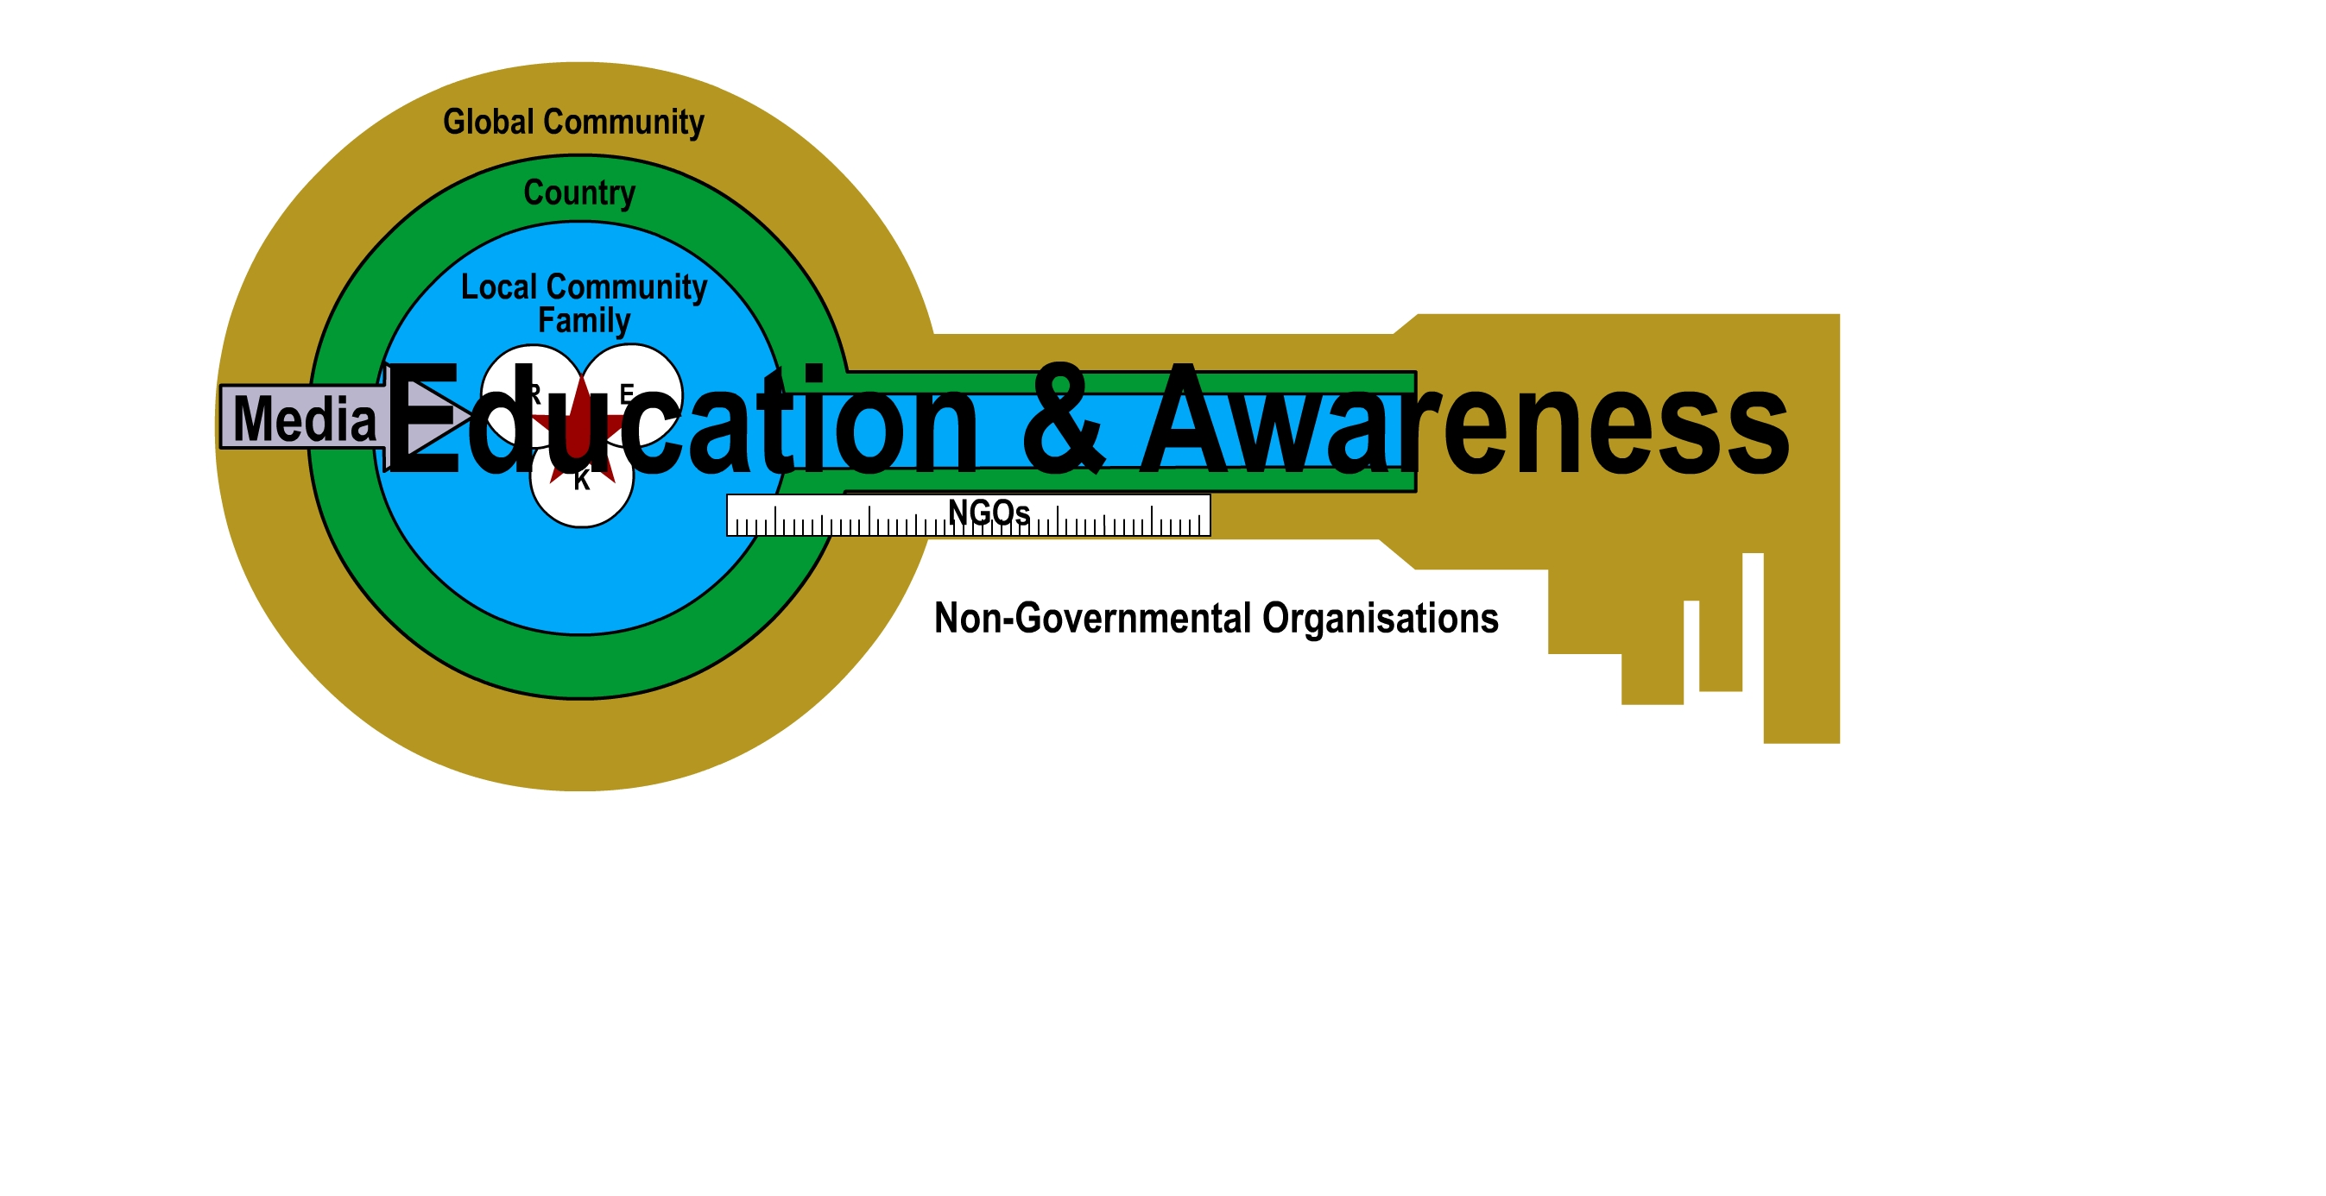

Slide 14
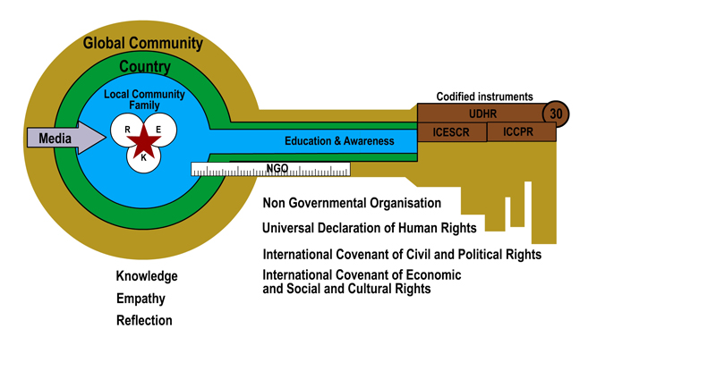
International Bill of Rights
Human rights norms & standards

Slide 15
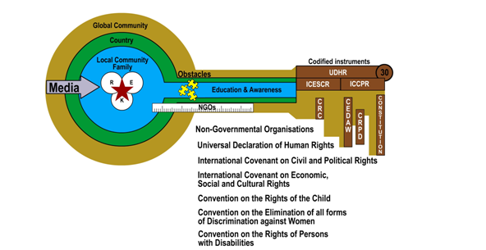
Human rights norms & standards

Slide 16
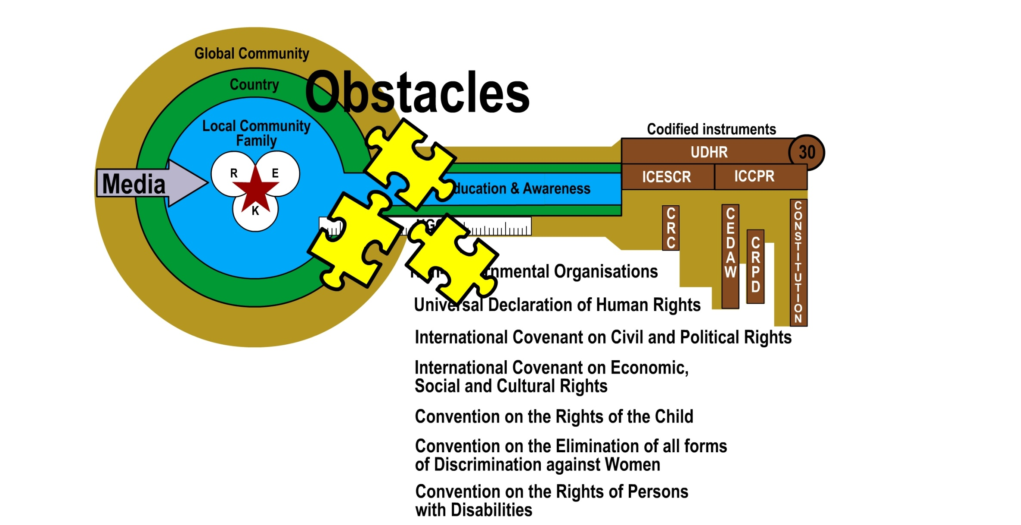
Implementation challenges

Slide 17
Collective action strengthens
the Human Rights Keys

Slide 18
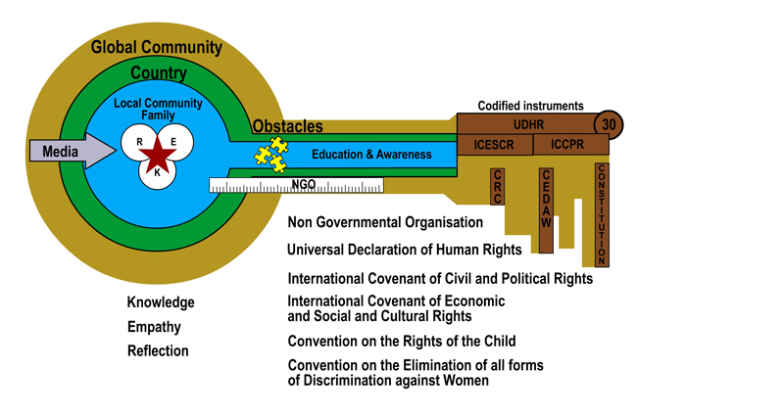

The Human Rights Key by Veronica Mitchell
University of Cape Town, 2011

Slide 19
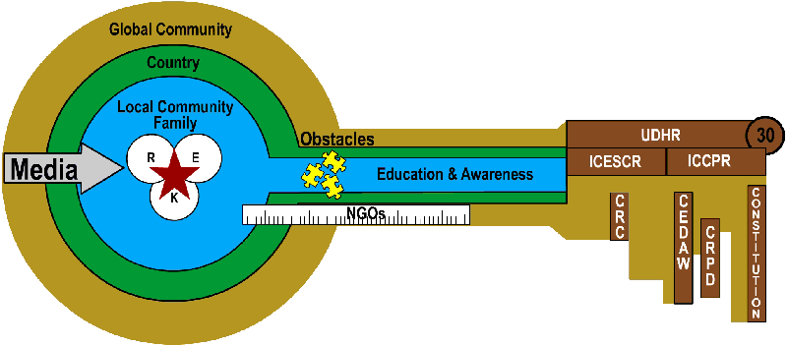
The Human Rights Key by Veronica Mitchell
University of Cape Town, 2011
Questions?
Barnett, R., Parry, G & Coate, K. 2001. Conceptualising Curriculum Change. Teaching in Higher Education. 6:4.
Boelen, C. 1993. The five-star doctor: An asset to health care reform? Geneva: World Health Organization, https://www.who.int/hrh/en/HRDJ_1_1_02.pdf [2011 March 1].
Olckers, L., Gibbs, T, & Duncan, M. 2007. Developing health science students into integrated professionals: A practical tool for learning. BMC Medical Education 7:45.

