Slide 1
Onderstepoort – OER Africa
Hewlett Foundation Briefing
17th March 2016

Slide 2
Agenda
Project Overview
Project Progress with some evidence
PAR research considerations

Slide 3
Onderstepoort progress

Slide 4
Phase I Background
Phase I: (2012-2014) OER Africa worked closely with Department of Veterinary Tropical Diseases to;
  Conceive an education model that embraced technology and ‘openness’
  Provide awareness of OER to staff within the wider faculty
  Construct AfriVIP, an online repository of quality veterinary teaching and learning resources, as an initial mechanism to achieve the vision of a blended open learning environment.
By the end of phase I AfriVIP was launched (http://www.afrivip.org/) containing predominately CPD resources.
Phase II commenced in 2015 and will run to early 2017.

Slide 5
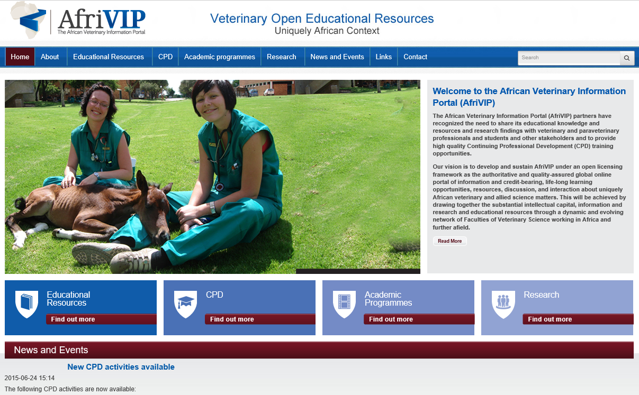

Slide 6
Phase II Vision
An important focus of the grant is to research how OER might support transformation in teaching and learning. Using PAR to collect data to determine any influence Phase II was designed to leverage progress made in the phase I grant. Activities have been designed in three particular areas to elicit data for the research:
Expand the AfriVIP repository and enhance the CPD experience but also design ways to use the database for teaching both undergraduates and postgraduates.
Encourage faculty staff and students, beyond the Veterinary Tropical Diseases Department who were the focus of phase I, to adopt and contribute OER for the development of courses through advocacy and training.
Use AfriVIP to develop collaborative partners with other faculties of Veterinary Science across the African continent using the creation and sharing of OER.
From lessons learnt during phase II provide the VC with a suggested revision of the institutional IP policy.

Slide 7
Phase II Targets
Continuing Professional Development (CPD) courses being offered by Onderstepoort will be developed using OER, with at least five new courses operational by the end of the grant.
The newly established AfriVIP Portal will be systematically integrated into the delivery of at least four different undergraduate and postgraduate programmes at the Faculty, as a primary source of educational materials for these programs
A revised institutional policy on intellectual property will have been developed under the auspices of the Information Governance Committee, based on the lessons learned from the work at Onderstepoort
Planning engagements with at least one other Faculty at the University of Pretoria will have been concluded, with commitment from that Faculty for integration of OER into its educational activities
At least two other Faculties of Veterinary Sciences from Southern and/or Eastern Africa will be actively contributing resources to the development of the AfriVIP Portal.
A detailed collaborative project will have been successfully designed, incorporating at least 4-5 of the Faculties of Veterinary Science participating in the Regional Deans’ meeting

Slide 8
Phase II Strategy & Progress
Specific Activities | Progress
Create a Faculty OER Management Team to co-ordinate initiatives. | Complete: Meets four times a year to coordinate OER initiatives
Create a steering committee to provide an enhanced vision | Stalled due to change in management
Expand AfriVIP functionality - Automate the allocation of CPD points & provide users with a CPD portfolio that creates a SAVC CPD report. | In process: OER Africa developing functional specs for improved AfriVIP experience. New resources being added monthly.
Advocate OER to staff and student and elicit contributions for AfriVIP | On going: Currently activities coordinated by OER Management Team and by the Block builders initiative.
With deans from regional faculties conceive a collaborative OER project. | Complete: Content being negotiated with potential collaborators. Using draft proposal.
Prepare a draft OER policy/strategy document at conclusion of Phase II to inform UP management on how to adjust IP policy statements. | Held over to later phase of the grant
Notes:
1. OER Working Group has been formed with representatives from each department and also representation from library that convenes 4 times a year. The most recent minutes show numerous OER Activities in process including the development of an workflow to quality assure OER before release.
2. Within departments various teaching resources have been identified and many have been loaded into the AfriVIP database, not as CPD but teaching resources. South African Veterinary Association (SAVA) has contributed 20 CPD readings with questions for distribution to help set up the automated points scoring mechanism. Once working they promise more. OER Africa is helping with the development of the functional specs
3. Two projects have commenced that target student contributions. Students were trained to use phones to document clinical procedures and experiences in the field.
4. Meeting with 4 regional deans (Namibia, Zimbabwe, Edwardo Mondelane and Soikoine) took place during 2015 and a draft project proposal was developed. This was followed up by visits to Mozambique and Tanzania.
5. Contact has been made with School of Health Systems and Public Health, and now potentially with Faculty of Education to investigate projects and initiatives around the use of OER.
6. Feb 2016. - A training programme was developed and deployed to support staff create open blended learning programmes that suit the block system.
A PAR research agenda has been developed that attempts to measure impact of blended open block teaching methods and UP/OP staff identified to coordinate the study

Slide 9
Phase II Strategy & Progress
Activity | Progress
Develop PAR research agenda to determine how the Block Teaching method, use of technology and OER are impacting teaching & learning | Complete: OER Africa in consultation with OP devised a draft document.
Nominate a PAR research team. | Partly complete: Research is being coordinated by Education Innovation unit. Faculty members are still being identified and approached.
Use the requirement to move to block teaching to encourage blended learning and use of OER in numerous 2nd Year subjects. | In process: First round of training, Block Builders Workshop complete. Now refining the programme to accommodate more educators.
Collect data and report on 1st round of findings. | Not yet commenced
See slides 12-18 for more detailed discussion of the research
Notes:
1. OER Working Group has been formed with representatives from each department and also representation from library that convenes 4 times a year. The most recent minutes show numerous OER Activities in process including the development of an workflow to quality assure OER before release.
2. Within departments various teaching resources have been identified and many have been loaded into the AfriVIP database, not as CPD but teaching resources. South African Veterinary Association (SAVA) has contributed 20 CPD readings with questions for distribution to help set up the automated points scoring mechanism. Once working they promise more. OER Africa is helping with the development of the functional specs
3. Two projects have commenced that target student contributions. Students were trained to use phones to document clinical procedures and experiences in the field.
4. Meeting with 4 regional deans (Namibia, Zimbabwe, Edwardo Mondelane and Soikoine) took place during 2015 and a draft project proposal was developed. This was followed up by visits to Mozambique and Tanzania.
5. Contact has been made with School of Health Systems and Public Health, and now potentially with Faculty of Education to investigate projects and initiatives around the use of OER.
6. Feb 2016. - A training programme was developed and deployed to support staff create open blended learning programmes that suit the block system.
A PAR research agenda has been developed that attempts to measure impact of blended open block teaching methods and UP/OP staff identified to coordinate the study

Slide 10
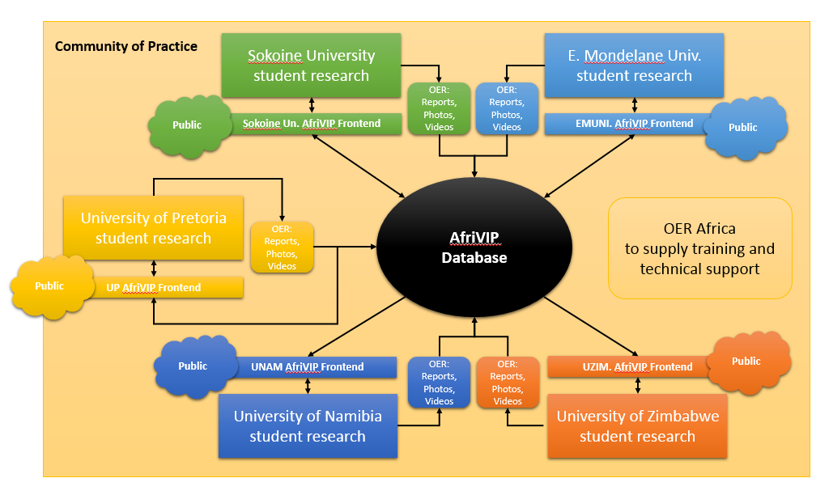
Phase II Strategy & Progress -
Regional Deans Project
The intention is to use AfriVIP as a central repository for OER generated by different institutions, each with their own user web interface but sharing the same backend resources. All four of the institutions consulted said they would use official student assignments to generate the OER teaching resources to share.
Notes:
The intention is to use AfriVIP as a central repository for OER generated by different institutions. Each with their own user interface but sharing the same backend resources. All four of the institutions consulted said they would use official student assignments to generate the OER teaching resources. Progress has been slow however although a strong relationship has been built with Edwardo Mondelane and Soikoine. Namibia too, after a credentialing crises, seems to be back in action.

Slide 11
Strategy & Progress - Evidence
Some examples of the new OER being offered by staff and students.
On AfriVIP see a selection of audio visual resources, Horse handling videos and theatre procedure videos:
  http://www.afrivip.org/education/audiovisualteaching
  http://www.afrivip.org/education/audiovisualteaching/videos/horse-handling/2014
  http://www.afrivip.org/education/audiovisualteaching/videos/theatreprocs/2015
On UP Space see slide collections (This one is Ecosystems and Ecology)
  http://repository.up.ac.za/handle/2263/33086
On YouTube see AfriVIP channel of streamed resources
  https://www.youtube.com/user/vethub
On EduWiki see Prof Kriek’s contribution on Wildlife diseases
  http://awp.eduwikis.co.za/index.php?title=African_Wildlife_Diseases

Slide 12
Participatory Action research to ascertain the effectiveness of the block system

Slide 13
Research Background
Supposed Benefits
During 2015, after consultation with staff, it was decided that the 2nd year Vet. Sci. course would be taught in continuous, subject dedicated, blocks rather than teaching departmental topics in parallel. In addition it was hoped that when revising topics departments would exploit technology, use inquiry-led methodologies and use Open Educational Resources.
The research is to ascertain what impact, either positive or negative, do these these new dimensions bring to the quality of learning.
Block Teaching
Exclusive focus on topic
Time for students to master knowledge and skills
Technology
Allows for anytime/anywhere access to learning resources and activities
Encourages alternatives to text-based resources
OER
Access to existing free, quality learning resources
Exposes developers to other teaching approaches
Forces different teaching methods to break monotony of lectures
Allows for diagnostics of student progress as captured in LMS
Opportunity to showcase staff and student generated resources beyond the university.

Slide 14
Primary Research Question
What effect does the teaching system have on the long-term performance of students in the Bachelor of Veterinary Sciences programme?
PAR OP OER Africa Research Agenda

Slide 15
Secondary Research Questions
What effect does the block teaching system have on short-term results? Is performance better or worse than previous years?
What effect does the block teaching system have on subsequent results beyond second year? Is performance better or worse than previous years?
How do teaching and learning methods and educational approaches change as a consequence of the introduction of block teaching?
Does the block teaching system lead to a sustained increase in the use of educational resources and teaching aids? Why? To what extent are lecturers harnessing OER as part of this increased resource use?

Slide 16
Secondary Research Questions
How do assessment practices change with the introduction of the block teaching system? What are the consequences – negative and positive – of this ?
What effect does the block teaching system have on lecturers? Does it demand more or less of their time? Does it lead to improved or diminished research output?
  If more, why is this? And is this only in the short term due to introduction of the block teaching system or is it likely to be ongoing?
  If less, where are the savings? And what are lecturers doing with the time saved?
What impact does the block teaching system have on programme management and administration? Do these associated overhead costs increase or decrease?

Slide 17
Secondary Research Questions
How are students’ lives affected by the block teaching system? Is it leading to any diminution in their social/campus life as students ?
What are the unintended consequences of implementation of the block teaching system?
Would this be + or – for the lecturer or the student or does it only refer to student performance? If only performance of students, will it only be the assessment practice in the block system that will determine whether it is positive or negative?
Would it be possible to determine this – it is the first year that the students come to OP (remember they do the 1st year at the Hatfield campus) What would it be measured against?

Slide 18
Research Team
Education Innovation Unit: El-Marie Mostert and Marius Pienaar
Faculty of Veterinary Science: Dietmar Holm (Acting Deputy Dean) & others
OER Africa: Neil Butcher & Andrew Moore

Slide 19
Recent developments
At the end of 2015 Linda van Ryneveld, Deputy Dean (Academics) and OP’s liaison person for this project, resigned and moved across to the Faculty of Education.
Dietmar Holm is in the process of being appointed as Acting Deputy Dean and has taken up the many of Linda’s duties, including coordinating our project.
The Dean, Darrell Abernathy, remains fully committed to our project, and has special interest in the results of the PAR.
Activities in the early part of 2016 focused on;
  Ensuring we still had the support of management for the project
  Preparing the Block Builders Workshop to capacitate staff in pedagogy, technology and OER.
  Fine tuning the PAR agenda and locating research champions.

Slide 20
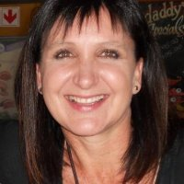
Recent developments
The movement of Linda van Ryneveld from Veterinary Science to Education does afford OER Africa a fortuitous opportunity to expand awareness of OER and also provide an additional campus to collect data for the PAR. Linda is an advocate of using OER and she notes the Education Faculty is already constructing a course using OER. Linda has expressed interest in using OER Africa support to drive these types of initiatives within the faculty.

Slide 21
Thank You
Hewlett Foundation Briefing

