Slide 1
Implications of openly licenced resources for librarians
This work is licensed under a Creative Commons Attribution 4.0 International License.
Kirsty von Gogh
kirstyvg@nba.co.za

Slide 2
Why open?
High costs: textbooks, tuition, transport, housing
Limited funds available to assist students
Faculty engages with open content
Courses change
Pedagogies evolve
This leads to:

Slide 3
Benefits of adopting OERs
Wider adoption leads to use of new pedagogies
Faculty become more open to sharing work
Availability of authentic, high-quality African resources

Slide 4
OER issues of concern
Copyright
Difficulty finding or creating OER for subject/level
Lack of skills to find or create OER
Not enough time
Reluctance to have others adapt/modify their work

Slide 5
Institutional OER requirements
Access to technology and infrastructure
Policies and strategies to adopt and use OER
Train librarians to find and use resources
Support faculty and librarians with funding, time and positive recognition
Give legitimacy to OER
Notes:
Don’t just OER it to add more work to librarians. New roles are being created: OER librarian, OER coordinator etc

Slide 6
How can librarians promote OER?
Introduce faculty and students to OER
Train users on OER access and use
Facilitate OER access
Assist with converting courses to OER
Become a champion OER policy development and implementation
Notes:
Provide leadership and guidance in advising faculty and students about open access, OER, copyright and open licences (CC)
(check copyright, replace text/images)

Slide 7
Introduce faculty and students to openly licensed resources
Internal communications
Workshops
Intranet
Libguides
E-learning portal (encourage faculty to take ownership)

Slide 9
Facilitate access to and understanding of OER
Teach faculty and students about Creative Commons licences
Show faculty and students how to search for OER
Compile and maintain lists of OER referral sites
Curate institutional OER content to maximize discoverability
Notes:
The task of converting a particular course into an OER can be difficult. Another potential issue is that it is fine to put together distance education material where it is only going to be used in-house, may be allowed to use copyrighted material. The issue is when the institutions put the course online and openly.
Common misconceptions:
It’s your job to make faculty switch to 100% OER
You’re going to create a list of all available OER ever
Two hours a week should be plenty for this
Just replace “old” librarian things with OER!

Slide 10
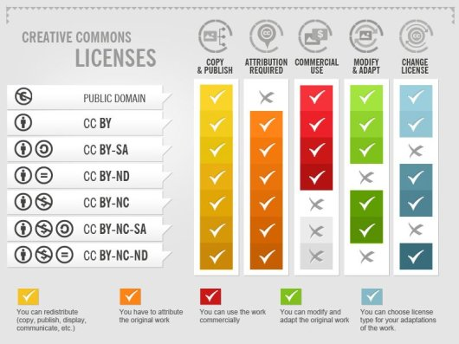
Creative Commons licenses by Foter (CC-BY-SA)

Slide 11
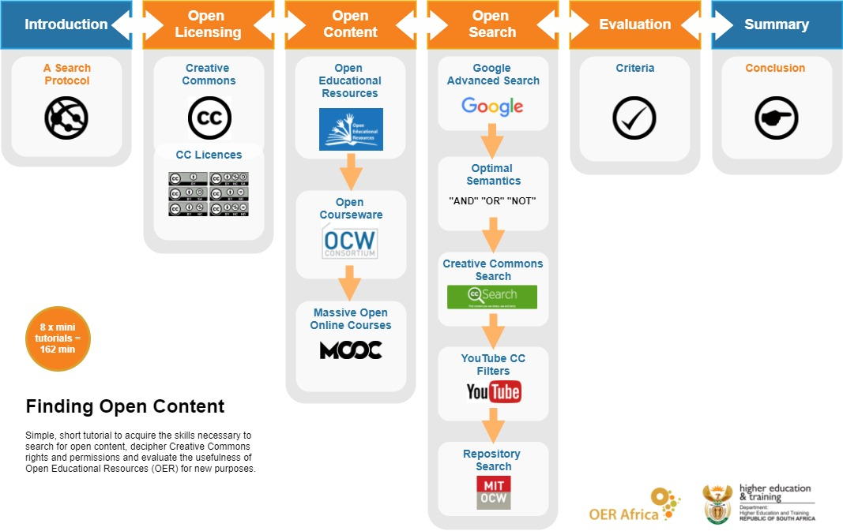
Finding Open Content tutorial

Slide 12
OER management
Assist with IPR to ensure that the OER does not use copyright-protected resources
Provide appropriate tagging, metadata, and resource descriptions
Archive OER in university repository in a file format that allows adaptation
Make African research more visible in a global knowledge pool by sharing beyond institutional repositories
Notes:
Provide appropriate tagging, metadata, and resource descriptions to make resources more discoverable

Slide 13
What about quality assurance?
Guide faculty and students to use sites that have their own quality assurance processes
Direct faculty to tools and resources to assess quality
Only faculty can determine quality
Quality needs to be of equal or greater quality than commercially available content
Notes:
Librarians should refer students to sites that have their own QA.

Slide 14
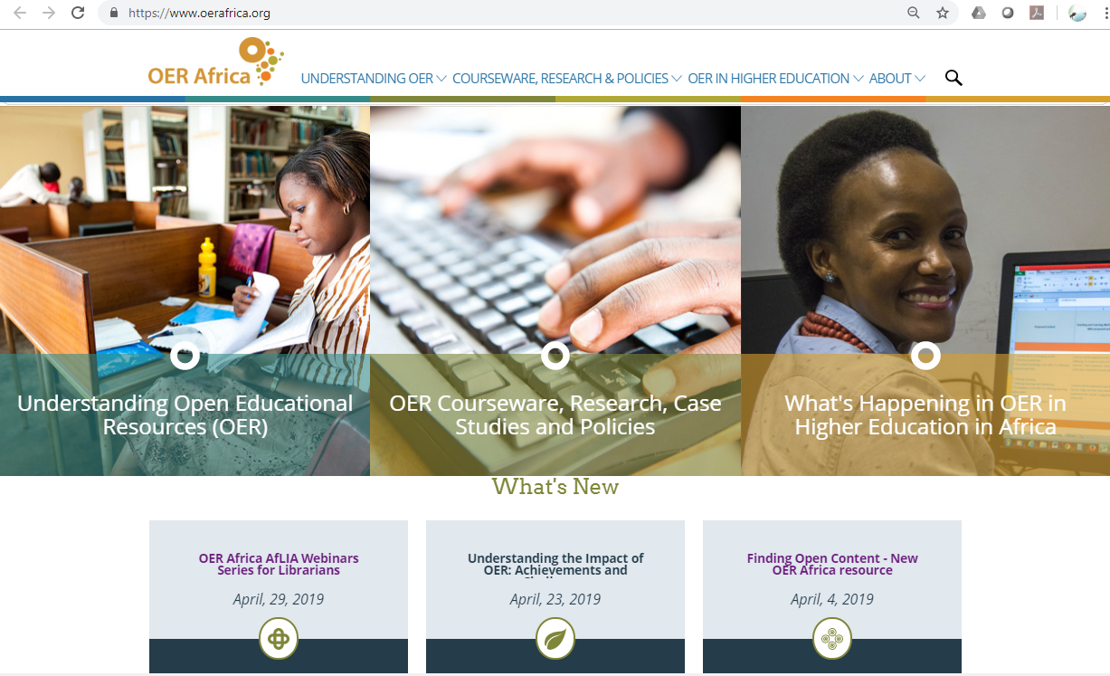
OER Africa
OER Africa
MERLOT
OER Commons

Slide 15
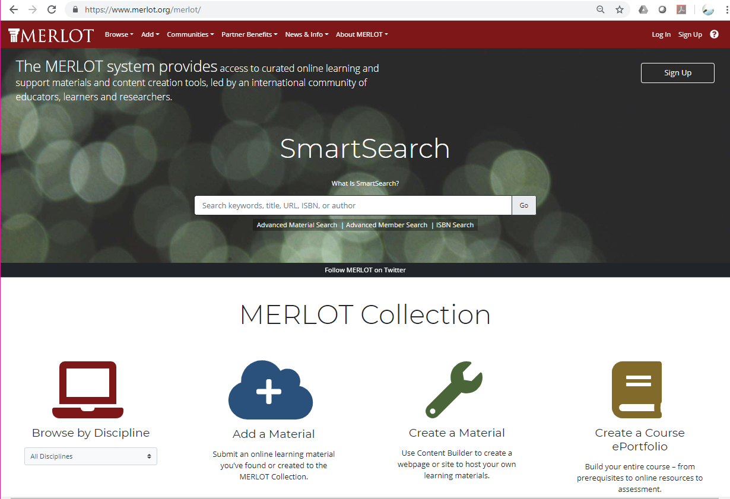
MERLOT

Slide 16
OER Commons

Slide 17
Unrecognized costs of OER
Advocacy work with university leadership, faculty, and students
Librarian’s time spent supporting faculty and students
Student-created content
Instructional design costs
Notes:
These are general institutional costs that are not always considered.

Slide 18
What cost factors need to be considered?
Policy, strategies, and planning
Training librarians and faculty
Technology and infrastructure
Creation and adaptation of resources
Uploading and hosting resources
Management of university OER content
Assistance with copyright clearance
Curation and discoverability
Notes:
What is required of a librarian costs money.
Funding and time for training librarians and faculty.

Slide 19
Tracking progress and challenges
Track time and function to understand your role
Track work to assess the needs and interests of different faculties
Document outcomes (both successes and challenges) of your OER efforts
Make OER recommendations based on evidence-based assessment
Notes:
Numerous case studies have found that student outcomes are as good or better with open content vs. traditional materials.
OER takes on more time than you would imagine – it’s not an add on to your job. Tracking can demonstrate effectiveness.
Determine the value of OER-related work of librarians.

Slide 20
OER policy and implementation
Librarians can champion OER policy development
Use policy to scale up OER efforts
Align policy with institutional vision, mission, and values
Review IP and copyright policy
Develop a plan to raise OER awareness
Determine necessary training
Establish responsibility

Slide 21
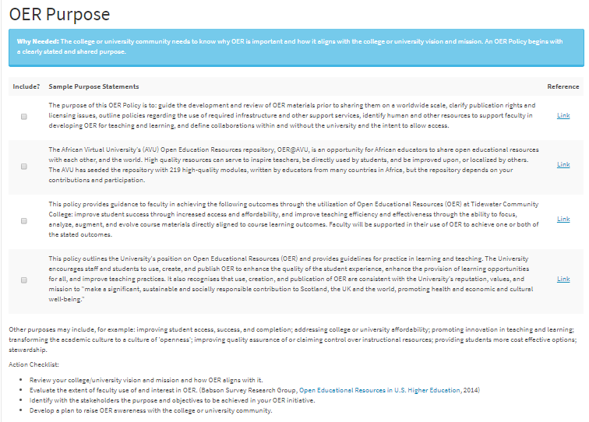
Use Lumen Learning OER policy development tool – purpose, licensing, procedures, responsibilities https://policy.lumenlearning.com/

Slide 22
Community building
Be vocal about using OER and open access content
Build rapport among OER champions and users
Be honest about challenges you face
Share time and ideas
Join online communities and listservs
Contribute to the OER World Map
Build AfLIA OER community
Notes:
You will not be the only person struggling. Change management is not easy.

Slide 23
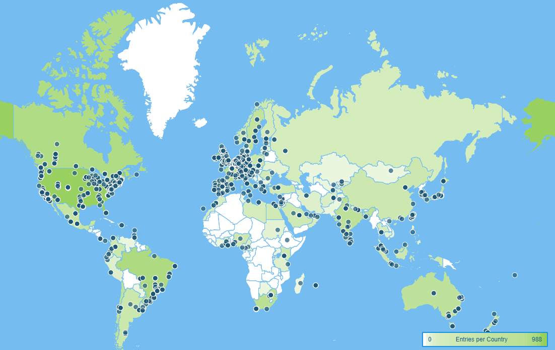
OER World Map https://oerworldmap.org/
Notes:
For librarians to explore other OER projects across the world, including librarians who do OER work.

Slide 24
Librarians are fundamental to OER management
Librarians can establish processes to manage OER content
Librarians can find ways to support academic and student access and use of high-quality OER
Librarians understand the importance of setting and implementing appropriate policies

Slide 25
Useful resources
Creative Commons
Finding Open Content tutorial
Where to search for OER
Rubrics for evaluating OER
QA rubric
Lumen Learning OER Policy Development Tool
Wits Libguide on OER
Open Education: Librarian Toolbox
Scholarly Publishing and Academic Resources Coalition (SPARC)
SPARC forum (and sign up)
Getting Started with OER: Getting buy-in (webinar)
OER World Map

