Slide 1
Open Access Publishing
This work is licensed under a Creative Commons Attribution 4.0 International License.
Lisbeth Levey (levey180@gmail.com)
Tony Lelliott (tonyl@saide.org.za)

Slide 2
Open Access (OA) Publishing
Publications are free to users worldwide and may be distributed without requesting permission.
OA allows access for researchers, teachers, journalists, policy makers and the general public without a subscription.
OA is compatible with copyright, peer review, prestige, quality, and indexing

Slide 3
Open Access (OA) Publishing
OA publications reduce permission requirements and eliminate price barriers for readers.
Studies demonstrate that OA literature receives more citations than subscription publications in some disciplines.
Authors own the rights to the fruits of their labour.

Slide 4
Licensing Models
Fully copyrighted journals – reader or advertiser pays.
OA journals - author usually pays a fee and retains copyright.
Hybrid journals – authors can select OA publishing option (fee required).

Slide 5
Traditional Journals
Make money through subscriptions and advertising.
Subscriptions usually driven by quality and impact factor.
Create an incentive for high-quality peer review and overall quality.
But publishers criticised for high fees, expecting peer review to be free, and for requiring authors to sign over all rights.

Slide 6
Open Access Journals
Free to access with no subscription.
Charge author fees to cover costs – an Author Processing Charge (APC).
Institutions and donors increasingly pay part/all of APC.
Increasing numbers of hybrid and quality OA journals, as funders require researchers to publish OA.

Slide 7
Hybrid Journals
Some subscription-based journal publishers allow authors to select an open access publishing option for a fee.
The author retains rights.
The publisher is making an extra profit—through subscriptions and the author’s APC.

Slide 8
Ways to determine reputable OA publishers: watchdog organizations
Quality of OA journals varies widely.
Consult the Directory of Open Access Journals.
Journals in DOAJ use peer review and editorial quality control.
Ascertain whether the publisher is a member of the Open Access Scholarly Publishers Association.

Slide 9
Ways to determine reputable OA publishers: scholarly databases
Check lists of reputable OA journals, such as the SA DHET list at the University of Pretoria.
OA journals included in a major index, such as Web of Knowledge or Scopus are likely to be reputable OA journals. Accessing journal lists are free, although full access requires a subscription.

Slide 10
Ways to determine reputable OA publishers: disciplinary databases
Certain research communities have major specialized academic databases and search engines that are used to search for literature.
Determine what your staff use and check whether the OA journal is abstracted by it.

Slide 11
Ways to determine reputable OA publishers: archiving
Ascertain whether a journal is archived, or preserved for future use if the publisher goes out of business.
Publishers’ policies and conditions regarding self-archiving and other OA options can be confusing, but SHERPA RoMEO’s directory lays details out clearly.

Slide 12
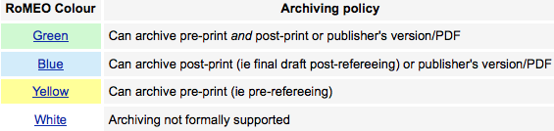
SHERPA/RoMEO categories

Slide 13
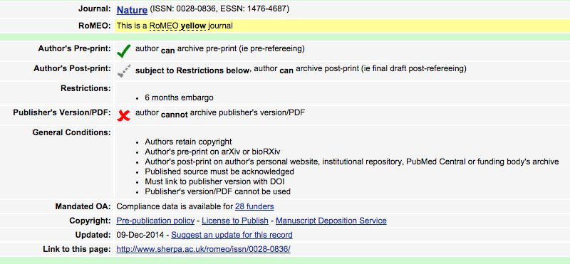
SHERPA-RoMEO journal record

Slide 14
Ways to determine reputable OA publishers: indicators
Indicators, such as impact factor, for the relative importance of a journal can provide helpful information.
Scopus has a free service to ascertain the impact factor of Elsevier journals.
Google Scholar has a free impact factor service.
The Web of Science publishes Journal Citation Reports, but access requires a subscription.
If an OA journal is relatively new, you can evaluate the publisher by checking indicators for their other journals.

Slide 15
‘Predatory’ OA Journals
Frequently make their money by charging a publication fee, sometimes very high, of the author (like normal OA).
But publish many poor-quality papers in “shell” journals with few staff.
Minimal or no peer review.
Resulting in hundreds of such journals, covering every academic area.

Slide 16
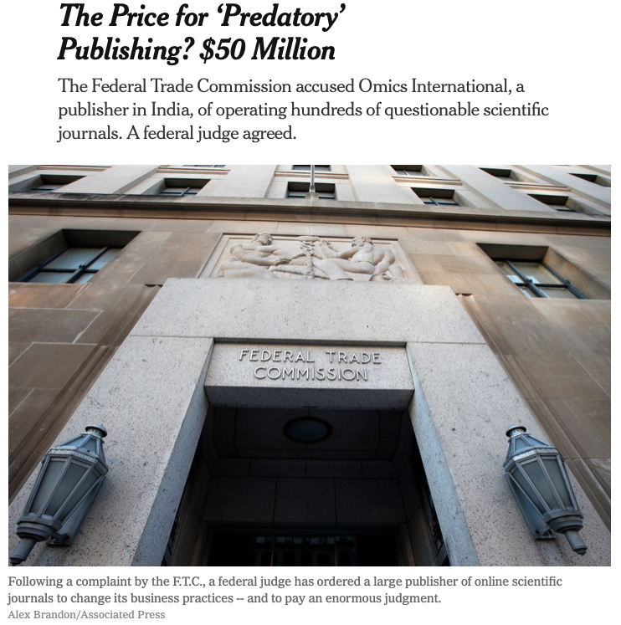
Striking back against predatory publishers
New York Times, April 3, 2019

Slide 17
The intersection between OER and OA
Good OA research can help educators prepare up-to-date and relevant learning materials.
OA resources can be used as supplemental or recommended reading for students.
Educators can assign students to search online for relevant OA resources, which bolsters their information retrieval skills and learner centered study,

Slide 18
African institutional repositories
Repositories can make African research more visible in the global knowledge pool.
Africa-wide repositories: ACBF, AfricArXiv preprints, AAU, OER Africa, RUFORUM, and UNECA.
University repositories in Botswana, Ethiopia, Ghana, Kenya, Namibia, Nigeria, Rwanda, Senegal, South Africa, Sudan, Tanzania, Uganda, and Zimbabwe

Slide 19
The importance of policies
Some African universities have OER, OA, and/or repository policies, but not many of them.
Every African university should integrate OER, OA, and repositories in its IPR policy.
Policies need leadership and champions to implement them.

Slide 20
University of Namibia scholarly communications policy
“The University recognises that as a largely public-funded institution, it has an obligation to share its research findings and scholarly outputs with all stakeholders and the wider society. It also recognises that the Open Access model of scholarly communication is a means to advance research. It allows scholarly outputs to reach a much wider audience, and thus to be cited more often, which raises the profile of the author/knowledge producer and the University.”
Go to: https://www.idea-phd.net/images/UNAM-Scholarly-Communication-Policy.pdf

Slide 21
AAU policy recommendations
In hiring, promotion, and tenure, the university will give due weight to all peer-reviewed publications, regardless of price or medium.
Faculty who publish articles must either (1) retain copyright and transfer only the right of first print and electronic publication, or (2) transfer copyright but retain the right of postprint archiving.
Adopt policies encouraging or requiring faculty to fill the institutional archive with their research articles and preprints.

Slide 22
AAU policy recommendations, continued
All theses and dissertations, upon acceptance, must be made openly accessible, for example, through the institutional repository or one of the multi-institutional OA archives for theses and dissertations.
All conferences hosted at your university will provide open access to their presentations or proceedings, even if the conference also chooses to publish them in a priced journal or book. This is compatible with charging a registration fee for the conference.
All journals hosted or published by your university will either be OA or take steps to be friendlier to OA. For example, see the list of what journals can do.
Go to: https://www.aau.org/2018/10/12/short-statement-from-the-sg-of-aau-on-open-access-to-all-heis-on-the-continent/

Slide 23
Repository management
D-Space is the standard platform.
Some African repositories provide licensing information, but not all of them.
Several organizations offer training in repository management. These have included AAU and EIFL.

Slide 24
Open Access Publishing and Librarians
Librarians understand the ramifications of high-cost journal subscriptions.
Librarians can help researchers identify high-quality OA journals.
Librarians can help users find relevant OA resources.
Librarians manage institutional repositories.

Slide 25
Librarians can be champions
Librarians can be champions of:
  Open access within the university community.
  Policy formulation and implementation.
  Promoting information retrieval skills and training.
  Open access advocacy within national and regional organizations.
AfLIA can be a champion too.

Slide 26

UNN librarian is a champion of OER/OA
Academic Librarian, Nnamdi Azikiwe Library, University of Nigeria, Nsukka
https://www.unn.edu.ng/unn-oer-upload-and-win-competition/

