Slide 1

OER Africa
OUT Collaboration
Open Educational Resources
(OER) in Africa

Slide 2
OER Definition
Open Educational Resources (OERs) are any type of educational materials that are in the public domain or introduced with an open license.
The nature of these open materials means that anyone can legally and freely copy, use, adapt and re-share them.
OERs range from textbooks to curricula, syllabi, lecture notes, assignments, tests, projects, audio, video and animation.
UNESCO
Notes:
And there is an explosion of freely available, high quality content online that educators and students can link to…

Slide 3
Use of OER in African HEIs
Openly share skills-based relevant OER across institutions and thus:
  Encourage the development of 21st century skills amongst students in-school and potential out-of-school students / life-long learners to:
    New ways of thinking: Creativity, critical thinking, problem-solving, decision-making and learning
    New ways of working: Communication and collaboration
    New tools for working: Information and communications technology (ICT) and information literacy
    New skills for living in the world: Citizenship, life and career, and personal and social responsibility
Notes:
Possibilities of OER to HE in Africa

Slide 4


OER Production
Workflow Process Models

Slide 5



  Issues regarding the transformation of teaching materials into OERs
  Staff attitudes to open access ( King et al., 2008)
  Degrees of openness (Hodgkinson-Williams & Eve Gray, 2009)
  Design for openness (Boyle, 2006; McAndrew and Weller, 2005)
  Open teaching (Laurillard, 2008)
  Evaluating learning objects for re-usability (Schoonenboom et al., 2009)
  Open licensing for educational resources (Bissell, 2009)
  Sustainability (Downes, 2006)

Slide 6
The CORRE evaluation framework
Teaching material
Publicly usable teaching material
OERs
CONTENT
OPENNESS
REUSE/REPURPOSE
EVIDENCE
Gathering
Transformation
Internal validation
Tracking
Screening
Rights Clearance
Release to repository
Formatting
External validation

Slide 7
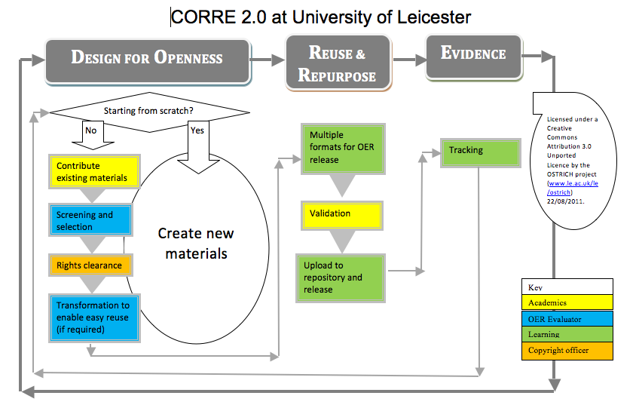

Slide 8
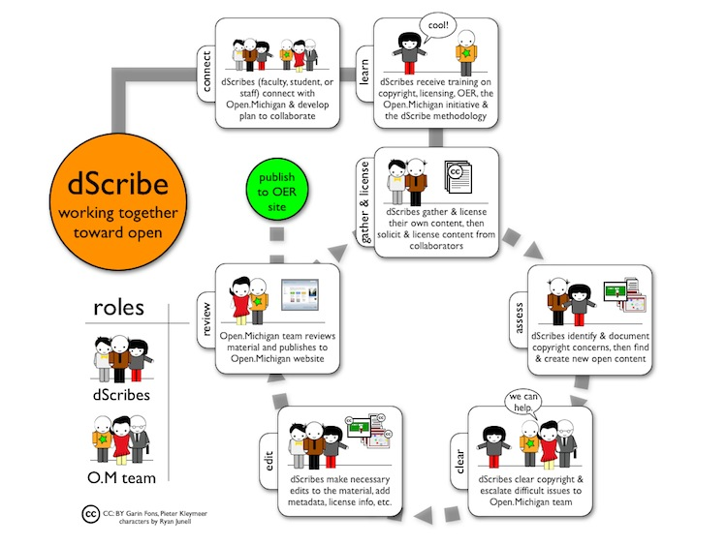
Notes:
The dScribe process at the University of Michigan (U-M) may be broken down into seven steps:
Connect: Prior to the semester, a dScribe2 or member of the U-M OER staff meets with a faculty member about the interest in making lectures, syllabi, and other educational materials available as OER. In this stage, the dScribe2 assists the faculty in licensing the selected course materials under a Creative Commons license. The faculty member and dScribe2 begin the process of recruiting a student enrolled in the faculty’s course to work as a dScribe. Some dScribes work on courses they have previously had.
Learn: Once selected, the dScribe attends a training course led by more experienced dScribe2s and members of the U-M Open Educational Resources team. Here, the dScribe learns about the OER movement, intellectual property, and the dScribe publishing process, develops techniques for soliciting educational material from faculty and students, learns about why we cannot simply publish faculty course materials as is, begins using OERca (web-based software for managing the clearing process) and masters the method of identifying and resolving copyright and privacy concerns within educational materials.
Gather & license: After the training session, the faculty and dScribe work together to gather all of the selected course materials in native file formats (e.g. Microsoft PowerPoint, Microsoft Word, OpenOffice).
Assess: As the semester progresses, the dScribe uses her knowledge of the dScribe clearing and publishing process to review the faculty’s course materials, identifying copyright and other similar concerns. The dScribe uses OERca - a web-based decision management tool developed by University of Michigan - to keep track of her work and recommended actions as she clears specific content.
Clear: When questions arise that the dScribe cannot answer, the dScribe collaborates with her faculty and dScribe2. Much of this communication is accomplished using OERca or during weekly workshops and in meetings with the faculty.
Edit: After the material has been vetted, the dScribe edits the material and inserts the necessary licensing information into the given material.
Review: With the edits complete, the faculty then reviews the material, suggests any changes, and gives the dScribe the final approval to publish to the U-M OER website for others to access, use, and share.

Slide 9

Thank you
This work is licensed under a
Creative Commons Attribution 4.0 License
Notes:
For such interesting questions and observations. In conclusion…

