Slide 1
OER Africa
The Role and Importance of an institutional OER policy

Slide 2
OER Africa PAR Grant
OUT Policy Workshop January 2016

Slide 3
Overview
Why policy?
Policy stakeholders
Policy framework

Slide 4
Why policy?
Make decisions more efficiently
Make decisions more fairly – less bias/ad hoc
Protecting staff and institution
Provide instructions / legacy guidelines without constant reference to management
Increased transparency and accountability

Slide 5
Key policy stakeholders
Students
Staff
Management
Accreditation agencies
Government
What are the likely pros and cons?
How well does policy address these?

Slide 6
Policy framework
International
National
Institutional
Faculty
OER policy
IPR
ICT
HR
QA

Slide 7
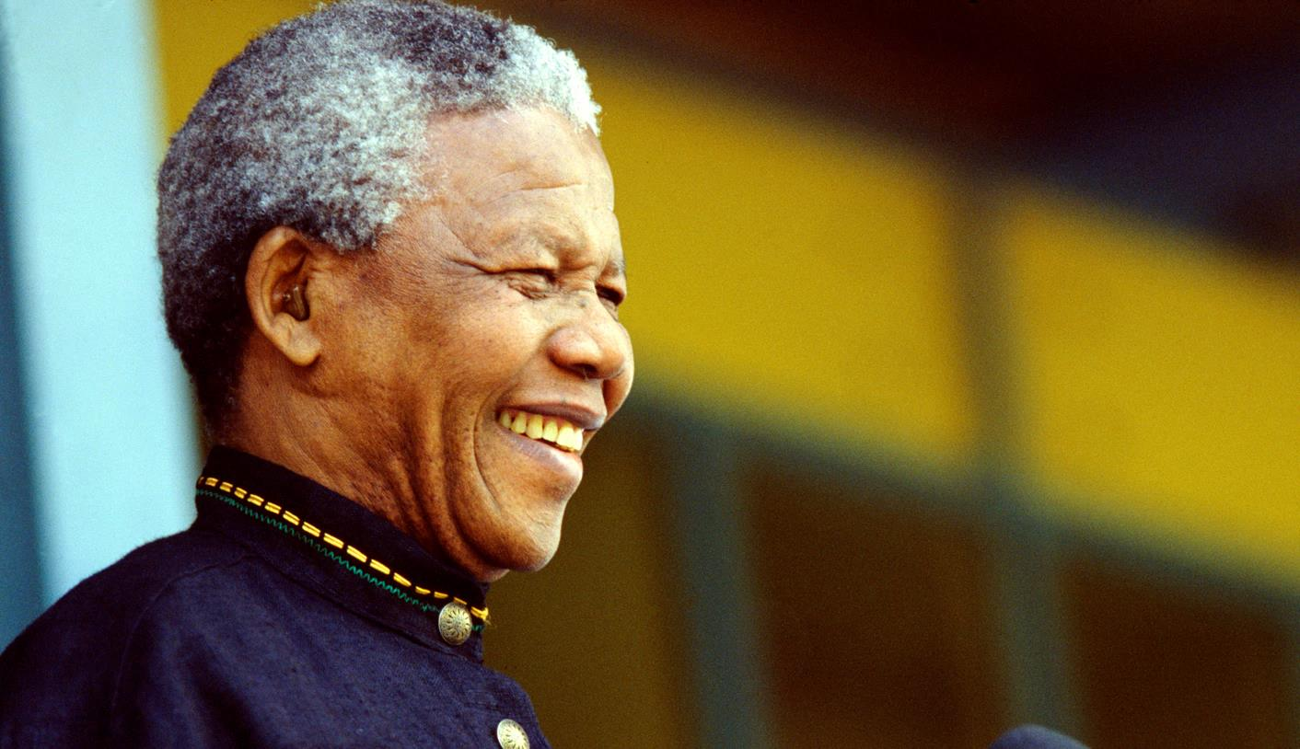
Nelson Mandela (1918 – 2013)
Nobel Laureate, 1993
Education is the most powerful weapon which you can use to change the world.
Notes:
Image: http://www.dailymaverick.co.za/images/uploaded_images/article/madiba%20in%20hospital%20again.jpg
Nelson Mandela was awarded the 1993 Nobel Peace Prize for his work for the peaceful termination of the apartheid regime, and for laying the foundations for a new democratic South Africa.
See: http://www.nobelprize.org/nobel_prizes/peace/laureates/1993/mandela-wall.html

Slide 8


Thank you
This work is licensed under an
Attribution 4.0 International (CC BY 4.0) License
Tony Mays
tonym@saide.org.za

