Slide 1

OER Africa
Utilising Open Educational Resources (OER) in support of curriculum transformation at Africa Nazarene University: a participatory action research (PAR) approach
ALARA, 4-7 November 2015

Slide 2
Overview
The challenge
The research
Progress to date
Part of the solution

Slide 3
The challenge
Utilising OER …

Slide 4
The contextual challenge
Participation rates in SSA (excl RSA), 6-7%
But: Singapore 45% target to be competitive in a global knowledge economy
Limited capacity for expansion of public HE
Therefore growth in private HE
Africa Nazarene University (ANU) first private charter

Slide 5
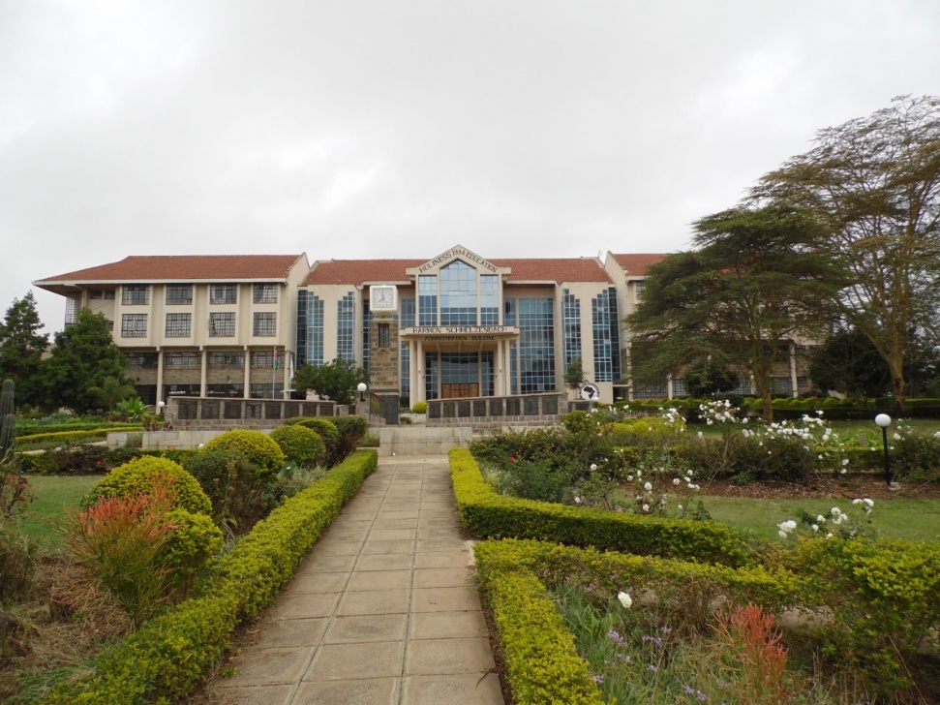
The institutional challenge
Increasing demand for non-campus-based provision
  Part-time
  Workplace-based
  Distance
Centres: Ongata Rongai + Nairobi, Meru, Kisii, Machakos, Mwingi, Migori, Eldoret, Malawi, + diaspora

Slide 6
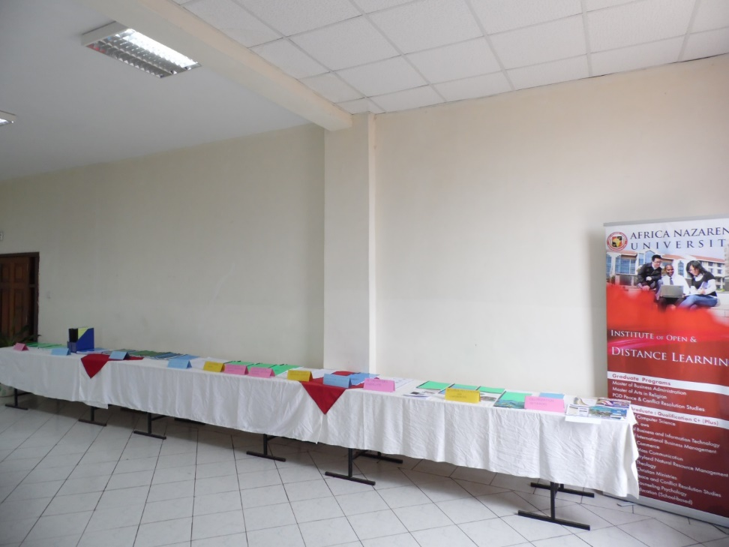
The institutional challenge contd.
All forms of non-traditional provision learning resource-based
Supportive policy framework?
Supportive financial modelling?
CPD for academics hired on the basis of qualifications and research?

Slide 7
Part of the solution
Utilising OER …

Slide 8
OER Definition
Open Educational Resources (OERs) are any type of educational materials that are in the public domain or introduced with an open license.
The nature of these open materials means that anyone can legally and freely copy, use, adapt and re-share them.
OERs range from textbooks to curricula, syllabi, lecture notes, assignments, tests, projects, audio, video and animation.
UNESCO
Notes:
Why do we exist?

Slide 9
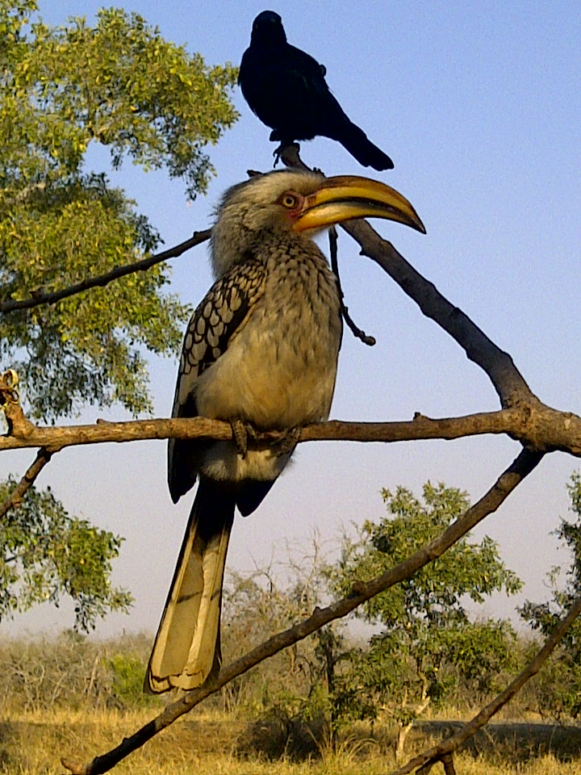
A resource
Notes:
Almost any kind of resource has potential educational value …

Slide 10
An educational resource
What is the name of the bird in the foreground of the picture?
Can you name 3 other varieties of this kind of bird?
Notes:
… however we are most interested in resources which have been incorporated into some kind of learning activity … but can you just use it if you like it?

Slide 11

An OER
What is the name of the bird in the foreground of the picture?
Can you name 3 other varieties of this kind of bird?
This work is licensed under a
Creative Commons Attribution 3.0 Unported License
Citation: Tony Mays 2011
Notes:
The “openness” relates to the way in which the resource is licensed for re-use.

Slide 12
A Remixed OER
              The yellow hornbill shown left is one of four varieties of hornbills common across sub-Saharan Africa. The other varieties are the grey- and red- hornbills and the much larger ground hornbill.
              As the name suggests, the large horny bill is the key characteristic of the species. What does this suggest about their typical diet?
This work is licensed under a
Creative Commons Attribution 3.0 Unported License
Citation: Jane Kamau 2012
Photo: Tony Mays 2011
Notes:
The least restrictive licenses allow the original resource to be adapted for a different audience or context.

Slide 13

Creative Commons
Notes:
Creative Commons is probably the most widely used open licensing system

Slide 14






OER Creative Commons: licenses
Notes:
Examples of different licensing conditions: attribution only, share-alike (but difficult to track), non-commercial use (but difficult to define and track), no derivatives (may be appropriate for a research paper but seems less so for a teaching/learning resource which needs to be contextualised) …

Slide 15
Developing a course
Requirements of
the job
National
policies
Target qualifications
and accreditation
Contextual
research
Target audience: needs and profiles
Learning environment
Approach to teaching
and learning
Key purpose and
outcomes
Content and skills
emphases
Assessment strategy
Teaching and learning
methods
Formative and
summative
Course materials
,
Independent study
Group activities
Feedback to
students
Staff or external agencies
Work-based activities
Recording and
reporting
Technologies
Individual support &
tutoring
Internal monitoring/moderation
External moderation,
quality assurance, and evaluation
© SAIDE 2003
Notes:
But not OER alone. The curriculum is much more than a list of content or topics. It is about the decisions we make about what to teach, how to each and how to assess the learning, who we involve in the process of decision-making, and how experience from practice feeds back into rethinking or reimagining what we choose to do …In an ODL setting we have the added challenge of working out how to do this without necessarily requiring teachers and learners to be in the same place at the same time.

Slide 16
The research
Utilising OER …

Slide 17
Transformative potential
Increased availability of high quality, relevant learning materials can contribute to more productive students and educators.
The principle of allowing adaptation of materials provides one mechanism amongst many for constructing roles for students as active participants in educational processes.
OER has potential to build capacity by providing institutions and educators access, at low or no cost, to the means of production to develop their competence in producing educational materials and carrying out the necessary instructional design.
(CoL 2011: 13)
Notes:
OER support socio-constructivist approaches and an evolving curriculum

Slide 18
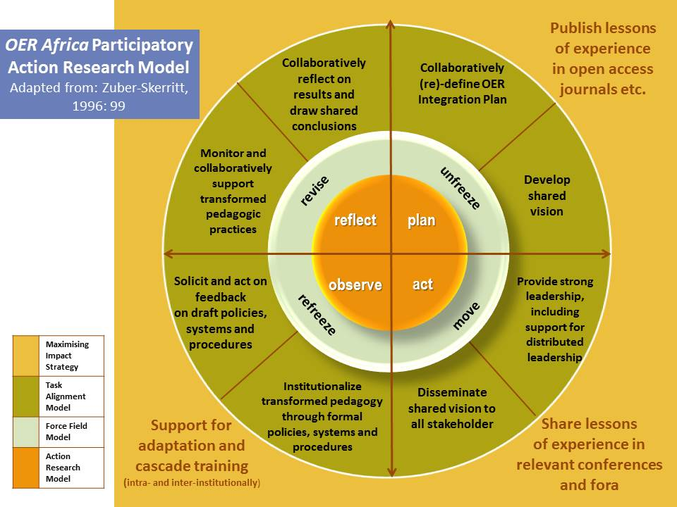

Slide 19
Long term goals
By end August 2017 have developed an ANU-specific case study/article and possibly M/D study which addresses the following questions:
  What kinds of pedagogical transformation are envisaged at ANU and within what timeframes are these changes expected to be introduced? How does this align with the OER community’s understanding of the transformative educational potential of OER?
  To what extent can use of OER constitute an effective catalyst in driving or supporting these envisaged pedagogical changes?
  In what ways can a focus on pedagogical transformation serve to embed effective OER practices into mainstream institutional activities and systems, rather than these practices operating parallel to the mainstream?
  What opportunities already exist within universities that can be used to drive this kind of pedagogical transformation and how can these opportunities most effectively be harnessed?
  What policy, procedural, systemic, cultural, and logistical challenges and barriers inhibit these changes within institutions?
  What strategies need to be implemented to overcome these challenges?
  What levels of institutional political support or championing are needed for changes made to become institutionalized?

Slide 20
Progress to date
Utilising OER …

Slide 21
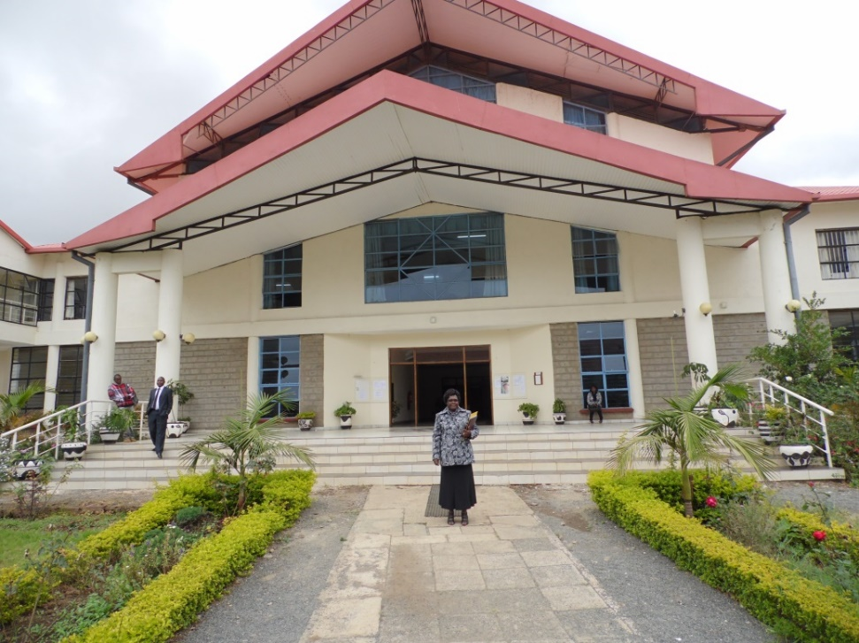
Materials published as OER
OER policy
Case study
7 ODL modules in process

Slide 22
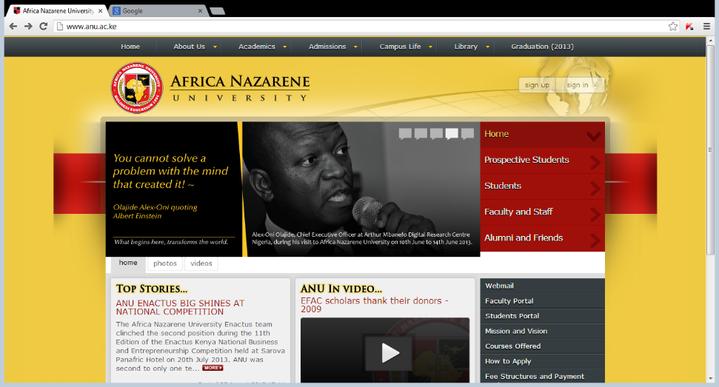
OER research in process
Doctoral study of process
Doctoral study on take-up of OER by Kenyan universities
Research on:
  Readiness of departments
  Readiness of centres
  Impact of reworked materials

Slide 23
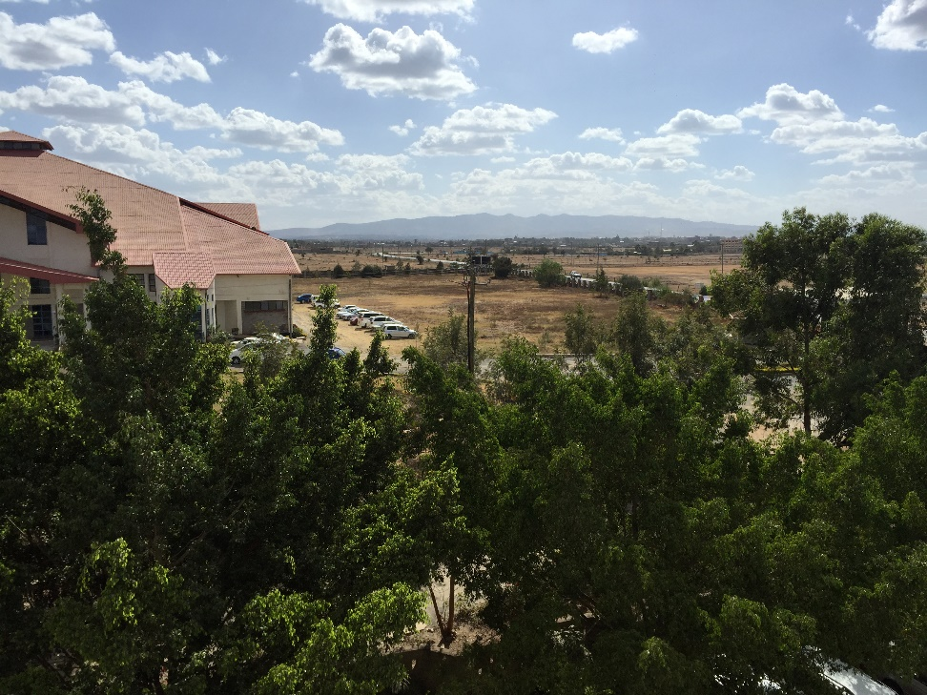
Extending the model to CPD
Using an action research CPD process to develop a portfolio of learning resource review, improvement, review cycles…

Slide 24
Bibliography of useful references
Africa Nazarene University (ANU). 2015. OER Policy. Nairobi: ANU.
Altbach, P. G., Reisberg, L., & Rumbley, L. E., (2009), Trends in Global Higher Education: Tracking an Academic Revolution. A Report Prepared for the UNESCO 2009 World Conference on Higher Education. Paris: UNESCO.
Beer, M., Eisenstadt, R. A., & Spector, B., (1990), Why change programs don’t produce change. Harvard Business Review, Nov-Dec. (68), 158-66.
Boyer, E. L., (1990), Scholarship Reconsidered: Priorities of the Professoriate. A special report prepared for The Carnegie Foundation.
Brown, J. S., & Adler, R. P., (2008), Minds on Fire: Open Education, the Long tail, and Learning 2.0. EDUCAUSE review, January/February 2008. Accessed at http://open.umich.edu/oertoolkit/references/mindsonfire.pdf on 20/10/12.
Butcher, N., (2011), A Basic Guide to Open Educational Resources (OER).Vancouver: Commonwealth of Learning.
Caswell, T., Henson, S., Jensen, M., & Wiley, D., (2008), Open Content and Open educational resources: Enabling universal education. IRRODL, Vol 9, No. 1, 2008. http://www.irrodl.org/index.php/irrodl/article/view/469/1009. Accessed 20/10/12.
Cohen, L., Manion, L., & Morrison, K., (2000), Research Methods in Education. 5th Edition. London and New York: RoutledgeFalmer.
Conole, G., (2012), http://cloudworks.ac.uk/cloud/view/6305. Accessed 17/10/12.
Council on Higher Education (CHE), 2014, Distance Higher Education Programmes in a Digital Era: Good Practice Guide. Pretoria: CHE.
Downes, S., (2007), Models for Sustainable Open educational Resources. Interdisciplinary Journal of Knowledge and Learning Objects, Volume 3, February 27, 2007. National Research Council Canada. 29-44.
Glennie, J., Harley, K., & Butcher, N., (2012), Conclusion: Reflections on Practice in: Glennie, J., Harley, K., Butcher, N., & Van Wyk, T., (Eds), Open Educational Resources and Change in Higher Education: Reflections from Practice. Vancouver: Commonwealth of Learning.
Haβler, B., & Mays, T., (2014), Open Content. Article in International Encyclopedia of Digital Communication and Society. Published online by John Wiley & Sons:
http://onlinelibrary.wiley.com/doi/10.1002/9781118767771.wbiedcs154/full
http://onlinelibrary.wiley.com/doi/10.1002/9781118767771.wbiedcs154/pdf
Lewin, K., (1946), Action research and minority problems. Journal of Social Sciences, 2 (4), 34-46; Lewin, K. 1948. Resolving Social Conflicts. New York: Harper.
Lewin, K., (1952), Field Theory in Social Science. London: Tavistock Publications.
Mays, T., (2004), From policy to practice: an evaluation of the Unisa National Professional Diploma in Education from the perspective of social critical theory. Unpublished MEd dissertation. Pretoria: Unisa.
Mays, T., (2013), Open Educational Resources (OER): do they make a difference and how do/will we know in Gouws, F. E., & Wolhuter, C, C,. (Eds), SAERA 2013 Conference Proceedings: Educational Research in South Africa: Practices and Perspectives. Cape Town: OUP. 123-146.
Mays, T., (2015), Chapter 6: Teaching, learning and curriculum resources in du Preez, P. & Reddy, C. Eds, Curriculum Studies: Visions and Imaginings, Cape Town: Pearson.
Omollo, Kathleen Ludewig, (2011a), Growing an Institutional Health OER Initiative: A Case Study of the Kwame Nkrumah University of Science and Technology. http://www.oerafrica.org/ResourceResults/tabid/1562/mctl/Details/id/38803/Default.aspx
Ooko, M. & Mays, T. 2015. Opening learning at the Africa Nazarene University: A case study. Nairobi: Africa Nazarene University.
Randell. C., (2006), Resources for new ways of learning: a manual for developers of learning resources. Pretoria:Saide. Downloaded from www.saide,org.za, 06/07/2006.
UNESCO, (2012), (2012) World Open Educational Resources (OER) Congress, 2012 Paris OER Declaration. http://www.unesco.org/new/fileadmin/MULTIMEDIA/HQ/CI/CI/pdf/Events/Paris%20OER%20Declaration_01.pdf. Accessed 18/10/12.
Welch, T., (2012), The OER Life Cycle. Pretoria: OER Africa.
Wiley, D., (2006), The current state of open educational resources. Blog. Iterating toward openness. Accessed January 2011, http://opencontent.org/blog/archives/247.
Wiley, D., (2008), http://www.wikieducator.org/ OER_Handbook/ educator/ OER_Lifecycle
Zuber-Skerritt, O., (1996), Emancipatory action research for organisational change and management development in Zuber-Skerritt, O. Ed. New Directions in Action Research. London: Falmer, 99 of 83-105.

Slide 25
Thank you
This work is licensed under a
Creative Commons Attribution 4.0 License
Citation:
Ooko, M. & Mays, T. 2015. Utilising OER in support of curriculum transformation at ANU: a PAR approach. OER Africa/Saide and ANU
Tony Mays
Senior Programme Specialist: HE
tonym@saide.org.za
Mary Ooko
Director: IODL, ANU
mooko@anu.ac.ke

