Slide 1
2
Webinar commences at 10h00 (UTC)
10h00 – Ghana
11h00 – Nigeria and Cameroon
12h00 – South Africa and Egypt
13h00 - Kenya
Emergency Remote Teaching
AAU / OER Africa webinar series W2 – What to teach during campus closure

Slide 2
Webinar rules and etiquette
Note: Your microphone has been automatically turned OFF. Please leave it off.
Note: Your video cam has been automatically turned OFF, we want to preserve bandwidth.
If you have a question, type it in the chat facility and the back-channel manager will respond, or pass on to the facilitator.
If for unforeseen issues we have to close the chat please e-mail queries to the back-channel manager: neilshel@nba.co.za
2
3
1

Slide 3
AAU messages
Nodumo Dhlamini
Director - ICT Services & Knowledge Management - AAU
ERT webinar
series
04
03

Slide 4
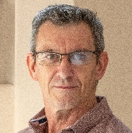
Today’s team
Nodumo Dhlamini
Andrew Moore
Director - ICT Services & Knowledge Management - AAU
Education specialist and webinar facilitator – OER Africa
ERT webinar
series
Neil Butcher
Cathy MacDonald
Co-project director and back channel manager – OER Africa
Assistant back channel manager – OER Africa
04
03

Slide 5
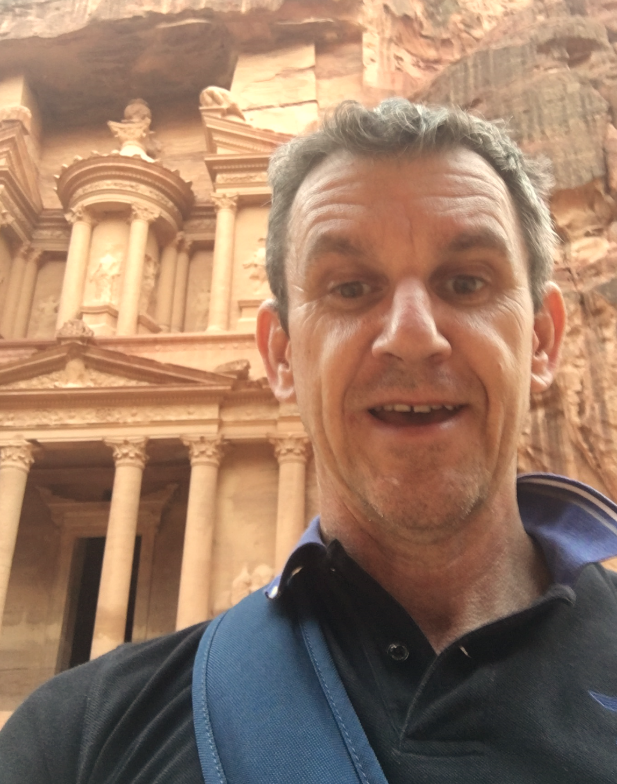
Your facilitator
Access
ERT tip: Lecturers should create an online presence to show students that they are ‘there’, involved and supportive.
Andrew Moore
Access
Director - ICT Services & Knowledge Management - AAU
Andrew Moore
Education specialist – OER Africa
Access
ERT webinar series
04
03
Access

Slide 6
ERT webinar series
Teach effectively during campus closure.
Tips and tricks: Media in PowerPoint
(Complete)
Aim: Guide academics to quickly and cheaply, adopt an emergency remote teaching strategy that enables student learning to continue?
1
Communicate effectively during campus closure.
Tips and tricks: Social media groups
(Friday 8th May)
2
4
3
What to teach during campus closure.
Tips and tricks: Google classroom
(Thu 30th April)
Know if learning is happening during campus closure.
Tips and tricks: Quizziz assessment tool
(Mon 4th May)

Slide 7
Webinar 2 – Agenda What to teach during campus closure
4.
Use a LMS to structure the ERT study programme
1. Choose curriculum topics that suit remote teaching
3.
Sequence the ERT study sessions carefully
2.
Choose activities, resources and tools that suit ERT
+ tips and tricks

Slide 8
Demonstration: tips and tricks
1
2
Create a Google Classroom account
Create a course structure with materials and activities
3
4
Add students to the classroom
Grade student activities
Add students to the class

Slide 9
Webinar 2 resources
W2
W1 & 2 Resources
Access the webinar resources in our Google classroom:
https://classroom.google.com/
code m7p5bd5
W1 Resources
Access resources on OER Africa:
https://www.oerafrica.org/aau-oer-africa-emergency-remote-teaching-webinar-series
What to teach during campus closure

Slide 10
ERT topic suitability
4.
Use a LMS to structure the ERT study programme
1. Choose curriculum topics that suit remote teaching
3.
Sequence the ERT study sessions carefully
2.
Choose activities, resources and tools that suit ERT

Slide 11
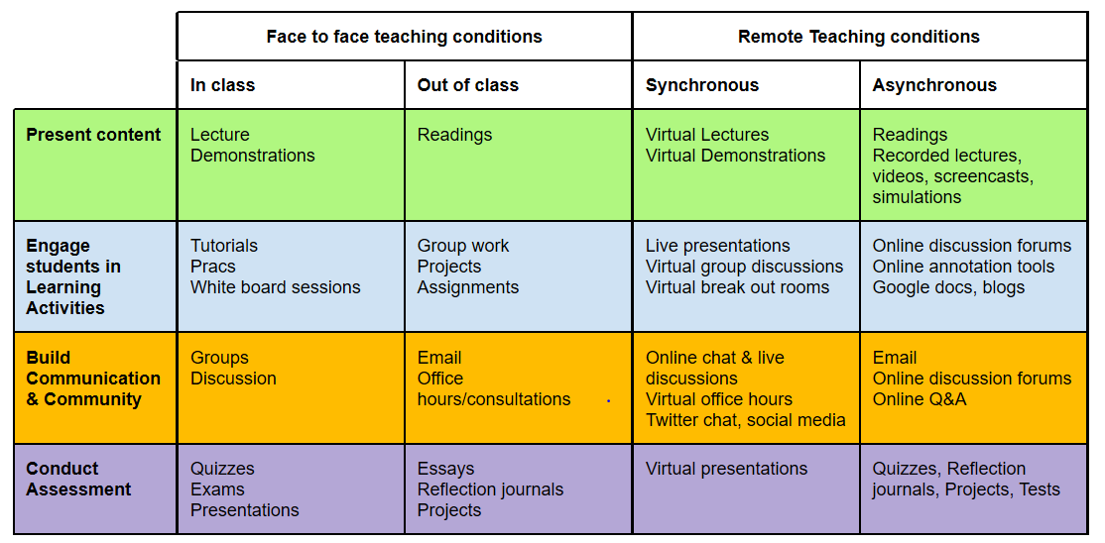
ERT topic suitability
What topics lend themselves to ERT? Some parts of the curriculum are notoriously difficult to teach online while others, it can be argued, are better taught remotely!

Slide 12
ERT topic suitability II
What topics lend themselves to ERT? Some parts of the curriculum are notoriously difficult to teach online while others, it can be argued, are better taught remotely!
Theory vs. practical considerations
Supervision
required?
Collaborative learning required?
Resource intensive?

Slide 13
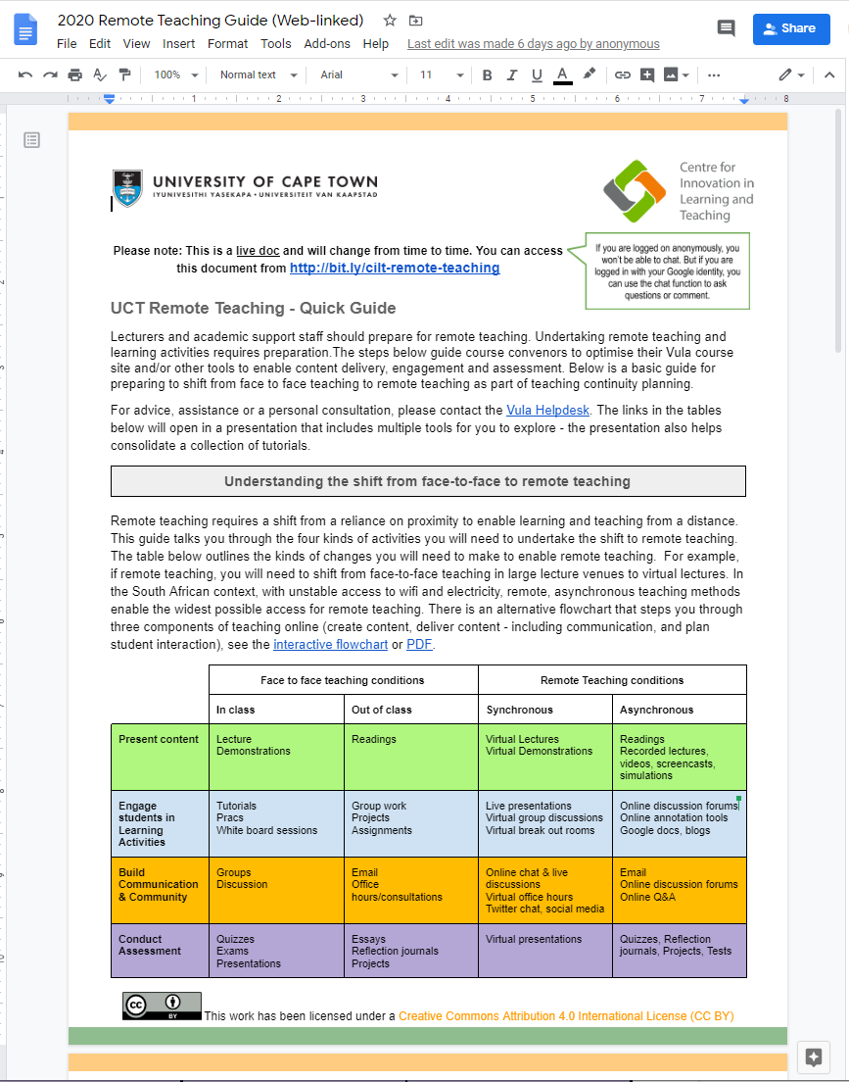
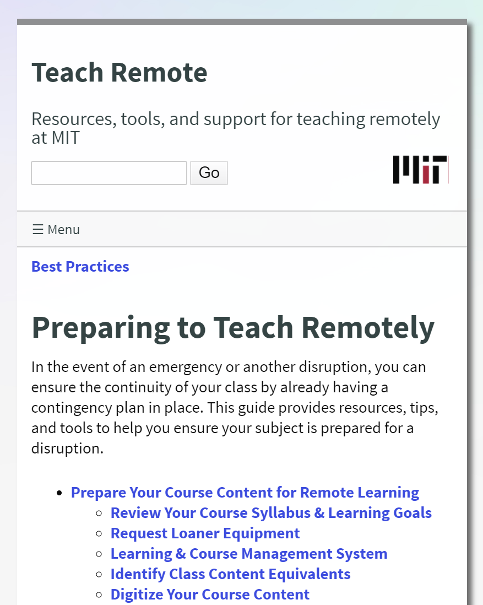
Some open resources
3
2
UCT Remote Teaching - Lecturers and academic support staff should prepare for remote teaching. Undertaking remote teach …
MIT’s briefing and resources provided to their own lecturers facing ERT
A New Pedagogy is Emerging... and Online Learning is a Key Contributing Factor by TeachOnline
Access
Access
Access

Slide 14
Consider…
How much of your course could be covered asynchronously?
AAU & OER Africa
Use either the Zoom chat facility or the Google Classroom discussion forum to tell us what your response is to the above query

Slide 15
ERT resource availability
4.
Use a LMS to structure the ERT study programme
1. Choose curriculum topics that suit remote teaching
3.
Sequence the ERT study sessions carefully
2.
Choose activities, resources and tools that suit ERT

Slide 16
ERT resource availability
ERT relies heavily on digital resources and tools. What specific considerations should you think about?
010110
Are your resources digital?
Appropriate Open content online?
Limitations of student access
Low-tech options

Slide 17
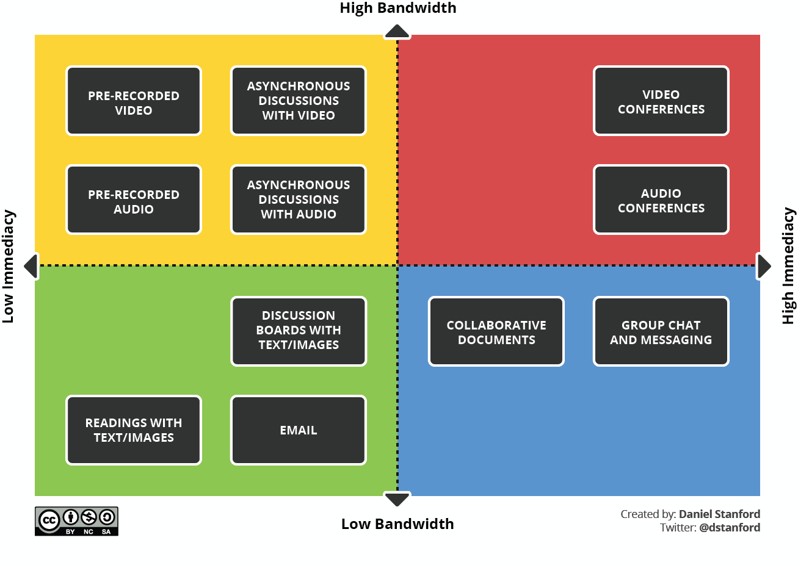
ERT resource availability
“Keep your presentation choices as low tech as possible or always provide low tech options for students with access constraints.”

Slide 18
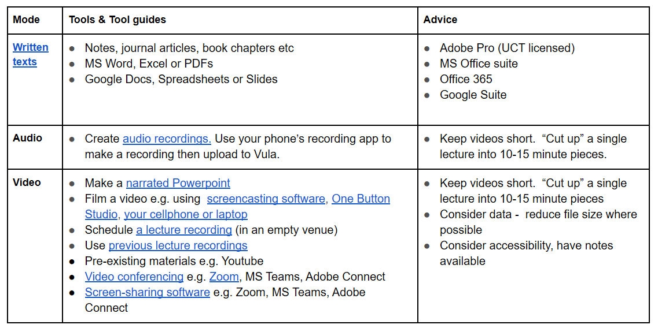
ERT resource availability
“Find, or make, suitable written, audio and video, audio content. If you are making content choose a suitable tool for making such content, using [this] table.”

Slide 19
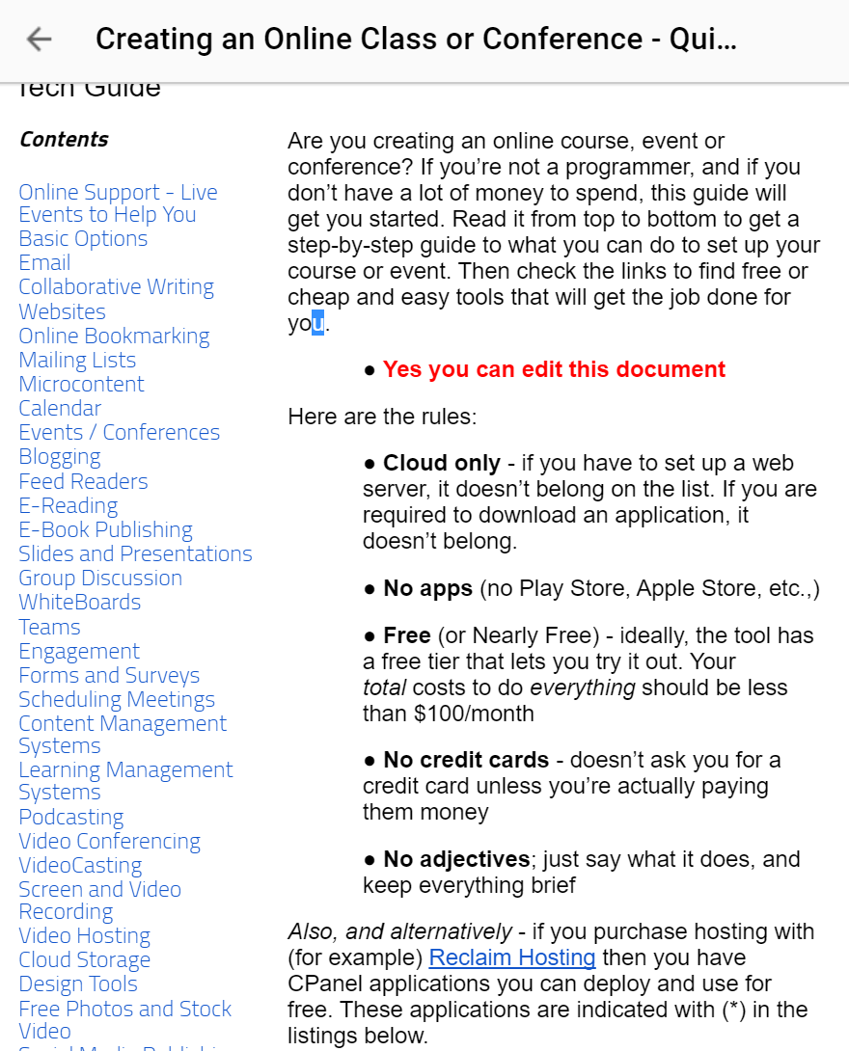
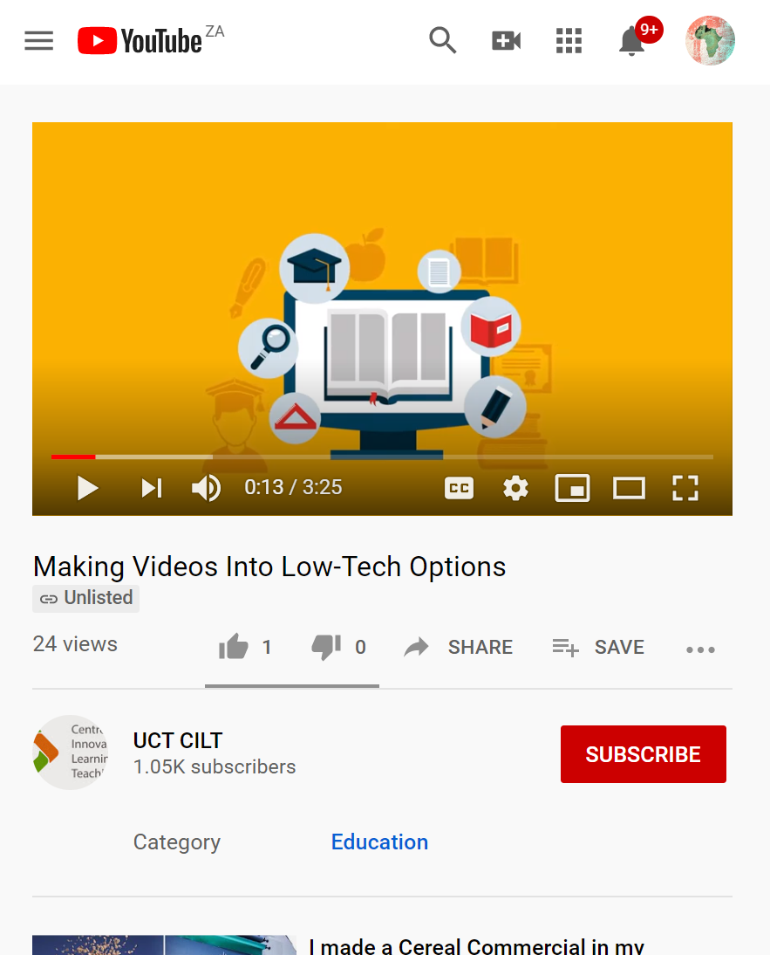
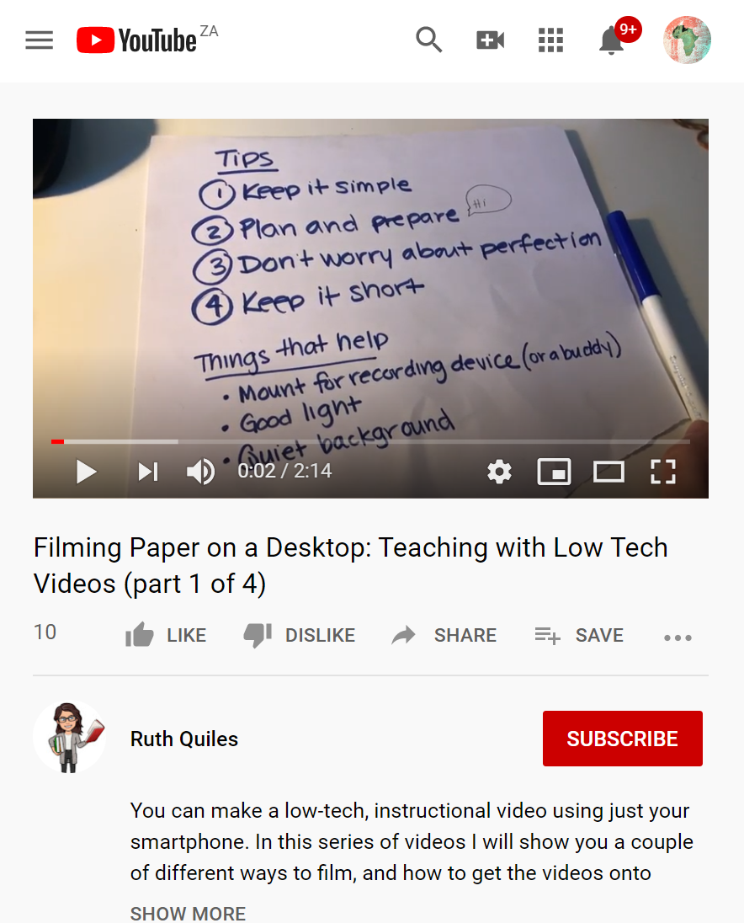
Some open resources
3
2
Stephen Downes’ Quick Tech Guide for ERT – Free low-tech resources ideal for ERT. This is an ongoing collaborative document. Updated regularly.
UCT CILT investigates low tech options for remote learning.
Ruth Quiles demonstrates really low-tech video … just your phone camera!
Access
Access
Access

Slide 20
Sequence ERT sessions
4.
Use a LMS to structure the ERT study programme
1. Choose curriculum topics that suit remote teaching
3.
Sequence the ERT study sessions carefully
2.
Choose activities, resources and tools that suit ERT

Slide 21
Sequence ERT sessions
It is possible to teach sophisticated skills sets and advanced knowledge online but requires careful sequencing of the ERT sessions. Consider…
Learning pathway
Build on prior knowledge
Develop skill sets over time
Transfer to new contexts

Slide 22
Sequence ERT sessions

Slide 23
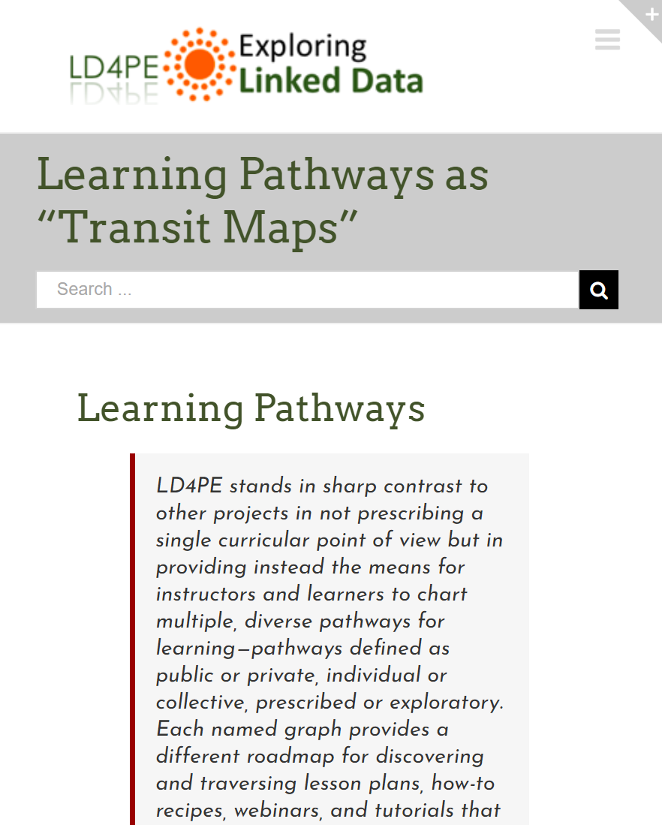
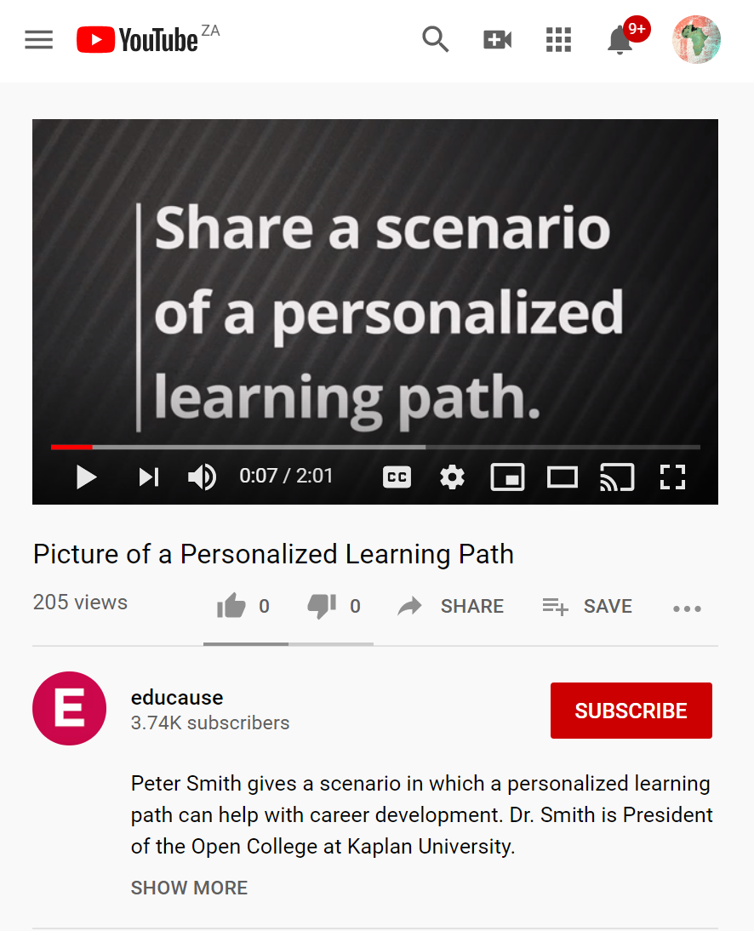
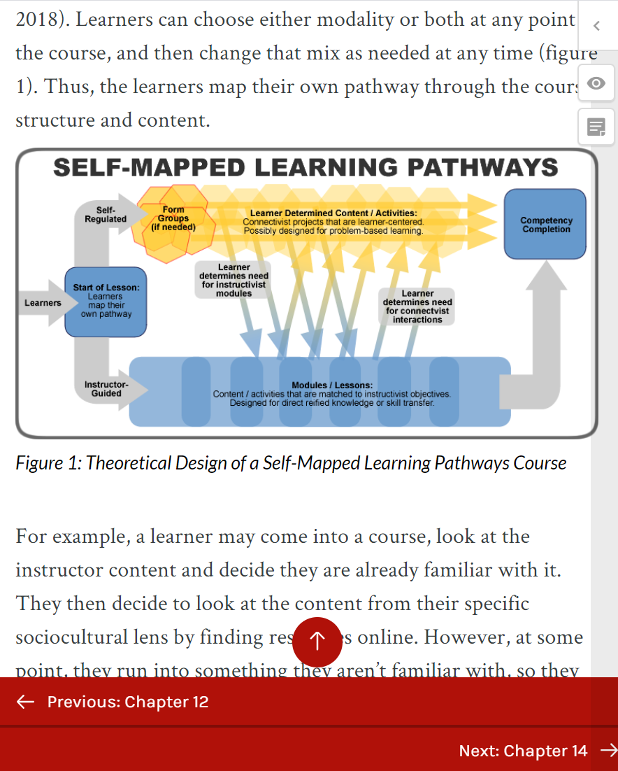
Some open resources
3
2
Interesting discussion about how good learning pathway design is similar to transit maps. LD4PE
Educause video that provides a scenario where learning pathways make sense for lesson design.
Textbook on creating learning pathways for digital learning environments. Has a good theory section relating to all education.
Access
Access
Access

Slide 24
Mastering the LMS
4.
Use a LMS to structure the ERT study programme
1. Choose curriculum topics that suit remote teaching
3.
Sequence the ERT study sessions carefully
2.
Choose activities, resources and tools that suit ERT

Slide 25
Mastering the LMS
A learning management system (LMS) will help you structure and sequence ERT lessons. Many universities have an LMS but it is also possible to use free online LMS for just a class.
Layout content and activities to create learning pathway
Communication tools
Student assignment submissions
Grades, feedback and certificates / badges

Slide 27
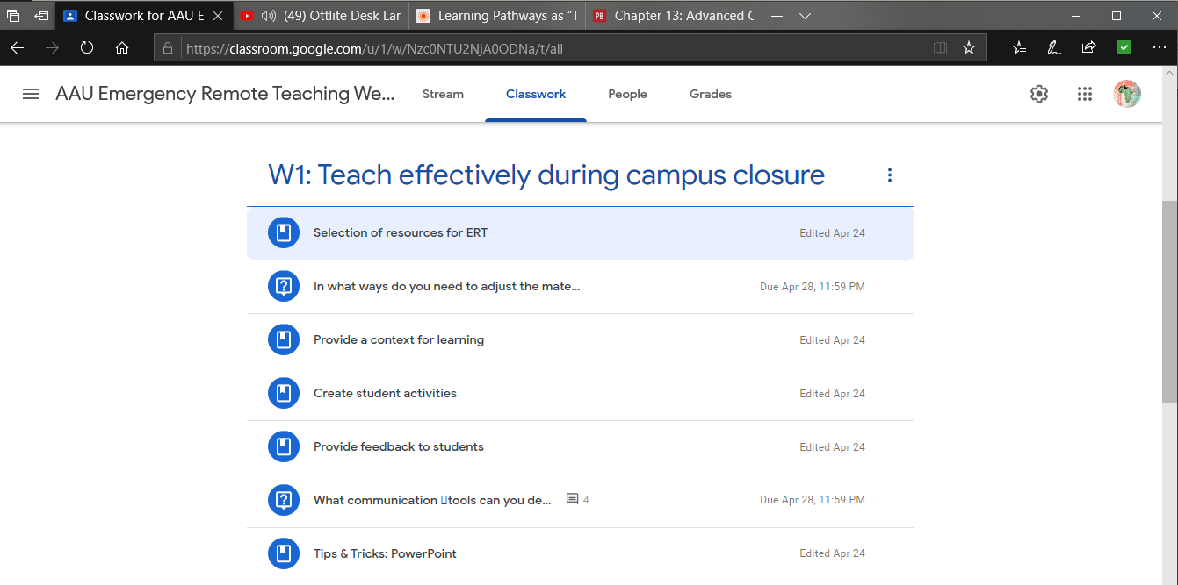
Mastering the LMS

Slide 28
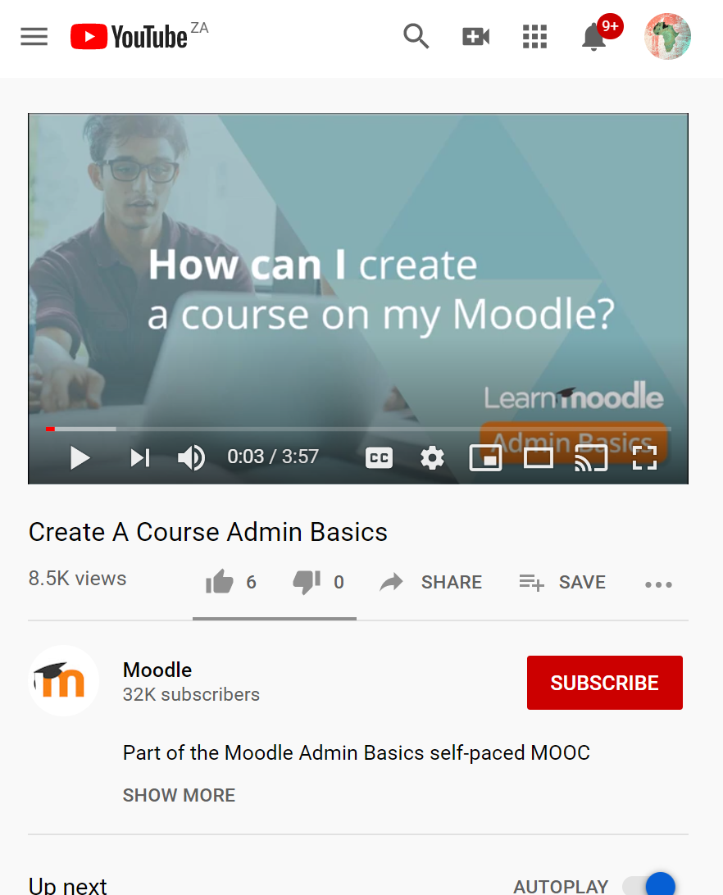
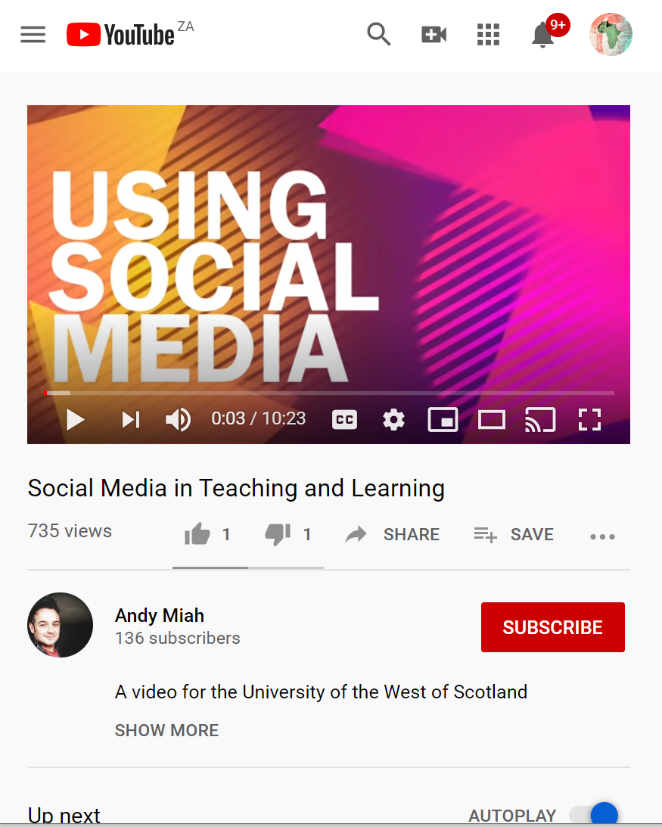
Some open resources
3
2
Vanderbilt University’s overview of different LMS pros and cons and functionality.
Introduction to creating a course on the free version of Moodle Cloud.
Article on the role of the LMS in selecting appropriate education technology to support teaching and learning.
Access
Access
Access

Slide 29
Consider…
Would you use the institutional LMS or prefer to have a personal LMS?
AAU & OER Africa
Use either the Zoom chat facility or the Google Classroom discussion forum to tell us what your response is to the above query

Slide 30
Demonstration
How to structure and sequence your online materials in GC

Slide 31
Demonstration: tips and tricks
1
2
Create a Google Classroom account
Create a course structure with materials and activities
3
4
Add students to the classroom
Grade student activities
Add students to the class

Slide 32
1
Set up a Google Classroom account
Time stamp
https://www.youtube.com/watch?v=pl-tBjAM9g4&t=33s

Slide 33
Queries?
Any questions?
AAU & OER Africa
Use either the Zoom chat facility or the Google Classroom discussion forum to tell us what your response is to the above query

Slide 34
2
Simple Course structure
Time stamps:
https://www.youtube.com/watch?v=pl-tBjAM9g4&t=596s

Slide 35
Queries?
Any questions?
AAU & OER Africa
Use either the Zoom chat facility or the Google Classroom discussion forum to tell us what your response is to the above query

Slide 36
3
Add students to the class
Time stamp:
https://www.youtube.com/watch?v=pl-tBjAM9g4&t=230s

Slide 37
Queries?
Any questions?
AAU & OER Africa
Use either the Zoom chat facility or the Google Classroom discussion forum to tell us what your response is to the above query

Slide 38
4
Grade students
Time stamp:
https://www.youtube.com/watch?v=pl-tBjAM9g4&t=1187s

Slide 39
Queries?
Any questions?
AAU & OER Africa
Use either the Zoom chat facility or the Google Classroom discussion forum to tell us what your response is to the above query

Slide 40
Webinar 2 – Summary What to teach during campus closure
4.
Use a LMS to structure the ERT study programme
1. Choose curriculum topics that suit remote teaching
3.
Sequence the ERT study sessions carefully
2.
Choose activities, resources and tools that suit ERT
+ tips and tricks

Slide 41
Webinar 2 resources
W1 & 2 Resources
Access the webinar resources in our Google classroom:
https://classroom.google.com/
code m7p5bd5
W1 Resources
Access resources on OER Africa:
https://www.oerafrica.org/aau-oer-africa-emergency-remote-teaching-webinar-series
W2
What to teach during campus closure

