Slide 1


3
Webinar commences at 10h00 (UTC)
    10h00 – Ghana
    11h00 – Nigeria and Cameroon
    12h00 – South Africa and Egypt
    13h00 - Kenya
Emergency Remote Teaching
AAU / OER Africa webinar series
W3 – How to know if learning is happening during campus closure

Slide 2
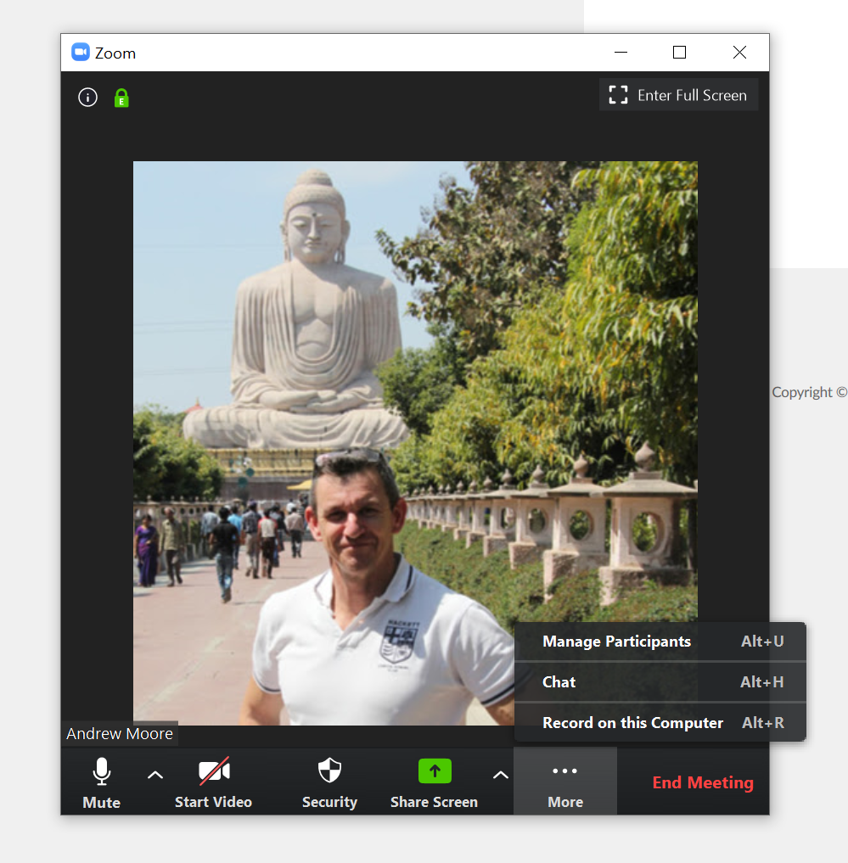
Webinar rules and etiquette
Note: Your microphone has been automatically turned OFF. Please leave it off.
Note: Your video cam has been automatically turned OFF, we want to preserve bandwidth.
If you have a question, type it in the chat facility and the back-channel manager will respond, or pass on to the facilitator.
If for unforeseen issues we have to close the chat please e-mail queries to the back-channel manager: neilshel@nba.co.za
2
3
1

Slide 3

AAU messages
Dr Violet Makuku
Quality Assurance Specialist - AAU
ERT
webinar
series
04
03

Slide 4



Today’s team
Andrew Moore
Dr Violet Makuku
Quality Assurance Specialist - AAU
Education specialist and webinar facilitator – OER Africa
ERT
webinar
series
Neil Butcher
Cathy MacDonald
Co-project director and back channel manager – OER Africa
Assistant back channel manager – OER Africa
04
03

Slide 5

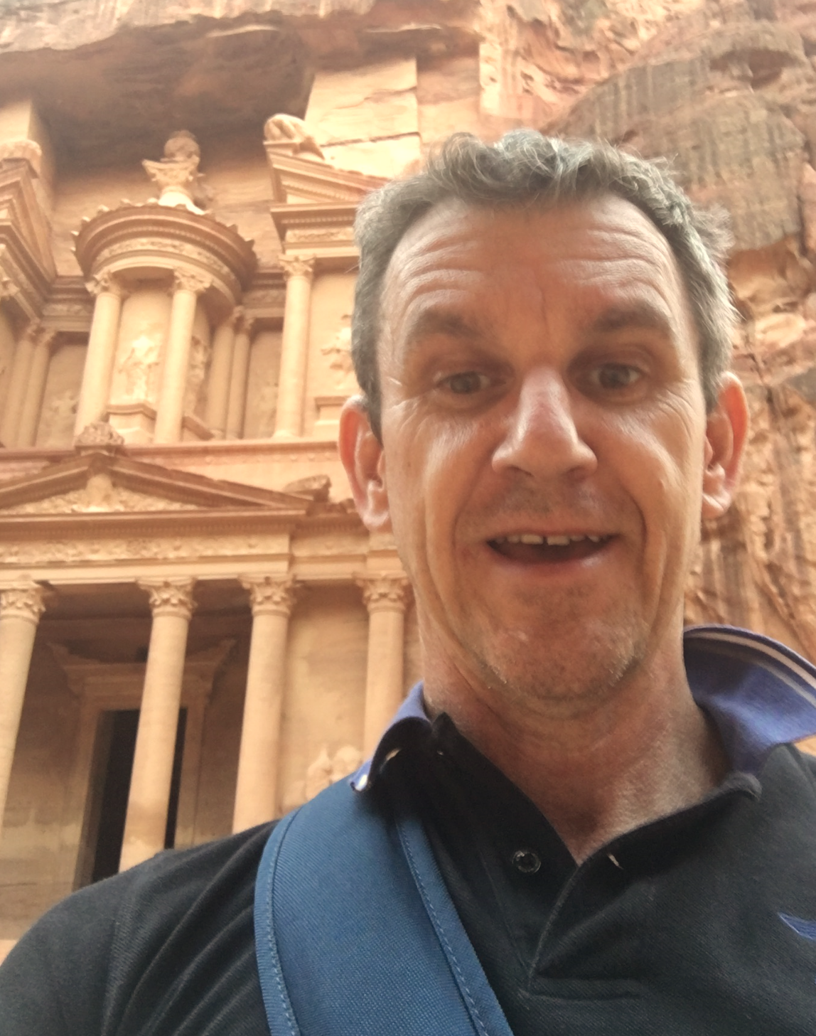



Your facilitator
Access
ERT tip:
Lecturers should create an
online presence to show students
that they are ‘there’, involved and
supportive.
Andrew Moore
Access
Director - ICT Services & Knowledge Management - AAU
Andrew Moore
Education specialist – OER Africa
Access
ERT
webinar
series
04
03
Access

Slide 6

ERT webinar series
Teach effectively
during campus closure.
Tips and tricks: Media in PowerPoint
(Complete)
Aim: Guide academics to quickly and cheaply, adopt an emergency remote teaching strategy that enables student learning to continue?
1
Communicate effectively
during campus closure.
Tips and tricks: Social media groups
(Friday 8th May)
2
4
3
What to teach
during campus closure.
Tips and tricks: Google classroom
(Complete)
Know if learning is happening
during campus closure.
Tips and tricks: Quizziz assessment tool
(Today - Mon 4th May)

Slide 7






Webinar 3 – Agenda
Monitor learning during campus closure
4.
Rethinking summative
assessment during ERT
1.
Activities that give feedback via the LMS
3.
LMS diagnostic
tools and tracking
2.
ERT assessment: Exploiting digital diagnostic and formative assessment tools
+ tips and tricks

Slide 8
Demonstration: tips and tricks
1
2
Create a Google
Classroom account
Create a course
structure with materials and activities
3
4
Add students to
the classroom
Grade student
activities
Add students to
the class

Slide 9


Webinar 3 resources
Resources
Access the webinar resources in our Google classroom:
https://classroom.google.com/
code m7p5bd5
Resources
Access resources on OER Africa:
https://www.oerafrica.org/aau-oer-africa-emergency-remote-teaching-webinar-series
W3
Learning happening
during campus closure?

Slide 10
Activities that give feedback
4.
Rethinking summative
assessment during ERT
1.
Activities that give feedback via the LMS
3.
LMS diagnostic
tools and tracking
2.
ERT assessment: Exploiting digital diagnostic and formative assessment tools

Slide 11



Activity feedback
What types of LMS/online activities provide learning feedback?
Machine markable quizzes
Moodle = Quizzes, but also
Google Classroom = Quiz
Apps = GoFormative, Socrative etc.
Course completion statistics
Peer review activities
Moodle = ‘Workshop’ activity
Check LMS student activity reports

Slide 12
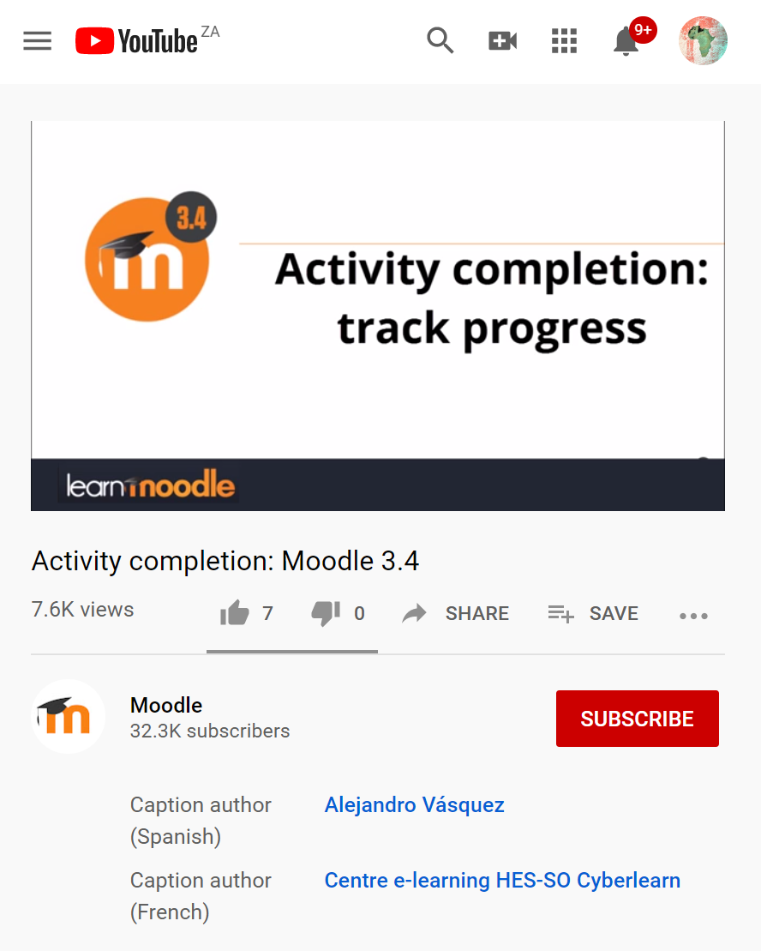




Some open resources
3
2
Moodle’s activity tracking tool explained.
Moodle’s Workshop peer review module introduced
Create a self marking quiz in Google classroom
Access
Access
Access

Slide 13
ERT assessment
4.
Rethinking summative
assessment during ERT
1.
Activities that give feedback via the LMS
3.
LMS diagnostic
tools and tracking
2.
ERT assessment: Exploiting digital diagnostic and formative assessment tools

Slide 14






ERT assessment?
What types of assessment lend themselves to ERT?
Diagnostic testing
Formative assessments
Summative assessments
Subjects using equations or skill sets
At least, not the way we do it normally
Will require new skill sets to do during ERT

Slide 15


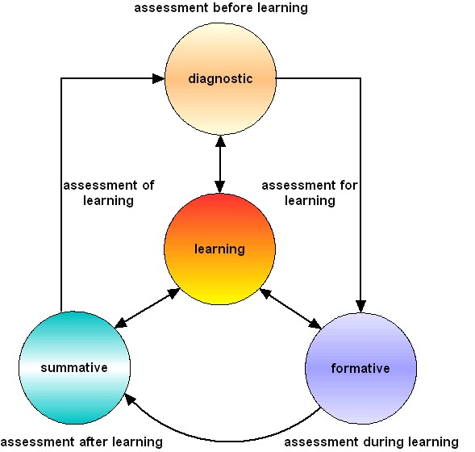






ERT assessment?
LMS
Gcrisp01 on Wikipedia

Slide 16
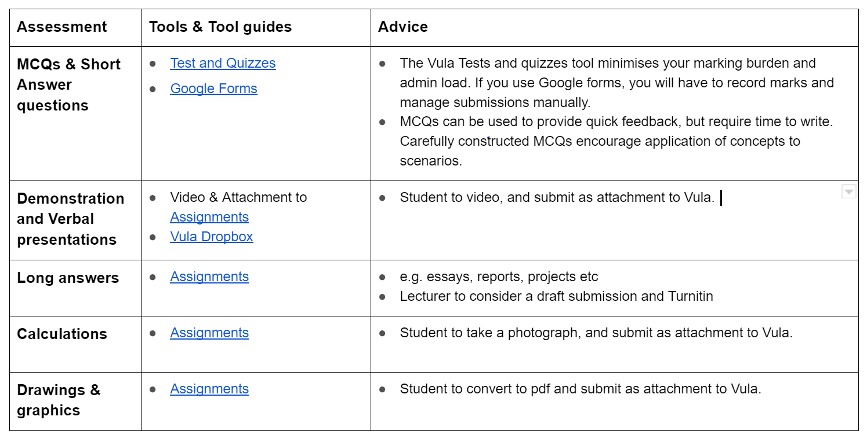




ERT assessment?
Can assessment be done in any meaningful way during ERT? Yes, but with caveats…

Slide 17

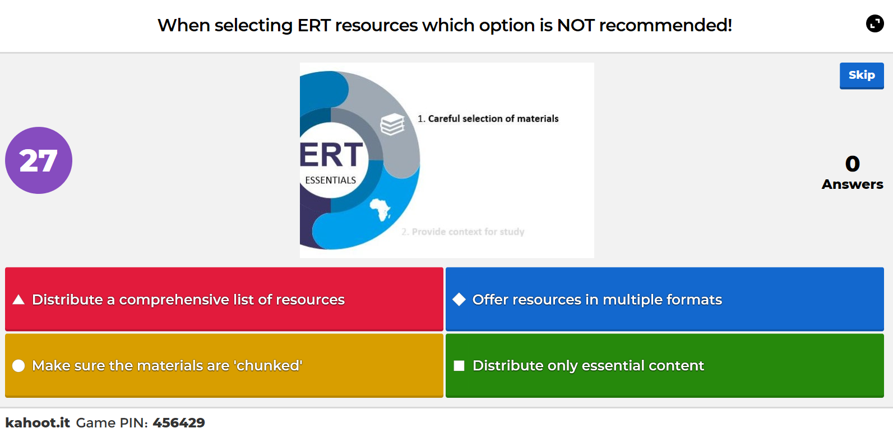
Formative example
Navigate to https://kahoot.it
on your phone or second device

Slide 18


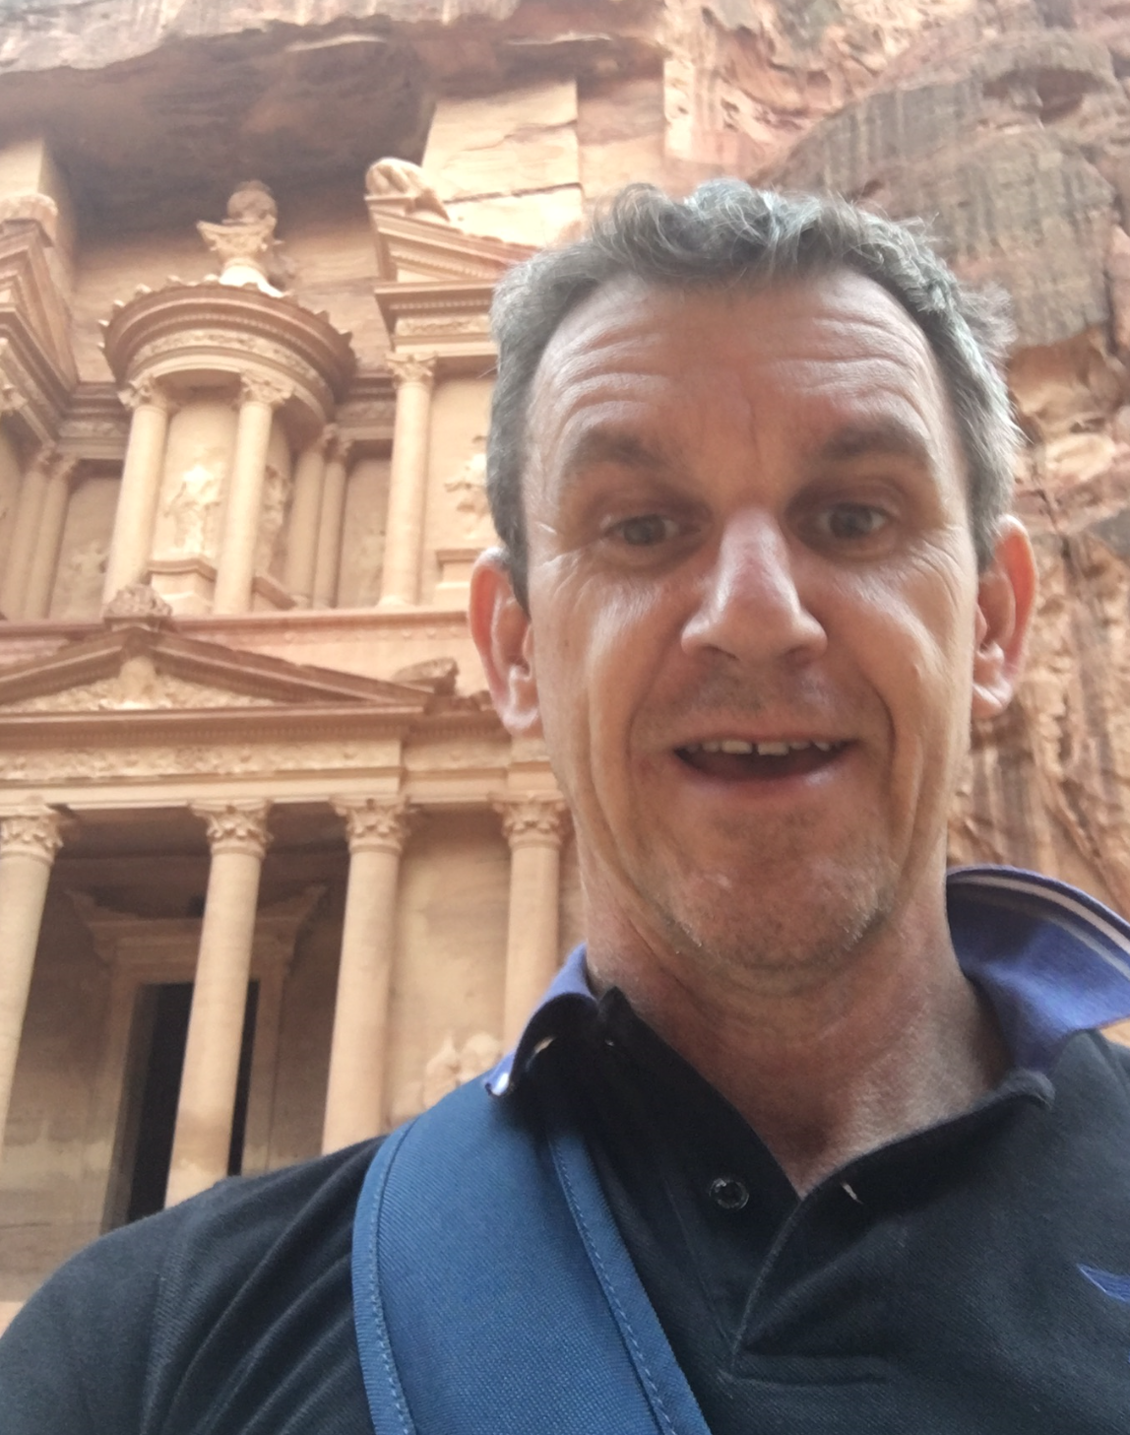
Consider…
What digital assessment tools do you use currently and what has been your experience using them?
AAU & OER Africa
Use either the Zoom chat facility or the Google Classroom discussion forum
to tell us what your response is to the above query

Slide 19
Diagnostic tracking
4.
Rethinking summative
assessment during ERT
1.
Activities that give feedback via the LMS
3.
LMS diagnostic
tools and tracking
2.
ERT assessment: Exploiting digital diagnostic and formative assessment tools

Slide 20
Diagnostic tracking
It is possible to track your students online… yes more than ever before
Course completion
Student activity reports

Slide 21
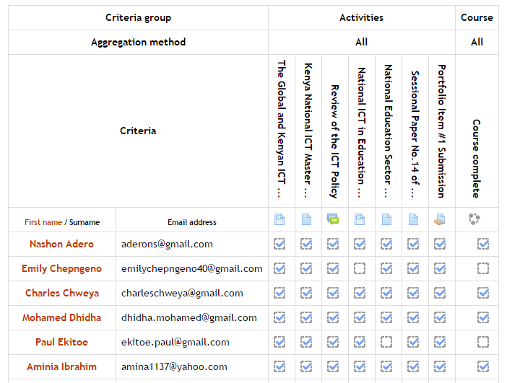
LMS student tracking
Tasks incomplete

Slide 22
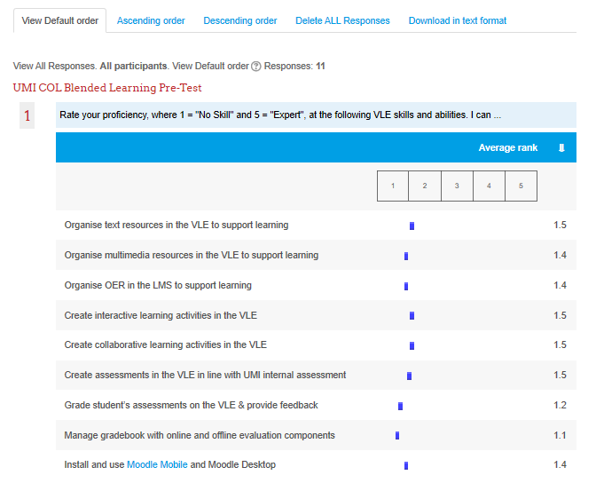
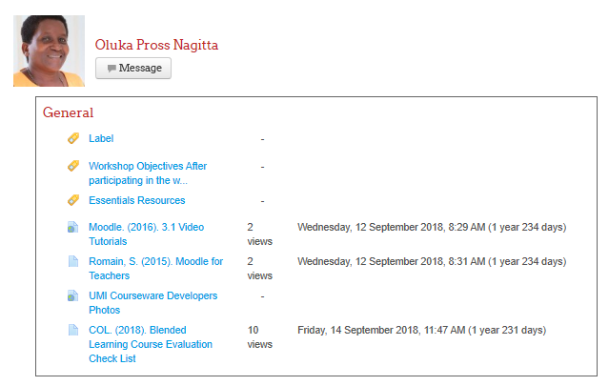
Diagnostic reports
Statistics at the individual level
Indicates strong engagement with the task
Statistics at the class and even activity level

Slide 23
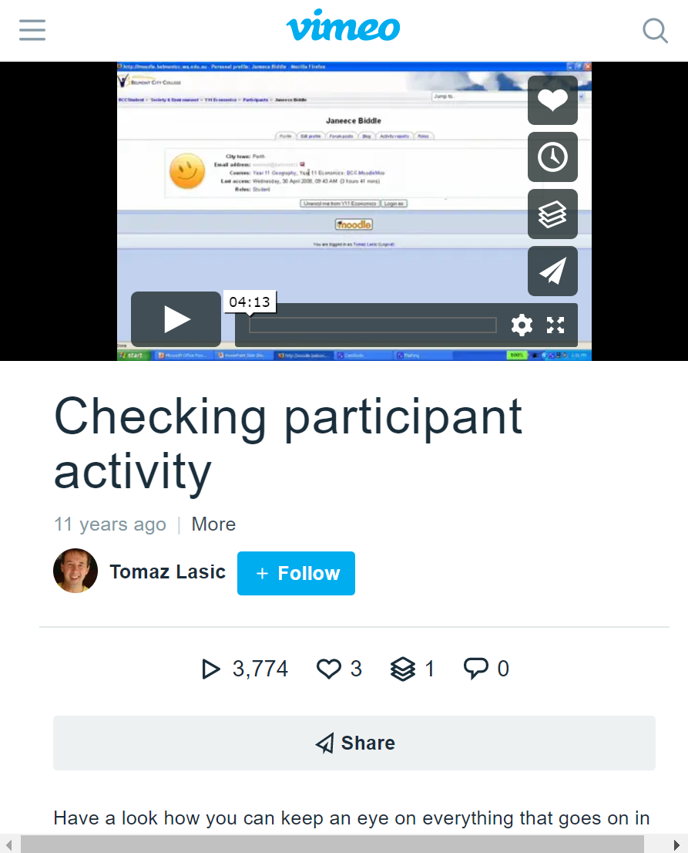

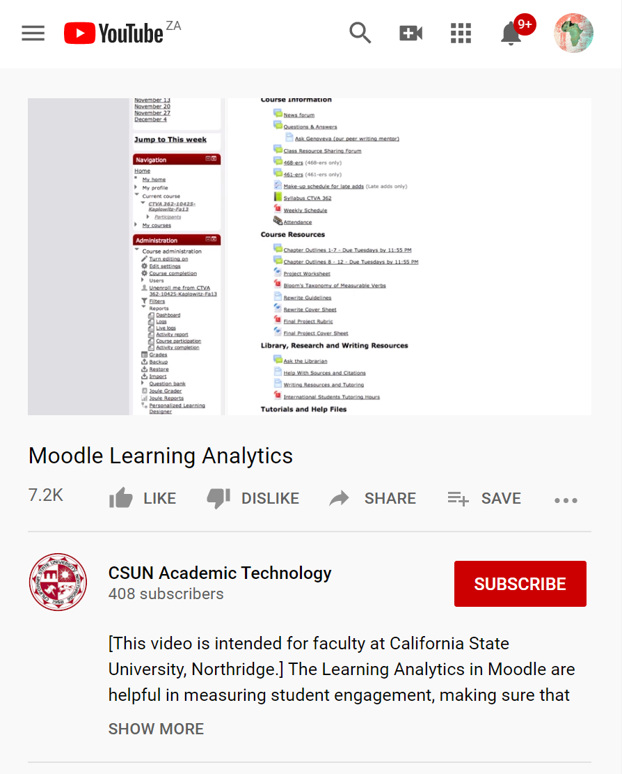


Some open resources
3
2
Tomaz Kasic’s Vimeo video outlines how to track students on the Moodle LMS
TEDx on Open Learning analytics by Erik Duval
Moodle learner analytics step by step tutorial from CSUN
Access
Access
Access
?

Slide 24
Rethinking summative assessment
4.
Rethinking summative
assessment during ERT
1.
Activities that give feedback via the LMS
3.
LMS diagnostic
tools and tracking
2.
ERT assessment: Exploiting digital diagnostic and formative assessment tools

Slide 25



Rethinking summative assessment
Can you do summative assessment online? Yes, but with some caveats… It might be better to rethink
how to do summative assessment during ERT.
Security improving but still problematic
LMS tools to support assessment
Aim for authentic assessment
E-portfolios

Slide 26
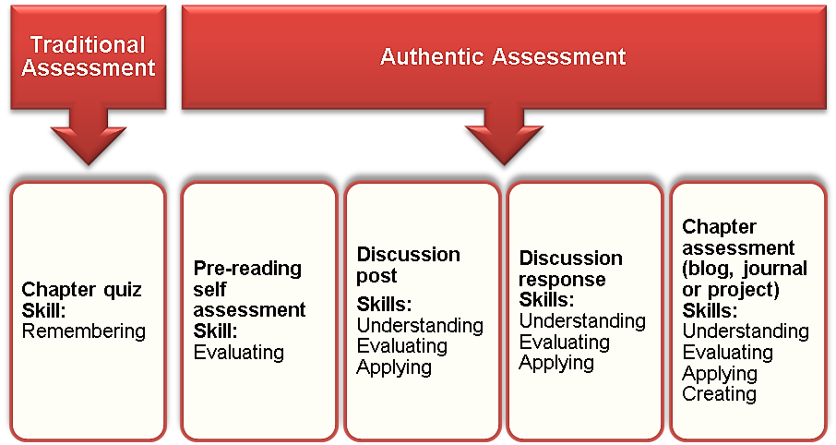

Diagnostic reports

Slide 27
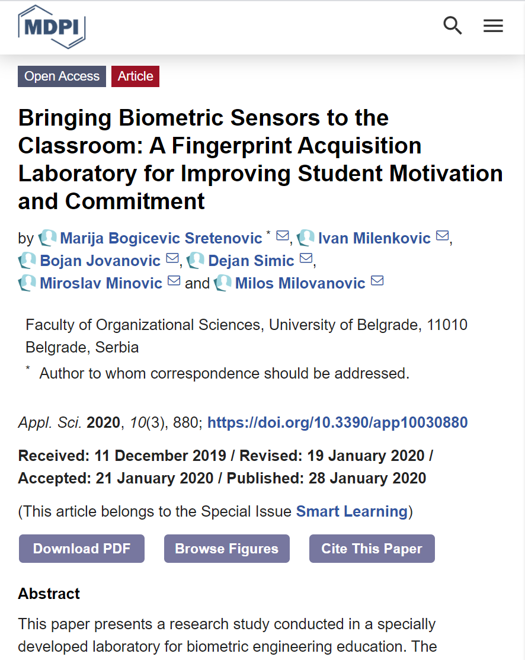


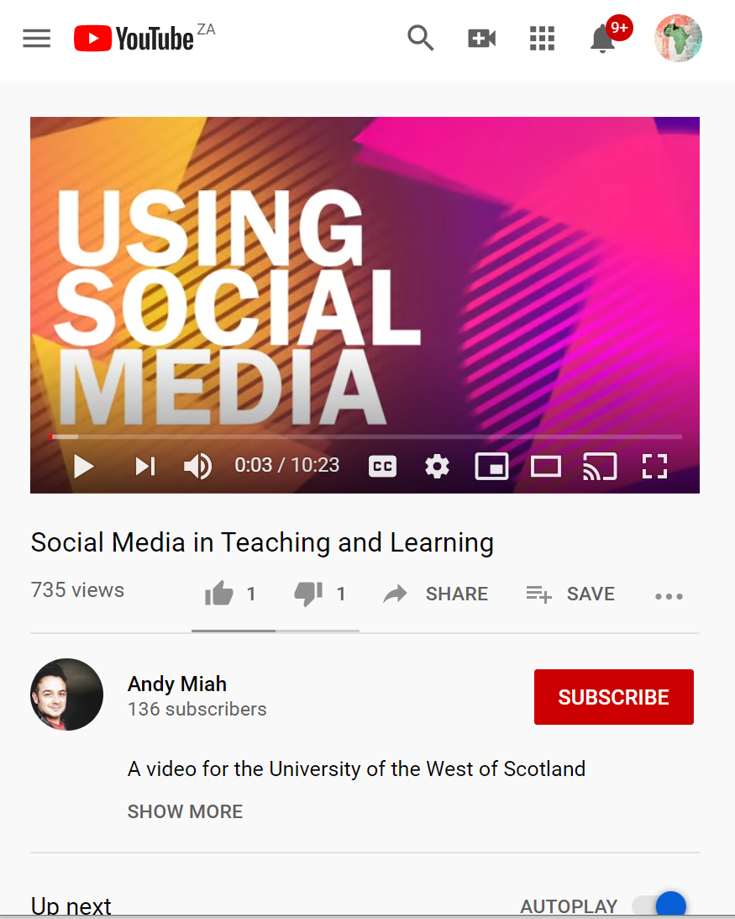

Some open resources
3
2
2020 Open Access journal article on using a fingerprint scanner during assessment
2018 Open Access journal article looking at how biometric assessment tools are perceived by educators.
2019 Open Access article on setting up the Moodle LMS optimally for online assessments
Access
Access
Access

Slide 28



Consider…
To what extent have you been using learning analytics before ERT? What was your experience?
AAU & OER Africa
Use either the Zoom chat facility or the Google Classroom discussion forum
to tell us what your response is to the above query

Slide 29
Demonstration
How to set up your own formative assessment using Quizizz

Slide 30

1
Create a quiz using Quizizz
https://youtu.be/9ktEUQ0quV8

Slide 31



Queries?
Any questions?
AAU & OER Africa
Use either the Zoom chat facility or the Google Classroom discussion forum
to tell us what your response is to the above query

Slide 32
Webinar 3 – Summary
Monitor learning during campus closure
4.
Rethinking summative
assessment during ERT
1.
Activities that give feedback via the LMS
3.
LMS diagnostic
tools and tracking
2.
ERT assessment: Exploiting digital diagnostic and formative assessment tools
+ tips and tricks

Slide 33
Webinar 3 resources
All Webinar Resources
Access the webinar resources in our Google classroom:
https://classroom.google.com/
code m7p5bd5
Webinar resources
Access resources on OER Africa:
https://www.oerafrica.org/aau-oer-africa-emergency-remote-teaching-webinar-series
W3
Monitor learning
during campus closure

