Slide 1


1
Webinar commences at 10h00 (UTC)
Emergency Remote Teaching
AAU / OER Africa webinar series
W1 - Teach effectively during campus closure

Slide 2
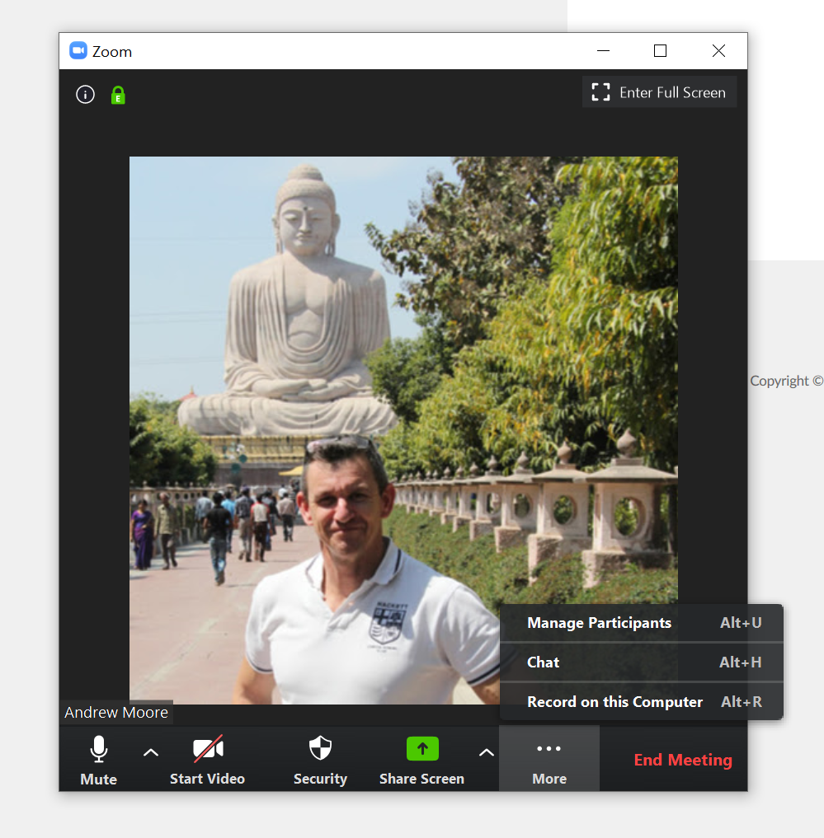
Webinar rules and etiquette
Switch your video cam off,
we want to preserve bandwidth.
Please mute your microphone,
we don’t want background noise to interfere.
If you have a question, type it in the chat facility and the back-channel manager will respond, or pass on to the facilitator.
If asked to respond verbally the facilitator will mention you by name. Remember then, to turn off mute before speaking.
2 and 4
3
1

Slide 3
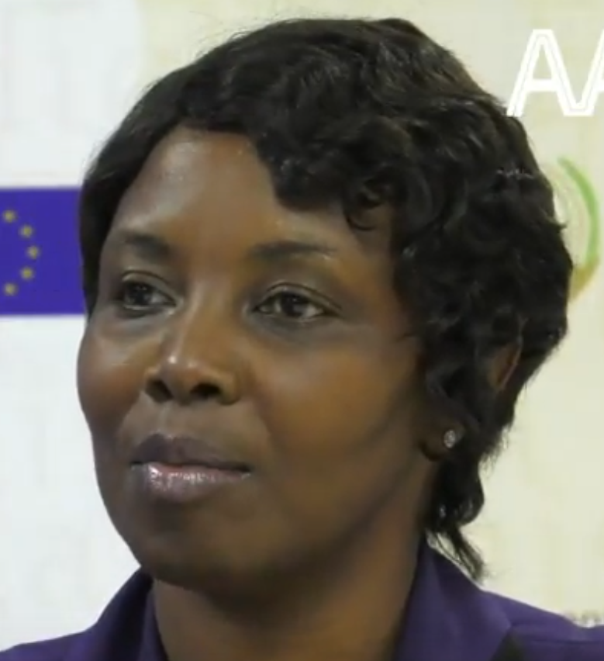
AAU welcome address
Nodumo Dhlamini
Director - ICT Services & Knowledge Management - AAU
ERT
webinar
Neil Butcher
Education specialist and back channel manager – OER Africa
04
03

Slide 4
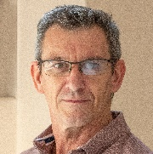


Today’s team
Nodumo Dhlamini
Andrew Moore
Director - ICT Services & Knowledge Management - AAU
Education specialist and webinar facilitator – OER Africa
ERT
webinar
Neil Butcher
Monge Tlaka
Education specialist and back channel manager – OER Africa
Waiting off stage
04
03

Slide 5
ERT webinar series
Teach effectively
during campus closure.
Tips and tricks: Media in PowerPoint
(Today!)
Aim: Guide academics to quickly and cheaply, adopt an emergency remote teaching strategy that enables student learning to continue?
1
Communicate effectively
during campus closure.
Tips and tricks: Social media groups
(Friday 8th May)
2
4
3
What to teach
during campus closure.
Tips and tricks: Google classroom
(Thu 30th April)
Know if learning is happening
during campus closure.
Tips and tricks: Quizziz assessment tool
(Mon 4th May)

Slide 6





Webinar 1 agenda
ERT essential elements
4. Provide feedback and support
1. Careful selection of materials
ERT
ESSENTIALS
3. Create student activities
2. Provide context for study
+ tips and tricks

Slide 7

Webinar 1 agenda
Tips and tricks: media for presentations
1
2
Insert free open
graphics
Insert free open
YouTube videos
3
4
Insert your own voice
Insert screen capture

Slide 8

Webinar 1 resources
W1
Teach effectively
during campus closure
W1 Resources
Access the webinar resources in our Google classroom:
https://classroom.google.com/
code m7p5bd5

Slide 9
Essential elements of ERT
4. Provide feedback and support
1. Careful selection of materials
ERT
ESSENTIALS
3. Create student activities
2. Provide context for study

Slide 10


Element 1: Selection of materials
Its important to carefully select content, and possibly edit materials, to ensure students
are not overwhelmed, remain focused and stay motivated.
Distribute
only essential content
Materials concise and/or ‘chunked’
Resources
in multiple
formats
Materials should have no barriers to access

Slide 11

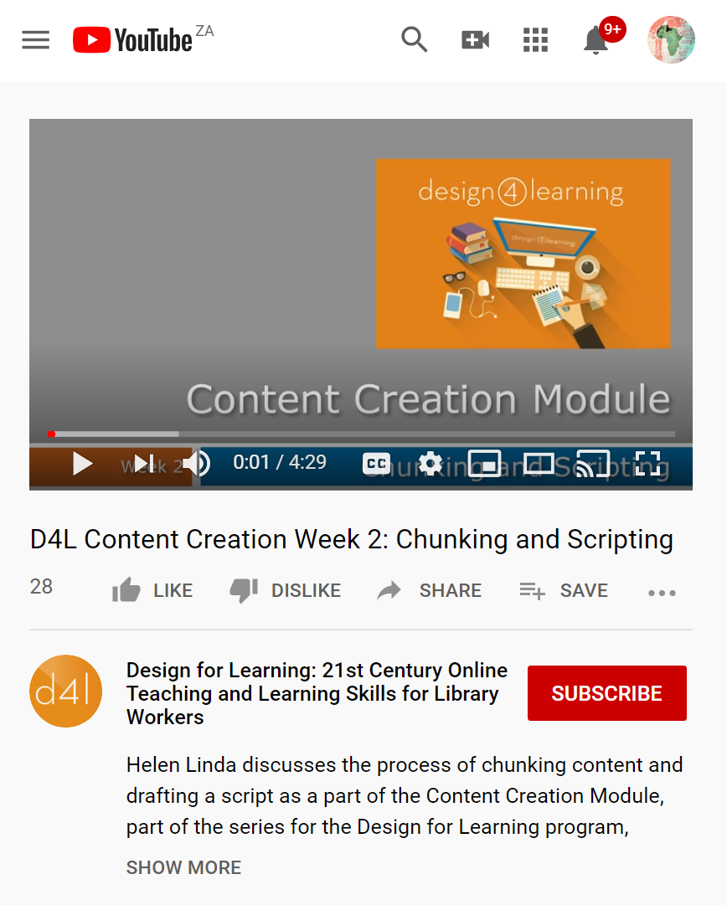
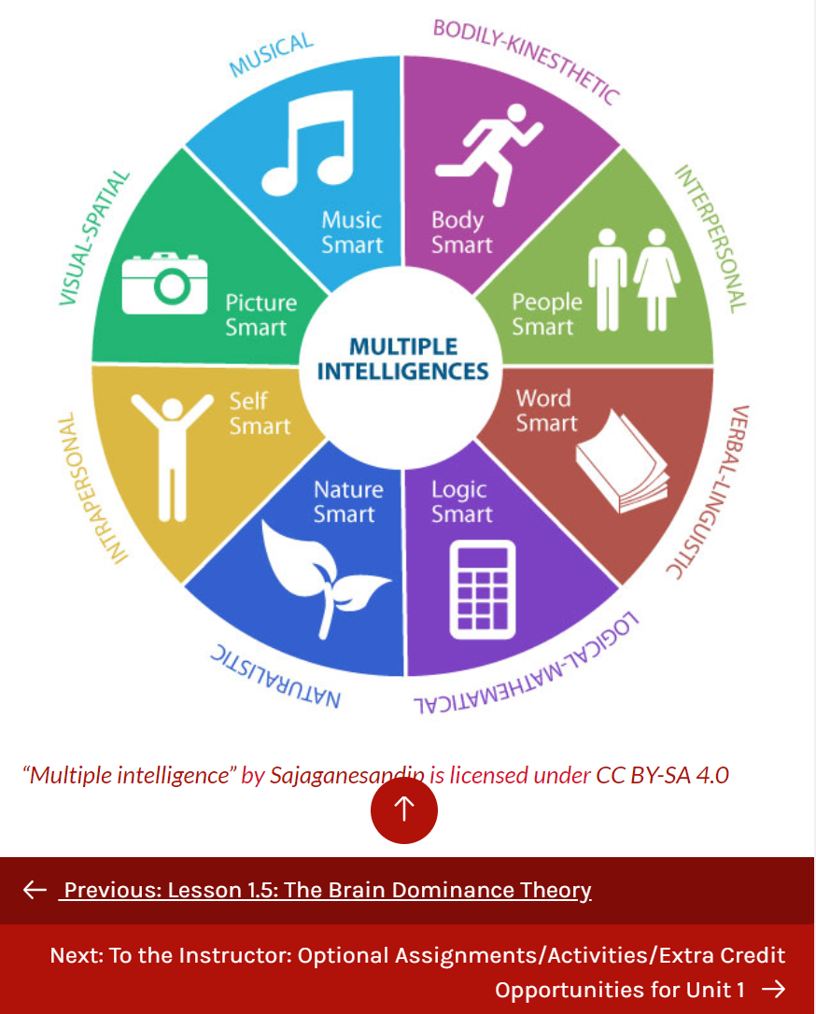




Some open resources
3
2
Tutorial to acquire the skills necessary to search for open content and decipher Creative Commons rights and permissions.
Helen Linda discusses the process of chunking content and drafting a script as a part of the Content Creation Module.
Overview of Gardener’s Multiple Intelligences Theory with diagram and exercises.
Access
Access
Access

Slide 12



Consider…
In what ways do you need to adjust the materials you have used previously?
AAU & OER Africa
Use either the Zoom chat facility or the Google Classroom discussion forum
to tell us what your response is to the above query

Slide 13
Need more detail and/or skill?
Participate in ERT webinar 2
W2
2
We will investigate how to select specific
parts of the curriculum suited to ERT and
then how to identify resources, edit them
and choose digital tools to support remote
teaching
What to teach during
campus closure

Slide 14
Essential elements of ERT
4. Provide feedback and support
1. Careful selection of materials
ERT
ESSENTIALS
3. Create student activities
2. Provide context for study

Slide 15



Element 2: Provide context
Learning without a context is difficult. Learning happens when students understand new
information in relation to what they already know or how it relates to prior experience.
?
Set
questions to focus study
Use real world problems to frame theory
Provide
a hook
Students transfer theory to new contexts

Slide 16
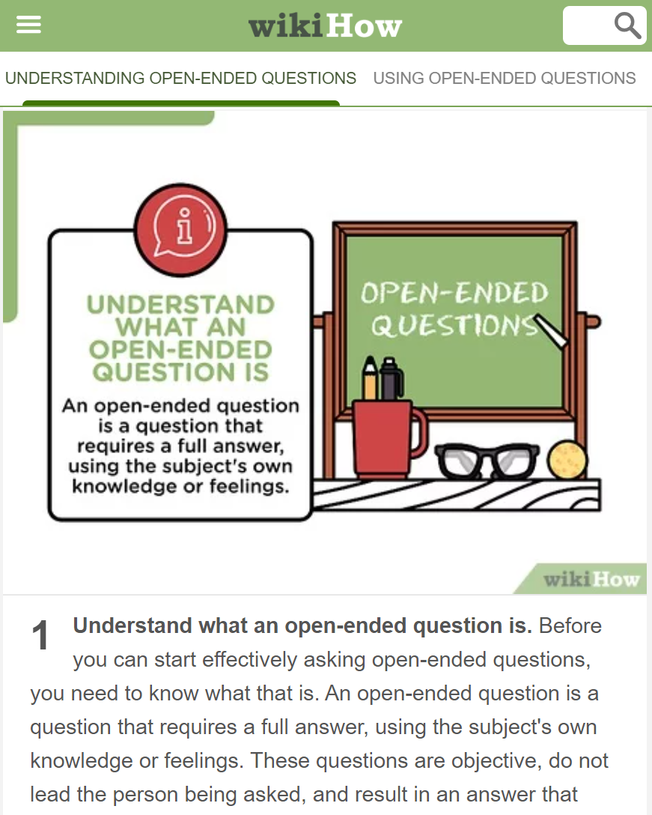
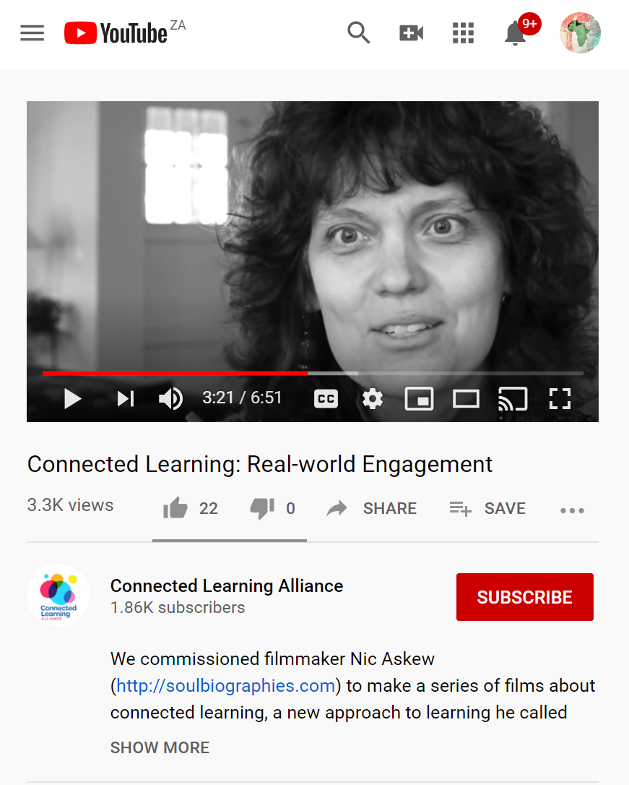
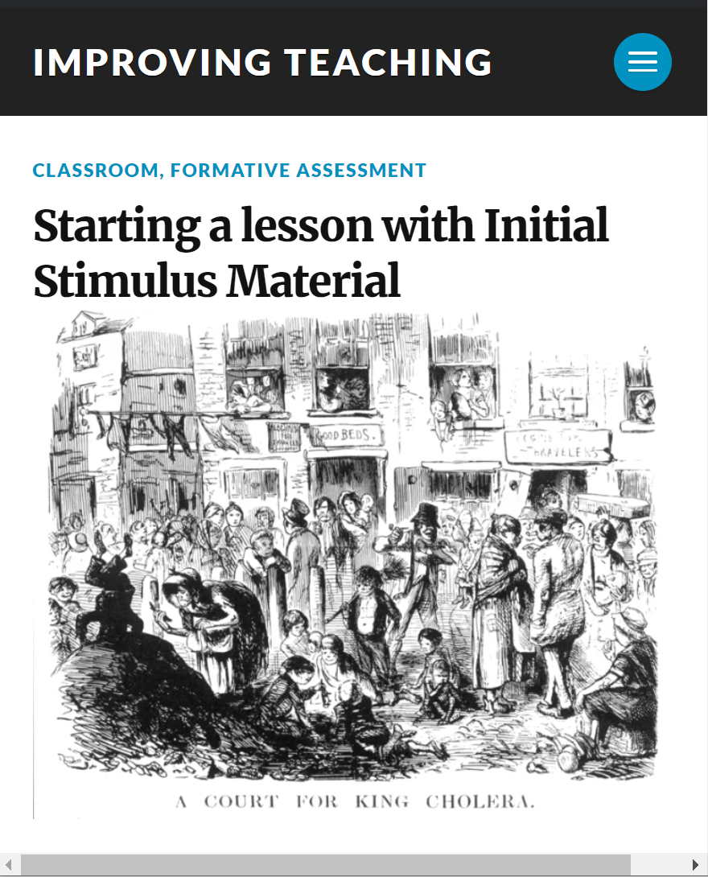


Some open resources
3
2
Asking questions is a basic way to gather information. Like everything else, there is a skill to it. Asking open-ended questions is a…
This film examines the critical role of curiosity and engagement for today's youth and in connected learning
Strategies to provide a hook or stimulus to hang a lesson on and create student engagement.
Access
Access
Access

Slide 17
Essential elements of ERT
4. Provide feedback and support
1. Careful selection of materials
ERT
ESSENTIALS
3. Create student activities
2. Provide context for study

Slide 18




Element 3: Set student activities
Student should be required to do something with the materials beyond simple recall/comprehension.
ERT activities might include,
Online debates or discussions
Short focused assignments
Project
work covering multiple lessons
Short quiz
or tests

Slide 19
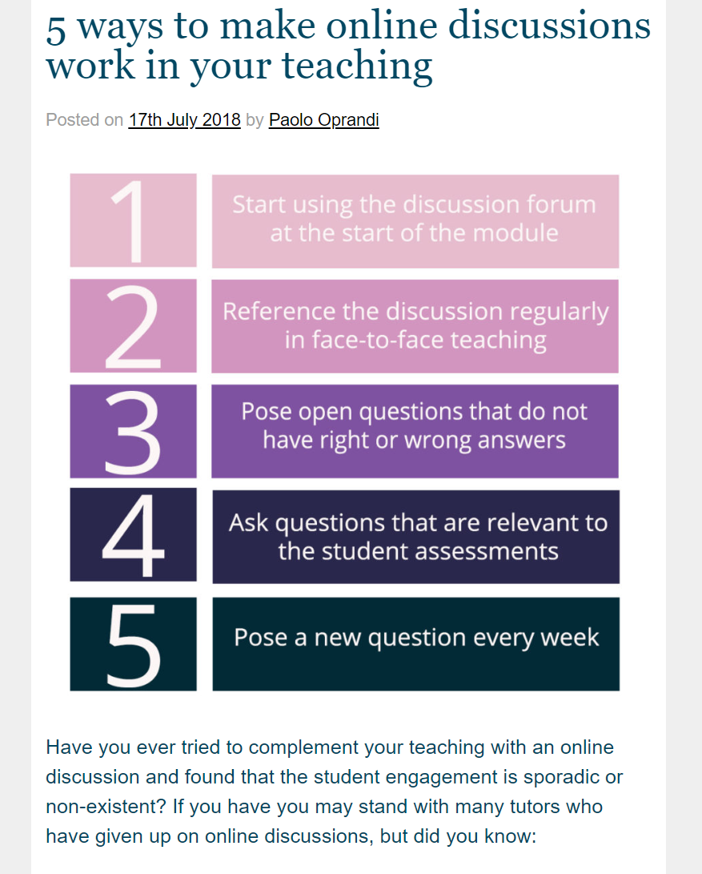
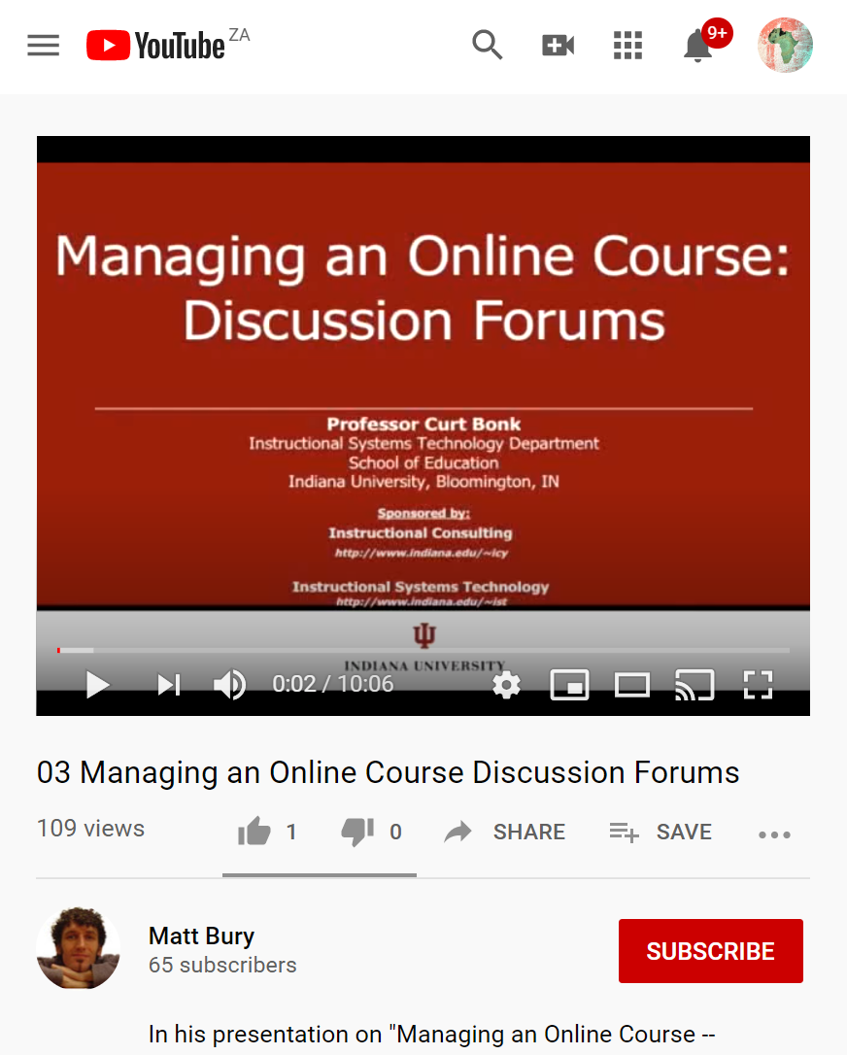
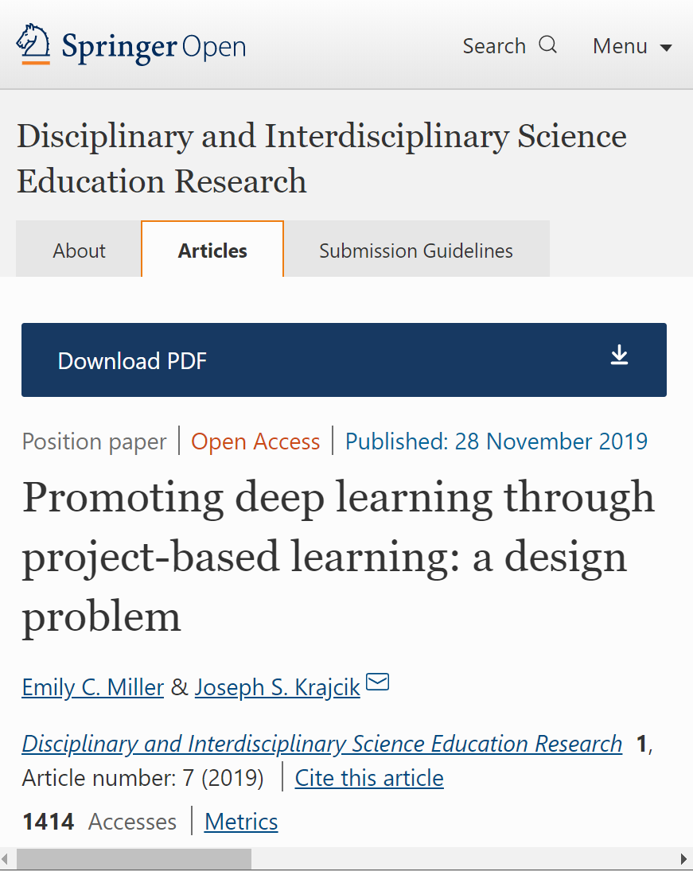

Some open resources
3
2
5 ways to make online discussions work in your teaching
Addresses the importance of discussion forums and managing them successfully. Points covered range from developing protocols and …
Promoting deep learning through project-based learning: a design solution that involves the bringing together of PBL …
Access
Access
Access

Slide 20
Need more detail and/or skill?
Participate in ERT webinar 3
W3
3
We will investigate how to set activities
assignments and tests and use them to
track student growth and learning.
Know if learning is
happening

Slide 21
Essential elements of ERT
4. Provide feedback and support
1. Careful selection of materials
ERT
ESSENTIALS
3. Create student activities
2. Provide context for study

Slide 22


Element 4: Provide feedback
Its important that students don't feel isolated or lost during ERT. You need to have an online presence
and demonstrate that you are engaging with them and their tasks even though they are studying remotely.
FAQ
Weekly ‘office hours’ video
Encourage
use of peer networks
FAQ
Summarize readings

Slide 23

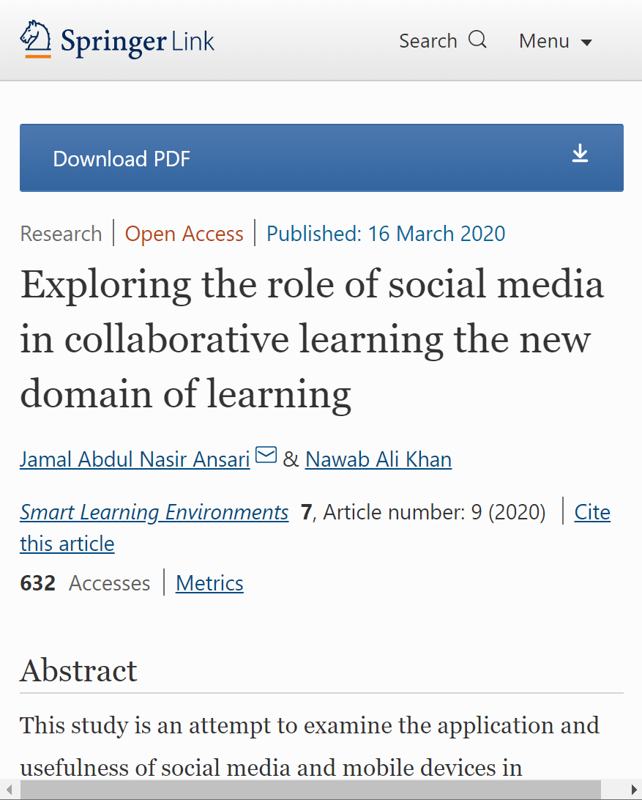
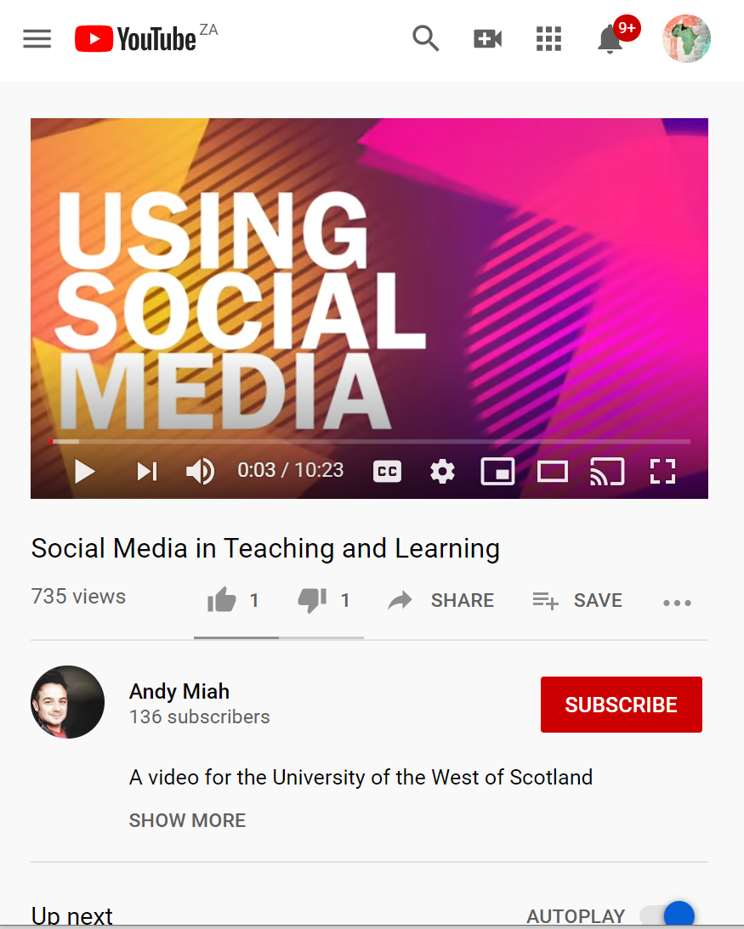
Some open resources
3
2
Create a compelling welcome video to let your students get to know you.
Andy Miah, University of West Scotland, discusses the pros and cons of using social media in higher education.
Examine the application and usefulness of social media and mobile devices in transferring the resources and interaction with academicians in HE institutions
Access
Access
Access

Slide 24

Consider…
What communication
tools can you deploy immediately?
AAU & OER Africa
Use either the Zoom chat facility or the Google Classroom discussion forum
to tell us what your response is to the above query

Slide 25
Need more detail and/or skill?
Participate in ERT webinar 4
W4
4
We will investigate strategies to effectively
support and communicate with the students
as well as protect yourself and faculty from
burnout.
Communicate effectively
during campus closure

Slide 26

Demonstration
How to make study materials engaging and easier to understand using popular software

Slide 27
Demonstration: tips and tricks
1
2
Insert free open
graphics
Insert free open
YouTube videos
3
4
Insert your own voice
Insert screen capture

Slide 28

1
Click the image to start the video.

Slide 29
Queries?
Any questions?
AAU & OER Africa
Use either the Zoom chat facility or the Google Classroom discussion forum
to tell us what your response is to the above query

Slide 30
2
Click the image to start the video

Slide 31
Queries?
Any questions?
AAU & OER Africa
Use either the Zoom chat facility or the Google Classroom discussion forum
to tell us what your response is to the above query

Slide 32
3
Click the image to start the video

Slide 33
Queries?
Any questions?
AAU & OER Africa
Use either the Zoom chat facility or the Google Classroom discussion forum
to tell us what your response is to the above query

Slide 34
4
Click the image to start the video

Slide 35
Queries?
Any questions?
AAU & OER Africa
Use either the Zoom chat facility or the Google Classroom discussion forum
to tell us what your response is to the above query

Slide 36
Webinar 1 – Summary
ERT essential elements
4. Provide feedback and support
1. Careful selection of materials
ERT
ESSENTIALS
3. Create student activities
2. Provide context for study

Slide 37
Webinar 1 resources
W1
Teach effectively
during campus closure
W1 Resources
Access the webinar resources in our Google classroom:
https://classroom.google.com/
code m7p5bd5
Including this presentation and
tips and tricks videos

