Slide 1
The African Teacher Education OER Network
Unisa, 28 March 2012

Slide 2
The African Teacher Education OER Network
Funded by Hewlett Foundation
to assist African teacher educators to inform and influence policy in their own institutions in respect of OER, and share expertise, experience, and resources to improve teacher education in their local contexts.
Started with a partnership between the TESSA programme and Saide /OER Africa
Given expression in jointly organised events such as
the DETA 2011 pre-conference workshop in Maputo
the forthcoming pre-conference workshop at the 56th World Assembly of the International Council on Education for Teaching (ICET) in Ghana (July 2011)

Slide 3
TESSA Project Activities
www.tessafrica.net
Ghana: Adapting TESSA for national Early Childhood Curriculum
Sudan: Writing new Teacher Practice Guides using TESSA OERs for both students and supervisors
Nigeria: Developing model TESSA demonstration school
Uganda, Kenya, Ghana, Zambia and Tanzania: create 15 study units in the science curriculum area (3 modules each of 5 study units), drawing on existing high quality OERs
Kenya: Developing dialogue with national and regional policymakers on TESSA and the national curriculum.
South Africa: Organising action research by B.Ed student-teachers using TESSA OERs.
Contributing to African Teacher Education OER Network

Slide 4
Saide: OER Network activities
Engagement with broader networks, such as the ACDE and its Technical Committee on Collaboration, for example,
to support the emerging pan African initiative to increase the numbers and quality of Maths, Science and Technology teachers, particularly women.
Work with African teacher education institutions to improve teacher education course design integrating OER, and to release newly developed or adapted materials as OER.
Fort Hare, Univ of Pta, Wits, UKZN, Rhodes
UDSM, Nistcol/Chalimbana, CUEA (Nairobi), UCM (Beira),
DHET (EU Strengthening FP programme) ER Africa OER Network activities
Increasingly to stimulate participants to work across institutions in collaborative initiatives.

Slide 5
From individual project to Network....
The full potential of OER depends on collaboration within an emerging community of practice across institutions.
As Ken Harley points out (following Bourdieu)
The concept of social capital links neatly with OER because it
calls attention to the fact that civic virtue is most powerful when it is embedded in a sense network of reciprocal social relations. A society of many virtuous but isolated individuals is not necessarily rich in social capital (Putnam, 2000, p.19)

Slide 6
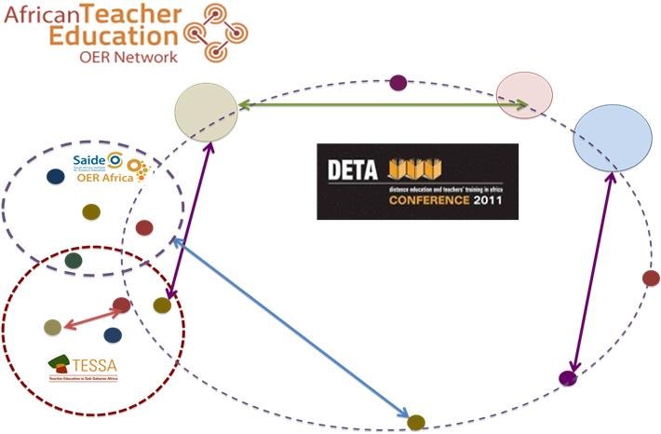

Slide 7
Thank you!

Slide 8
Primary science education CPD proposal
Existing relationships
ACEMaths
Development in community of practice
Existing materials
Policy
NICPD - courses and diagnostic assessment
Science Ed

