Slide 1
ANALYSIS OF Curriculum Materials
COURSE CODE & TITLE
ED 2216: IT TEACHING METHODS

Slide 2
OBJECTIVES
At the end of this lecture, students should be able to:
Identify curriculum materials
Explain the criteria for judging good curriculum materials.

Slide 3
Curriculum materials
In implementing curriculum, there must be availability of important curriculum materials for the teacher.
These curriculum materials are useful in planning instruction at different stages.
These curriculum materials are syllabus, textbook, teachers guide, reference materials.

Slide 4
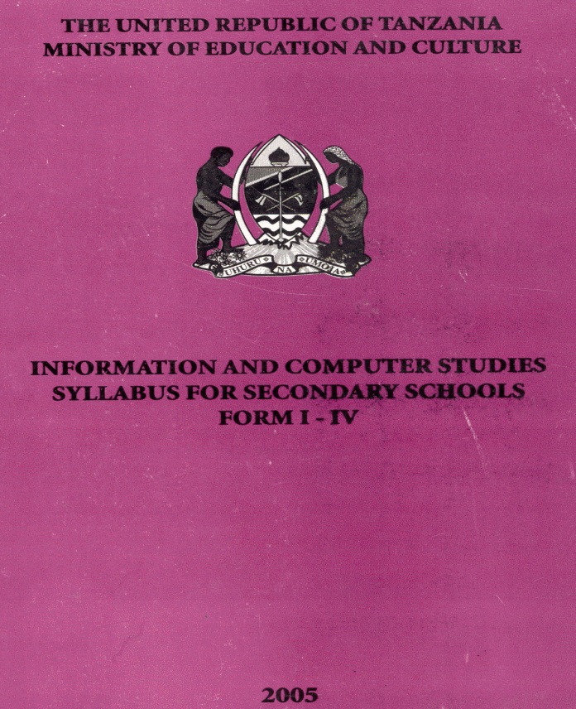
Syllabus

Slide 5
Syllabus
Syllabus is the summary of contents, methods and instructional materials that enable the classroom teacher to know what, how and which materials are to be used for teaching at a particular subject and topic.

Slide 6
Components of Syllabus
The components of syllabus
Competencies
Topics/sub-topics
General/specific objectives
Teaching /learning techniques
Materials /Aids
Assessment
Periods

Slide 7
Criteria for Judging the Effectiveness of Syllabus
General appropriateness
Organization of topics, scope vs students’ ability levels, completeness of topics contained, etc
Feasibility
Possibility of the syllabus to be implemented
Applicability of the suggested methods
Are the objectives realistic and attainable?

Slide 8
Criteria for Judging the Effectiveness of Syllabus
Utility
How much its content is meaningful to learners and society?
Does the content help to meet the needs of the society and individual students?
Adequacy
Does the syllabus provide enough learning required?
Are the methods and strategies suggested adequate for assisting the learners to achieve the objectives or master the skills?

Slide 9
Criteria for Judging the Effectiveness of Syllabus
Appropriate to content and methods
Accuracy of concepts, principles and facts
Is it relevant for the students, time, society, environments needs and desires?
Scope and consistency between grades
Depth and breadth of the content
Has it been consistent with lower grade or highest?

Slide 10
Criteria for Judging the Effectiveness of Syllabus
Internal consistency
Checking if sequence of topics have been arranged in a consistent way
Consistent between components and their contents
Clarity
Have the items been presented in a clear way?

Slide 11
Criteria for Judging the Effectiveness of Syllabus
Up- to-datedness
Does the syllabus include current issues?
Are the materials suggested still relevant?
Balance
Are all topics presented in a relatively the same depth or scope?
Balance of a major areas in a syllabus

Slide 12
Text Book

Slide 13
Meaning of text book
Pupil’s book is a form of “programmed learning”.
The book usually depend on the teacher for use and interpretation of the subject matter.
However, the book is used by both teacher and pupils during the lesson.
Pupils book comes out of a subject syllabus or in other words is a part of curriculum materials

Slide 14
Cont..
The text book helps the pupils to:
Learn through written words
Gain skills in reading and writing
Learn vocabulary
Learn through doing activities and exercises at school or home
Learn privately (private study)
Learn through textual and visual communication.

Slide 15
Cont…
Thus the book is organized in the following components:
Preliminaries (Prelims)
Main Body
Back matter ( end matter)

Slide 16
Preliminaries (Prelims)
These are the first page s of a book.
They show the level to which the book intended.
It shows what is to be found in the book and how to use it the book.
Also acknowledgements and table of content are found in this section.

Slide 17
Cont…
The section is therefore organized as follows:
Book title
Copyright declaration (©)
Acknowledgments
Preface
Table of content
These few pages are written in Roman numbers ( i, ii, iii etc)

Slide 18
Main body
The main body contains materials from the syllabus objectives.
The content of the book is organized through topics, and each topic stands as a chapter or a lesson.
Questions and exercises may be placed at the end of each topic or lesson. Some books are written as a series of activities .
The book must be well illustrated. For the lower classes the illustration must be in full colour.
The illustration includes drawings, tables, graphs, maps, pictures etc.

Slide 19
Cont…..
This part must cover all the topics contained in the prescribed syllabus.
The content part that is the subject matter must include effective motor skills and knowledge.
Also, there should be different methods, approaches and activities in different topics.
Arabic numbers are used in this section (1,2,3, etc)
This part is organized:
Topics and subtopics
Methodology
Activities, exercises, tasks etc.

Slide 20
Back matter (End matter)
Not all books end up in this form especially in lower classes, however this end part consist of:
Bibliography (Reference)
Glossary (mini dictionary)
Index
Appendix
Written in Arabic numbers

Slide 21
Criteria for Judging the Effectiveness of text book
In evaluating the textbook, the following criteria are helpful for the teachers:
Contribution of the textbook in helping teachers and students to attain curriculum goals
A recent copyright date of the textbook (within five years)
Clear and accurate presentation of concepts, generalizations and relationship
Students find the textbook easy and interesting to read

Slide 22
Cont…
Content of the text
Coverage to all or most of the topics of the syllabus
Up-to-datedness
Accurately reflect ethnic cultures and life styles but not biased to one ethnic culture
Free of racist and sexist connotations
Objective presentation of controversial issues
Providing material or examples of how the concepts or content are correlated with other subject

Slide 23
Cont…
The textbooks highlight the new and difficult words
Graphs tables and diagrams are clearly illustrated and easy to read
Quotation or other authoritative sources are used to highlight concepts or contents
The textbook contains recommended readings book for students
The textbook is attractive, colorful, well designed with the type size that easy for students to read and easy to handle
The text binding and page paper is strong enough to withstand students’ use over a number of years

Slide 24
Teacher’s Guide

Slide 25
Teacher’s Guide
A teacher’s guide is a printed teaching material prepared to guide teachers on how to teach effectively.
This book provide suggestions for teaching strategies and tactics on how to use pupils’ book effectively.
Teacher’s guide also allocates time scheduled for each topic.
Answers of the questions and activities from the pupils’ book are written in this book.

Slide 26
What Does the Teacher’s Guide Contain
Although teacher’s may be of different styles and emphasis, the following elements are found in most of teacher’s guides
Specific learning objectives
Suggested learning activities
Suggested teaching/learning resources
Suggested teachers organization of activities
Assessment tools
Suggested supplementary materials and references

Slide 27
Assignment
Description
Organize yourself in groups of two. Your task is to anaysis the syllabus based on the given criterion in this presentation. The syllabus allocation is as shown in the next slide
Deliverable
An analysis report
Duration : 4 weeks

Slide 28
Assignment
GROUP NO | SYLLABUS
1 | FORM I
2 | FORM II
3 | FORM III
4 | FORM IV
5 | FORM V
6 | FORM V1

