Slide 1
OER Africa
Africa Nazarene University:
Revisiting the business model

Slide 2
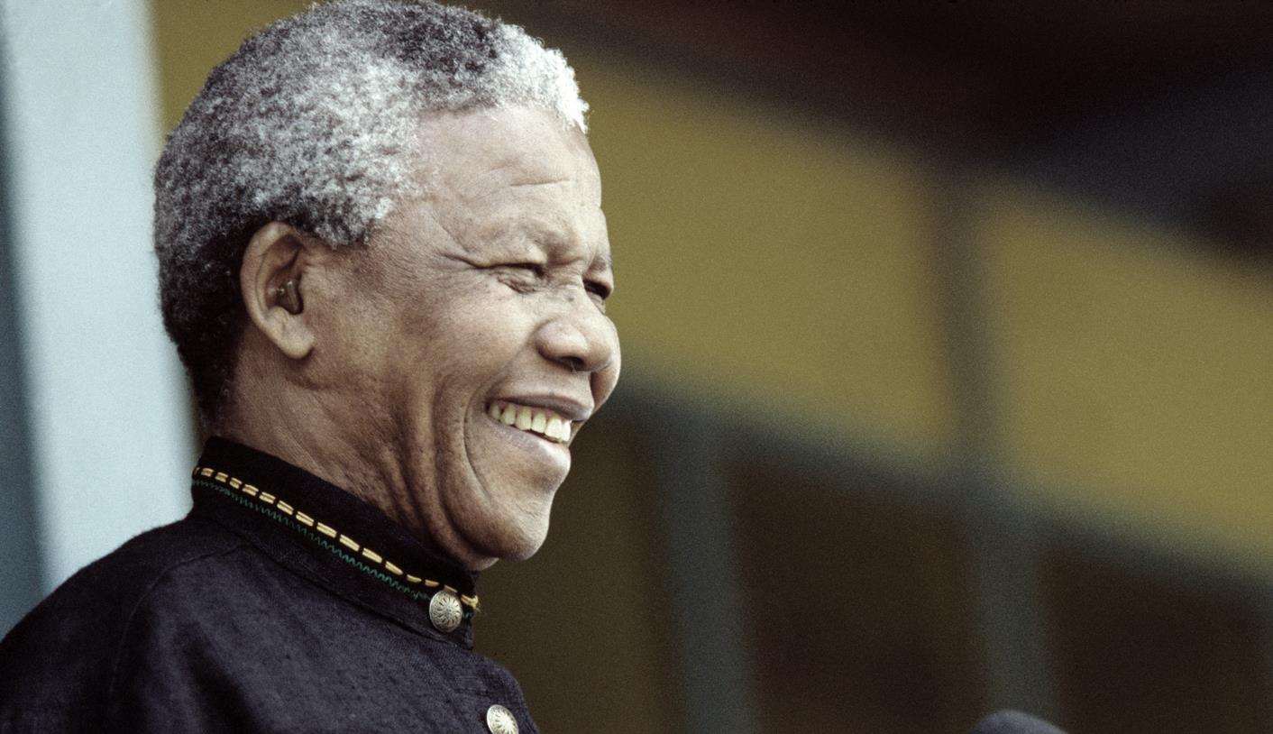
Nelson Mandela (1918 – 2013)
Nobel Laureate, 1993
Education is the most powerful weapon which you can use to change the world.
Notes:
Image: http://www.dailymaverick.co.za/images/uploaded_images/article/madiba%20in%20hospital%20again.jpg
Nelson Mandela was awarded the 1993 Nobel Peace Prize for his work for the peaceful termination of the apartheid regime, and for laying the foundations for a new democratic South Africa.
See: http://www.nobelprize.org/nobel_prizes/peace/laureates/1993/mandela-wall.html

Slide 3
Overview
Changing context
Systemic implications
Costing implications
New modes of provision

Slide 4
Changing context
ANU: Revisiting the business model

Slide 5
Changing context
Increasing demand for university education
Lifelong-learning, just-in-time learning and a changing demographic
Rising costs of tuition – fees, residences, transport, textbooks, opportunity costs …
More role-players both public and private
ICT
Notes:
Five key changes impacting on what constitutes provision characterised by fitness of and for purpose, value for money and social transformation (CHE 2004)

Slide 6
Q & A 1
What programMes are declining, growing, possibilities for the future?
Notes:
Q&A

Slide 7
New modes of provision
ANU: Revisiting the business model

Slide 8
Blend 1 (US)
Contact
Online

Slide 9
Blend 2 (ADEA ODL WG)
Contact
Print-based correspondence

Slide 10
Blend 3 (Unisa)
Online
Print-based correspondence

Slide 11
Blend 4 (TVET)
Theory
WIL
Practical

Slide 12
Blend 5: focus on learning
Independent learning
Collaborative learning
Cooperative learning
Practical learning
WIL

Slide 13
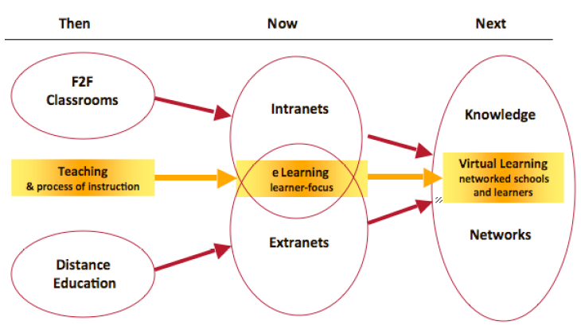
The emerging Networked School environment
Notes:
http://blog.core-ed.org/derek/2010/files/2010/06/The-emerging-Networked-School-environment.pdf

Slide 14
Continuum of educational provision
From purely face-to-face (contact) tuition through to education solely at a distance.
As for face-to-face education, there are many variations of distance provision.
Notes:
The mode of education provision is typically viewed on a continuum from purely face-to-face tuition through to education purely at a distance, the latter traditionally conceptualised as correspondence tuition with no face-to-face interaction between teachers and learners.
However, there is now more resource-based (independent) learning in f2f programmes, more f2f interaction in distance. Prediction that, especially with growing use of educational technology there will be rapid movement to the centre.

Slide 15
DE delivery using the WWW
Types of e-learning using the World Wide Web (WWW) are commonly referred to as:
web-supported, web-dependent, and fully online.
These can also be represented using a continuum:
An expanded definition of e-learning includes the use of ALL digital resources, systems, hardware devices, and electronic communication in the support of education
Notes:
A second continuum could represent another dimension by plotting the extent of supporting ICTs – ranging from fully offline to fully online.
An expanded definition of e-learning includes the use of all digital resources, systems, devices/computers, and electronic communication in the support of education. e.g. a course may supported digitally by the use of CDs, but it is not necessarily an online course.
The commonly used terms of ‘web-supported’ and ‘web dependent’ are deemed to be too specific and have given way to ‘Internet-Supported’ and Internet-Dependent’.

Slide 16
Moving to a second dimension
Spatial or geographic distribution of teachers and learners
Face to face (F2F) Mixed Mode Distance Education
On Campus Off campus
Extent of ICT support
No digital support Digitally Supported Internet-supported Internet-dependent Fully online
Offline Online
Notes:
A second continuum could represent another dimension by plotting the extent of supporting ICTs – ranging from fully offline to fully online. Note the inclusion of ‘digitally supported’ in the ICT dimension. Furthermore, the commonly used terms of ‘web-supported’ and ‘web dependent’ are deemed to be too specific and have given way to ‘Internet-Supported’ and Internet-Dependent’. In internet-supported programmes, participation online is an option or alternative for learners. In internet-dependent programmes, participation via the internet is a requirement, and could include online interaction, communication and access to course materials via the web. In fully online programmes, there is no physical face-to-face component, although there could be a virtual face-to-face component.
In our African context, it is pertinent to also consider digital forms of support that do not require internet access. The digital forms of support for learning could be offline via a CD/DVD, and a further detail could be expressed by clarifying exactly which elements of the ICT dimension may be on- or offline. Of course, within a particular course, learning could be supported both online and digitally offline at various stages.
The continued evolution of e-learning is contributing to the blurring of the distinction between face-to-face and distance education provision.
It is useful to conceptualise the two continua in relation to each other as horizontal and vertical axes.

Slide 17
Mode of Delivery
Fully Online
D
E
Internet Dependent
B
<----------- Online ----------->
Internet Supported
B
Digitally Supported
A
C
← Off-line -->
Fully Offline
Campus-based
Hybrid / Blended
Remote
Notes:
Rather than view these two continua separately, it is useful to conceptualise them in relation to each other as horizontal and vertical axes. Situating various courses or programmes on the resulting grid allows one to describe both the extent of spatial or geographic distribution and the ICT supported dimensions of a course or programme. The circles positioned on the grid represent examples based on courses or programmes at actual higher education institutions. This would enable for an HEI to position a particular course or programme (such as B) on the grid in terms of where they are situated right now, and then determine where the institution would like them to move to over a period of time. This could assist in identifying what changes would be required in order to move or reposition the course in terms of this grid, and the other influencing factors or aspects of the course would need to be taken into account.

Slide 18
Characterising Modes of Delivery
Transactional Distance
programme structure
instructional dialogue
learner autonomy
Structural Aspects | Teaching and Learning Elements to be aligned | Pedagogical Approach (Young & Chamberlin 2006)
Course Title / sub-discipline & level | Objectives | Independent Learning (low level of mediation) ranging to Interactive learning (high level of mediation)
Target Audience | Course materials
Location of Target Audience | Learning Support
Expected level of learning support required | Level of interaction / engagement
Size of Annual Enrolments | Assessment
Notes:
Other possibly interdependent characteristics or aspects of the course or programme would need to be taken into account. For example, various structural and pedagogical aspects would need to be examined to inform the appropriate positioning of a course on the grid.
Young and Chamberlin (2006) describe a Blended Learning Continuum in terms of two discrete tracks of using supporting or supplementing ICTs, differentiating the strategies that apply to the deployment of an Independent Learning Environment from that which focuses on an Interactive Learning Environment. The exposition of these strategies would need to be underpinned by a particular educational approach that in turn would be informed by a third human dimension which needs to be considered across all forms of provision. This is the extent to which the approach is fit for purpose in terms of the target audience, the purpose and level of the course being offered, as well as the extent to which an equivalent learning experience is offered across different contexts of learning and practice. Transactional distance is determined by the inter-related function of 3 sets of variables: instructional dialogue, programme structure, learner autonomy.

Slide 19
Different strokes for different folks?
 | Contact mode | Part-time mode | Workplace mode | ODeL
Traditional audience | 18-24 year olds | Young workers Mature workers not very ICT literate | Mature workers in-service | Mature learners with competing demands/ marginalised/ barriers to access
Traditional focus | UG degrees | UG degrees CPD PG structured | CPD | CPD/short courses Just-in-time learning PG research-based
Emerging trends/ Issues …? | School-leavers from wealthy families? Flipped classrooms? | 18-118? Non-workers, PT, FT? | Teachers Police/Security Nurses …? | Extreme diversity: readiness for mode? Cross-border?
 | All require that students have access to appropriate learning resources

Slide 20
Model: equivalence
Contact | Distance
16 credits =160h/module 64 hours reading, thinking and making notes 32 hours completing and uploading assignments (2/module) 16 hours preparing for summative assessment 10,5 hours contact tutorials (7 x 1,5) 37,5 campus-based, structured peer cooperation and collaboration | 16 credits =160h/module 64 hours reading, thinking and making notes 32 hours completing and uploading assignments (2/module) 16 hours preparing for summative assessment 48 hours online self-assessment, peer cooperation and collaboration (16w x <3h) e.g. <0,5 hours intro activity <1 hour quiz on new content <1,5 hour consolidation discussion/feedback
Notes:
The distance model should have the same demand and outcomes; only the “how” changes

Slide 21
Concluding Remarks
Blended mode
  An infinite number of ways to blend
  Offline & online
Influencing factors
  Learner demographics
  Class size
  Pedagogical approach
Dimensions
  Spatial separation (geographic)
  Temporal (asynchronous & semi/synchronous)
  Determining extent of digital support (ICTs)
Re-examine core assumptions for the changing environment
Notes:
Given the use of continua and the attempt at a graphical representation as suitable vehicles to frame the dimensions of education provision, it is clear that there is no single blend for delivery mode, but rather an infinite number of ways that one can deploy a course or programme. The development of a grid is an attempt to prompt careful consideration of the relevant aspects that affect education provision in the blended and online mode.
The deployment of supporting ICTs opens up many possibilities for a more interactive engagement but whether the affordances of ICT are used in this way must be a conscious design decision: at a basic level, ICT can be used simply to transmit content more efficiently. However, in institutions that consciously seek to use supporting ICTs to enhance their teaching and learning, the role of the lecturer is changing to that of facilitator, learning environment designer, co-learner, and may also include content curation. The role of the learner in such institutions and programmes is also changing, moving towards more self-directed independent study, and greater collaboration and engagement both with peers inside the institution and others outside the walls of the classroom or lecture hall. Plomp, 1999:26; Berge, 2000; Kahn 2012; Richardson u.d., c.2013
The core assumptions of DE (access, independence, economics of scale) need to be re-examined in the context of online learning theory and practice (collaboration, community, quality assurance)

Slide 22
ICT caveats
… most [of 11 institutions surveyed] seemed content to use technology to enhance traditional classroom teaching, rather than to use technology to transform the way teaching is designed and delivered … (Bates and Sangrà 2011:xx).

Slide 23
ICT goals
Increasing flexible access for a more diverse student body
Increasing interaction between instructors and students, and allowing for more individualization of learning
Developing student skills in identifying, collecting, analysing, and applying knowledge
Teaching students how information technology can be used within a particular professional or subject domain
Using technology to support the development of twenty-first century skills of independent learning, initiative, communication, teamwork, adaptability, collaboration, networking, and thinking skills within a particular profession or subject domain
Greater cost-effectiveness: more students at a higher quality and less cost through use of technology. (Bates and Sangrà, 2011: xxi).

Slide 24
A Final Thought:
‘Good teaching may overcome a poor choice of technology but technology will never save bad teaching’
Tony Bates, 2012
Notes:
Preserve the integrity of the teaching and learning process and environment by:
using ICT to support (not drive) teaching and learning
Employ flexibility to ensure the ICT support is appropriate for:
the topic, level of study, student context
and the expertise of the lecturer / tutors / students
The way in which we use digital technology models particular values for our students and places particular kinds of demands both on them and on their teachers. Therefore, we need to make conscious choices to use suitable technologies in appropriate ways taking cognizance of both our learning purposes and the technology profile of our target learners and staff.

Slide 25
Q & A 2 different modes for different folks?
Notes:
Q&A

Slide 26
Systemic implications
ANU: Revisiting the business model

Slide 27
Common challenges for ODeL provision
Increasing dual or blended – but not always obvious
DE Units isolated from mainstream – too much teaching; too open; little tracking/cohort analysis; low throughput; watered down curricula …
Systemic fragmentation
Programmatic fragmentation
Conceptual fragmentation
Notes:
Frequent contextual challenges iro ODL provision

Slide 28
Learner system
Bronfenbrenner (1979, 1989, 1993) social systems of learners
Micro-system: home, family, friends – direct impact
Meso-system: one-step removed but can have a direct impact e.g. immediate neighbourhood, church, learning centre
Exo-system: may not be a direct experience but may still have impact e.g. spouse’s work, friends of family members, government agencies & NGOs in area
Macro-system: cultural or sociopolitical context – dominant beliefs, values, customs, laws and resources

Slide 29
ODL systems #1
1st generation: correspondence – mailing systems
2nd generation: specially prepared self-study material – materials development, storage, despatch
3rd generation: print + multi-media and two-way communication – teams/ learner support
4th generation: ICTs and two-way interaction – social learning/multi-skilling
5th generation: communities of learning – multi-skilling/decentralised decision-making: LMS/PLE
Notes:
Different generations of ODeL provision have raised different systemic challenges

Slide 30
ODL Systems #2a
A distance education system consists of all the component processes that make up distance education, including learning, teaching, communication, design, and management, and even such less obvious components as history and institutional philosophy. Within each of these broadly named components are subsystems …While we may choose to study each of these systems separately, we must also try to understand their inter-relationships. (Moore & Kearsley, 1996:5)
Notes:
Moore and Kearsley pioneered formal systems thinking in DE

Slide 31
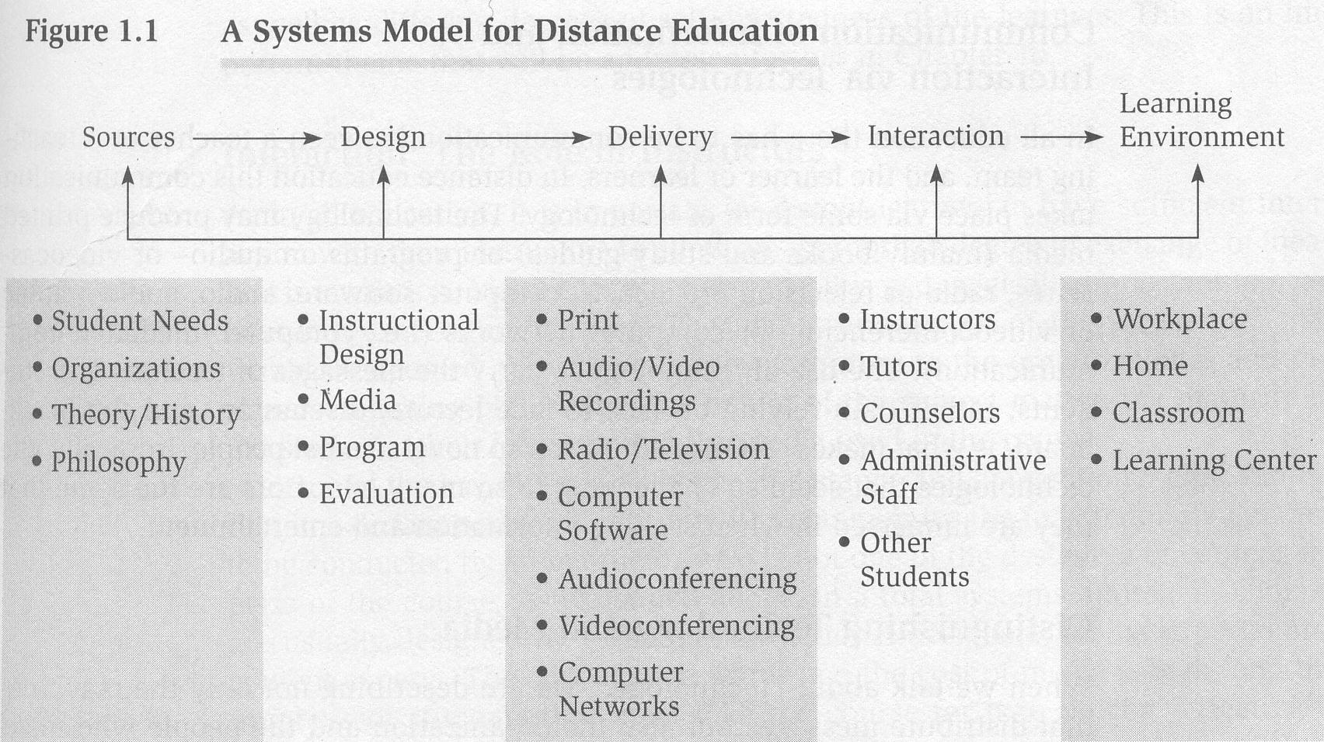
ODL Systems #2b
Notes:
Of course the process is not as linear as this in practice …

Slide 32
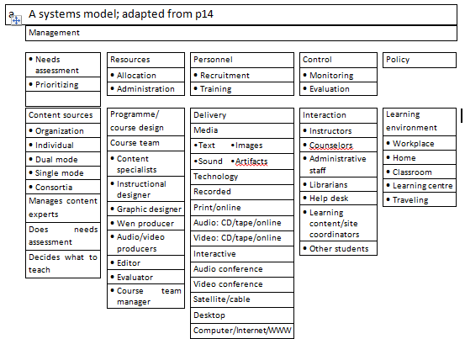
Systems for online provision, Moore & Kearsley 2012

Slide 33
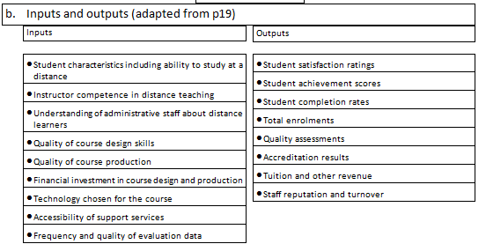
Systems contd.

Slide 34
Dean
Faculty of Education
Unit for Distance Education
Manager
Tony Mays
Deputy Dean
Faculty of Education
Accountant
Willem Cronje
Department of Finance
Faculty Administration
Researcher
Ruth Aluko
Undergraduate
Student Administration
Postgraduate
Student
Administration
Distance Education
Administration
Rita Venter
Learning designer
Hendri Kruger
Education Innovation
Deputy
Emsie Piek
Admin Officers
Mamello Matima
Lerato Magagula
Academic Integrity
Module Coordinators
Call centre
coordinator
Admin
Officer
Student
Accounts
Matrix structures:
Organogram for distance education at UP UDE
Admin
Officer
Admin
Officer
Admin
Officer etc.
Notes:
Three key components to successful DE provision – module coordinators ensuring academic integrity, UDE for strategy/marketing/policy/budget/research/development and the engine-room/heartbeat of DE admin …

Slide 35
ODL systems dependent on effective regional support and ICT structures
ICT
Regional support
Production | Effective operational management | Counselling
Regional coordination | Core business activities | Registration
Graduations | Marketing | Recruitment
Regional support
ICT
Notes:
Within an ODeL environment the core business is usually supported by a strong ICT architecture as well as distributed support centres

Slide 36
Quality issues (CoL 2009)
Criteria |  | No. standards | No. of PIs
1 | Vision, mission and planning | 21 | 54
2 | Management, leadership and organisational culture | 27 | 79
3 | The learners | 7 | 19
4 | Human resource development | 7 | 22
5 | Programme design and development | 13 | 33
6 | Course design and development | 13 | 37
7 | Learner support | 15 | 49
8 | Learner assessment | 12 | 38
9 | Infrastructure and learning resources | 8 | 35
10 | Research, consultancy and extension services | 7 | 20

Slide 37
Q & A 3
What does a SWOT analysis suggest about ANU’s responsiveness?
Notes:
Q&A

Slide 38
costing implications
ANU: Revisiting the business model

Slide 39
Overview
Why a Nadeosa exploration of programme cost modelling?
Models and assumptions?
Preliminary findings?
Where to from here?
Working hypotheses

Slide 40
Why a Nadeosa exploration of programme modelling?
SAHEA 1997; Luckett 2003 – place emphasis on whole, coherent programmes/qualifications
Concerns about coherence and staffing capacity (CHE 2004, 2007, 2010)
Lingering assumption that ODL cheaper than contact
Misleading conflation: ODL = elearning = online learning and cheaper than contact
Skewed perspectives: cost efficiency vs cost effectiveness
Huge differences in staffing models across the world (Insung 2005)

Slide 41
Models and assumptions 1
Three common models
  Print-based and contact supported
  Resource-based and internet-supported
  Internet-dependent mix of off- and on-line engagement
Notes:
This links to the accompanying spreadsheet

Slide 42
Models and assumptions 2
Common elements
  educational strategies
  assessment types
  other personnel costs
  other costs (e.g. course design, management and administration, course materials, technology etc.)
  course income; and
  overheads.

Slide 43
Models and assumptions 3
Model A (print/contact) least design time (10h/nlh) but contact tutorial support costs increase with student numbers (1:30)
Model B (internet supported) more design time (15h/nlh) but asynchronous etutorial support for larger numbers (1:50)
Model C (internet dependent) most design time (20h/nlh) but compulsory synchronous elements limit student numbers (1:15)

Slide 44
Models and assumptions 4
  Towards a new business model for ANU Addendum 1.xls
  Towards a new business model for ANU Addendum 2.xls.xlsx
Notes:
Provide an opportunity for participants to play with the spreadsheet by changing assumptions. Suggest they save each model with a different name.

Slide 45
Preliminary findings?
At R3000 per module and with 300 students, A and B are sustainable and C is not
At R3000 per module and 1000 students, all three sustainable
At R3000 per module and 100 students, only B is sustainable
At R3000 per module and 15000 students all models are viable and generate significant surpluses but scale complex to plan, manage, monitor and review
But, of course, different assumptions will yield different results
But, surely better to model before investing?

Slide 46
Working hypotheses 1
That ODL provision should continue to focus on large scale provision for which some forms of economy of scale can be achieved by amortising curriculum and learning resources development costs over time.
That where low enrolment, high input niche programmes can be justified at a national level, they will require dedicated additional funding.
Notes:
Comments?

Slide 47
Working hypotheses 2
That provision needs to be made at programme level for the management of tutors and/or work integrated learning of various kinds and an increasing commitment to programme management time related to enrolment and complexity.
Notes:
Comments?

Slide 48
Working hypotheses 3
That if there is an intention to move from a print-based correspondence model to an interactive and supported elearning model – whether web-supported or web-dependent – the implications for curriculum design and ongoing support need to be carefully budgeted. At one extreme there is a danger that the move towards an elearning model simply replicates poor transmission mode teaching and perfunctory rote-learning assessment; at the other extreme, the open interactive possibilities of Web 2.0 technologies and the increasing number of resources available on the web could result in programmes that are unsustainable in terms of costs and human resources.

Slide 49
Q & A 4
DOES ANU need a new business mODel?
Notes:
Q&A

Slide 50
In conclusion

Slide 51
Focus Group Interviews
Date/time | Prof Ken Harley and Ms L Levey | Tony Mays
16/05/16
0830-1000 | Interviews with: Prof Linda Ethangatta Purpose, nature and examples of action-research CPD programme. Possibilities for OER focus and open access publication on OpenANU Progress on other proposed OER-related research projects e.g. regional centres, take-up across departments. Mr Eric Osoro, Education lecturer Rationale for and preliminary findings of PhD study on OER take-up by students in Kenya. | Workshop chaired by Prof Reed to explore a new business model for ANU involving: Registration Finance IODL Academic Deans ICT Examinations and certification QA Marketing Management Information System (MIS)
1000-1030 | Break
1030-1115 | Interview with Prof Reed, DVC Academic ANU context Work in progress and plans iro OER Reflection on engagement with OER Africa | Focus group interview Finance
1130-1215 | Interview with IODL team IODL context Work in progress and plans iro OER Reflection on engagement with OER Africa | Focus group interview Registration, Marketing
1215-1300 | Interview with Library services Library context Work in progress and plans iro OER Reflection on engagement with OER Africa | Focus group interview Academic Deans, QA, IODL
1300 – 1345 | Break
1345 – 1430 | Focus group interview with materials developers Materials development at ANU Work in progress and plans iro OER Reflection on engagement with OER Africa | Focus group interview Examinations and certification, MIS, ICT
1430-1500 | Interrogation of Tony’s reports/ issues to pursue during convening | Prelim feedback to DVC
1500-1530 | Courtesy meeting with Principal and VC

Slide 52
Focus Group Interviews
What are the current trends in terms of demand for ANU’s services – programmes and modes? And what do we anticipate regarding future demand?
Should all programmes be offered in all modes or should we differentiate? If so, how?
What does a SWOT analysis of ANU’s existing systems suggest regarding readiness to respond to 1 and 2?
Does our current costing model need to change? If so, how?
How can engagement with OER contribute?
Follow up research …

Slide 53

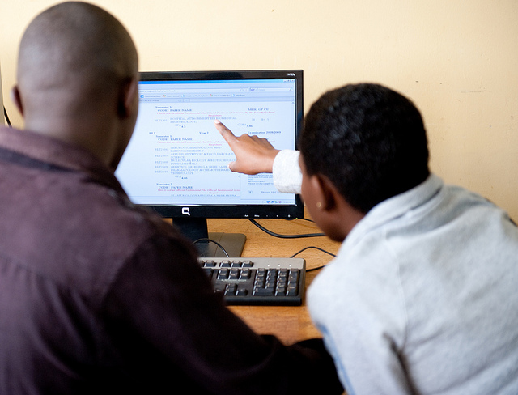

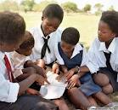
OER for Africa… and the world
OER show-cases African intellectual capital – allowing us our rightful participation as contributors to the global knowledge economy.
Notes:
Because OER allows flexibility in module and course design and in the long-term, cuts costs
No Royalties; Choose how to share; Freely available
Allows contextualisation of existing quality resources
Facilitates conversations about institutional and national policy necessary to support quality teaching, learning and research
OER is a tool that enables Africa to share with the rest of the world its wealth of knowledge!

Slide 54
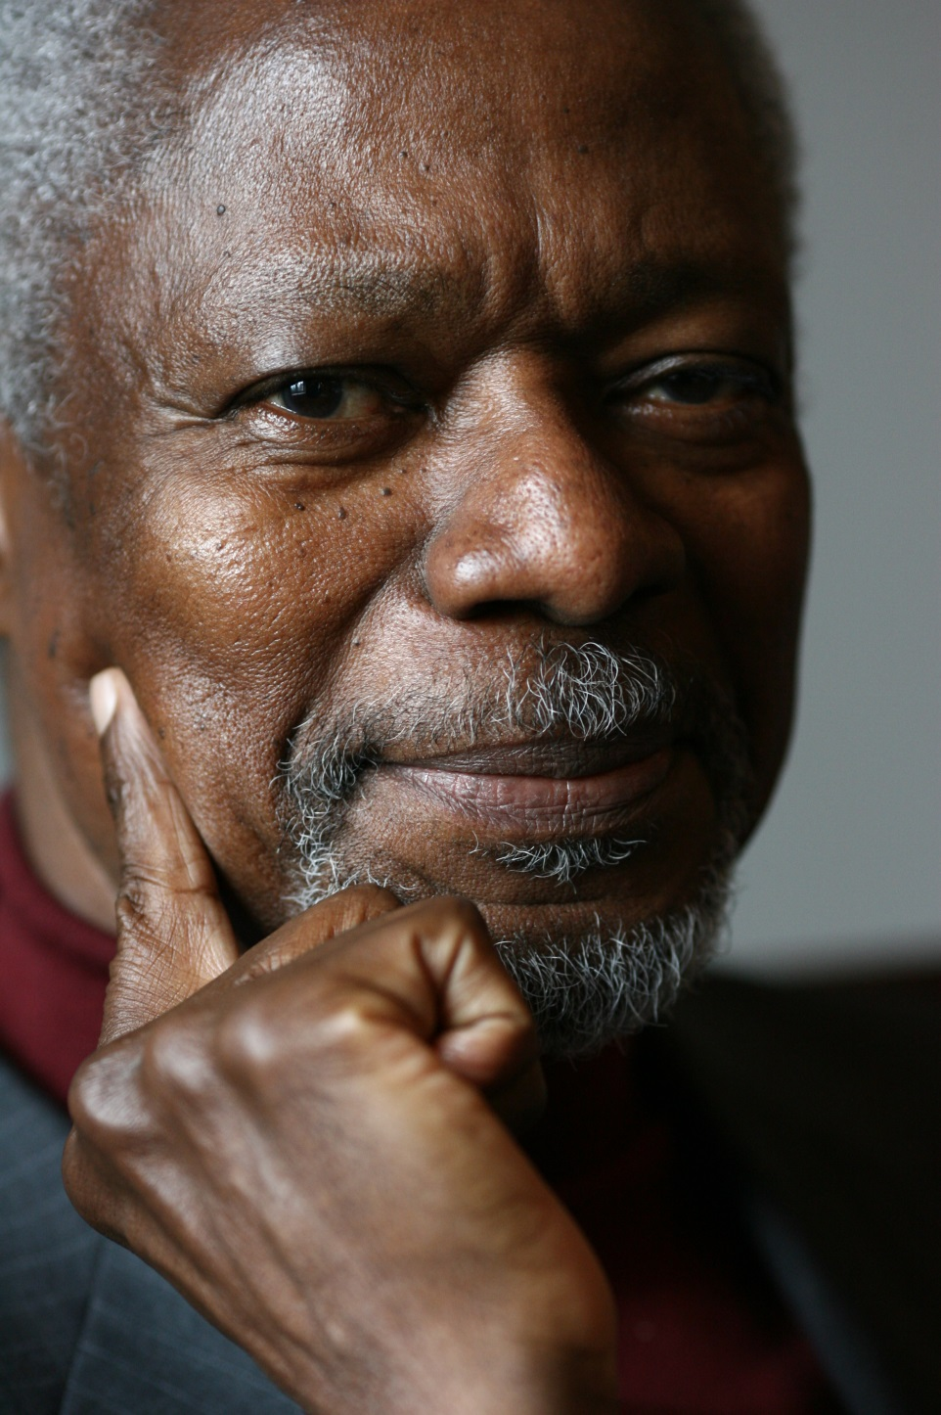
Kofi Anan
Nobel Laureate, 2001
“Education is a human right with immense power to transform. On its foundation rest the cornerstones of freedom, democracy and sustainable human development.”
Notes:
OER is a powerful tool towards transforming higher education in Africa. This is a transformation that will see Africa take its rightful place as a major actor in the transformation of our societies, livelihoods, economies, politics, the practice of science and the performance of the arts. Africa’s contribution to the global knowledge economy is vital.
Picture: http://static.goal.com/100000/100084.jpg
Quote from : http://www.unicef.org/sowc99/sowc99a.pdf – The State of the World’s Children (1999) [downloaded Sept 20th 2014)
Kofi Annan was awarded the Peace Prize for having revitalized the UN and for having given priority to human rights. The Nobel Committee also recognized his commitment to the struggle to contain the spreading of the HIV virus in Africa and his declared opposition to international terrorism.
(http://www.nobelprize.org/nobel_prizes/peace/laureates/2001/annan-facts.html)
He served as the seventh Secretary-General of the United Nations from January 1997 to December 2006.

Slide 55
Selected bibliography
Ally, M. Ed. 2009. Mobile Learning: Transforming the Delivery of Education and Training. Edmonton: Athabasca University Press.
Anderson, T. & Elloumi, F. Eds. 2004. Theory and Practice of Online Learning. Athabasca: Athabasca University.
Bates, A. W., & Sangrà, A., (2011), Managing Technology in Higher Education: Strategies for Transforming Teaching and Learning. San Francisco: John Wiley & Sons, Inc.
Commonwealth of Learning (CoL). 2009. Quality Assurance Toolkit: Distance Higher Education Institutions and Programmes. Vancouver: CoL.
Council on Higher Education (CHE). 2004a. Criteria for Institutional Audits, Higher Education Quality Committee, June 2004. Pretoria: CHE.
Council on Higher Education (CHE). 2004b. Criteria for Programme Accreditation, Higher Education Quality Committee, November 2004. Pretoria: CHE.
Du Vivier, E. 2010. A Sustainable Open Schooling System for Ghana – Report of a Short-term Consultancy to devise strategies for the Centre for National Distance Learning and Open Schooling (CENDLOS) prepared for the Commonwealth of Learning (CoL): Vancouver.
Glennie, J. & Mays, T. 2009. Towards a model for ODL. Open Learning through Distance Education (OLtDE), 15(6), 2009.
Heydenrych, J. F. & Prinsloo, P. (2010). Revisiting the five generations of distance education: Quo Vadis? Progressio; South African Journal for Open and Distance Learning Practice, 32(1), 2010. 5-26
Higgs, P. & Moeketsi, RMH. (2011). An African Perspective on Academic Development: The University of South Africa’s, College of Human Sciences’, Scholars Development Programme. 9th International Conference on Comparative Education and Teacher Training (2011 – Sofia, Bulgaria).
Holmberg, B. 1995. Theory and Practice of Distance Education. 2nd Edition. London: Routledge.
Horsthemke, K. (2006). The idea of the African university in the twenty-first century: Some reflections on Afrocentrism and Afroscepticism. South African Journal of Higher Education (SAJHE), 20(4), 2006. 449-465.
Louw, H. A. 2007. Open and Distance Learning at Unisa. Pretoria: Unisa.
Mays, T. (2011). Programme modelling: a Nadeosa investigation into the cost and human resource implications for different models of ODL provision – draft post-conference version 5. Johannesburg: Nadeosa and Saide. Available at: http://www.nadeosa.org.za/Resources/NADEOSAPublicationsandReports/tabid/1510/Default.aspx
Moore, M. G. & Kearsley, G. 1996. Distance Education: A Systems View. USA: Wadsworth.
Moore, M. G., & Kearsley, G., (2012, 2005), Distance education: A Systems View of Online Learning. Third Edition. Belmont, CA: Wadsworth, CENGAGE Learning.
Simonson, M., Smaldino, S., Albright, M. & Zvacek, S. 2003. Teaching and Learning at a Distance: Foundations of Distance Education. Second Edition. New Jersey: Pearson Education Inc./Merrill-Prentice Hall.
Treml, A. K. 1995. Systems Theory Pedagogics in Higgs, P, Ed. 1995 Metatheories in Philosopohy of Education. IIsando: Heinemann.
Welch, T. & Reed, Y. Eds. 2005. Designing and Delivering Distance Education: Quality Criteria and Case Studies from South Africa. Johannesburg: NADEOSA.

Slide 56

Thank you
tonymays0@gmail.com
Mays, T.J. 2016. Africa Nazarene University: Revisiting the business model. Johannesburg: Saide/OER Africa
This work is licensed under a
Creative Commons Attribution 4.0 License

