Slide 1
Challenging our approach to accessibility in OER design
Josie Gray (she/her/hers)
Coordinator of Collection Quality, Open Education
BCcampus
josie.gray@bccampus.ca
Twitter: @josiea_g
October 30, 2019
Slides: bit.ly/grayopened19
Notes:
Hello everyone,
Thank you all for being here today. My name is Josie Gray and I work for BCcampus, a provincial organization that supports all of the post-secondary institutions in B.C. in the areas of teaching and learning, educational technology, open education, and other special projects. I am part of the Open Education team, so I manage the B.C. Open Textbook Collection and I do a lot of work supporting the production and publication of open educational resources, and I often provide training, resources, and assistance around making open educational resources accessible.
When I started at BCcampus three years ago, my focus was on technical accessibility. But since then, I have had the opportunity to learn from many others who have really pushed me to think beyond just technical accessibility. To think more about approaches to design and what inclusion looks like.

Slide 2
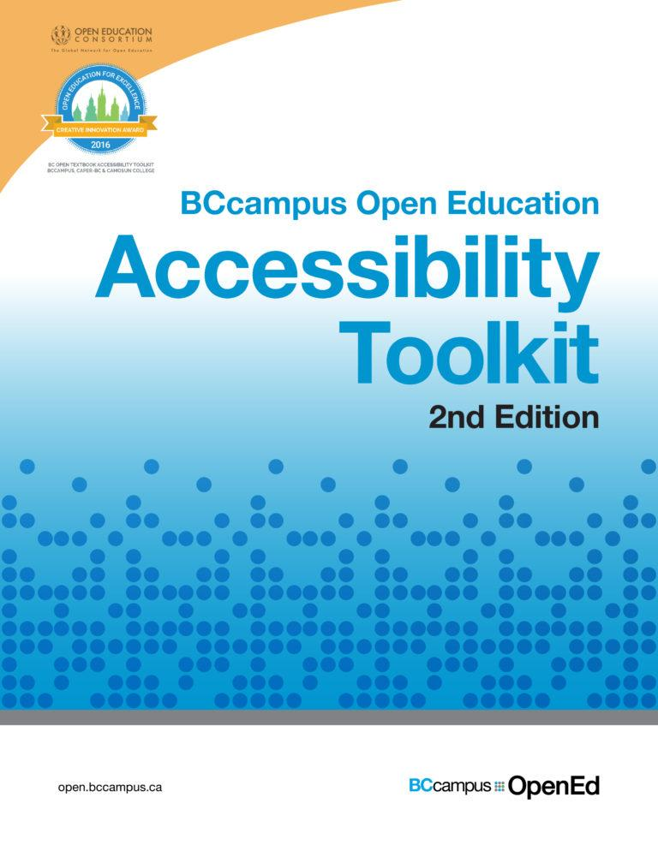
Accessibility Toolkit
Organizing content
Images
Links
Tables
Multimedia (Video, audio)
Formulas
Font
OpenTextBC.ca/accessibilityToolkit
Accessibility Toolkit cover by BCcampus. CC BY 4.0
Notes:
I do not know everyone in this room, so I don’t know how many of you are familiar with this resource. So I am going to quickly talk about it first to make sure everyone knows it exists.
This is the Accessibility Toolkit written by Amanda Coolidge, Sue Doner, and Tara Robertson, and published by BCcampus in 2015. This toolkit was my very first encounter with digital accessibility when I started working with BCcampus. Since then, I’ve been able to update and expand the toolkit, and it is the first place I point people to when they have questions about creating accessible open resources.
This toolkit provides an introduction to how to create accessible open educational resources. It covers things like organizing content, images, links, tables, multimedia, formulas, and font. Those who are new to digital accessibility will want to make a note to come back to this resource, because it is an invaluable guide for how to ensure the resources you create are accessible. It can be accessed at opentextbc.ca/accessibilitytoolkit/
However, in this presentation, I want to go beyond the content covered in the Accessibility Toolkit and talk more about how we understand accessibility in general.

Slide 3
Open educational resources are…
“freely accessible online.”
Notes:
In open education, there are a number of core values guiding the work we do. But one I want to highlight right now is “access.”
A statement that I hear quite often is that open educational resources are “freely accessible online.”
In my opinion, when people talk about OER as being “freely accessible online.” What they really mean is that the book is “freely available online.” Because when I see a statement like this beside a textbook, I check the book’s images for alt tags, I look for heading tags, and link text, and I am usually disappointed. Because although I’ve found a great textbook that is online with editable files and an open licence… it is not accessible.
As I mentioned, part of my job at BCcampus is to manage the B.C. Open Textbook Collection. And as such, I’ve reviewed a lot of open textbooks from a lot of different publishers and authors. When I add a new book to the collection, there is a check that asks “Is this textbook accessible?” It is rare that I get to mark that checkbox as a yes.
And this isn’t surprising. Digital accessibility is not something most of us – if any of us – were taught in school. It may not be a default practice for you to be thinking about the accessibility of every digital document that you create. We get comfortable in our own ability, and it’s easy to forget that what may work for me, may not work for someone else.
If thought of at all, accessibility is still coming in as an afterthought in OER design. And this can cause a lot of problems. Not only can it cause problems in the design of the textbook, but it can make people less likely to ever take any steps to ensure a resources is accessible. When a resource is created without accessibility in mind, it often takes A LOT of work to come in after to make it accessible, and often once you get to the end of a long project, going back and spending a bunch of time fixing the accessibility might not feel worth it.
As someone who started her work in digital accessibility by remediating inaccessible open textbooks, I am absolutely sympathetic to this point of view. Remediation takes a lot of work, and it can be a frustrating process to have to go back and find a way to fix things.
But universal access to education is something that we say we value in the open education movement, and ultimately there is more to “access” than just putting a resource up for free online. For open, the “available for free online” does wonders for access when we understand access in a general sense, without looking too closely at the experience of individual students with a particular textbook. But in a movement that wants to make education open for everyone, including students with disabilities, we have to do better.

Slide 4
Accessibility Checklists
Strengths
Easy to understand and follow
Highlight the most important technical considerations to make sure students with disabilities can access the material
Weaknesses
Accessibility as something that we can go back and fix later
Do not ensure good design
Students face challenges not addressed in standard accessibility checklists
Does not ensure equal access to learning outcomes
Notes:
Let’s start by talking about accessibility checklists, which cover the technical aspect of accessibility. Accessibility checklists are really useful tools, and the BCcampus Accessibility Toolkit includes a checklist in the back matter of the book. They are really useful as they:
Are easy to understand and follow with clear success criteria
And they highlight the most important technical considerations to make sure students with disabilities can access the material.
However, a checklist approach to accessibility has a number of weaknesses.
It makes accessibility seem like something that can be fixed later,
it does not ensure good design,
students face access challenges that are not addressed in standard accessibility checklists, and
it does not ensure equal access to learning outcomes.

Slide 5
Medical vs. Social Model of Disability
Notes:
When talking about accessibility, it is helpful to talk a bit about how we think about disability.
The medical model of disability “understands disability as an individual problem, affliction, or deficit that needs a cure or accommodation. It sees disability as grounded in the individual. This is the model that is used in medical settings, and it is also often used at universities and colleges where students need to have a diagnosed disability to be eligible for accommodation.
In contrast, the social model of disability sees disability emerging when there is a mismatch between a person and their environment.
The social model of disability illustrates the false dichotomy between bodies and minds we perceive as “disabled” and those we perceive as “abled.” Instead, disability becomes more of a spectrum that can affect different people in different ways depending on their context, environment, and the tools they have access to, and is a product of history and culture.
The social model of disability is useful for challenging how we perceive and understand disability. It gives us a way to do something about disability, a motivation to help break down barriers for those with disabilities through inclusive design. And it acknowledges the way that people, systems, environments, and technologies can create barriers.

Slide 6
What is an average student?
The classroom, “far from neutral, is constructed for a mythical, “able-bodied,” neurotypical norm that neither reflects nor accommodates the wide range of diverse learners within it, regardless of whether these learners have been diagnosed with a disability” (Wilson, 2017).
Notes:
In an article written by Jan Wilson, she argues that the classroom
“far from neutral, is constructed for a mythical, “able-bodied,” neurotypical norm that neither reflects nor accommodates the wide range of diverse learners within it, regardless of whether these learners have been diagnosed with a disability.”
What she is getting at here is this problem that comes up when we design for what we think is normal, or what we think is average. The reality is, there is no such thing as a normal or average student. Students vary greatly in their interests, family situation, culture, background, experience, strengths, and weaknesses. And all students benefit when educational materials are designed to be accessible and inclusive.

Slide 7
What else affects accessibility?
Day-to-day life
Digital literacy
Access to technology
Notes:
There are a lot of things that affect accessibility that are not covered by accessibility checklists. A student’s day-to-day life can affect access. Consider a student who spends an hour on a crowded bus everyday commuting to school and spends long days on campus studying. For this student, a heavy print textbook would be really annoying, and they might decide to leave it at home rather than lug it to school. That is a barrier to access.
Another example is differences in digital literacy among students. More and more resources are being offered in digital formats, and for those of us who work on a computer all day take for granted our comfort and experience with working with digital content. Even young college students who grew up with smartphones and easy access to Internet may not know how to search a PDF. If your students are adult learners, paying attention to digital literacy and comfort using digital materials will be even more important. A student can’t learn well from a resource they don’t know how to use or don’t like using.
Another example is access to technology. Not every student has access to a computer. For example, I know a trades student who only spends a few months of the year in school. They don’t have a computer because they usually don’t need one. But last year, this person had a course where the textbook was only available online. Without a personal computer, this student regularly struggled with accessing their textbook.
Day-to-day life, digital literacy, access to technology – all of these things are very individualized and context dependent.

Slide 8
Universal Design for Learning (UDL)
Provide multiple means of
Engagement
Representation
Action and Expression
What might multiple means of representation look like?
Incorporating multiple modalities (video, audio, interactive activities)
Making resources available in multiple formats (PDF, HTML, EPUB)
http://udlguidelines.cast.org/
Notes:
One way of addressing these concerns is by employing universal design for learning, or UDL, which encourages designing teaching and learning environments and materials so that they provide multiple means of engagement, multiple means of representation, and multiple means of action and expression for students. This is a huge topic and much more than I could every cover in one slide, but I did want to highlight the principle of multiple means of representation.
This could include incorporating multiple modalities, including video, audio, and interactive activities. For example, when you provide captions and a transcript for a video, not only are you making that video accessible for students who are deaf, you are also giving students a choice in how they would like to interact with the material. Some students will prefer to watch the video, others will want to just read the transcript.
It might also look like making resources available in multiple formats, such as PDF, HTML, or EPUB. For example, the trades student I mentioned would really have valued a copy they could read on they phone or a print version. Someone who spends long hours on transit would likely prefer a digital copy that they could download on their computer for easy offline access. Someone who likes to annotate their textbooks would probably love PDFs.
Ultimately, different formats have different accessibility affordances and while a HTML file might be most accessible for a student using a screen reader, some students really don’t like reading on a computer and will want a print copy. Being able to offer students choice in how they access the material makes it possible for them to use the format that works best for them.

Slide 9
Inclusive Design
“Design that considers the full range of human diversity with respect to ability, language, culture, gender, age, and other forms of human difference.”
— Inclusive Design Research Centre
Notes:
When we bring all of these things together, all of these considerations, all of these practices, we are really starting to talk about inclusive design.
Inclusive Design is defined by the Inclusive Design Research Centre as “design that considers the full range of human diversity with respect to ability, language, culture, gender, age and other forms of human difference.” In inclusive design, one of the most important things is recognizing the people are different. And by designing for differences, we can create things that are more useful, powerful, and accessible to all.
With inclusive design, the work is never done. It’s not a box you can check off. It is an iterative and ongoing practice.

Slide 10
What is our tolerance for failure?
Mitchell, J. (2018, October 10). Tolerance for failure: Open education and its ethical edges [Keynote]. OpenEd. Retrieved frm https://www.slideshare.net/jesshmitchell/tolerance-for-failure-open-education-and-the-ethical-edges
Notes:
Now, none of these things I’ve talked about today are new concepts. I am definitely not the first person to challenge accessibility checklists or think of different ways of understanding accessibility. And in many ways, I am new to this way of thinking about accessibility, and I am constantly learning about how to complicate and push my understanding and challenge myself.
But I do think accessibility and usability are too easily and too often overlooked in OER development, or it is ignored until the last minute. Or people think about it for the web version, but not the print version, or vice versa. And I get that it can be a lot of work, and thinking about accessibility adds another layer to the already complex process of developing and adapting open educational resources. However, as a community that values *access,* it’s something we need to be always thinking about, and always striving to improve.
In her keynote at OpenEd last year, Jess Mitchell from the Inclusive Design Research Centre asked us all to consider our “tolerance for failure in open education.” She pointed out that when we say “good enough,” or “that is all that I can do,” we are drawing a line. And this is normal. This is something we do all of the time. This is something I did when finishing up my presentation at 1030 last night.
But in her talk, Jess encouraged us to be more aware of that line. Ask, “Who is on the other side of that line?” When the majority of the OER we are creating are inaccessible, we are leave a lot of students on the other side of that line.

Slide 11
Changing Our Practices
Notes:
So to finish off my presentation, I would like to highlight some ways that we can integrate accessibility practices into the work we do in open education and things to think about when creating open educational resources.
First, learn about the basics of digital accessibility. Familiarize yourself with the Accessibility Toolkit and read through the accessibility checklist. Understand why those considerations are important and how they work. One thing that has helped me is to try to think about accessibility whenever you are creating digital material, even if you don’t plan to share it. Use headings in your Word Documents, add text descriptions to your images on Twitter, use descriptive link text when you’re sending emails.
For those involved in creating and publishing open textbooks and other OER, think about how you can include accessibility considerations as part of the creation process. Include accessibility in style sheets; design, format, and organize with accessibility in mind from the very beginning. Think about the different ways that students may want to access information and what formats you can make available. For example, think about how you will make sure that students using a print copy and students using a digital copy can access the same information
When it comes time to share the resource with students, make sure they know how to use it.
• Are they aware of all formats available and how to use those formats?
• Are there features that allow them to customize their experience?
• Are there tools that allow them to interact with the content in a different way? Think annotation tools or text-to-speech software
And then if it’s possible, be open to and encourage feedback from students.
Ultimately, accessibility and inclusion isn’t a one-and-done kind of a thing. It is not a pass/fail. It is a spectrum, and it may look differently for each person depending on their context. And that plays into one of the best parts of OER: the ability for us to be able to go in and make things better.
And if we continue to work towards designing educational resources so that they are accessible, inclusive, and incorporate principles of Universal Design for Learning, we will be producing resources that are actually freely accessible for all students.

Slide 12
Questions?
Contact: jgray@bccampus.ca
Twitter: @josiea_g
Slides: bit.ly/grayopened19

Slide 13
Resources
Accessibility for Specific Content Types
Complex Images for All Learners [PDF]
Accessible Presentations
Rev (Transcription/captioning service)
MathML
Accessibility Checkers
Web Accessibility Evaluation Tool (WAVE)
Contrast Checker (Checking colour-contrast ratios)
Digital Accessibility
Web Content Accessibility Guidelines (WCAG) 2.1
Introduction to Accessibility in Educational Materials
Accessibility Toolkit
Accessibility Checklist
Inclusive Design
Introduction to Inclusive Design (webinar)
Inclusive Design Guide
Inclusive and Universal Design for Learning
Inclusive Learning Design Handbook
UDL Guidelines
SNOW: Inclusive Learning & Education
Notes:
I’ve compiled an initial list of resources related to the different things I talked about today. You can access

Slide 14
References
CAST. (2018). Universal Design for Learning Guidelines version 2.2. Retrieved from http://udlguidelines.cast.org
Coolidge, A., Doner, S., Robertson, T., Gray, J. (2018). Accessibility Toolkit – 2nd Edition. Victoria, B.C.: BCcampus. https://opentextbc.ca/accessibilitytoolkit/
Inclusive Design Research Centre. (n.d.). What is inclusive design? Retrieved from https://idrc.ocadu.ca/about- the-idrc
Rose, T. (2016). The End of Average: How We Succeed in a World that Values Sameness. New York, NY: Harper Collins.
Treviranus, J. (January/February 2014). The value of the statistically insignificant. EDUCAUSE Review, 49(1). Retrieved from https://er.educause.edu/articles/2014/1/the-value-of-the-statistically-insignificant
Wilson, J. D. (2017). Reimagining disability and inclusive education through universal design for learning. Disability Studies Quarterly, 37(2). http://dx.doi.org/10.18061/dsq.v37i2.5417

