Slide 1
OER Africa
Participatory Action Research Grant
August 2014 to June 2017

Slide 2
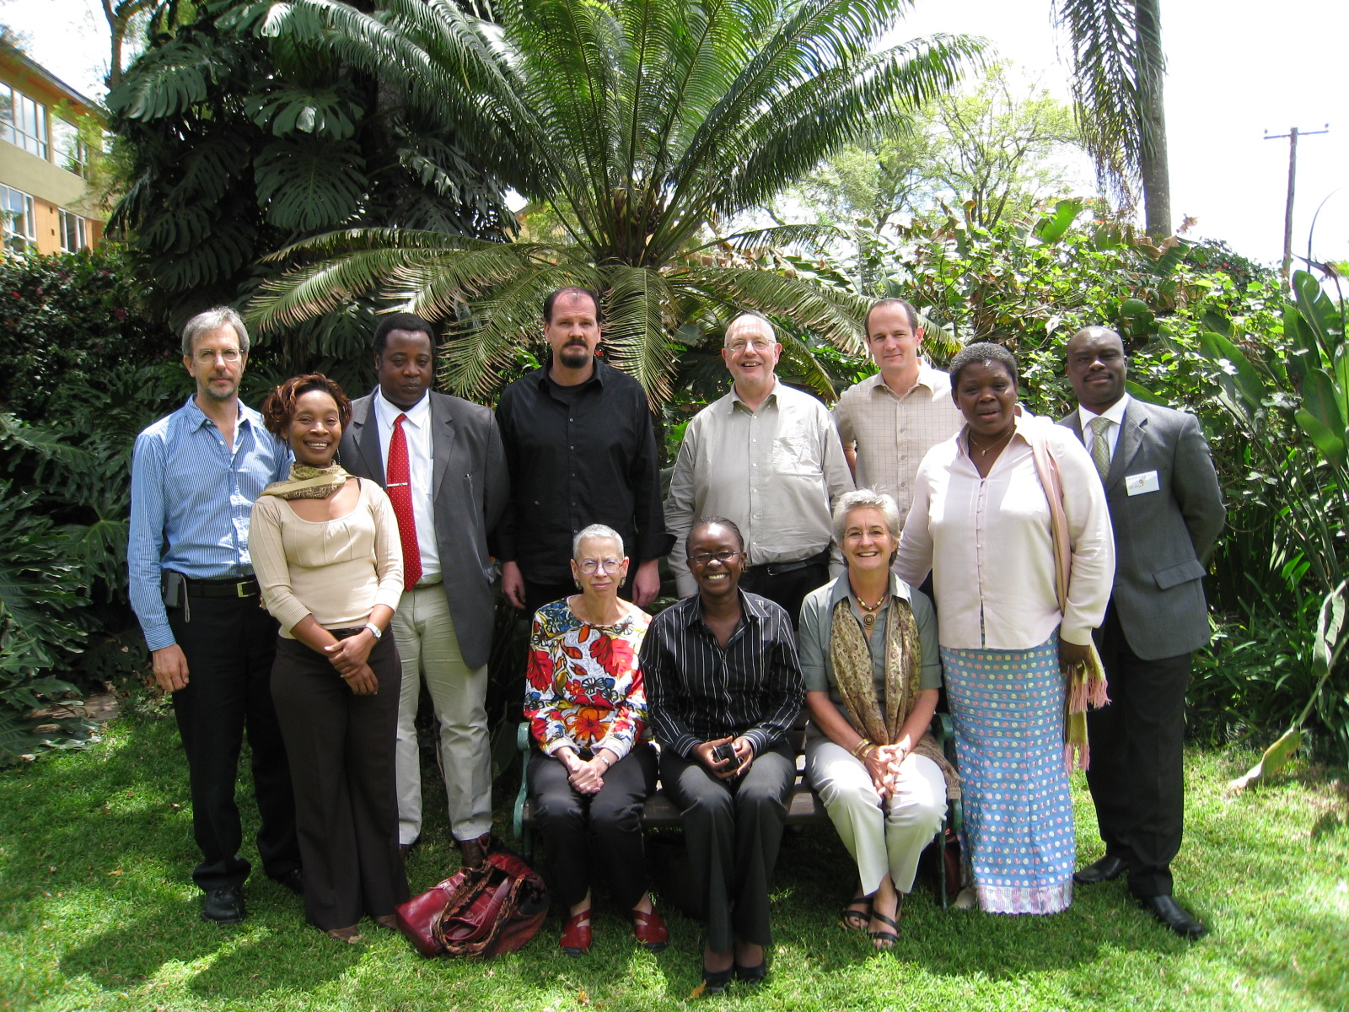
OER Africa Mission
to establish vibrant networks of African OER practitioners
by connecting like-minded academics from across the continent
to develop, share, and adapt OER
to meet the higher education needs of African societies.

Slide 3
Research and Advocacy
Commissioned pieces & consolidation
Action Research
Reports
Guides
Tool Kits
Conference Papers / Presentations
Advocacy
Sensitisation Workshops
Conference Presentations
Website to showcase Africa IP
Publications

Slide 4
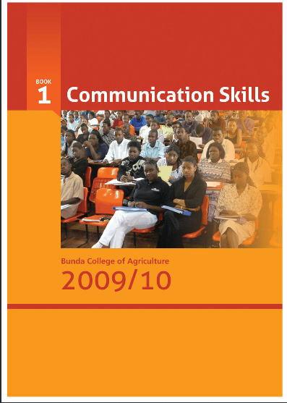
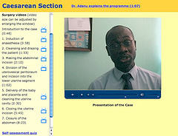
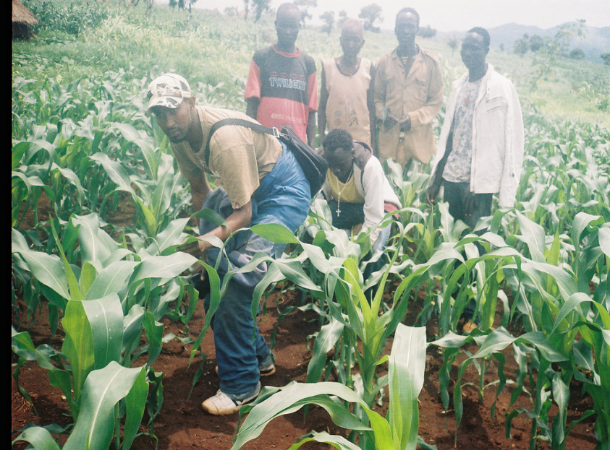
Proof of Concept Pilots
OER DVD for students at Kamuzu College of Nursing
Dr. Adanu’s multi-media module
Notes:
For us, the OER Concept pertains to Educational resources that are freely available for use by educators and learners, without an accompanying need to pay royalties or licence fees.
Over the past 4 years or so, we have worked with African universities to create, adapt and share OER in the fields of agriculture, health, teacher education and foundation skills.
We have found it important to stress that whilst OER are not synonymous with online learning or e-learning, they can certainly enhance all types of teaching and learning;
Finally, as we had anticipated from the onset, within the African context in which we mainly work, many of the resources produced – whilst shareable in a digital format (both online and via offline formats such as CD-ROM) – are frequently printable.
OER Impact
Impact – on faculty (new t&l); on students (active participation in their own learning) on institutions (show-casing African IP)

Slide 5
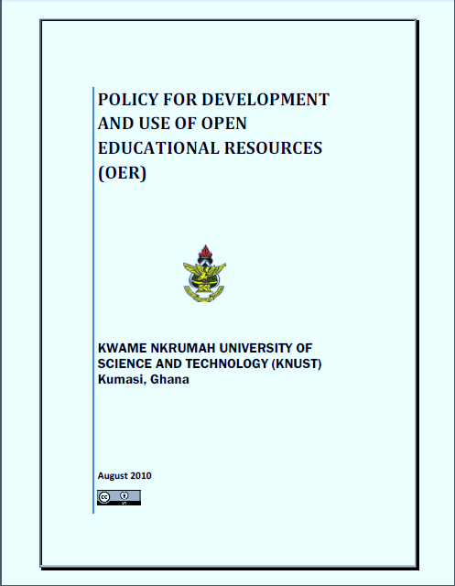
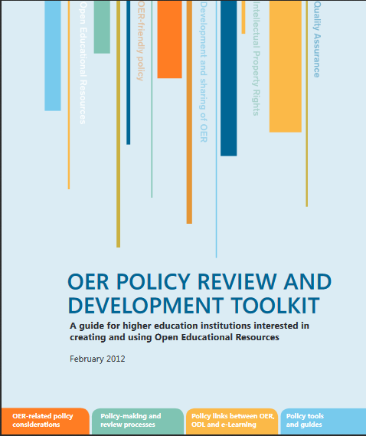
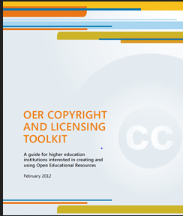
Policy Reviews

Slide 6
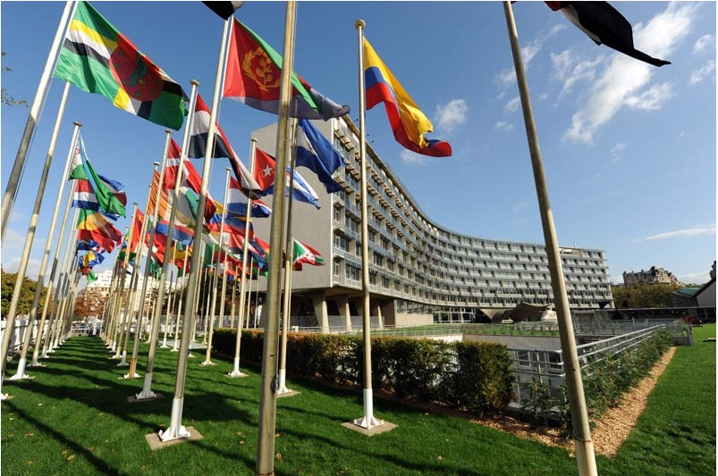
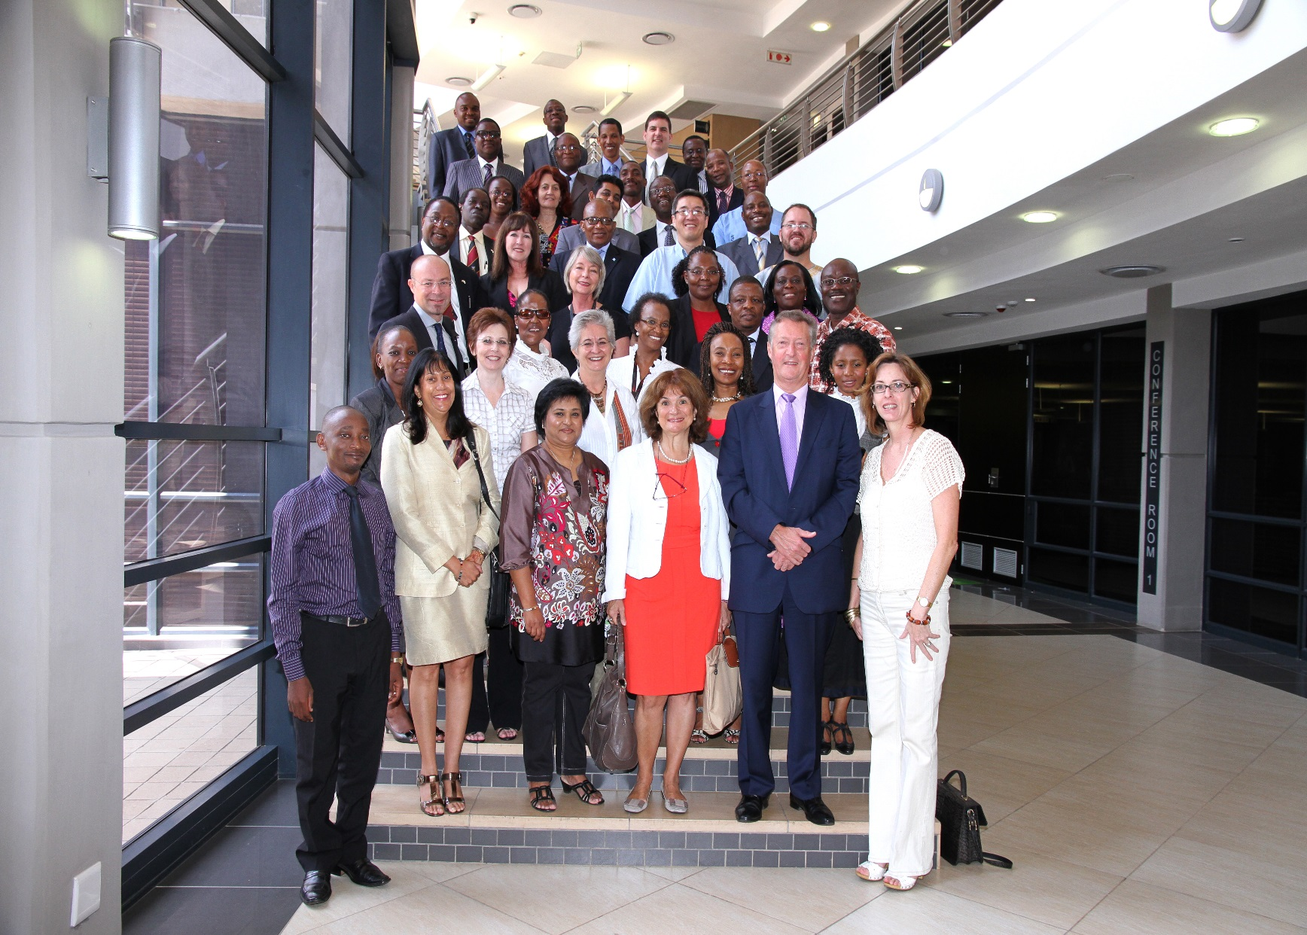
Advocacy
Notes:
Flags Photo, Tony Bates: http://www.tonybates.ca/wp-content/uploads/UNESCO-HQ.jpg

Slide 8
Africa’s HE Context
Changing student profiles
Continuing students, mature students, part-time, professional…
New demands from learners
Ubiquitous access (VLEs, OER Repositories, Open Access Journals, etc.)
New pressures on HE systems
Delivery: face to face, distance, blended mode
Content: relevant, interactive, appropriate
New pressures on governments
Funding, connectivity, reliable power, education for all…
Notes:
These changing expectations are manifested in Africa in these ways – amongst others
Image: http://wp.vcu.edu/medcgsa/wp-content/uploads/sites/2847/2013/05/graduation-cap-and-diploma.jpg

Slide 9
Pedagogical Transformation Grant
In this phase OER Africa is integrating a Participatory Action Research (PAR) agenda into each of our institutional engagements. We believe that more focused interactions will facilitate a collaborative agenda and will therefore support four carefully selected institutional partners to:
build a deepened understanding of how OER practices can support transformation of teaching and learning
ensure that such accumulating understanding is widely shared and incorporated into policy and advocacy
OER Africa believes that hands-on practice at institutional level will generate action-research and advocacy required to understand institutional transformation and the role of OER therein.

Slide 10
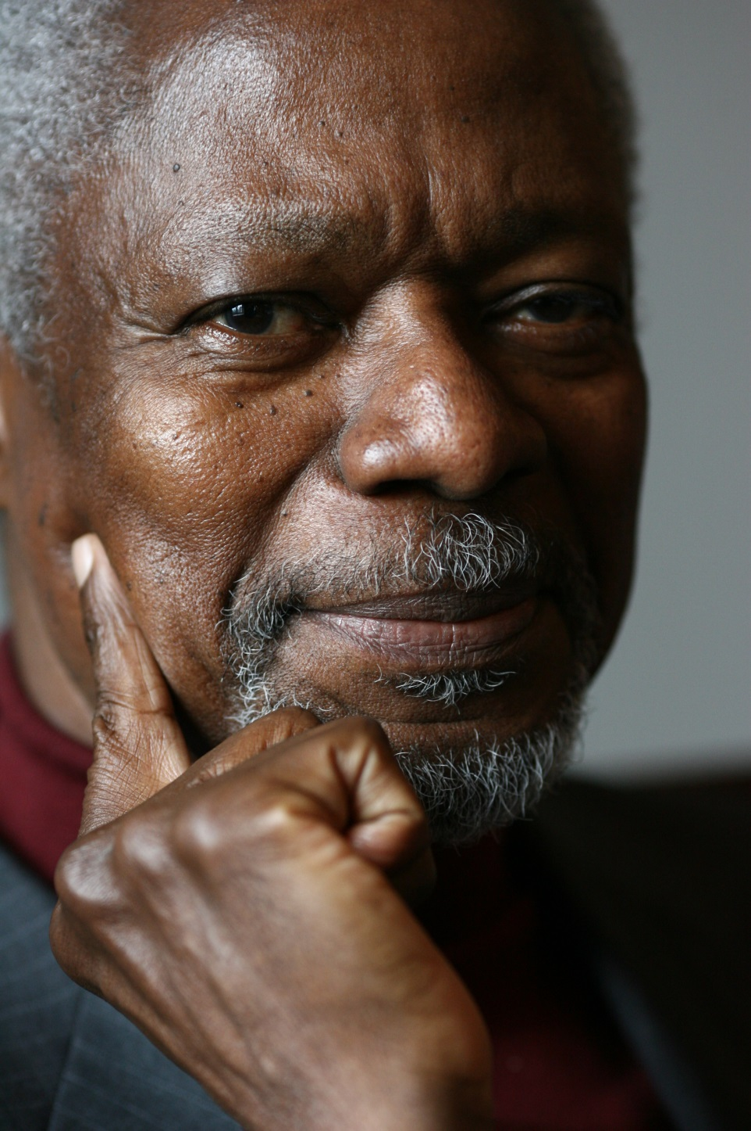
Kofi Anan Nobel Laureate, 2001
“Education is a human right with immense power to transform. On its foundation rest the cornerstones of freedom, democracy and sustainable human development.”
Notes:
OER is a powerful tool towards transforming higher education in Africa. This is a transformation that will see Africa take its rightful place as a major actor in the transformation of our societies, livelihoods, economies, politics, the practice of science and the performance of the arts. Africa’s contribution to the global knowledge economy is vital.
Picture: http://static.goal.com/100000/100084.jpg
Quote from : http://www.unicef.org/sowc99/sowc99a.pdf – The State of the World’s Children (1999) [downloaded Sept 20th 2014)
Kofi Annan was awarded the Peace Prize for having revitalized the UN and for having given priority to human rights. The Nobel Committee also recognized his commitment to the struggle to contain the spreading of the HIV virus in Africa and his declared opposition to international terrorism.
(http://www.nobelprize.org/nobel_prizes/peace/laureates/2001/annan-facts.html)
He served as the seventh Secretary-General of the United Nations from January 1997 to December 2006.

