Slide 1
Early Experiences
of the
Course Conversion to OER Process at Open University of Tanzania
Doreen Mushi, OUT
Brenda Mallinson, OER Africa

Slide 2
Who / what is OER Africa?
Headquartered in Nairobi (estab. 2008)
… to play a leading role in supporting higher education institutions across Africa in the development and use of OER to enhance teaching and learning.
http://www.oerafrica.org
Notes:
OER Africa commenced in 2008 through seed funding from the William and Flora Hewlett Foundation. Since then, we have diversified our projects and partnerships to focus primarily, but not exclusively, on agriculture education, teacher education, health education and academic skills for higher education. This work continues to be supported by the Hewlett Foundation as well as the Bill and Melinda Gates Foundation, amongst other donor partners.

Slide 3
Background
2008 – 2012: Expansive Partnership Strategy
2013: Deepened Engagement Planned
2014 – 2017: More focused interactions
→ Collaborative agenda with 4 selected HEIs
build a deepened understanding of how OER practices can support transformation of T&L
ensure that such accumulated understanding is widely shared and incorporated into policy and advocacy
Notes:
Initially, OER Africa adopted an expansive partnership strategy in seeking to respond to a growing urgency to meet the demands of students and faculty for improved pedagogical content and practice on the one hand and the demands of African societies for competent higher education graduates on the other.
In 2013, OER Africa determined that its best course of action, over the next 5 years, would be to support a small selection of HEIs which are committed to transforming teaching and learning practices, in the context of the information society, through Action Research and Critical Practice, to build evidence that OER practices can both lead to and support transformation, and can be successfully mainstreamed and institutionalized.
Accordingly, OER Africa embarked upon a Participatory Action Research grant through which we are supporting pedagogical transformation in particular institutions with a view to identifying key supporting and inhibiting factors to sustaining such changes. Our proposed approach is informed by an understanding that supporting significant change in this way requires sustained engagement and support over an extended period and that, while some critical success factors will be generic, others will be institutionally specific.
OER Africa believes that hands-on practice at institutional level will generate action-research and the advocacy required to understand institutional transformation and generate a model for harnessing OER to improve both the content and the delivery of higher education in Africa.

Slide 4
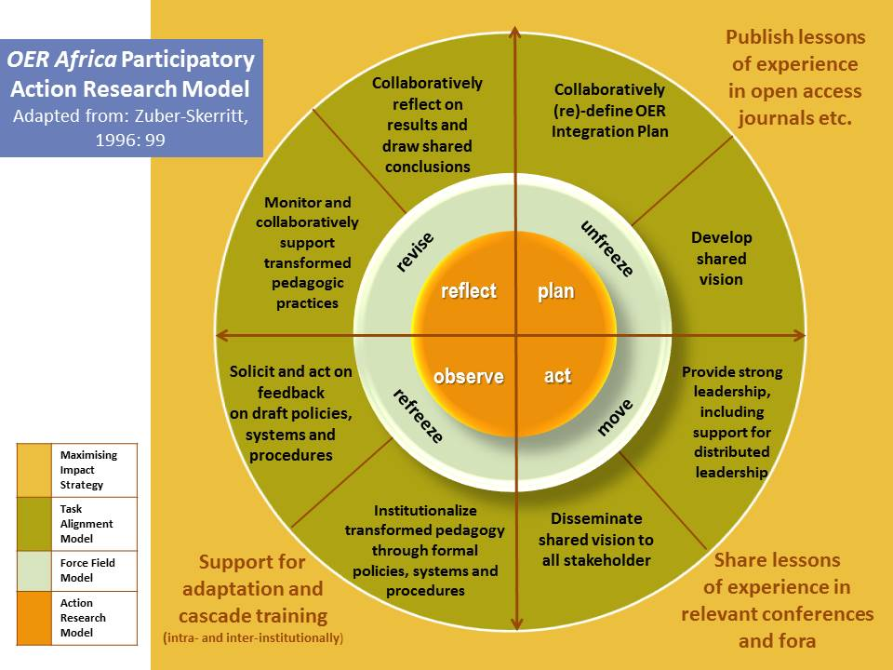
Notes:
Participatory Action Research Agenda (PAR)
We define PAR as ‘collaborative research, education and action used to gather information to use for change on social issues’. It involves people who are concerned about or affected by an issue who take a leading role in producing and using knowledge about it. A PAR approach has the following features: It is driven by participants; It offers a democratic model of who can produce, own and use knowledge; It is collaborative at every stage, involving discussion, pooling skills and working together; It is intended to result in some action, change or improvement on the issue being researched.
Pain, R. et al. Participatory Action Participatory Action Research Toolkit: An Introduction to Using PAR as an Approach to Learning, Research and Action. Durham University.

Slide 5
Open University of Tanzania
Goals: (Aug 2014 - July 2017)
A comprehensive OER policy initiated that references / augments existing related institutional policies.
A Digital Fluency Course for Academics (comprising five modules) to be designed, developed, mounted online, and piloted.
OUT courses mounted in appropriate OER repositories
PAR Agenda defined and researcher/s identified to undertake the research.
Establish: OER course conversion Process and central OER Support team
Rethink the OUT Open Repository
Notes:
OUT – ODL model established in 1992. Now over 40,000 students, with 30 regional centres. Move to use technology rather than old correspondence mode, further move to use OER – benefits seen by senior management. Several senior staff members have engaged in OER Projects such as TESSA, AVU, and Ministry of Education, TZ.
The Digital Fluency modules will also be disseminated via the OUT Open repository (amongst other appropriate repositories, such as the ACDE) when they are ready for publication as OER.

Slide 6
Drafting the Process - Starting Points
dScribe (Open.Michigan, 2012)
CORRE (Univ of Leicester, 2012?)
Curation for Participation (OpenUCT Guide, 2014)
Notes:
An OER course conversion team was established and undertook the drafting of a course conversion to OER process.
This was informed by 3 sources, but mainly adapted from the DScribe process - so good to have models to refer to and be guided by the reported experience of others!

Slide 7
OUT Draft Process Stages
Digitized content
Identifying repository / portal
Publishing for distribution
Copyright clearance
Selecting CC License
Integrating MM content
(Academic Staff, Students, SMEs)
(IEMT / Library / Quality Ass.)
OUT OER Working Group (IEMT)
Notes:
Subject matter experts are tasked with ensuring that their courses are available in digital form and they are developed according to the OUT in-house style format. This includes elements such as course description, learning outcomes, summaries, review questions, and references.
This stage involves reviewing course content and making sure that it is correctly referenced (ensuring that there is acknowledgement of who owns the intellectual property and obtaining author’s / right owners’ permission, if necessary). The stage also involves checking for plagiarism and includes adaption and use of relevant openly licensed materials to support the course content.
Subject matter experts will select the appropriate creative commons licenses that will guide the public on further reuse of the material. This is guided by the licences of any existing content, as well as the preferred open license adopted by the University.
The stage involved incorporating multimedia elements to make the material more interactive and engaging. Once again, existing content licenses should be adhered to, and original media should be licenses as guided by University policy.
Selection of relevant repositories to upload and release the course content online. In the first instance, this would be made available in the OUT Open Repository, and then indexing in further appropriate repositories can be investigated.
Making the material known and publically available to the wider academic community and monitor the usage of the OER (views, downloads etc) using web analytics software.

Slide 8
Working Retreat
5 days
3 OER support staff
2 lecturers (SMEs)
Guidance
Conversion Process Activities
Reflection
Funded by:
Notes:
Two lecturers interested in converting their courses to OER were selected to proof the process by following the adapted steps with the support of the OER conversion team. These 2 courses are now available online internally at OUT, with all of the constituent lectures having undergone copyright clearance. The 2 lecturers concerned shared their experience at an institutional ‘Show and Tell’ in December 2015. It remains for these courses to be published as OER within the OUT Open Repository.
The workshop started with a session which introduced the lecturers to the basic concepts of OERs, licensing and repositories. The lecturers were then guided through copyright clearance and how they should go about ensuring that their content is well referenced. This was the main activity of the workshop. It took lecturers a considerable amount of time to modify their content systematically and follow up on licence specifications from the source documents.
The workshop schedule encompassed activities addressing content preparation, copyright clearance, creative commons licences at the end of each day, the lecturers undertook a reflection on the successes and challenges of the day’s activities, and elaborated on their related experiences of the course conversion process.
At the end of the retreat about half of the materials of each of the two courses were successfully converted into OER. This involved clearance of copyrighted material and application of antiplagiarism software to detect any traces of plagiarised content. The next step was to select an appropriate creative commons license that would be used on the course material. The team chose CC BY Attribution licence and it was reflected in all course modules. In addition, OUT OER portal has been identified as the repository for the courses but publication of this material will remain pending until the institutional OER Policy has been finalised. Due to time limitations the authors were not able to add OER multimedia to the courses during this retreat.

Slide 9
What we Learned / Confirmed
Academic staff inhibitors:
Absence of:
OER Policy
Plagiarism checker
Copyright clearance
Complexity of process
Time intensive
Institutional disruptors:
Pedagogical issues
Sustainability query
Limited understanding of IP issues
Staff Incentives issue
Notes:
Policy: At the time the workshop was taking place, OUT was still in the process of developing an OER policy that would have guided the implementation of OER related activity at the university.
During the workshop period, the University did not have plagiarism detection software that could be used to screen for plagiarised content and incorrectly referenced material. The team overcame this by downloading and deploying a freely available tool that had some limitations when used in this ad hoc manner.
The process of replacing copyrighted material was considered time consuming and in way it could affect the pedagogical aspect of the course content. Subject matter experts found it hard to replace material that was referenced from old books and resources that have not been digitised. In addition, finding relevant OER from repositories was difficult due to the nature of the subjects (Law and Philosophy) and the relative inexperience of the team in this area.
Both lecturers expressed to the OER Africa support person that in future, they would develop their courses differently from the start. They would be sure to keep track of their references accurately from the beginning, and write materials using their own words, and without incorporating direct quotes from other authors.
With the University subsequently having purchased the use of proprietary plagiarism detection software, both these pilot courses will be checked through and the report analysed thoroughly before the courses are made available as OER on the OUT Open Repository.

Slide 10
Reflections
Lecturers changed attitude towards course development
Next time, do it right from the start!
Observe copyright (process became easier as time went on)
Search for and use existing OER; develop own OER
Time constraints & Lack of incentives
Institutional change inhibitors:
Pedagogical practice slow to change
Some anxiety around Quality
Notes:
Need for OER advocacy remains very high – once one goes past a small group of knowledgeable people, awareness drops rapidly
Conversely, resistance to engaging with OER is declining – more groups expressing interesting in both sharing under open licences and integrating OERs into courses.
Growing focus on harnessing OERs to improve quality – quality concerns remain but negative perceptions of OER as ‘poor quality’ are reducing
Technology take-up in universities, especially amongst students, remains frustratingly slow – access is expanding, but relatively slowly compared to other parts of the world

Slide 11
Way Forward …
Process revision necessary
Quality Assurance (increased review role)
Library personnel (repository & dissemination)
Continued Institutional support vital to
Move from OER ‘projects’ to institutionalisation
Scale up course conversion initiative
‘80% of OUT courses should be OER’
Use this experience to inform the operationalisation of the Draft OER Policy.
Notes:
Need for OER advocacy remains very high – once one goes past a small group of knowledgeable people, awareness drops rapidly
Conversely, resistance to engaging with OER is declining – more groups expressing interesting in both sharing under open licences and integrating OERs into courses.
Growing focus on harnessing OERs to improve quality – quality concerns remain but negative perceptions of OER as ‘poor quality’ are reducing
Technology take-up in universities, especially amongst students, remains frustratingly slow – access is expanding, but relatively slowly compared to other parts of the world

Slide 12
Notes:
Continue with Dual approach – it is effective

Slide 13
Thank you!
brendam@saide.org.za
http://www.slideshare.net/brenda6
This work is licensed under a
Creative Commons Attribution 4.0 International License.

