Slide 1
Open Educational Resources for Activity-Based Distance Provision
Daystar University
Nairobi
16th September 2014

Slide 2
Overview
Context
Role of ODeL
Designing ODeL Curricula and Resources
Role of OER

Slide 3
CONTEXT
Open educational resources for activity-based distance and flexible provision

Slide 4
Context
6% HE participation rate in SSA
45% HE participation for a global knowledge economy
So: expand access x7
RSA 20% ➔ 23% (900 000 to 1,6m)
Daystar strategic planning?

Slide 5
Role of ODeL
Open educational resources for activity-based distance and flexible provision

Slide 6
Learning from distance education …
Learning resources
Learning support
Assessment
Working at scale
Mediating a curriculum without necessarily requiring teachers and learners to be in the same place at the same time
Overcoming the ‘iron triangle’ of access, quality and cost

Slide 7
Learning from experience
Rapid growth in demand because no alternative
Surpluses used to cross-subsidise inefficient campus-based courses
Deteriorating quality of DE provision leads to low retention and throughput; enrolments decline; DE programmes close

Slide 8
Designing odel curricula and resources
Open educational resources for activity-based distance and flexible provision

Slide 9
Developing a course
Requirements of
the job
National
policies
Target qualifications
and accreditation
Contextual
research
Target audience: needs and profiles
Learning environment
Approach to teaching
and learning
Key purpose and
outcomes
Content and skills
emphases
Assessment strategy
Teaching and learning
methods
Formative and
summative
Course materials
,
Independent study
Group activities
Feedback to
students
Staff or external agencies
Work-based activities
Recording and
reporting
Technologies
Individual support &
tutoring
Internal monitoring/moderation
External moderation,
quality assurance, and evaluation
© SAIDE 2003
Notes:
The curriculum is therefore much more than a list of content or topics. It is about the decisions we make about what to teach, how to each and how to assess the learning, who we involve in the process of decision-making, and how experience from practice feeds back into rethinking or reimagining what we choose to do …In an ODL setting we have the added challenge of working out how to do this without necessarily requiring teachers and learners to be in the same place at the same time.

Slide 10
Nomenclature
Qualification
Programme
Module
Unit

Slide 11
Enablers in re-imagining higher distance education
OER, OEP
Increasing emphasis on T&L ?
Access to digital tech and connect-ivity

Slide 12
But….
OER often don’t provide a fit-for-purpose learning pathway
‘’
Role of teachers undermined by some
Good teaching may overcome a poor choice of technology but technology will never save bad teaching

Slide 13
Key questions
How does institutional vision and mission inform ODeL practice and expansion?
Which programmes in the PQM best lend themselves to ODeL provision?
What is/are the best model/s for provision of a particular programme to a particular target audience learning and working in particular contexts?
How do these choices advance the causes of equity, access, redress and social justice and a faith-based mission?

Slide 14
Key tensions iro “openness”
Opening choices about WHAT to study vs ensuring a coherent learning programme.
Opening choices about WHEN to study vs providing structure and pacing so that underprepared students are offered a reasonable chance of success.
Opening choices about HOW to study vs the need for integrity of programme design, closing digital divides and the need to develop collaborative competences.
Opening choices about WHERE to study vs need for WBE/WIL/practical components
Opening choices about ASSESSMENT options vs need to ensure recognition / accreditation of learning achievements
Opening access iro AFFORDABILITY vs ensuring a quality experience

Slide 15
Prioritising engagement
Sir John Daniel references a large meta-analysis by researchers at Concordia University focusing on the contribution of the three forms of interaction to student learning outcomes:
"Some important research by Bob Bernard and his group at Concordia University, Montreal is relevant here. They did a meta-analysis of 600 papers reporting attempts to improve student performance in distance learning courses by increasing one of three types of interaction: student with instructor; student with student; and student with content.
The results revealed that … Increasing student-content interaction was most effective; increasing student-instructor interaction was least effective.
This again suggests that careful course preparation, which builds in more engagement with course content, is more effective and probably less costly than expecting academics to be answering e-mails, SMS or phone calls at every hour of the day or night."
See Sir John Daniel, Will Higher Education Split?

Slide 16
Active Engagement … (Adapted from: Carl 2009:96)
Lecture | Discussion | Group work | Self-activity
Class lecture Speech Paper Story Demonstration Symposium Panel | Free group discussion Controlled class discussion Forum | Horseshoe groups Round-table groups Syndicates Buzz groups Brainstorming Nominal group method Fishbowl | Play Project work Activity cards Learning contracts Self-study models Programmed learning Teaching machines
In distance education, we might design activities that guide students towards engaging with print, audio, video or multimedia resources. | In distance education, we might use contact sessions, audio or video-conferencing or online forums to facilitate this kind of interaction. | In distance education, we might build group work into contact sessions or by using various kinds of online tools such as wikis to enable more collaborative learning. | In distance education, we need to think carefully about how we scaffold activities and feedback to support different kinds of independent study.
Experiential learning
Simulation Dramatisation Role play Socio-drama Case studies Advanced learning programme Laboratory learning Sensitivity training
In distance education, we need to think about how we might use ICTs to support these kinds of learning experiences: for example, simulations, virtual reality, gaming etc.
Notes:
Carl, A. E. 2009. Teacher empowerment through curriculum development – Theory into practice. Third Edition. Lansdowne, Cape Town: Juta and Company Limited.

Slide 17
Module outline
Title page
Imprint page (incl licence and citation)
Contents page(s) (use MS Headings)
Introduction
Unit 1
Unit 2
Unit 3 etc.
References
Glossary
Appendices (e.g. Readings)

Slide 18
Key Headings for Introduction to Module
Welcome
Why should I study this module? (purpose incl link to programme)
What will I learn? (outcomes plus content overview)
How much time will I need?
How will I learn? (incl icons)
How will I be supported?
How will I be assessed?
What resources will I need?
What is my study schedule? (incl contact + ENAZ)

Slide 19
Structure of a Unit
Introduction (with links)
Time allocation
Resources/Readings
Introductory activity
Feedback
Content 1
Developmental activities (at least 1 every 3 pp; incl ENAZ)
Feedback
Content 2+
Consolidating activity
Summary
Concluding remarks (with links)
Recommended optional further reading (see Resources 2.5 and 2.6)

Slide 20
Summary
In non-campus-based provision it is harder to track student progress; there tends to be lower retention and throughput
We need to keep students actively engaged when they are not directly with us in the classroom/ lecture hall
Distance learning materials are therefore activity-based
There needs to be a clear link between intended learning outcomes, assessment criteria, summative and formative assessment tasks and supporting in-course learning activities for self-assessment
For each unit of learning think about:
An introductory activity and feedback
A number of developmental activities and feedback
A consolidating activity and feedback
Try to avoid more than 3 pages without a learning activity.

Slide 21
Introduction to oer Africa
Open educational resources for activity-based distance and flexible provision

Slide 22
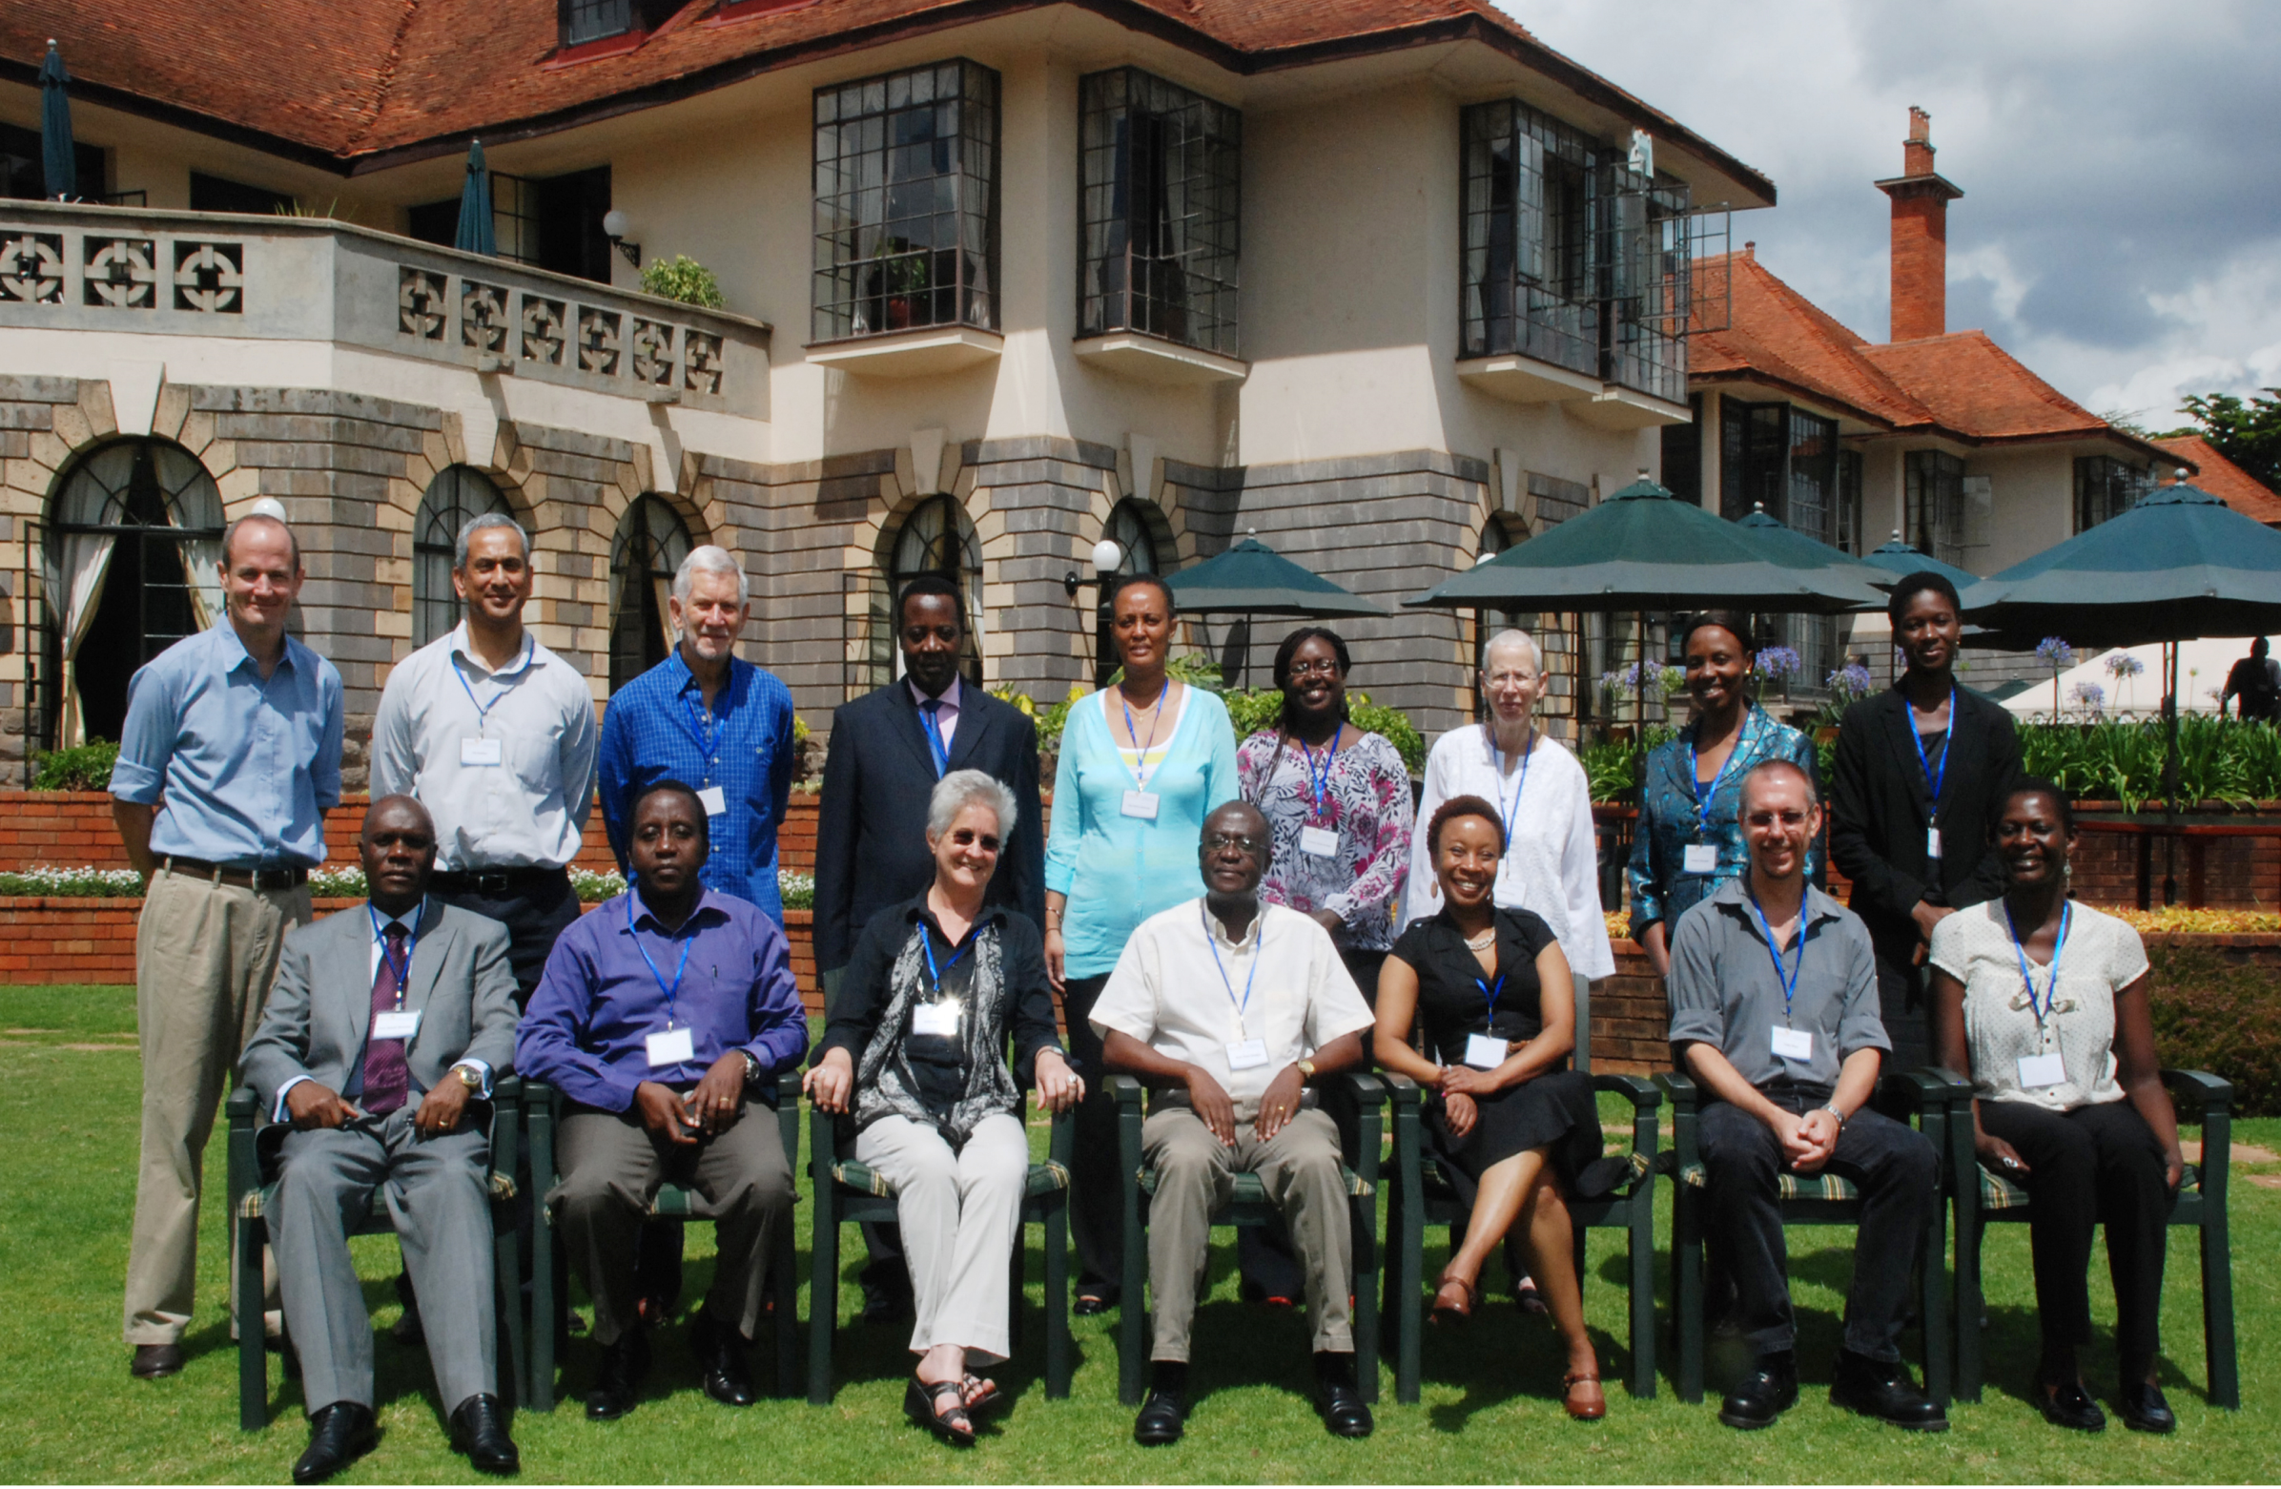
OER Africa is:
Notes:
See: www.oerafrica.org

Slide 23
OER Definition
Open Educational Resources (OERs) are any type of educational materials that are in the public domain or introduced with an open license.
The nature of these open materials means that anyone can legally and freely copy, use, adapt and re-share them.
OERs range from textbooks to curricula, syllabi, lecture notes, assignments, tests, projects, audio, video and animation.
UNESCO
Notes:
Why do we exist?

Slide 24
Africa’s HE Context
Changing student profiles
Continuing students, mature students, part-time, professional…
New demands from learners
Ubiquitous access (VLEs, VLs, Open Access Journals, etc.)
New pressures on HE systems
Delivery: face to face, distance, blended mode
Content: relevant, interactive, appropriate
New pressures on governments
Funding, connectivity, reliable power
Notes:
Image: http://wp.vcu.edu/medcgsa/wp-content/uploads/sites/2847/2013/05/graduation-cap-and-diploma.jpg

Slide 25
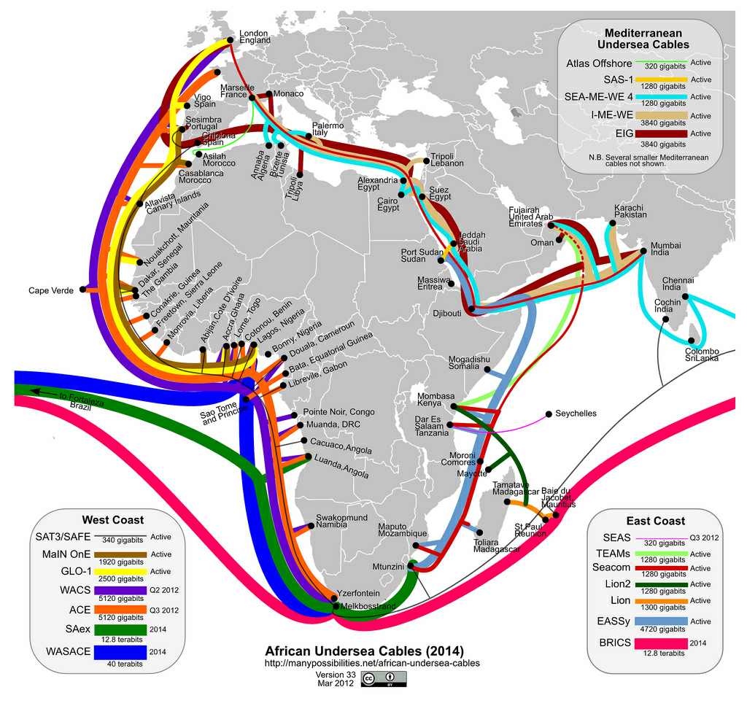
Notes:
http://jellyfishcoolman.files.wordpress.com/2009/07/african-submarine-fibre-optic-cables.jpg
Spinal Image: http://www.murrelektronik.com

Slide 26
Why institutionalize OER?
Open licensing provides a cost-effective means to increase investment in creating more effective teaching and learning environments using resource-based learning.
Notes:
Need to keep up with the new roles and ways of working:
Team-based curriculum design and materials development including students
E-tutoring Saide Supporting distance learners.docx
Ongoing CPD, LLL: e.g. AfriVip

Slide 27
… undergraduate education is not just about discipline specific knowledge or cognitive skills;
instead, dispositions and cognitive skills that enable graduates to be effective citizens are also valued outcomes for students completing a bachelor’s degree.
Chan et al (2013)
Notes:
Chan et al (2013) See Roy Y. Chan Boston College; Gavin T. L. Brown, The University of Auckland; Larry H. Ludlow, Boston College., “What is the purpose of higher education?: A comparison of institutional and student perspectives on the goals and purposes of completing a bachelor’s degree in the 21st century.” Paper presented at the annual Association for the Study of Higher Education (ASHE) conference. St. Louis, MO: November 15, 2013. Downloaded from: https://www.academia.edu/2626994/What_is_the_purpose_of_higher_education_Comparing_student_and_institutional_perspectives_for_completing_a_bachelors_degree_in_the_21st_century on December 16th 2013

Slide 28
Role of oer
Open educational resources for activity-based distance and flexible provision

Slide 29
Overview
What are OER?
Why use OER?
How can we use OER?

Slide 30
Setting the Scene
Too few learning resources for learners and lecturers in African universities, and many of those available are too expensive to be purchased by students, or even universities
Conversely, also many resources, including African, underutilised;
Impossible to find a single resource that meets all needs for all time
Changing expectations of students
Increasing diversity of students …
All point to need to access more, and more diverse, learning resources.
Notes:
More info here

Slide 31
What are OER?

Slide 32
The OER Concept
Educational resources that are freely available for use by educators and learners, without an accompanying need to pay royalties or licence fees.
OER is not synonymous with online learning or e-learning;
Within an African context, many of the resources produced – while shareable in a digital format (both online and via offline formats such as CD-ROM) – are also printable.

Slide 33
A resource
Notes:
Almost any kind of resource has potential educational value …

Slide 34
An educational resource
What is the name of the bird in the foreground of the picture?
Can you name 3 other varieties of this kind of bird?
Notes:
… however we are most interested in resources which have been incorporated into some kind of learning activity … but can you just use it if you like it?

Slide 35
An OER
What is the name of the bird in the foreground of the picture?
Can you name 3 other varieties of this kind of bird?
This work is licensed under a Creative Commons Attribution 3.0 Unported License
Citation: Tony Mays 2011
Notes:
The “openness” relates to the way in which the resource is licensed for re-use.

Slide 36
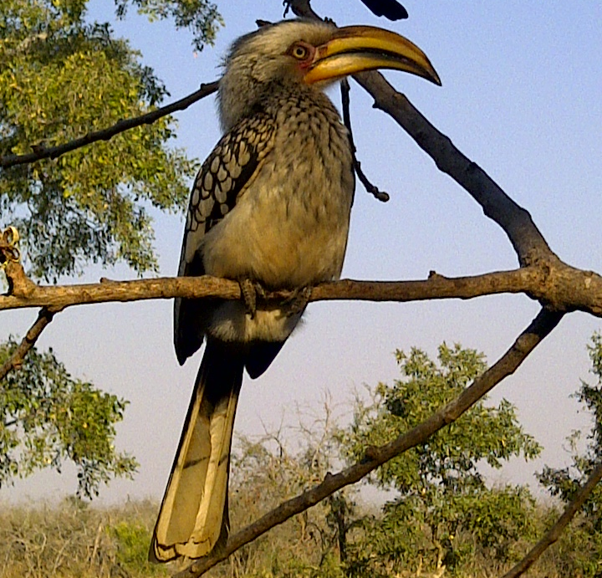
A Remixed OER
The yellow hornbill shown left is one of four varieties of hornbills common across sub-Saharan Africa. The other varieties are the grey- and red- hornbills and the much larger ground hornbill.
As the name suggests, the large horny bill is the key characteristic of the species. What does this suggest about their typical diet?
This work is licensed under a Creative Commons Attribution 3.0 Unported License
Citation: Jane Kamau 2012
Photo: Tony Mays 2011
Notes:
The least restrictive licenses allow the original resource to be adapted for a different audience or context.

Slide 37
Creative Commons
Notes:
Creative Commons is probably the most widely used open licensing system

Slide 38
OER Creative Commons: licenses
Notes:
Examples of different licensing conditions: attribution only, share-alike (but difficult to track), non-commercial use (but difficult to define and track), no derivatives (may be appropriate for a research paper but seems less so for a teaching/learning resource which needs to be contextualised) …

Slide 39
OER Creative Commons: licenses
X
X
Notes:
OER Africa promotes the more open licensing conditions for teaching/learning resources

Slide 40
Some rights reserved: a spectrum for OER
X
X
X
Public
Domain
All Rights Reserved
least restrictive
most restrictive
Notes:
A spectrum of licensing conditions

Slide 41
Why use OER?

Slide 42
Transformative potential
Increased availability of high quality, relevant learning materials can contribute to more productive students and educators.
The principle of allowing adaptation of materials provides one mechanism amongst many for constructing roles for students as active participants in educational processes.
OER has potential to build capacity by providing institutions and educators access, at low or no cost, to the means of production to develop their competence in producing educational materials and carrying out the necessary instructional design.
(CoL 2011: 13)
Notes:
OER support socio-constructivist approaches and an evolving curriculum

Slide 43
Engagement: Authentic tasks Biodiversity data collection activity
Use detailed field notes on a sample of birds, dragonflies and woodlice. Students observe their area, noting what species they find
Complete field notes and upload to the U316 Biodiversity database
This creates a geographically referenced map of all the students’ data, enabling students to see where there are species ‘hot spots’ and to work out what might be good strategies for nature reserves
Submit an assignment based on this activity, for credit
The OU data is submitted to the national biodiversity database and so adds to ‘real’ knowledge. (Thorpe, 2006)
Notes:
From: Thorpe, M. 2006. Using ICT for curriculum design, development and delivery: design for active and interactive networked learning. Nadeosa, Pretoria, 2006.
OER Africa has supported a similar approach at Masters’ level at Makerere University Schools of Agriculture and Veterinary Sciences – case studies from previous years contribute to the pool of learning resources for the following years …

Slide 44
What does OER make possible?
Notes:
Unisa CEDU required a manual, at short notice, for a workshop to train supervisors and school-based mentors to support teaching practice … so we re-purposed an existing module on Mentoring from the national ACE in School Leadership and Management …
Institutions often use OER to supplement / complement print-based materials with other media such as videos, audios, animations …

Slide 45
OER has the Potential
Notes:
This resource developed by UCT staff and students is now widely used across other institutions

Slide 46
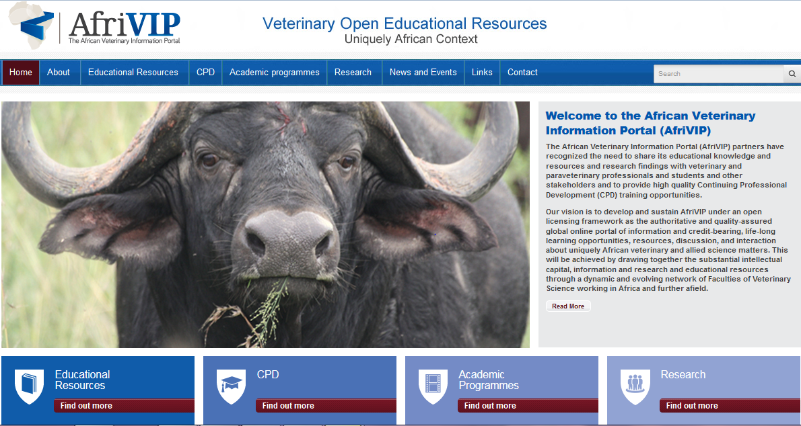
Notes:
Front page of a new OER initiative with UP: See: http://www.afrivip.org/
All the resources are Open Education Resources (OER) and therefore carry an open license (Creative Commons), allowing it to be freely copied, distributed, and adapted without asking copyright permission.
The Faculty of Veterinary Science, University of Pretoria, and its partners, has recognized the need to provide high quality Continuing Professional Development (CPD) training for veterinarians and allied professions including para-veterinary professionals. This has initiated the development of the African Veterinary Information Portal (AfriVIP), for veterinary training and information and a training platform of the OIE Collaborating Centre for Training in Integrated Livestock and Wildlife Health and Management.

Slide 47
UP Student
Student Login
Under & Post Graduate Courseware
Public Web Access to PD Materials
Database of PD materials with Open Licenses
Professional Vet
UP’s ClickUp (Blackboard LMS)
Search Facility
Content
Content
PD Test using Bb MC Tools
Option to collect PD points
On success
Payment
PD Registration
History & Payment details
1 x
CEatUP (DNN)
E-Mail confirmation to CE, SAVC and User
PD Login
Bb Blackboard Platform (LMS)
CEatUP Continuing Education Unit at UP
LMS Learner Management System
MC Multiple Choice Assessment
PD Professional Development
UP University of Pretoria
Digital Certificate (e-Mail)
Open Environment
Controlled Environment
Notes:
Open component of the platform allows for public access to the Univ. Pretoria Professional Development (PD) materials web page. No registration, nor log-in, is required and a search facility allows users to find and access Open courses and materials. This web site would be the point of entry for professionals looking for PD opportunities as well as members of the public.
The public web interface (1) accesses the open materials from a database that is also shared with the university’s ClickUp! platform.
Within the public web interface (1), on those pages of content that lend themselves to PD credits, there is a button that allows anyone to initiate a process to apply for their PD ‘credits’.
Users register the first time on the CEatUP platform and are provided with a username and password. They also fill out a limited profile that includes professional practice & payment details. On subsequent visits they simply log in using their password.
The user is then directed to the UP ClickUP platform where they complete the relevant PD multiple choice test. These short quizzes really only test comprehension and are a device to ensure the vet did read and comprehend the materials.
On successful completion of the test the user is alerted to their pass and congratulated. The points tally for that PD activity is also communicated, has the administration fee deducted from their account. PD portfolio is updated to reflect the up to date history of the user.
The Continuing Education at UP (CEatUP) unit is alerted as PD tests are completed and are responsible for managing the database of and for coordinating the e- mailing the official PD points certificate to the recipient and the the South African Veterinary Council (SAVC) although this communication process is automated.

Slide 48
edX
Notes:
Possibilities for opening up access to just-in-time learning without all the traditional application and registration procedures … but you need to have high levels of self-discipline and intrinsic motivation and not all courses may lead to recognition for credit

Slide 49
OERu
Notes:
Offering free accredited university courses

Slide 50
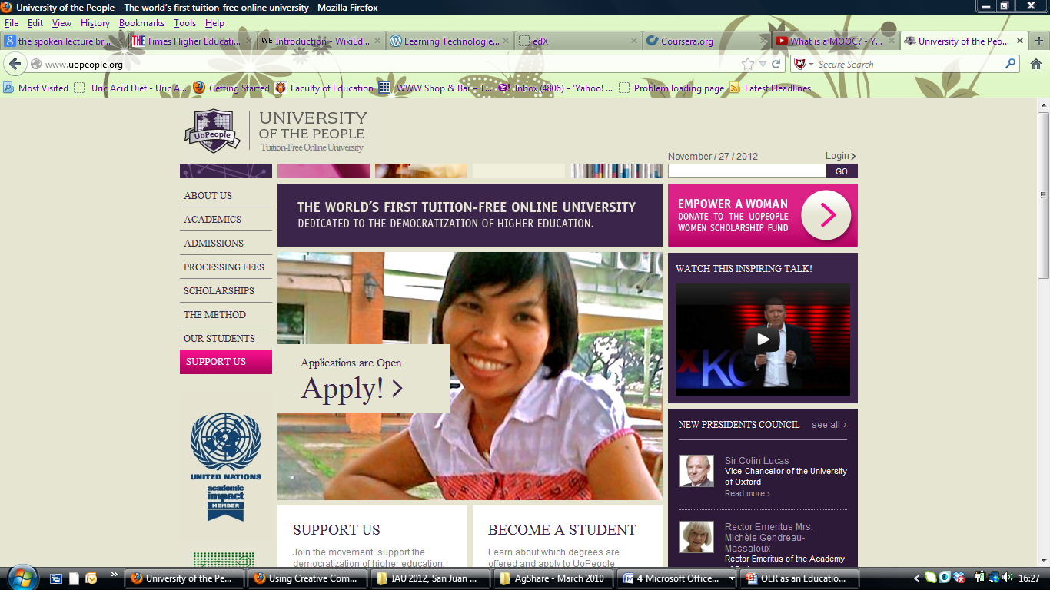
Notes:
Increasing the role of peer mentoring and support

Slide 51
The Potential of OER
With tools that are already available, e.g. open office and Moodle, there are almost limitless opportunities to design high quality teaching and learning environments…
See A Basic Guide to OER on the Commonwealth of Learning website.
Notes:
http://www.col.org/resources/publications/Pages/detail.aspx?PID=357

Slide 52
How can we use OER?
As with research, look for what already exists and see how we can add value: adopt, adapt, create?
Employ same level of rigour as in selection of traditional resources – source, fitness for purpose, contemporariness, accessibility, licence …

Slide 53
But
It’s not just about INFORMATION literacy
It’s about PEDAGOGIC literacy
How does the resource teach?
How will the resource fit into the way that you teach in your course?
What are the underlying assumptions about how learning takes place?
Or possibly another question
What challenge to your teaching approach is offered in the resource?

Slide 54
Possibilities include
Mixing and remixing
Adapting/ localising
Translating
Extracting
Re-using/re-purposing
Re-curriculating
“Mobilising”

Slide 55
More about OER
https://oerknowledgecloud.com/
Notes:
Source: McGreal, R. 2013. Contact North OER Workshop. Collège Boréal, November 19, 2013.

Slide 56
NADEOSA
Nadeosa creates a forum for a community of practice
Comprises institutions and individuals
Key achievements:
Hosted 2nd pan-commonwealth forum on open-learning 2002
Published criteria, guidelines and case studies for quality ODL 2005, +2012/3
Members contribute to and comment on policy incorporating strong drive towards mainstreaming OER and strengthening ODL provision generally by, for example, online discussion and face-to-face colloquia
OER can support both more open campus-based provision as well as ODeL
www.nadeosa.org.za

Slide 57
Examples of OER for ODeL
Notice the differences between open textbooks and open distance education learning resources …

Slide 58
Thank you
This work is licensed under a Creative Commons Attribution 4.0 License
Citation:
Mays, T. & Ngugi, C, 2014. Open Educational Resources for Activity-based Distance Provision. Daystar, Nairobi: OER Africa/Saide
Tony Mays
Senior Education Officer
tonym@saide.org.za
Catherine Ngugi
OER Africa Project Director
catherine.ngugi@oerafrica.org

