Slide 1
OER Powered by AI
Mitja Jermol
UNESCO Chair in Open Technologies for Open Educational Resources and Open Learning
Jozef Stefan Institute , Slovenia

Slide 2
Open Educational Resources
Various isolated sites
Different modalities
Various formats
Language diversity
Unresolved rights
Dead links
Undescribed modes of use
Different levels of quality
Source: Hewlett Foundation

Slide 3
Some AI technologies related to OER
Content gathering, cleaning and structuring
  Independent on modality, language, alphabet
Automatic translation and cultural adaptation
Contextualisation and adaptation to personal needs and preferences
Learning analytics and user modelling
Content understanding
AI teacher
  Crowd learning
  Micro and in-context learning

Slide 4
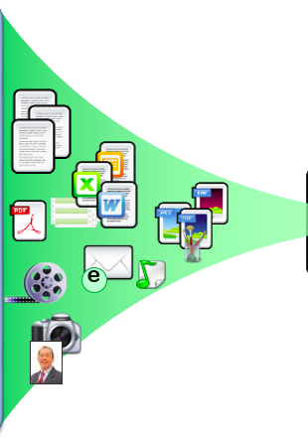
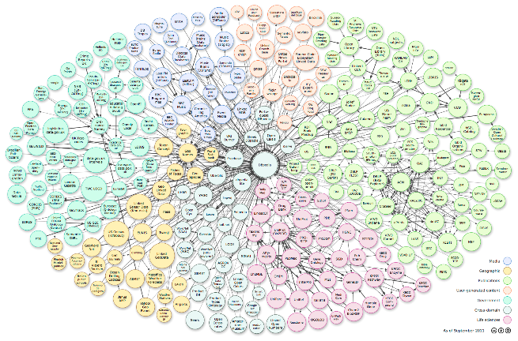
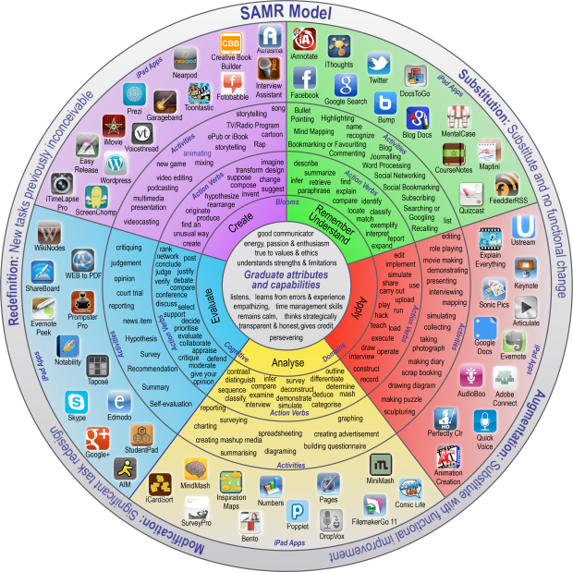
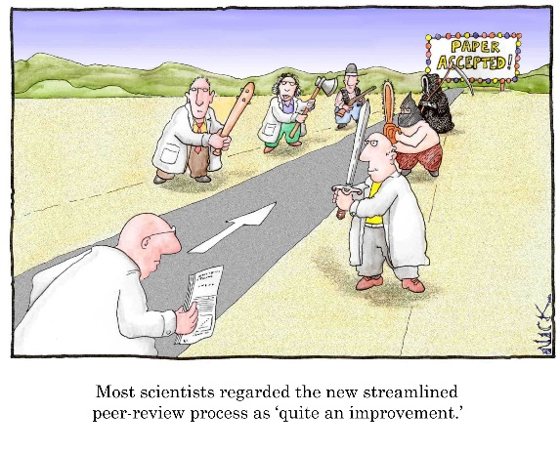
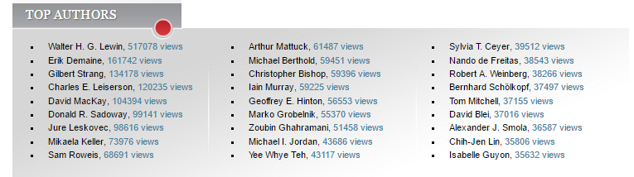
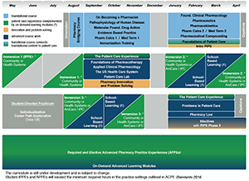
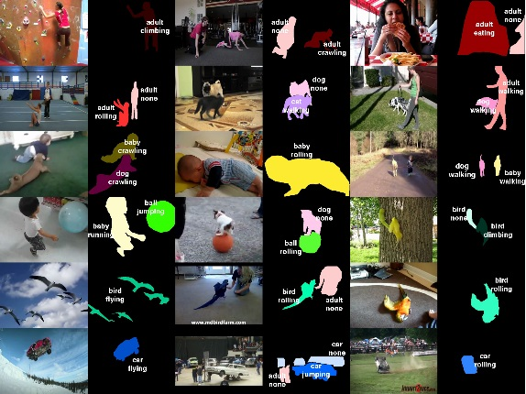
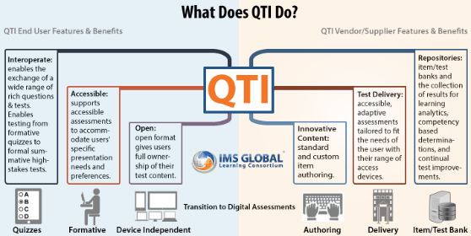
Learning resources open pipeline
Automatic ingestion, cleaning, fusion, preprocessing
Cross-lingual, cross-modal
Semantic processing
Resources quality processing
Didactic design and pedagogical processing
Innovation
Research

Slide 5
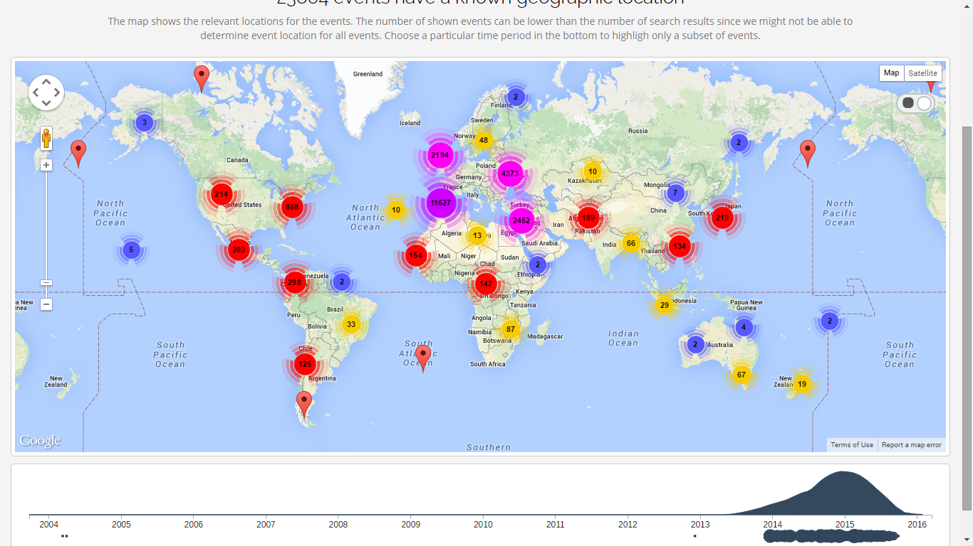
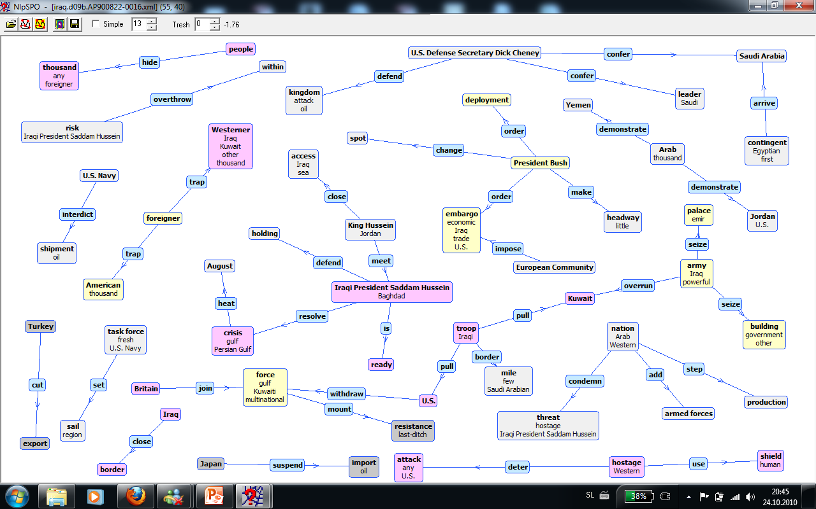
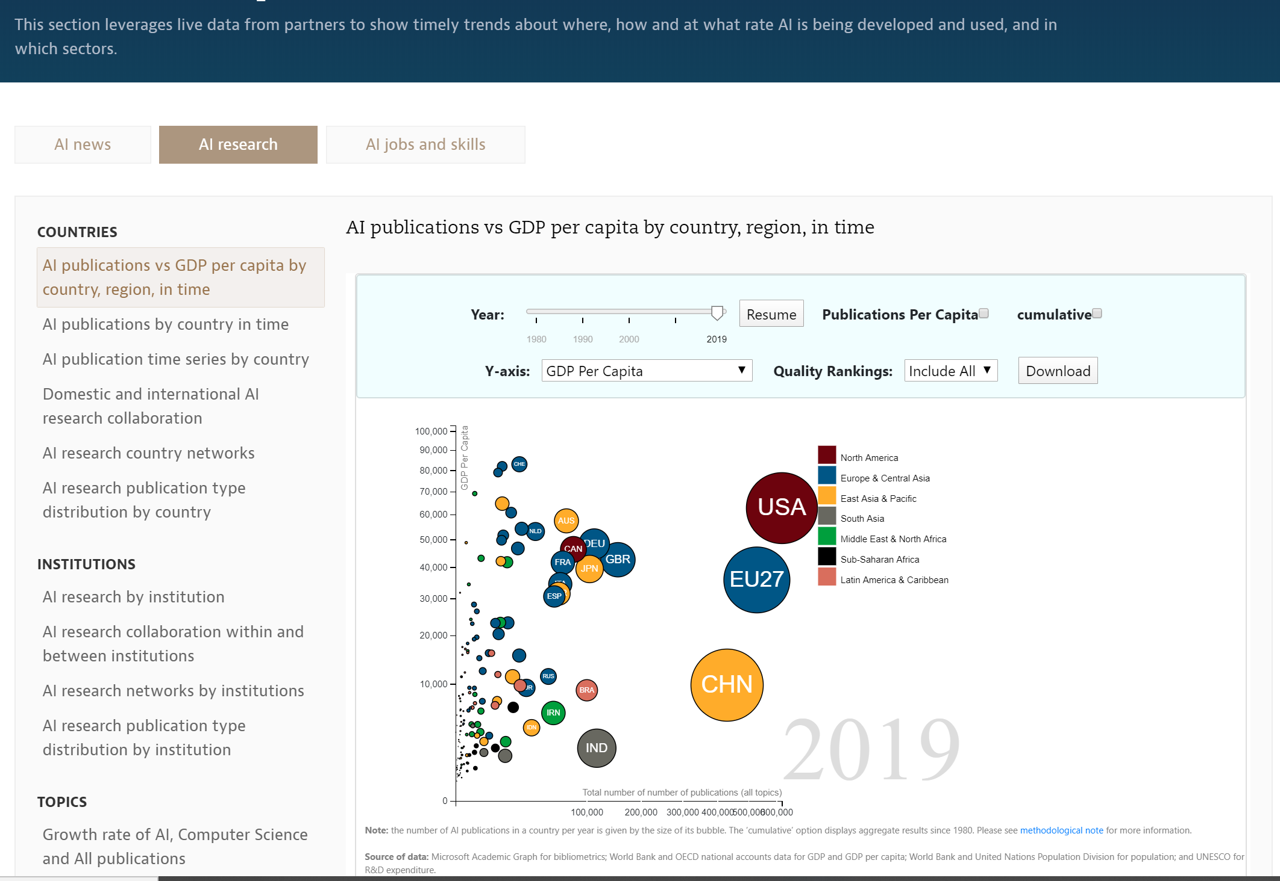
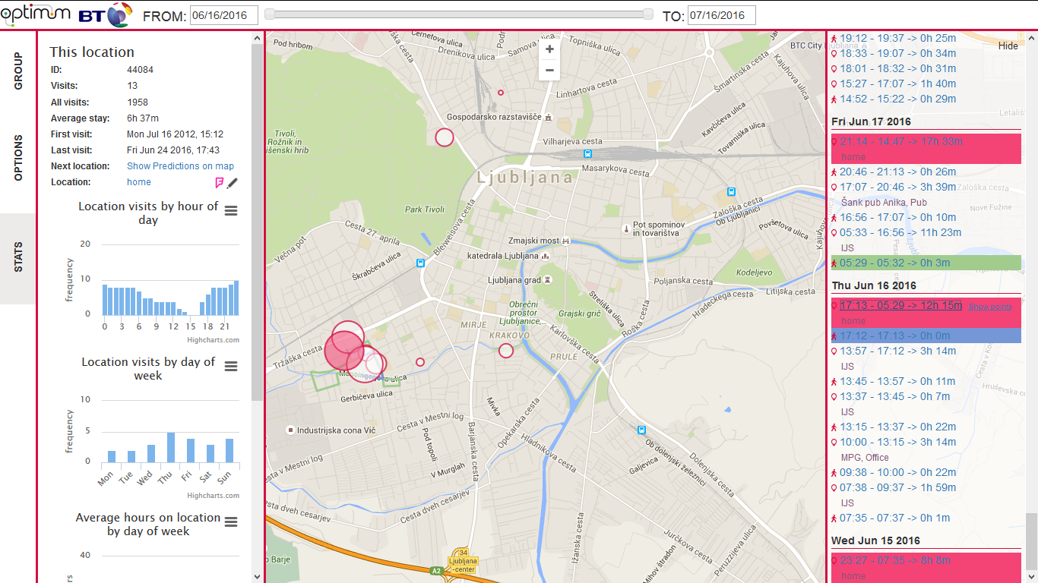
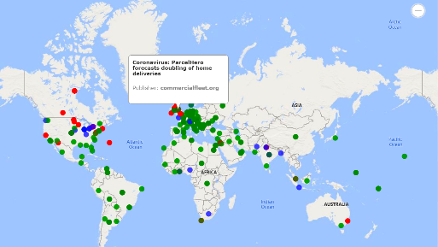
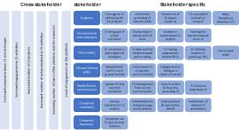


Global Education Situational Awareness
Infrastructure
OER
Global Education
Observatory
Global Education
Simulator
Global Education Adviser
Applications
Organisation Models
Value Models
Rules
External related data
i.e. coronaviruswatch.ircai.org
Policies
Data, information collection
Monitoring and analytics
Predictions and simulations
Proposing and evaluating actions

Slide 6
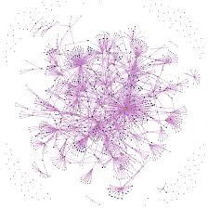



AI: Open knowledge vs open content
OPEN SOURCE AND OPEN KNOWLEDGE AI
Checking
WEB, IoT
Checking
Learning
Learning
Teaching
Learning

Slide 7
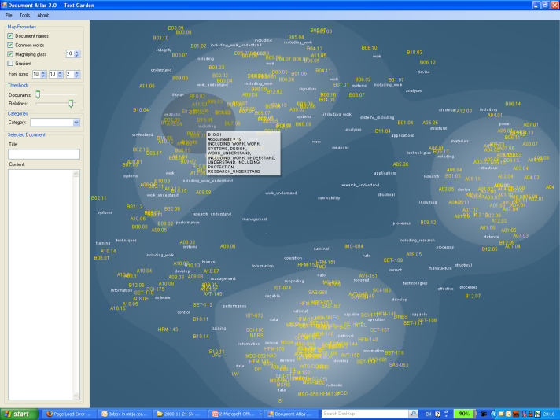


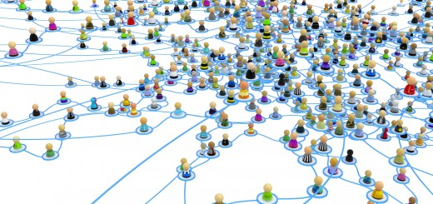

What if…
X5oerfeed
X5analytics
X5recommend
CurriousCat
TextGarden
Scienceatlas
JobAnalysis
Eventregistry
Chatboots
DocumentAtlas
Searchpoint
CareerPath
QMiner
Automatic ingestion, cleaning, fusion , structuring, preprocessing
User modelling and understanding,
social network modelling
Career path
Adaptive learning, education and social environment

Slide 8
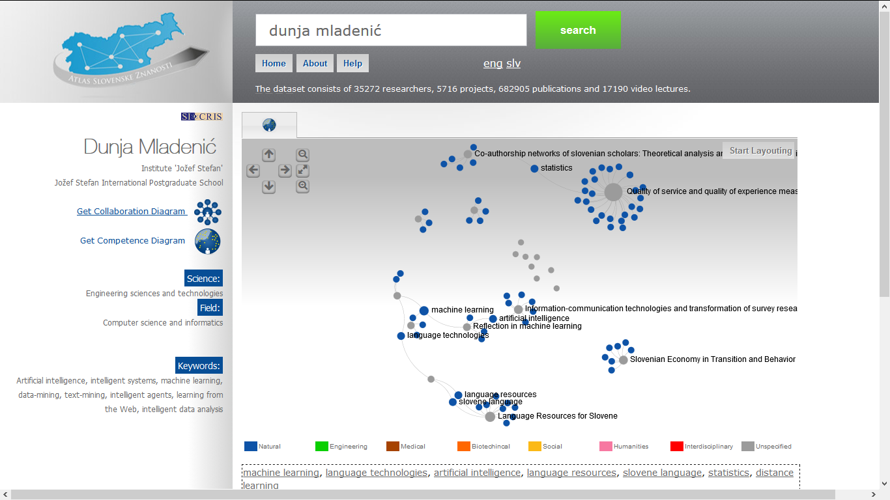
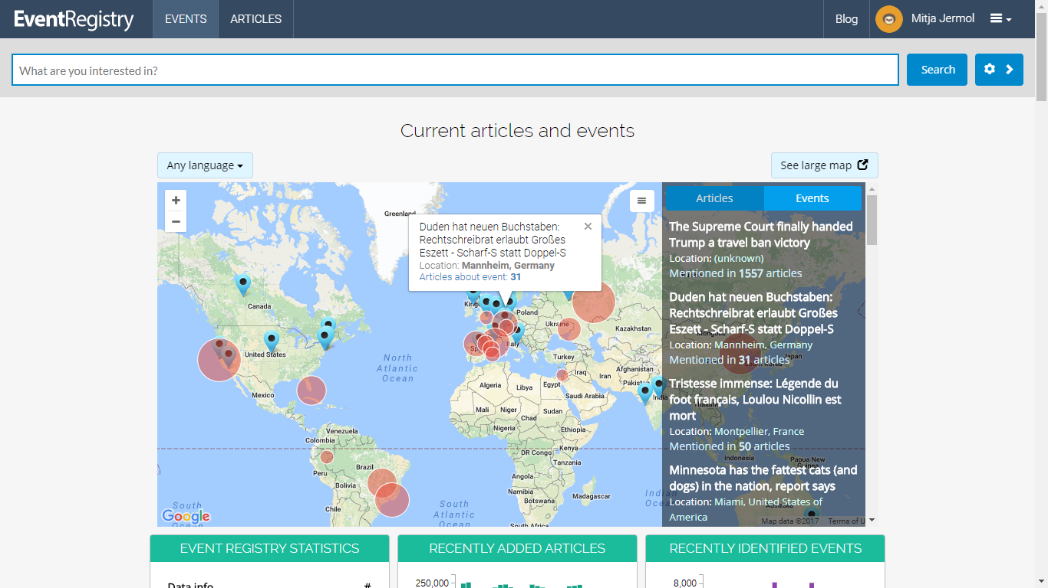
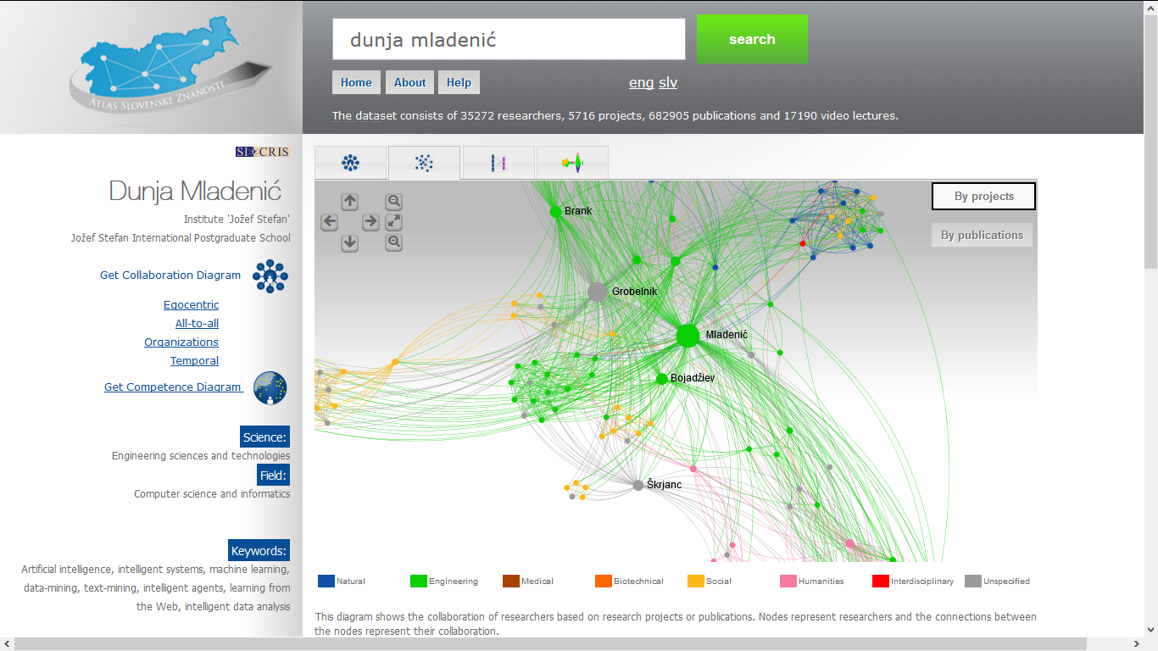
Competency calculation

Slide 9
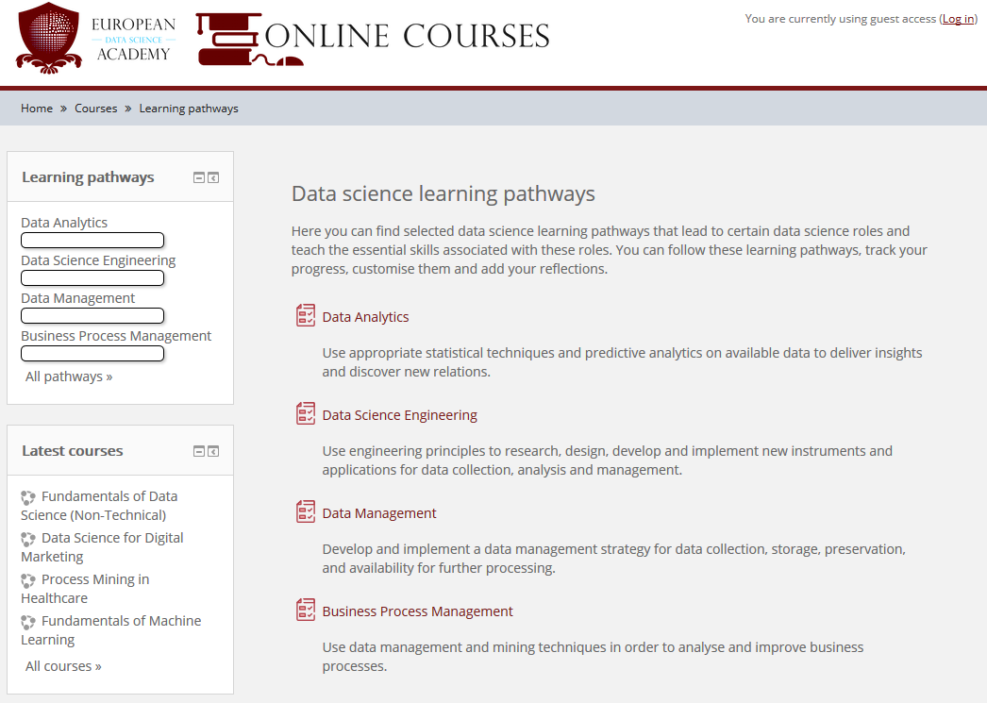
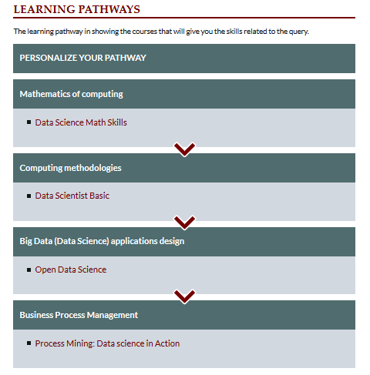
Learning Pathways
Learning Pathway – route recommended to a learner through a range of trainings provided and recommended by EDSA partners, which allows them to build knowledge progressively.

Slide 10
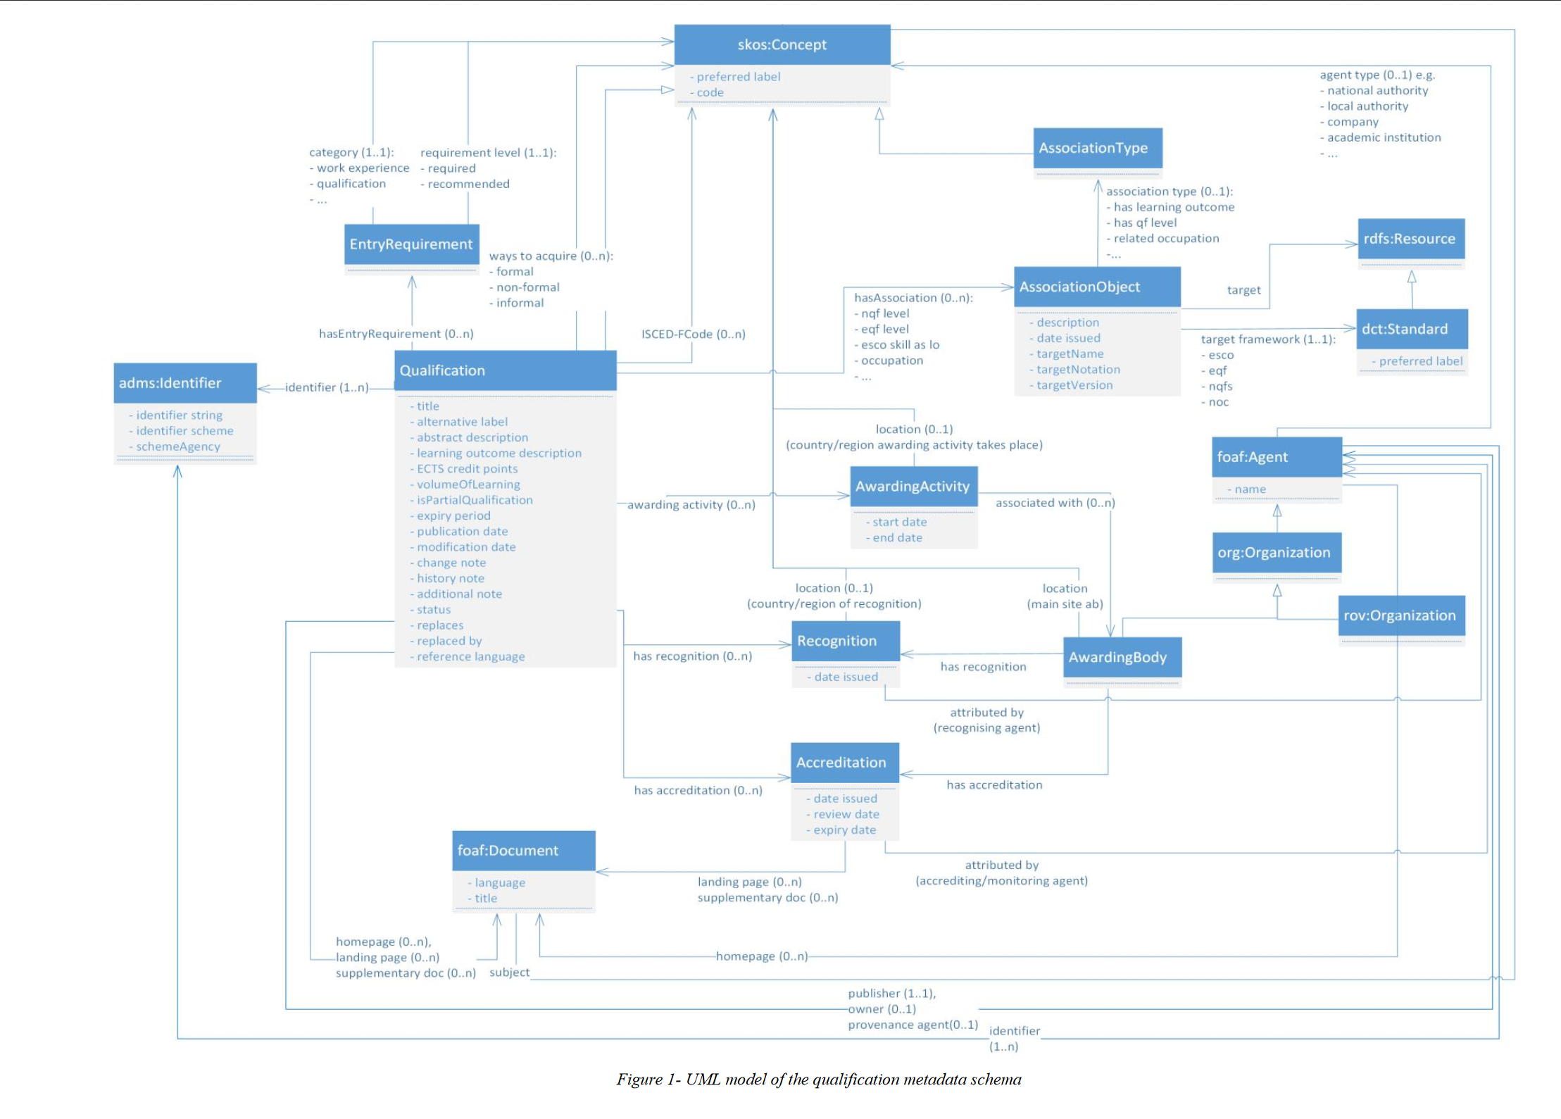
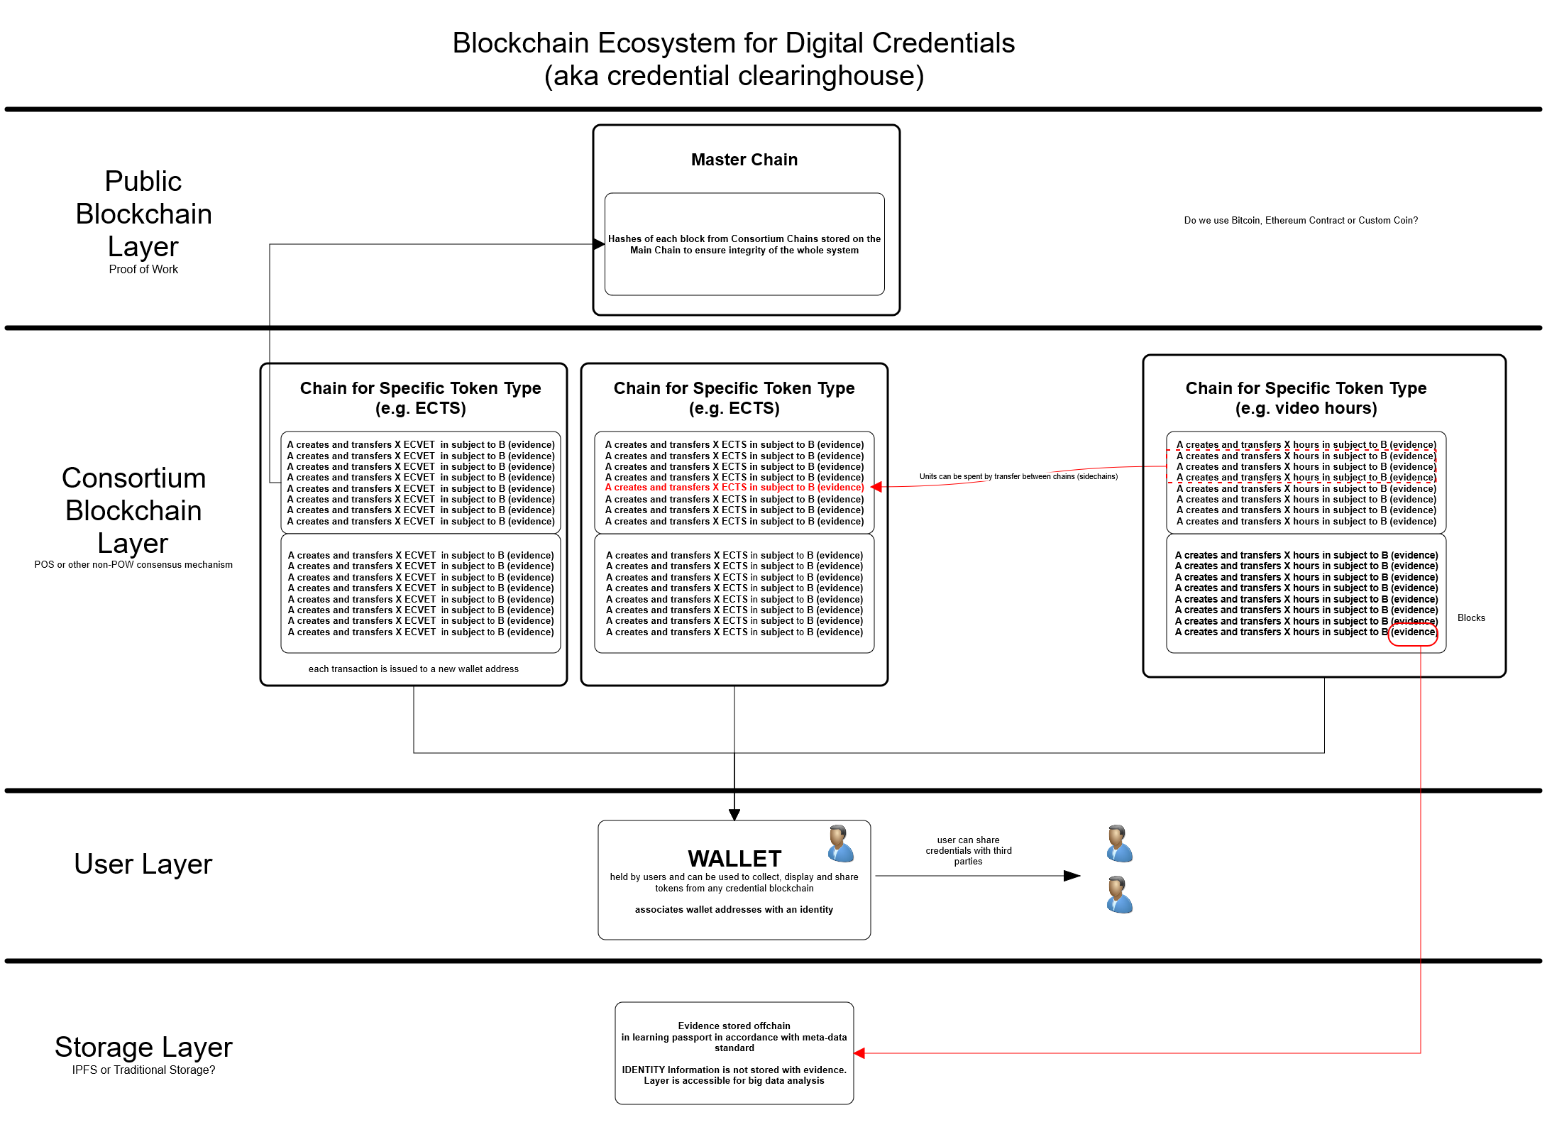
Micro-credentials and Qualifications
Projects (Blockchain):
https://0xcert.org/
https://ecta.io/
https://www.blockcerts.org/
https://www.myequals.net/
https://gledos.io/

Slide 11
Links and additional information
http://unesco.ijs.si
http://ailab.ijs.si
http://ircai.org
http://ct3.ijs.si
http://www.k4all.org
http://x5gon.org
https://microcredentials.eu/
https://credentify.eu/
http://eventregistry.org
http://videolectures.net
http://opencast.org/matterhorn/
http://scienceatlas.ijs.si
mitja.jermol@ijs.si

