Slide 1
ICT in Education

Slide 2

ICT in Education

Slide 3
ICT in Education
"ICT"is the Information and Communication Technologies.
"ICT in Education" means "Teaching and Learning with ICT".

Slide 4
ICT in Education
Main advantages of ICT tools for education
1‧ Through ICT, images can easily be used in teaching and improving the retentive memory of students.
2‧ Through ICT, teachers can easily explain complex instructions and ensure students' comprehension.
3‧ Through ICT, teachers are able to create interactive classes and make the lessons more enjoyable, which could improve student attendance and concentration.

Slide 5
ICT in Education
Main disadvantages of ICT tools for education 1‧ Setting up the devices can be very troublesome.
2‧ Too expensive to afford
3‧ Hard for teachers to use with a lack of experience using ICT tools

Slide 6
ICT in Education
In educational institutions (e.g., schools, high schools, universities.) and in work life, the question of how to utilize modern information and communication technologies for learning purposes is important. Altarawneh, 2011).
Technology-assisted learning tools is quickly changing the face of education, transitioning the classroom only learning environment to an online only or blended online learning experience.

Slide 7
ICT in Education
We have experienced how individuals, societies, even countries are benefit with the use of ICT in all aspects of the human life i.e socially, academically and others.
This is also supported by Karsenti, et al (2012) who argued, we must be concerned about ICT in education because it is clear that ICT will continue to significantly impact all societies worldwide, in all economic, social, and cultural domains.

Slide 8
ICT in Education
The use of ICT in teaching and learning is called e-learning.
Zhang et al (2004) defined e-learning as technology-based learning in which learning materials are delivered electronically to remote learners via a computer network

Slide 9
E-learning definitions
Elliott Masie
  “The use of technology to design, deliver, select, administer, support and extend learning“
Percepsys
  “Using a technological means (Internet/Intranet/Extranet) to access and manage learning that supports and enhances the knowledge of an individual”

Slide 10
Benefit of E-learning
ICT supports the facilitation process by providing infrastructure and material
learner-centered and self-paced, time and location flexibility, cost-effective for learners,
unlimited access to knowledge and archival capability
Technologies such as computer, internet, e-mail, mobile phones and others are used in flexible learning systems for delivery of courses, facilitation of access to resources, enhancing of interactions with students, and provision of feedback and support to students

Slide 11
Benefit of E-learning
ICT encourage communication and collaboration in science research activity, and in primary science education enable students to collect science information, interact with resource such as image, video and encourage communication and collaboration
Research shows that ICT in education can support delivery and access, student understanding knowledge creation and as a goal, enable students acquire the technical skills that they will be able to use in the workplace (Kozma R 2005).

Slide 12
Challenges of E-learning (According to different scholars
Insufficient prioritization of ICT in the implementation of educational and development policies
Inadequate infrastructure in regard to electricity, telecommunication especially in rural and remote areas
Insufficient numbers of qualified technical personnel to manage and maintain ICT resources
Inadequate training and capacity resulting in underutilization of ICT facilities

Slide 13
Challenges of E-learning (According to different scholars
Widespread view of ICT as a status symbol rather than a tool
Lack of awareness of the multifaceted range of ICTs and how they can be used to address existing challenges
Hierarchical and territorial organizational structures and cultures, and resistance to change
Insufficient financial resources to ensure the equitable and sustainable integration of ICT in education and at all levels

Slide 14
Challenges of E-learning
Lack of time (ICT integration is not prioritized in teaching practice, where the workload is already very heavy);
Hardware issues (lack of hardware, difficulty of access, obsolescence, defects, lack of adequate peripheral devices such as printers and scanners, too-slow or non-functioning Internet connections, etc.);
Technical difficulties (technical problems encountered when using technologies);
Absence or lack of technical support for ICT integration
Absence or lack of administrative support by the educational institution;

Slide 15
Challenges of E-learning
Class management problems that limit the potential for techno pedagogical innovations in the classroom;
Group size (too many students in the class for effective ICT integration)
Organizational constraints and barriers within the education system;
Absence or lack of relevant pedagogical materials

Slide 16
E-learning tools
Radio, Television
LMS eg MOODLE, BLACKBOARD
Dropbox
Google drive/Google docs/plus
OER
  You tube
  MOOCs – External LMS (Coursera, Udacity, Khan Academy, Edx)
  Wikipedia
Recording tools – eg Screencast –O-Matic, a tube catcher
Others

Slide 17
E-learning Organization
The evolution of e-learning in lower/higher education has gone through three major periods: the
  Traditional Institution;
  The Blended Institution; and
  Online Institution.

Slide 18
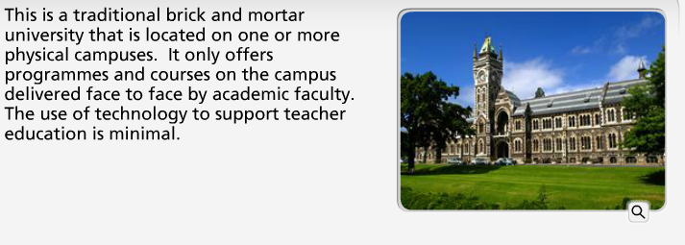
Traditional institution

Slide 19
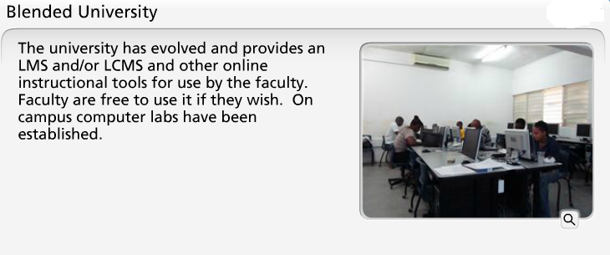
Blended Institution

Slide 20
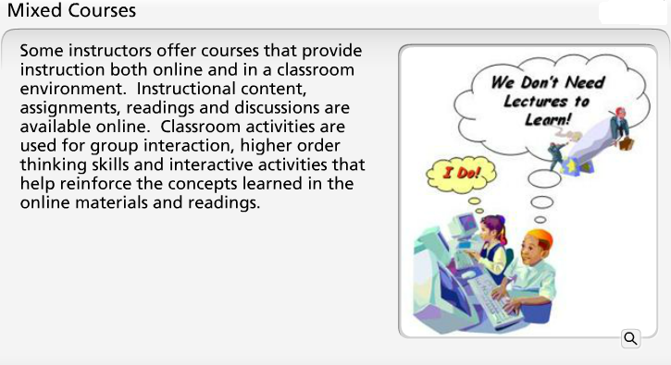
Cont…

Slide 21
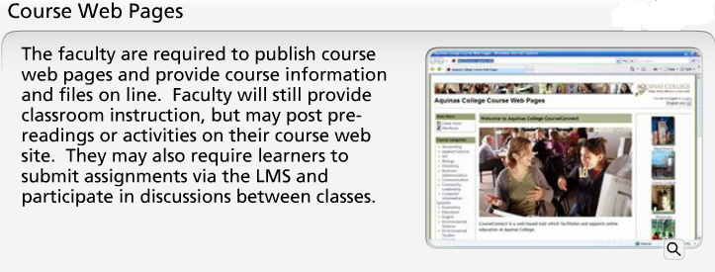
Cont…

Slide 22
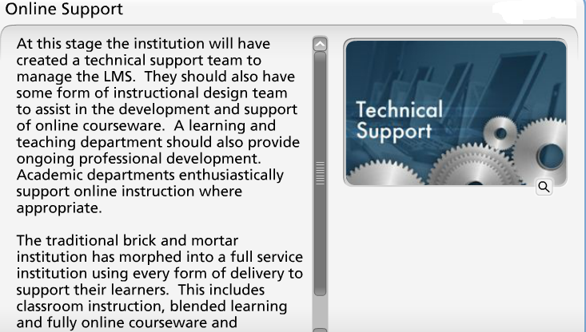
Online institution

Slide 23
MOODLE as an effective LMS

Slide 24
What is Moodle
Modular Object-Orientated Dynamic Learning Environment
Open Source under GNU Public Licence.
It is a learning management system that is designed to help instructors create an online classroom setting with opportunities for rich interaction and collaboration
Moodle can be used to supplement on ground courses or can be used to host completely online courses.

Slide 25
Features
Site Management
User Management
Course Management
Assignment Module
Chat Module
Quiz Modules
Forum Module
Resources (webpages, documents etc..)
Activites (assignment submission, wikis, discussion board, journals, blogs etc..)
Many other custom modules created by Moodle users.

Slide 26
OER
Open educational resources (OER) are freely accessible, openly licensed documents and media that are useful for teaching, learning, and assessing as well as for research purposes
    MOOCs (Coursera, Khanacademy, ..etc)
    You tube
    Wikipedia
    E-book
    Other sources

Slide 27
List of OER
S/N | Website | Themes, Discipline
1. | http://www.scoop.it
2. | https://www.oercommons.org
3. | http://www.jorum.ac.uk
4. | http://www.temoa.info
5. | http://xpert.nottingham.ac.uk
6. | http://edtechpost.wikispaces.com/OER+Dynamic+Search+Engine
7. | http://www.jiscdigitalmedia.ac.uk/guide/finding-video-audio-and-images-online/#creative-commons
8. | https://open4us.org/find-oer/
9. | http://oerconsortium.org/discipline-specific/
10. | https://jisc.ac.uk/guides/open-educational-resources
11. | http://ocw.mit.edu/index.htm
12. | http://languagebox.ac.uk/
13. | http://humbox.ac.uk/

Slide 28
Questions
Q & A

