Slide 1
Our context
We’re in a context of:
Knowns
Unknowns
Unknown unknowns
Universities are a “thousand year old industry on the cusp of profound change”. (Australian study)
“Over the next ten-15 years, the current public university model … will prove unviable in all but a few cases” (Craig Blewett, 2016).
Notes:
We don’t even know what we don’t know. American politician : Donald Rumsfeld

Slide 2
Digital Promise: and the challenge of knowing what to do
“ … information and the infrastructure through which it flows represent not only power, but a new kind of economic and social force.” But:
“Intellectually, socially and legislatively, we are lagging years, if not decades, behind the facts of the present.”
(Chatfield, M. 2012. How to thrive in the digital age. Macmillan; London. p. 4.)

Slide 3
So what do we do?
Survival strategies of cost cutting, freezing posts etc? OR
Strategies to survive and thrive that also enable us contribute to society?
Premise of my argument here: The survivor/ thrivers and the contributors will be those who offer the most accessible, most flexible quality learning programmes in an OER/ Open Access environment. It’s all about facilitating and supporting student learning.
This is in line with OER Africa strategy “which will, over the next five years, seek to promote a model for harnessing OER to improve both the content and the delivery of higher education.” (Grant proposal, June 2014,p.2.)
Notes:
Much prefer to Grant Proposal idea to the grandiose and elusive ‘pedagogical transformation’

Slide 4
In practical terms, what does this argument mean?
Grappling with an understanding of pedagogy
Institutions, departments and individual academics use their understanding of pedagogy to improve content delivery across all programmes.
Notes:
Understanding first; applying understandings second

Slide 5
Grappling with pedagogy: Base 1
utilizing the opportunities afforded by OER and Open Access
Using high quality, thoughtfully designed peer reviewed multi-media learning resources that students can access at low cost; and that students use to take control of their own learning in ways that best suit their personal circumstances, and at their own pace.
Notes:
Just having access to the material is huge

Slide 6
Base 2:
Linking pedagogy with Knowledge
Knowledge
Production: Research
Knowledge Recontextualisation
Curriculum committees; Faculty Board; Rules Committee; Senate; Learning materials (OER?)
Knowledge Reproduction
Teaching in the classroom or through various modes of delivery
Notes:
Knowledge is recontextualised at a number of levels. Recontextualisation involves a selection of knowledge. Reason for colours – increasing uncertainties!

Slide 7
AgShare: an example of blending Knowledge Production, Recontextualisation, Reproduction
1. Students and supervisors carry out field-based research into farmers’ practices and needs
2. Student research is published in three ways:
  (a) as OER multimedia learning packages for incorporation into degree programmes;
  (b) as information for farmers that is used for follow-up visits and extension materials;
  (c) as research in masters’ and PhD theses
  (d) some research is reported at conferences and in scholarly journals.
3. The OER are published in appropriate formats and widely disseminated.
In integrating knowledge production, recontextualisation and reproduction (and having the same people involved) prospects for quality pedagogy are improved - immeasurably.
Notes:
Red might become a less threatening amber. In integrating knowledge production, recontextualisation and reproduction, the university achieves its mission of teaching, research and community service.

Slide 8
Grappling with pedagogy: Base 3
Knowledge structures within our own disciplines and fields
An idea of generic pedagogic principles can take us only so far because each of our disciplines or fields has its own unique concepts and ways testing its own ‘truths’, e.g.
Sciences: gravity, acceleration, hydrogen and photo-synthesis
Mathematics: number, patterns and relations, shape and space
Religion: God, sin, salvation
History: empathy and evidence to develop explanations of cause and effect
Some disciplines are hierarchical: they have vertical knowledge structures that require a particular kind of sequencing, and teaching approaches reliant on Conceptual Coherence
Others (including professional fields) have more horizontal knowledge structures that call for Contextual Coherence.
Notes:
Gravity and salvation ??? Differences across disciplines are evident in the growing number of publications in, for example, Mathematics education, Engineering education, History education etc. It’s no longer just the pure disciplinary stuff.
Like a Russian doll: big enclosing fact is OER/ open access learning materials; inside that, how the university links pedagogy with research and its central task of knowledge production, recontextualisation, reproduction

Slide 9
Conclusion
If there are universal truths about good pedagogy, trust between teachers and learners is surely one of them. But pedagogy must be more thoughtful than ambiguous, politically correct terms like “learner centred” and “activity based”. (“For any complex problem, there is an answer that is clear, simple and wrong” HL Mencken).
We offer a variety of programmes with their own unique concepts. We also operate in very different contexts; our universities each have their unique features, cultures and challenges.
We need to develop and implement our own pedagogies to survive and thrive, and to contribute meaningfully to society.

Slide 10
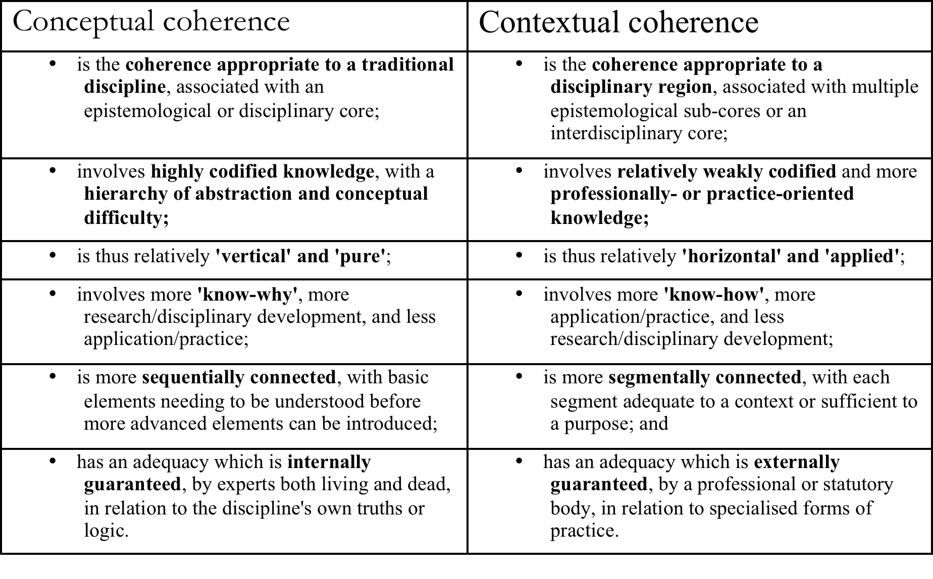
In case needed …....

