Slide 1
OER Online Consultation – WG2 - Policy
Dra. María Soledad Ramírez Montoya
Profesora investigadora
Escuela de Humanidades y Educación
Tecnológico de Monterrey
http://sitios.itesm.mx/eehcs/msramirez.htm
Conexión Zoom: https://itesm.zoom.us/j/837814255
Cátedras UNESCO e ICDE:
Movimiento educativo abierto para América Latina
https://oerunesco.tec.mx/
Dr. Jane-Frances Obiageli AGBU
Associate Professor of Clinical Psychology & ICDE Chair in Open Educational Resources (OER)
Director, Wuse 11 Study Centre
National Open University of Nigeria
5 Dar-Es Salaam Street, off Aminu Kano Crescent, Wuse 11
Abuja, Nigeria
oagbu@noun.edu.ng; agbujane2005@yahoo.com
+2348033215030

Slide 2
MEETING OBJECTIVES
2) Identify activities and issues relating to electronic tool s for development and sustenance of supportive policy for OER
1) Further clarifications of priority areas of action (draw recommendations from online surveys to determine priority areas of action)

Slide 3
Area of Action 2: Developing Supportive Policy for OER (Recommendations)
(a) developing and implementing policies and/or regulatory frameworks which encourage that educational resources developed with public funds be openly licensed or dedicated to the public domain as appropriate, and financial and human resources coordinated for the implementation of the policies;
(b) encouraging and supporting institutions to develop or update legal or policy frameworks to stimulate the creation, access, use, adaptation and redistribution of quality OER by educators and learners; and to develop and integrate quality assurance mechanism for OER into the existing quality assurance strategies for teaching and learning materials;
(c) developing mechanisms to support and incentivize all stakeholders to publish source files and accessible OER using standard open file formats in public repositories;
(d) aligning OER policies with other open policies and guiding principles such as those for Open Access, Open Data, Open Pedagogy, Open Source Software and Open Science; and
(e) adjusting or reforming the curriculum and assessment in accordance with the needs of the use of OER and to motivate the active use, creation, and sharing of OER by teachers and students; and recognizing the learning outcomes of OER-based programmes of study.
Member States are encouraged to consider the following:

Slide 4
Synthesis of the Survey – March 2020 (100 experts from 28 countries)
High level dialogue (Ministers, Directors) on the benefits of supporting OER policy should be encouraged across regions
Awareness on UNESCO-OER Recommendations should be sustained across regions
Periodic interactive regional and inter-regional forum on education should endevour highlight the role of OERs to the attainment of the SDGs
OER policies should be aligned with the prevailing educational, copyright, publishing, IP policies.
Regional and inter-regional government should develop and regulate frameworks that encourage embedding open-licensing in public-funded educational materials
Advisory support in the development of open policies should be established.
Sharing of experiences and documents on OER at regional and inter-regional levels should be sustained.
A portal to share documents should be initiated across regions should be maintained
Collaboration with commercial publishers in OER is needed
Allignment of OER policy with open data is needed
Review and revision of existing policies and recommendations to remove barriers to OER

Slide 5
Synthesis of the Survey – March 2020 (100 experts from 28 countries)
12. Educational institutions across regions should enable policies that encourages recognition for OER creators and users
13. Encourage collaborative platforms to enable regions identify gaps, offer or share alternative solutions to embracing OERs.
14. Regions should encourage and support institutions to develop legal frameworks to stimulate OER activities
15. Guidelines detailing quality assurance measures should be part of OER creation and update regionally and nationally.
16. Research networks in OER and open education should be encouraged across and within regions with corresponding policy guidelines
17. Continuous support and capacity building among the UNESCO member states to develop OER policies to address the existing issues in their education system should be encouraged.
18. Regional and inter-regional collaboration mechanisms towards inclusion of OER transforming education, adjusting or reforming curricula and all form of learning so as to exploit OER potential and opportunities should be encouraged.
19. Encourage and support institutions to develop or update legal or policy frameworks to stimulate the creation, access, re-use, repurpose, adaptation and redistribution of quality OER by educators and learners in a manner consistent with national copyright legislation and international obligations
20 Develop and integrate a quality assurance mechanism for OER into the existing quality assurance strategies for teaching and learning materials
21. Encourage research in OER
22. Annual meeting with donors and potential donors should be encouraged

Slide 6
The Roadmap - (From the Survey)
Identification and sharing of information on and support of:
Development and implementation of institutional policies (both stand-alone and integrated)
Aligning OER related policies to Open education, OA and prevailing IP policies
Regional and inter-regional frameworks that encourage embedding open licensing to public-funded educational materials
Mechanism and tools to share best practices in policy issues inter-and-intra-regionally
Encourage International multilateral frameworks that reinforce open access to information, data and transparency in education
Encourage collaborative mechanisms to:
Develop and implement tools to support copyright and IP policies and laws
Collectively develop templates based on analysis of good practices
Encourage development of policies that recognize OER users and creators
Encourage and develop policies that stimulate creation, access, re-use, repurpose, adaptation and redistribution of quality OERs by educators and learners
Develop and integrate policies that identify and address barriers for OER integration in education
Research – Establish research networks to provide evidence base to/for policy development in OER

Slide 7
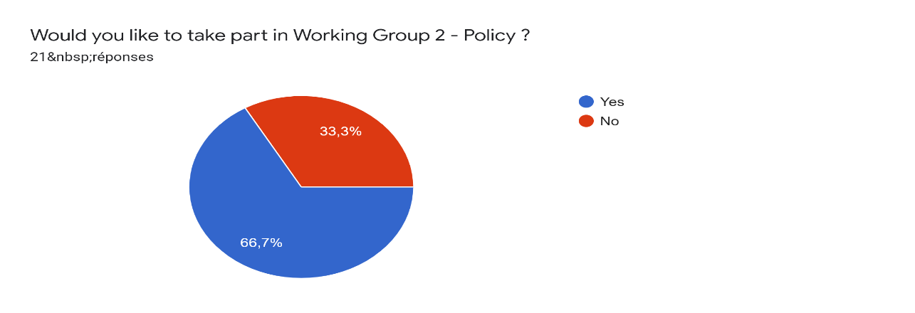
Further clarification of priority areas July 2020

Slide 8
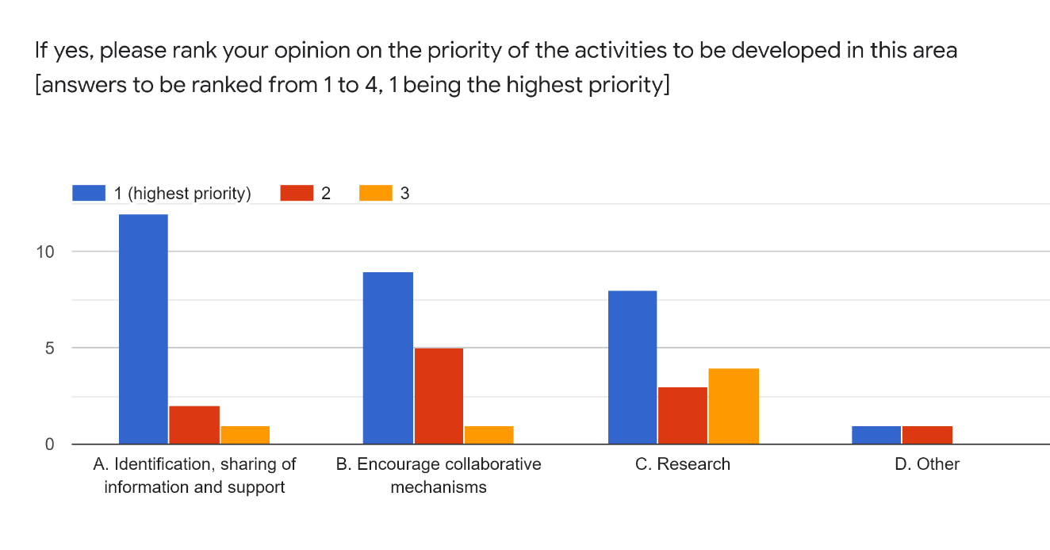
Further clarification of priority areas
If you have chosen 'Other' above please elaborate
Create good practices in OE and Openness policy

Slide 9
Question
Any other area of action to be addressed as priority in future work for policy recommendation?

Slide 10
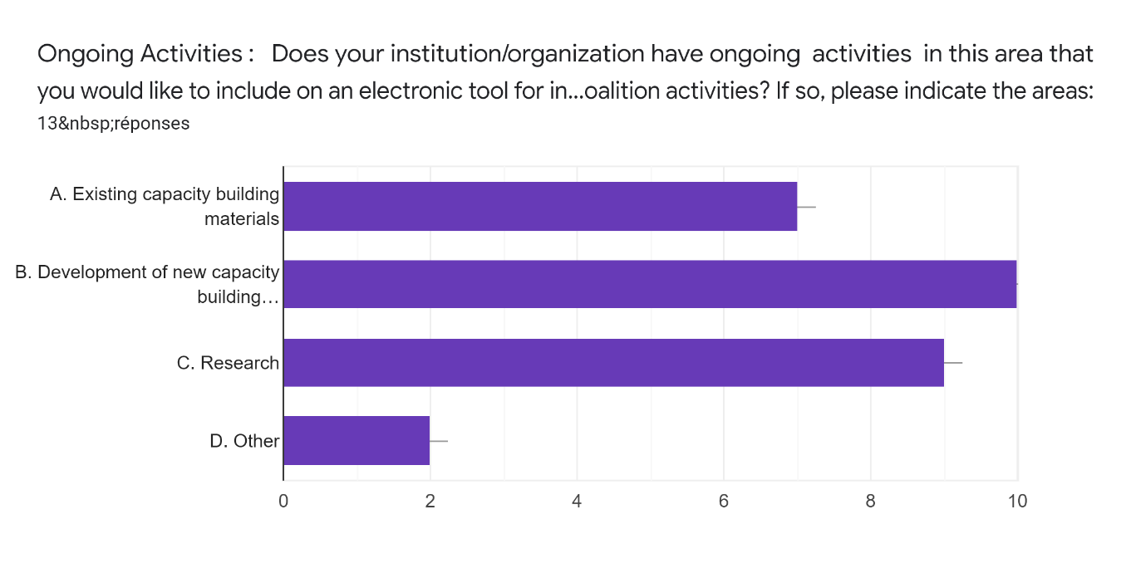
Further clarification of priority areas - Electronic tools

Slide 11
Electronic tools/Collaborations
Open Government Partnership | https://www.opengovpartnership.org/
OER World Map | https://oerworldmap.org/
Open Education Policy Network | https://oerpolicy.eu/oe-policy-forum/
Oasis COLs Open Access Repository/Institutional OER Policy Template | http://oasis.col.org/ http://oasis.col.org/handle/11599/2361 https://www.thecommonwealth-educationhub.net/oer%20-
ICDE | https://www.icde.org/ https://www.icde.org/knowledge-hub/icde-oer-advocacy-committee https://www.icde.org/knowledge-hub/icde-chairs-in-oer
SNEP | http://snep.edu.uy/grupo-de-trabajo-sobre-educacion-abierta-en-la-educacion-publica/
Open Education Policy Lab | http://education.okfn.org/projects/open-education-policy-lab/
OER Policy Development Toolkit | https://policy.lumenlearning.com/

Slide 12
Electronic tools/Collaborations
Global Reading Network | https://www.globalreadingnetwork.net/resources/open-licensing-primary-grade-reading-materials
OpenEd Consult | http://www.openedconsult.nl/en/portfolio-competences
OER Info | https://open-educational-resources.de/
European Inst. for Learning, Innovation and Cooperation | http://elc-institute.com/
The International Community for Open Research and Education | http://icore-online.org/
Opening Up Education by Learning Innovations | http://opening-up.education/
Learn STEM | https://ou.edia.nl/courses/course-v1:OUNL+LearnSTEM+2020/about
Zenodo | https://zenodo.org/record/3903175#.XxhDGyhKjIU
Hivos | https://www.hivos.org/what-we-do/

Slide 13
Electronic Tools/Collaborations
Open Education Global:
Many of the activities related to OE/OER Policy making are done in collaboration/through partnerships with other organizations and also through the work of Open Education Global members.
1. Activities of Open Education Global: Open Education Global annual conference https://conference.oeglobal.org/2020/
2. Relevant Activities done in partnerships/collaborations with other organizations:
  Open Education Policy Forum https://oerpolicy.eu/oe-policy-forum/
  OER World Map/OE Policy Hub: https://oepolicyhub.netlify.app/
  Global OER Graduate Network: http://go-gn.net/
  Open Education for a Better World: http://oe4bw.ijs.si/

Slide 14
Electronic Tools/Collaborations/Capacity Building
Creative commons ready to help to create model open policies for all kinds of education policy including but not limited to:
  Open licensing and sharing policies on publicly funded educational resources
  Open licensing and sharing policies on publicly funded research resources
  Promotion and tenure policy that supports instructors who openly license and actively share their educational resources as OER
  ‘Legal open licensing training’ for Ministry/Departments of Education, Lawyers, etc

Slide 15
Question
Thinking about platform…
What are the user’s needs for electronic tool for Policy in OER
Who would use it?
How?
What functionalities are necessary for sharing of information

