Slide 1

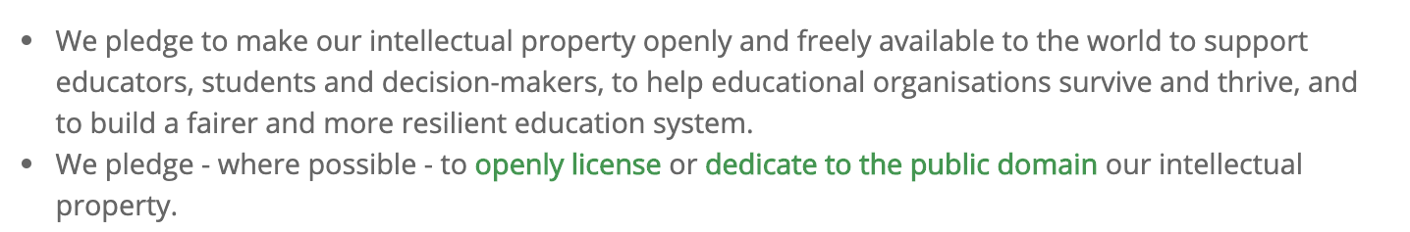
Inspired by CC’s ‘Open Covid Pledge’ to share knowledge and know-how for the global pandemic response
Responds to the UNESCO Recommendation on OER (2019)
Builds on broader Open Education values of the Capetown Declaration
http://bit.ly/OpenCovid4Ed

Slide 2
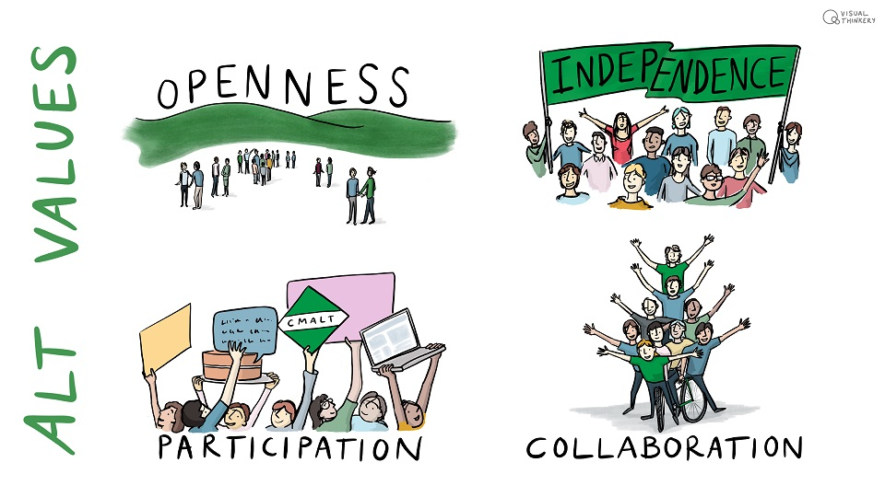
Hosted by the Association for Learning Technology in the UK…
http://bit.ly/OpenCovid4Ed

Slide 3

Signed by open educators around the world
http://bit.ly/OpenCovid4Ed

Slide 4
Why ‘Open Covid ’?
The common purpose and shared human experience of Covid-19 makes ‘open’ more meaningful than ever
  the important problems are common problems
  collaborative development is faster
  knowledge spreads and is acted on rapidly in open networks
Organisations are seeing the case for open
  put more minds to work to solve the problems
  prove the value of our contribution
Opportunities for radical rethink of values and processes
  ‘no return to business as usual’ is the mantra
  care of each other / shared humanity to the fore
  but many risks too…
#OpenCovid4Ed

Slide 5
Why ‘for Education’?
Public education is just as necessary as public health
  UNESCO report, Education in a post-Covid world (2020)
  “We are safe when everybody is safe; we flourish when everybody flourishes”
  We must save life chances as well as lives
Consensus around the world that a good society means
  old & vulnerable ppl are safe from harm
  young ppl continue to learn and flourish
But ambivalence about the ‘online pivot’
  How to get past the headlines and hero/villain narratives?
  Listen, share and understand
  From ‘online pivot’ to ‘open pivot’?
#OpenCovid4Ed

Slide 6
What is shared?
We ask signatories to commit to sharing:
Open Educational Resources (OERs) for educators, to support teaching and learning in pandemic times
Practice and policy lessons: how you/your organisation are responding and what you are learning
We also encourage sharing of:
Open data e.g. from surveys
Open access research
Unpublished research, organisational research, action research
Open source applications to support open education
#OpenCovid4Ed

Slide 7
How can I get involved?
Who is involved?
Open Education bodies, professional organisations
Universities and university departments, research centres
Individual researchers and open educators, UNESCO Chairs, Professors, Heads of Department…
How can I get involved?
Sign the pledge as an individual or organisation
Upload your logo (there is guidance about this)
Blog about why, and share using #OpenCovid4Ed
Join the discussion list OPEN-COVID-ED@jiscmail.ac.uk
Spread the word with our twitter handle and hashtag
http://bit.ly/OpenCovid4Ed

