Slide 1

OUT OER
Institutional Analysis workshop
OUT, 24 November 2014

Slide 2

Workshop Objectives
1. build a deepened understanding of how OER practices can support transformation of teaching and learning
2. ensure that such accumulating understanding is widely shared and incorporated into policy and advocacy
Notes:
Over the past six years, OER Africa has sought to respond to a growing urgency to meet the demands of students (and faculty) for improved pedagogical content and practice on the one hand and, the demands of African societies for competent higher education graduates on the other. In this next phase OER Africa will take the innovative approach of integrating a Participatory Action Research (PAR) agenda into each of our institutional engagements. We believe that more focused interactions will facilitate a collaborative agenda and will therefore support four carefully selected institutional partners to:
build a deepened understanding of how OER practices can support transformation of teaching and learning
ensure that such accumulating understanding is widely shared and incorporated into policy and advocacy
OER Africa believes that hands-on practice at institutional level will generate action-research and advocacy required to understand institutional transformation and the role of OER therein. Recognizing that extensive change in institutional practice is required to transform higher education provision in ways that overcome the challenges alluded to above, OER Africa will, over the next five years, seek to promote a model for harnessing OER to improve both the content and the delivery of higher education.

Slide 3
Thinking about
OER …
Brenda Mallinson
OER Institutional Analysis
Workshop
OUT, 24 November 2014

Slide 4
So what are OER?
Teaching, learning, and/or research resources ranging from assets to full programmes, that have been released under an
intellectual property license that permits their
free use or re-purposing by others.
OER include full courses, course materials, modules, textbooks, streaming videos, tests, software, and any other tools, materials, or techniques used to support access to knowledge. (adapted from: Atkins)
Notes:
OER are teaching, learning, and/or research resources (ranging from assets to full programmes) that have been released under an intellectual property license that permits their free use or re-purposing by others. OER include full courses, course materials, modules, textbooks, streaming videos, tests, software, and any other tools, materials, or techniques used to support access to knowledge. (adapted from: Atkins)

Slide 5
OER Definition:
“Open educational resources are educational materials and resources offered freely and openly for anyone to use and − under some licenses − to remix, improve and redistribute.”
Wikipedia: OER, http://en.wikipedia.org/wiki/Open_educational_resources
Notes:
as in the OER definition from wikipedia.
The key point here is that OER goes beyond just sharing materials. By openly licensing these materials it enables others to remix, repurpose, improve, and redistribute educational materials.

Slide 6
Free?
“Free use”
  Free as in no cost
  Free as in no permission required
AND/OR
Some can be “re-purposed”
  Adapted, translated, re-mixed…

Slide 7
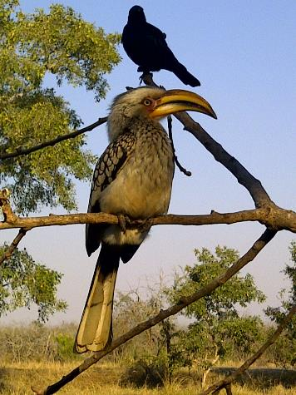
A resource …
Citation: Tony Mays 2011

Slide 8
An educational resource
What is the name of the bird in the foreground of the picture?
Can you name 3 other varieties of this kind of bird?
Can you use this resource?
Citation: Tony Mays 2011

Slide 9

An OER
What is the name of the bird in the foreground of the picture?
Can you name 3 other varieties of this kind of bird?
This work is licensed under a
Creative Commons Attribution 3.0 Unported License
Citation: Tony Mays 2011
Notes:
What can you do with it?

Slide 10
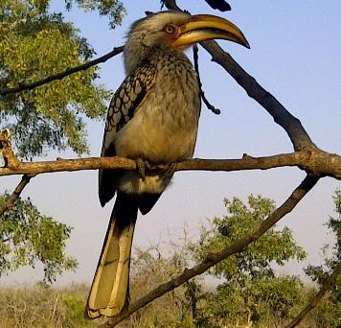
A remixed (adapted) OER
              The yellow hornbill shown left is one of four varieties of hornbills common across sub-Saharan Africa. The other varieties are the grey- and red- hornbills and the much larger ground hornbill.
              As the name suggests, the large horny bill is the key characteristic of the species. What does this suggest about their typical diet?
This work is licensed under a
Creative Commons Attribution 3.0 Unported License
Citation: John Doe 2012
Photo: Tony Mays 2011

Slide 11
What types of materials can be OER??
Classroom Materials: including lecture
presentations, reading lists, syllabi, etc.
Websites
Videos
Image Collections
Software
Textbooks
Blog postings …
Notes:
OER are teaching, learning, and/or research resources (ranging from assets to full programmes) that have been released under an intellectual property license that permits their free use or re-purposing by others. OER include full courses, course materials, modules, textbooks, streaming videos, tests, software, and any other tools, materials, or techniques used to support access to knowledge. (adapted from: Atkins)

Slide 12
OER has the Potential to …
Increase availability of high quality, relevant and need-targeted learning materials;
Reduce the cost of accessing educational materials;
Allow adaptation of materials and possibly contribute to enabling learners to be active participants in educational processes;
Achieve collaborative partnership of people working in communities of practice, preferably across/within institutions;
Build capacity in African higher education institutions by providing educators with access, at low or no cost, to the tools and content required to produce high quality educational materials.

Slide 13
What is the difference between Open Courseware and OER?
OCW focuses on sharing open content that is developed specifically to instruct a course
OER includes any educational content that is shared under an open license, whether or not it is a part of a course
Notes:
So, OCW is generally packaged and presented as a course. OER can be a course, or can also be just a presentation or a paper or a bibliography or a website or an image collection. OER is any resource that is related to learning and has been openly licensed for others to share.

Slide 14
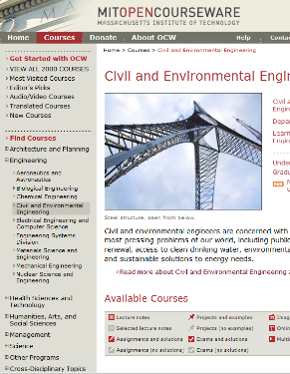
MIT Example
The flagship of the Hewlett Foundation OER investments is the MIT Open Courseware project. This project emerged from MIT faculty and administrators who asked themselves the following question:
“How is the Internet going to be used in education and what is our university going to do about it?”
The answer from the MIT faculty was this:
“Use it to provide free access to the primary materials for virtually all our courses. We are going to make our educational material available to students, faculty, and other learners, anywhere in the world, at any time,
for free.”
http://ocw.mit.edu/index.htm

Slide 15
Typical Life Cycle of an OER
Search & find OER
Compose
(Piece Together)
Adapt to Local Contexts
Produce a Learning Resource
Refine Learning Resource
Deploy and Use Resource
Share and make available for reuse

Slide 16
Challenges to Adoption
OER culture not established and academics / universities cling to IPR in the hope it might become revenue stream and policy environment sometimes reflect this.
Fear of a loss of ownership and/or branding.
OER Repositories are not comprehensive across all subjects nor unified into key sites.
Skill required in remixing & reworking materials for new context. Requires capacity development.
Not clear what resources are actually being used for. Therefore materials are not packaged for particular purposes.

Slide 17
Discussion Questions
To what extent should/could you adopt OER?
How might OER be used to enhance education?
What OER skills would need to inform capacity building needs of your staff?
Can OER be considered a cost effective way to develop new courses for the institution?
What needs to be done to ensure OER based courses are of sufficient quality?

Slide 18

Thank you!
This work is licensed under a
Creative Commons Attribution 4.0 Unported License
Adapted from work created by Tony Mays
Contact: tonym@saide.org.za
Adapted from: Enriching Scholarship, 6 May 2011
by Susan Topol, Kathleen Ludewig Omollo
Copyright © 2011 The Regents of the University of Michigan

