Slide 1
Overview of the discipline
Information technology (IT)
IT Education

Slide 2
A Short history of computing
Read chapter 1 of this book
“Basic Concepts of Information Technology (Brendan and Paul, 2001)”

Slide 3
Activity 1: Think – pair -share
Why should we teach technology in the schools?

Slide 4
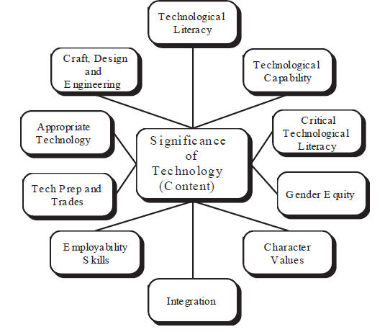
Justifying Technology Studies

Slide 5
Activity 2: Work in pairs, share to the whole classroom
What Information technology is
What are the challenges of teaching information technology in Schools?

Slide 6
Activity 3: Work in pairs, share to the whole classroom
Should the teaching of Information technology be different from the teaching of math, science and art? If yes – how; if not – why?

