Slide 1
OER Dynamic Coalition Working Group 3: Inclusive, Equitable Accessible, Quality OER

Slide 2
Objectives of this Online Consultation:
Identify/Determine priority areas and establish teams for the development of project proposals.
Identify information sharing on activities of participating organizations that feed into the WG activities

Slide 3
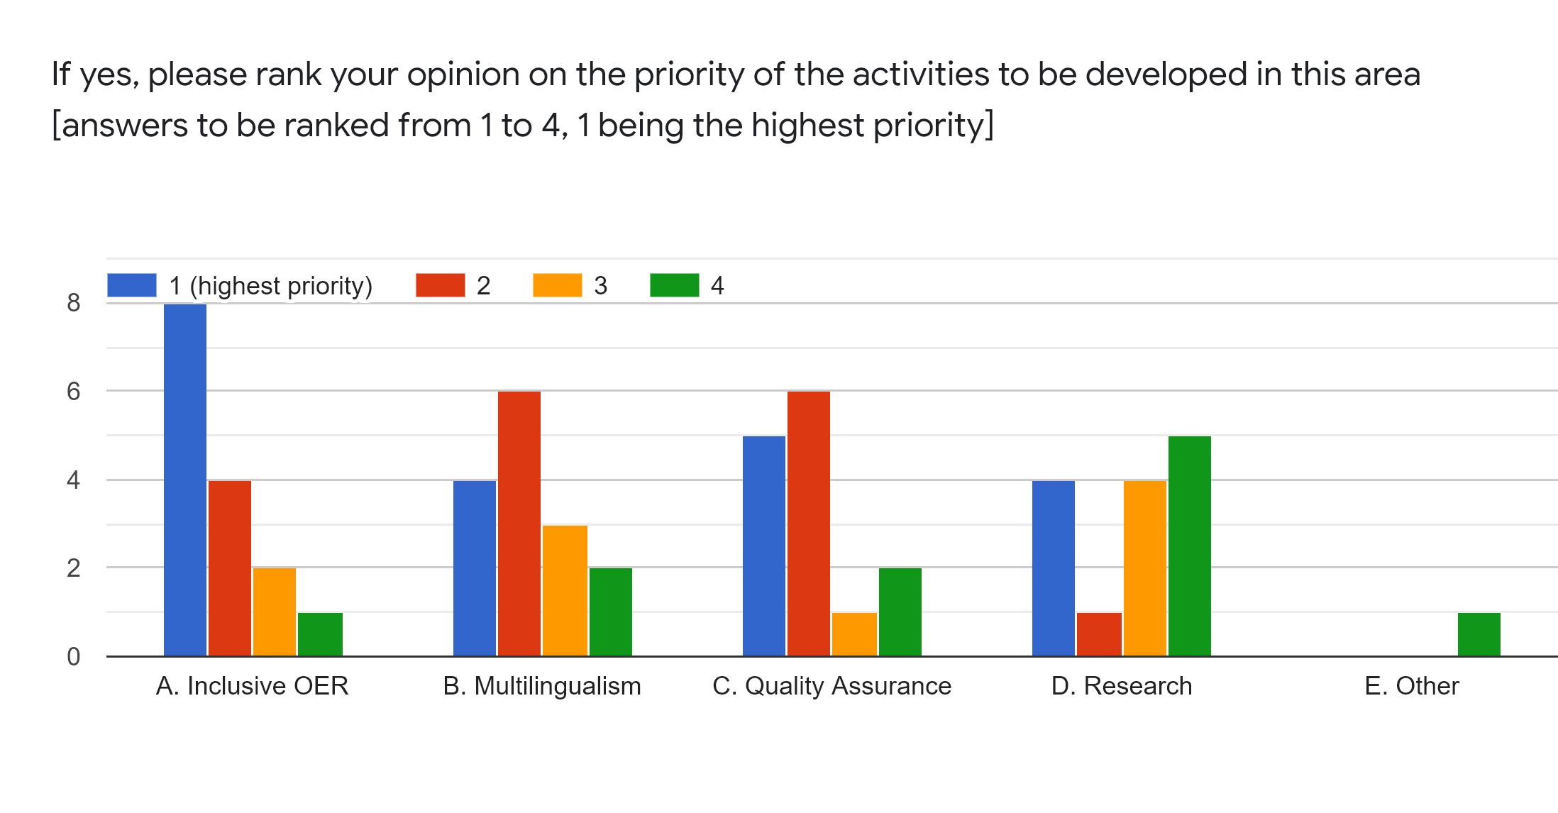
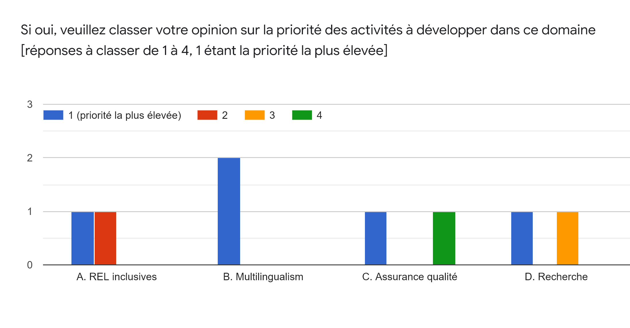
Results of the Survey: For Discussion
SQ: Rank your view on the priority of projects to be developed in this area:

Slide 4
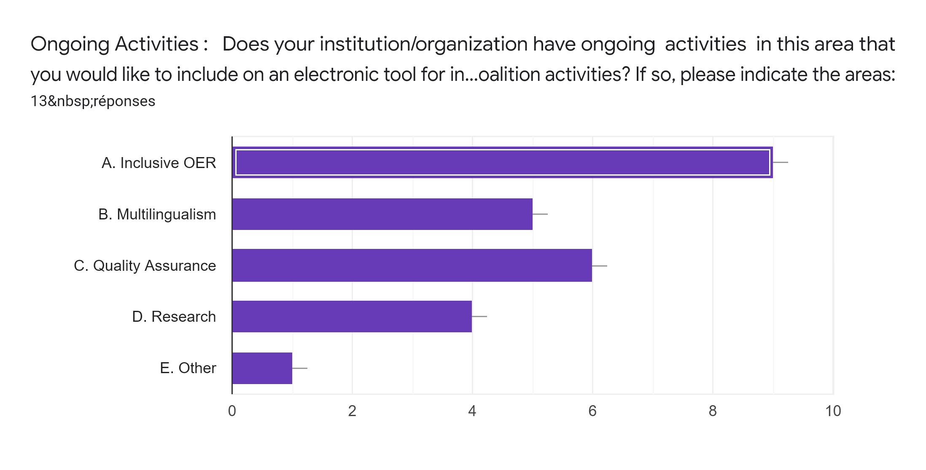
Ongoing Activities: Does your institution/organization have ongoing activities in this area that you would like to include on an electronic tool for information sharing and collaboration on Dynamic Coalition activities? If so, please indicate the areas: [Yes/No]

Slide 5
A. Inclusive OER: Discussion
Include use of assistive technologies and accessible formats
Initiate and support Communities of Practice made up of OER expert and Instructional Designers with expertise in accessibility issues
Ensure gender equality in all OER activities (with regard to participants, supporting access to funding, actors, beneficiaries);This includes identifying barriers to gender equality, and addressing them

Slide 6
B. Multilingualism: Discussion
Create a multilingual and accessible federated OER discovery system based on agreed upon common meta-data
Leverage AI for translation of OER
Use open formats and standards to promote ease in translation and contextualization
Create a platform that calls for translations

Slide 7
C. Quality Assurance: Discussion
Development of QA criteria and descriptive tag development
QA and Recognition bodies that need to be integrated in review and accreditation processes at the course, institutional and governmental levels.

Slide 8
D. Research: Discussion
Encourage research with communities of practice in the area of accessibility, inclusiveness, quality assurance and mutilingualism to inform the development of OER by diverse communities

Slide 9
E. Communication; Monitoring; AI
Leverage AI for translation of OER

Slide 10
Thank you!

