Slide 1

ROLE AND RESPONSIBILITIES

Slide 2
Contents
Meaning of Roles and responsibilities
Role and responsibilities of ICT teacher
Role and responsibilities of ICT technician

Slide 3
Meaning of Roles and responsibilities
Roles are the positions team members assume or are assigned --the part that each person plays in the organization.
Responsibilities are the specific tasks or duties that members are expected to complete according to their roles. They are the specific activities or obligations for which individuals are held accountable when they assume—or get assigned —a role.
For example, one of the responsibilities of the person in the role of Project Manager is to make sure that roles and responsibilities are clearly defined for the Project.

Slide 4
Activity: Think –pair-share
What are the Roles and responsibilities of a teacher?
What are the Roles and responsibilities of ICT teacher?

Slide 5
Roles and responsibilities
The role of a teacher is to use classroom instruction and presentations to help students learn and apply concepts such as math, English, Information technology and science. Teachers prepare lessons, grade papers, manage the classroom, meet with parents, and work closely with school staff.
However, being a teacher is much more than just executing lesson plans: in today's world. Today teaching is a multifaceted profession; teachers often carry the roles of a surrogate parent, class disciplinarian, mentor, counselor, bookkeeper, role model, planner, and many other related roles.
Elementary school teachers play an important role in the development of students. What students learn in their formative years can shape the men and women they will become.

Slide 6
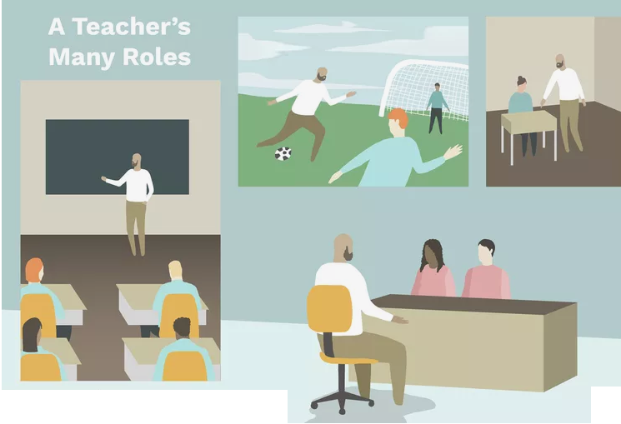

Slide 7
ICT Teacher responsibilities
Working with the Head teacher to ensure the delivery of the Computing curriculum to the highest possible standard
To implement and deliver an appropriately broad, balanced, relevant curriculum for ICT and Computing
To monitor and support the overall progress and development of students
To facilitate and encourage a learning experience which provides students with the opportunity to achieve their individual potential
To share and support the school’s responsibility to provide and monitor opportunities for personal and academic growth
Preparing learning materials
Used participatory teaching methods
Assessment, marking, feedback and corrections

Slide 8
ICT Teacher responsibilities
Participate in relevant meetings with colleagues, school panels, parents and be involved in links with external agencies as part of curriculum enhancement, including extra-curricular activities including sports and off-site visits
Review your own professional development and maintain professional standards
ICT teacher should work closely with laboratory technician in arrangement of laboratory activities
ICT teacher should work together with technician on procurement of ICT facilities needed for teaching and learning.
Participate in extra-curriculum activities with mates, students and other school staff like sport, or school club
Work with head teacher to help some management tasks

Slide 9
ICT Teacher responsibilities
Proper code of wearing (Acc to the ministry guidelines)
Community involvement
Participating in construction of book, evaluation, format of text book
Curriculum development and review
To assist in the development of appropriate schemes of work towards selected ICT and computing syllabuses.
To develop teaching resources, schemes of work, lesson plans, marking policies and teaching strategies in the curriculum area.
To contribute to the curriculum area and department’s development plan and its implementation

Slide 10
ICT Teacher responsibilities
Punctual and teaching
Participating in procurement process of ICT teaching resources
Enough Knowledge
To assist in the process of curriculum development in ICT and Computing so as to ensure the continued relevance to the needs of students, examining and awarding bodies and the school’s ethos.
To ensure that the equipment is in good working order and suitable for teaching use.

Slide 11
ICT Technician
  Computer lab setting and installation of equipment and software
  Troubleshooting and repairing of computer lab equipment
  Supervising computer lab rules, make sure they are followed by learners
  Participating in procurement of ICT resources for the school
Working with the Head teacher and subject teachers to ensure the delivery of the Computing curriculum to the highest possible standard
Maintenance: Troubleshooting and repairing of ICT equipment
Preparing computer lab rules and policy
Arrangement of lab session for students by cooperating with subject teacher

Slide 12
Thank you
https://www.thoughtco.com/becoming-a-teacher-4132510

