Slide 1
Building Capacity in Universities to Harness Open Content Effectively
Presentation at CILT Bi-Annual Conference 2023
Dr. Tony Lelliott, OER Africa, Saide, Johannesburg

Slide 2
What is open content?
Teaching, learning, and research resources that reside in the public domain or have been released under an intellectual property licence that permits their free use and repurposing by others.
Open content = Open Educational Resources (OER)

Slide 3
OER and open education in African universities
OER Africa – 2008
Cape Town Open Education Declaration – 2008
Use of OER in 2023 more prevalent but still limited

Slide 4
We suggest that at universities in Africa
Amongst senior managers, academics, and academic librarians,
there is limited awareness of the principles and potential of OER to promote active learning,
and limited capacity to leverage that potential effectively.
So in addition to advocacy, how can we build capacity effectively?

Slide 5
Current OER project
Our answer is to work to improve Continuous Professional Development (CPD) within institutions
Collaboratively developing comprehensive CPD frameworks ……
…… for university senior managers, academics, and academic librarians to support effective OER practices.

Slide 6
What is CPD?
CPD is the term used to describe the learning activities professionals engage in to develop and enhance their abilities
Professional learning that results in changes to knowledge and practices, and improvements in student learning outcomes

Slide 7
What is a CPD framework, and why is one needed?
A planning guide for CPD that supports the career development of higher education professionals
A framework is needed because, although CPD can be carried out in an ad hoc and informal manner, it is likely to be more effective if it is planned

Slide 8
Our experience at OER Africa is that
Ad hoc CPD that relies on individuals participating of their own volition has had limited take-up.
To encourage university professionals to participate in CPD, a clear pathway that maps out the full spectrum of skills and competencies required for different audiences within universities …..
…. is a possible way forward to encourage participation in CPD and to make it more purposeful.

Slide 9
Drivers for CPD in higher education worldwide
The massification and marketisation of Higher Education;
The digitalisation of Higher Education; and
The value of professional success for individual academics
(Inamorato, Gausas, Mackeviciute, Jotatutyte, & Martinaitis, 2019)

Slide 10
Barriers that discourage higher education professionals’ participation in CPD
Reluctance to renounce (teaching) practices with which they are familiar.
The absence of inducements for teaching development in HEIs.
Lack of time.
HEIs lack of pedagogical expertise and institutional capacity to develop effective CPD schemes
(Inamorato, Gausas, Mackeviciute, Jotatutyte, & Martinaitis, 2019)

Slide 11
Three CPD frameworks
Academics
Senior Management
Academic Librarians
Each framework consists of
  Domains – areas of practice that we consider highly valuable
  Capability descriptors – break the domains down into smaller units

Slide 12
Framework purpose
To assist those responsible for managing CPD at university, faculty or departmental level to identify areas of need.
To break down areas for professional development into smaller units, and to provide OER to support the implementation of the PD

Slide 14


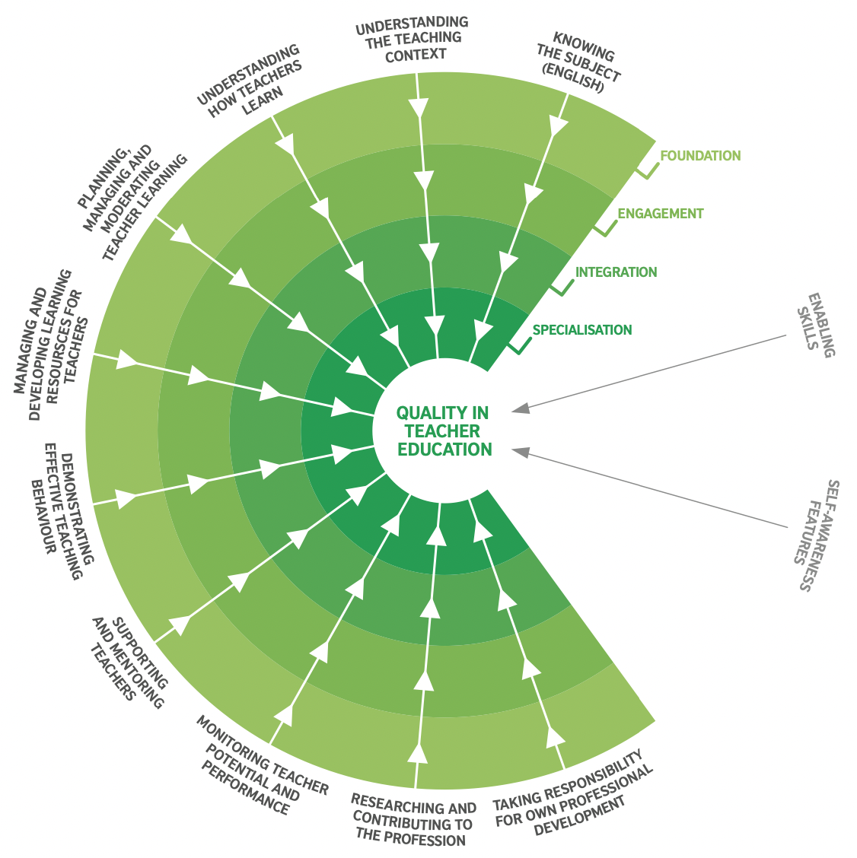
Development of the framework
Ideas from the British Council framework for teacher education

Slide 15
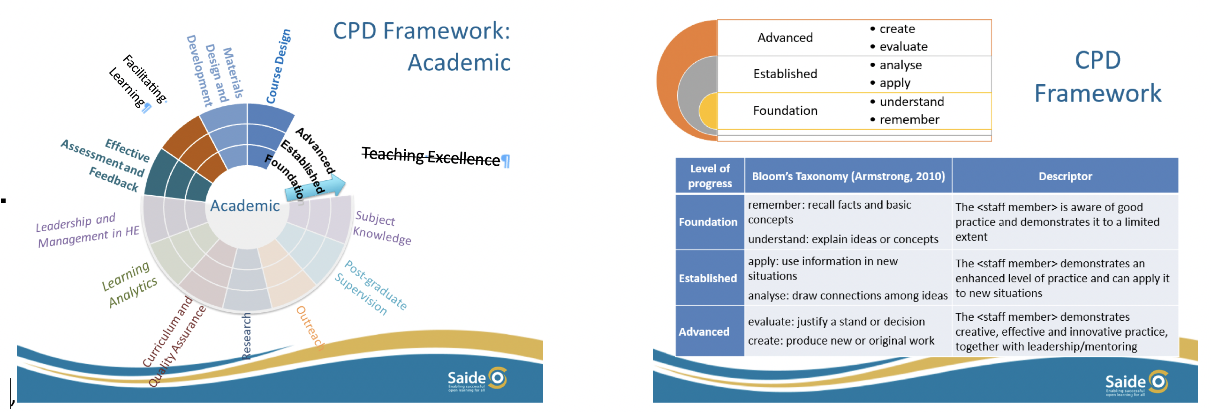
Development of the framework

Slide 16
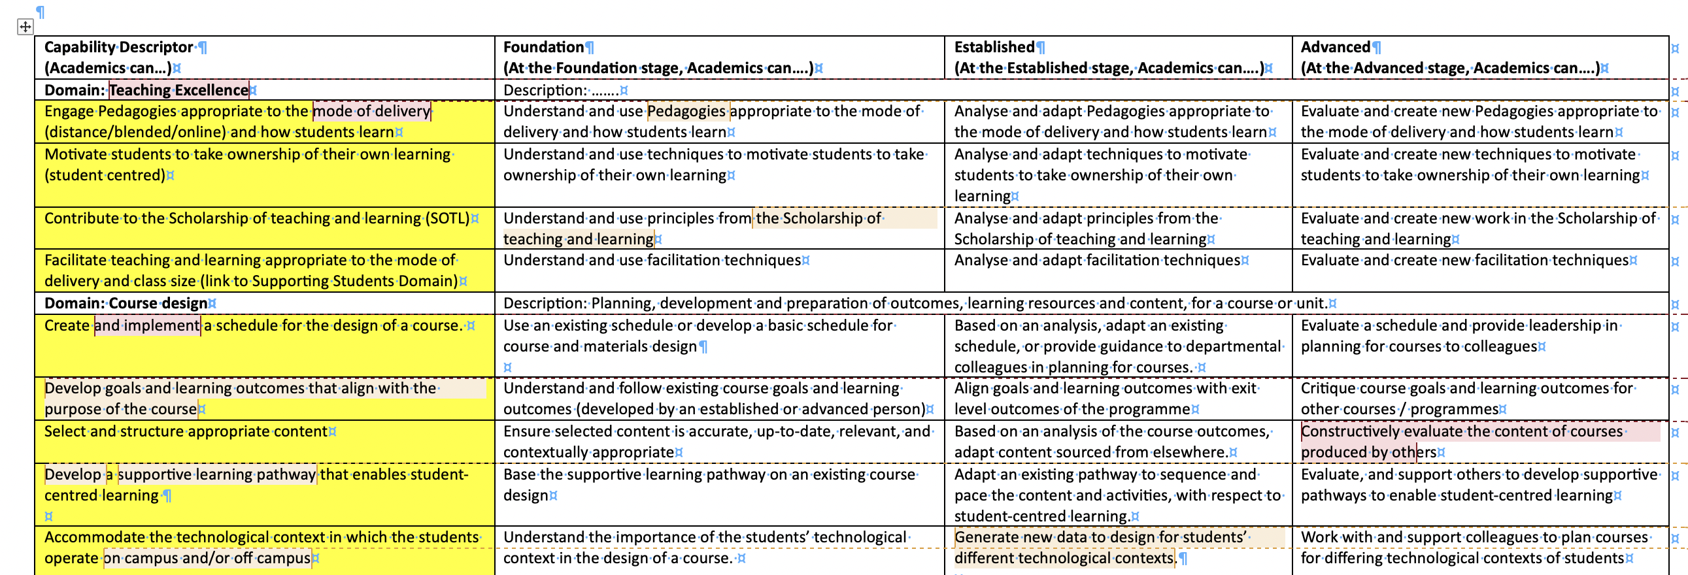
Development of the framework
Resulted in critique from our peers!!

Slide 17
CPD framework for Academics
Suggested
domains – we realise there is overlap and linkage between them

Slide 18
Current framework for Academics

Slide 19
Each institution will have its own priorities for CPD
It’s important to have priorities, as it shows that an institution is thinking about CPD for its staff.
If an institution has strategic goals, these will shape its CPD priorities.
e.g. a university might have a goal related to the 4th Industrial Revolution (4IR).
Competence in the use of OER strengthens universities' capacity to deliver curricula and learning experiences that provide students with lifelong learning skills required in 4IR economies.

Slide 20
We have developed capability descriptors for each of the four domains we have chosen

Slide 21
Capability descriptors for ‘Facilitating Learning’
Domain | Capability Descriptor. Academics can....
Facilitating Learning. Mediating and facilitating content and resources guided by sound pedagogical practices | Provide a learning environment that supports students’ academic and contextual needs.

Slide 22
Capability descriptors
Domain | Capability Descriptor. Academics can....
Facilitating Learning. Mediating and facilitating content and resources guided by sound pedagogical practices | Provide a learning environment that supports students’ academic and contextual needs. Provide ongoing feedback to support teaching, learning and assessment.

Slide 23
Capability descriptors
Domain | Capability Descriptor. Academics can....
Facilitating Learning. Mediating and facilitating content and resources guided by sound pedagogical practices | Provide a learning environment that supports students’ academic and contextual needs. Provide ongoing feedback to support teaching, learning and assessment. Facilitate and motivate students to take ownership of their own learning.

Slide 24
Capability descriptors
Domain | Capability Descriptor. Academics can....
Facilitating Learning. Mediating and facilitating content and resources guided by sound pedagogical practices | Provide a learning environment that supports students’ academic and contextual needs. Provide ongoing feedback to support teaching, learning and assessment. Facilitate and motivate students to take ownership of their own learning. Apply a range of pedagogies appropriate to the mode of delivery (distance/blended/online) and how students learn. Facilitate teaching and learning appropriate to the mode of delivery and class size. Evaluate and improve their own practice and share with wider community.

Slide 25
OER linked to the framework
We are identifying appropriate OER for each domain and preferably each capability descriptor.
Each resource we find can be used by institutions and individuals for capacity building
Some resources can be used for independent learning, while others can be facilitated.

Slide 26
OER linked to the framework –example 1
Domain: Course Design
Descriptor: “Develop purpose, goals and learning outcomes of the course”
A tutorial that explains how to use learning outcomes
https://spscoursedesign.commons.gc.cuny.edu/analysis-for-design-and-understanding-learning-outcomes/

Slide 27
OER linked to the framework –example 2
Domain: Assessment and feedback
Descriptor: “Align assessment strategies to learning outcomes and course activities”.
Developing a High-Quality Assessment Strategy
https://ecampusontario.pressbooks.pub/qualitycourses/chapter/developing-an-assessment-strategy/

Slide 28
OER Africa collaborations
Collaborations with selected institutions will enable rollout of revised frameworks and make associated openly-licensed CPD content available to all universities across Sub-Saharan Africa via the OER Africa website.
Currently collaborating with CILT at UNAM, Botswana Open University, Copperbelt University, UnISCED (Mozambique)

Slide 29
Lessons learned so far
There is relatively little research into CPD in Higher Education, especially in the Global South. This presents an opportunity for academics who (want to) work in this area.
Finalising a framework is an iterative process between complexity and minimalism: a complex framework is unlikely to be implemented.
Most OER available are produced in the global North, and many require adaptation for use in African contexts.

Slide 30
Lessons learned so far
Innovative approaches to CPD, such as using digital interventions for just-in-time learning, can play a key role in solving the challenges across institutions.
Properly implemented open policies can facilitate institutional change.

Slide 31

This work is licensed under a
Creative Commons Attribution
4.0 License
Tony Lelliott
tonyl@saide.org.za

