Slide 1
OER for African Teacher Education
ACDE meeting 7 February 2012

Slide 2
Useful Sites for Teacher Education OER
African
Whole modules
http://oer.avu.org/
www.saide.org.teachered
School-based material to incorporate into teacher education modules
www.tessafrica.net
Multimedia resources for the teaching of English
http://orelt.colfinder.net/index.php?title=Main_Page

Slide 3
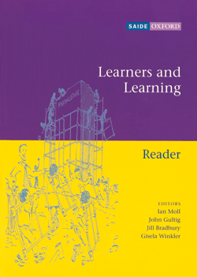
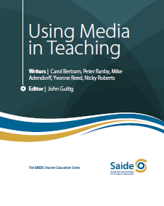
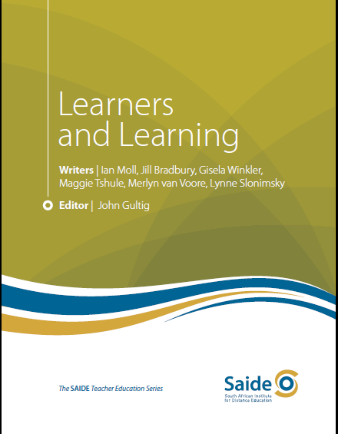
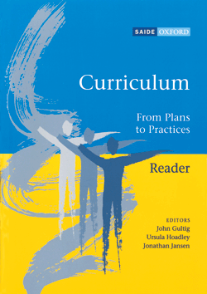
From
All rights
Reserved
To
Open
Educational
Resources
Five 200 page learning guides
Four sets of readings to support learning guides
29 audio clips of interviews and classroom events
23 video clips - issues and debates from the modules and methods in action in classrooms

Slide 4
Teacher Education sites non Africab
The Teachers’ Domain - http://www.teachersdomain.org/
Merlot Teacher Education (Multimedia education resource for learning and online teaching) http://www.merlot.org/merlot/materials.htm?category=2276&&sort.property=overallRatin
Teachers without Borders http://teacherswithoutborders.org/

Slide 5
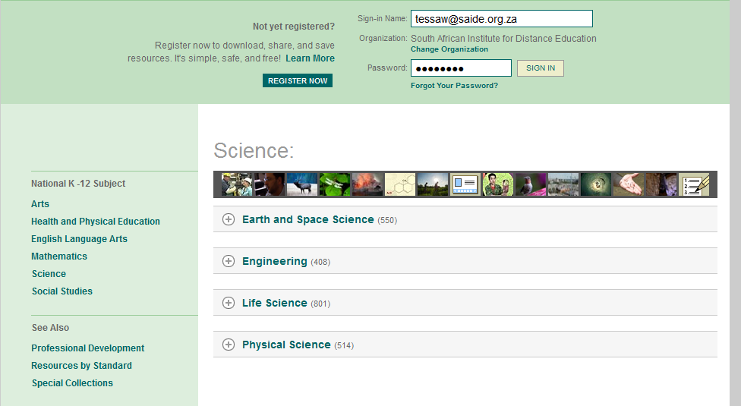
The Teachers’ Domain

Slide 6
General OER repositories
Connexions
OER Commons
Open CourseWare Consortium
and
Open textbook sites (eg http://oerconsortium.org/discipline-specific/ )
Open access research sites (eg OpenDOAR, http://www.opendoar.org/index.html nb4 and
DOAJ http://www.doaj.org/ )

Slide 7
Example of a subject specific search
Google + Creative Commons often the most productive
Ed Psych OER & spreadsheet\0Ed Psychology spreadsheet.xls

Slide 8
African network
See participant list from recent DETA pre-conference workshop
See list of TESSA partners
www.tessafrica.net
See list of AVU partners at
http://oer.avu.org/partners

Slide 9
Learning Object Review Tool (LORI) http://elera.net/eLera/Home/Articles/LORI%201.5.pdf
1. Content Quality: Veracity, accuracy, balanced presentation of ideas, and appropriate level of detail
2. Learning Goal Alignment: Alignment among learning goals, activities, assessments, and learner characteristics
3. Feedback and Adaptation: Adaptive content or feedback driven by differential learner input or learner modeling
4. Motivation: Ability to motivate and interest an identified population of learners
5. Presentation Design: Design of visual and auditory information for enhanced learning and efficient mental processing

Slide 10
LORI tool (contin)
6. Interaction Usability: Ease of navigation, predictability of the user interface, and quality of the interface help features
7. Accessibility: Design of controls and presentation formats to accommodate disabled and mobile learners
8. Reusability: Ability to use in varying learning contexts and with learners from differing backgrounds
9. Standards Compliance: Adherence to international standards

